Slide 1
CN ASSIGNMENT 3
Avi Sharma 2022119
Sahil Gupta 2022430

Slide 2
Approach
The code represents the bidirectional Go Back N protocol in which there are two entities which have nearly the same code base , but the change in them is the different interchanged socket they bind to and the different interchanged remote address they send the packets to.
This used UDP sockets for communication and includes features such as sequence numbering , acknowledgments , timeouts and retransmission mechanisms.

Slide 3
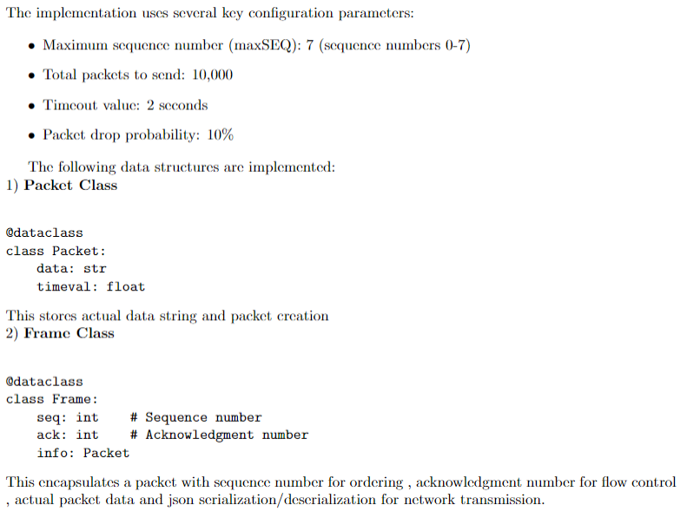
Protocol Configuration

Slide 4
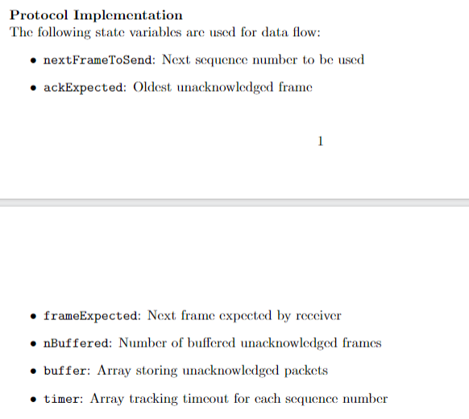
Protocol Configuration

Slide 5
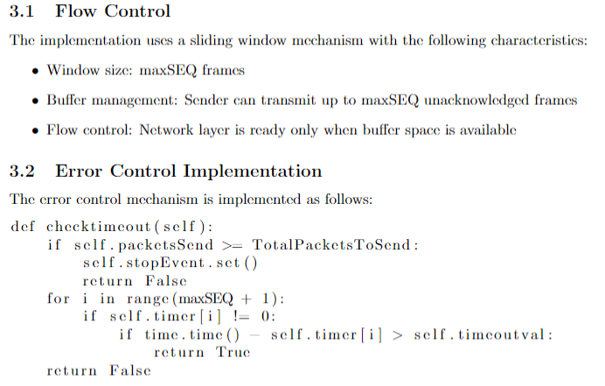
Core Mechanisms

Slide 6
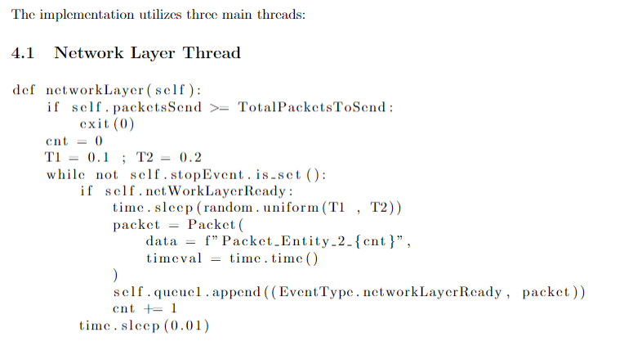
Threading Model

Slide 7
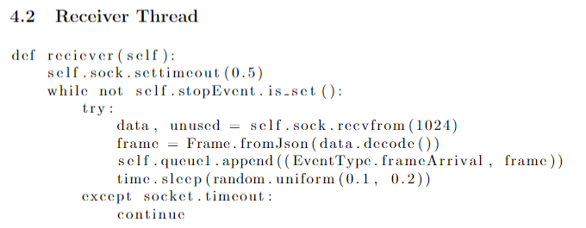

Slide 8
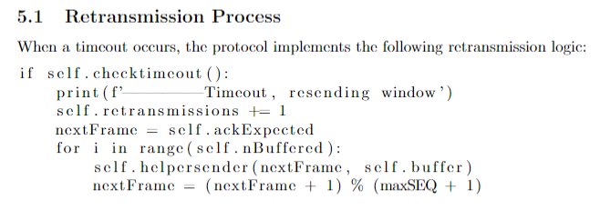
Error Recovery

Slide 9
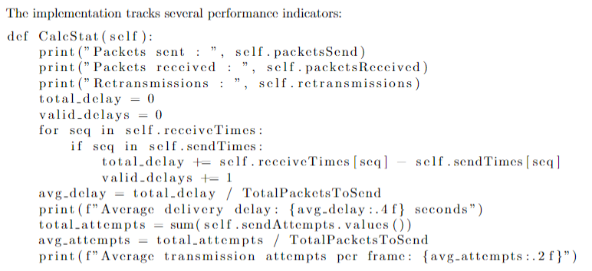
Performance Metrics

Slide 10
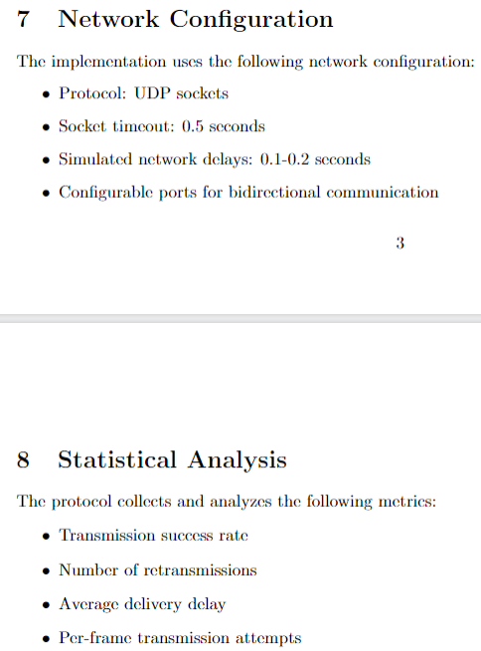

Slide 11
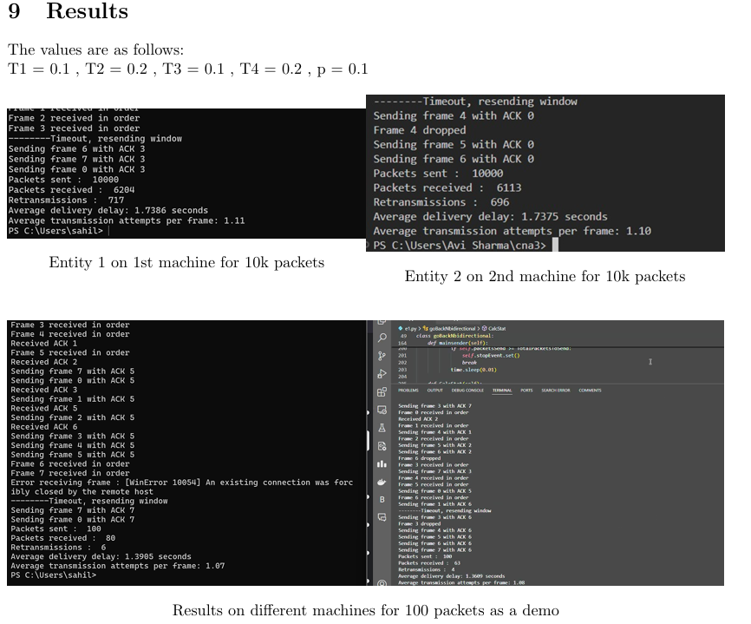

Slide 12
