Slide 1
SQL PROJECT ON HOSPITAL DATA
HOSPITAL DATA ANALYSIS USING SQL focused on the analysis of patient records and disease trends
Performed this analysis on MYSQL WORKBENCH

Slide 2
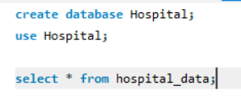
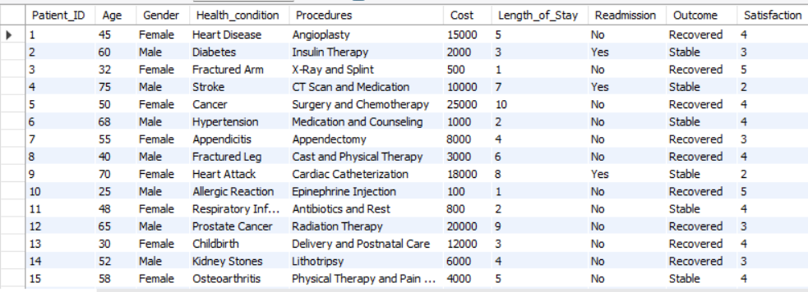
ImPORT data on mysql workbench
Viewed my data in workbench.

Slide 3




Viewed total number of patients and average age of patients
Calculated Total no of patients.
Calculated Average Age of patients.

Slide 4


AVeraGe age of people who are recovered

Slide 5
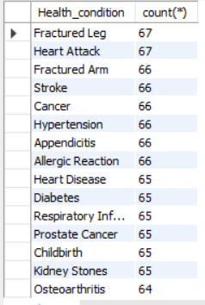
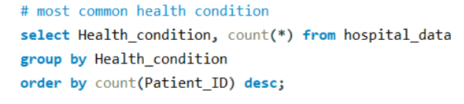
Most common health condition

Slide 6

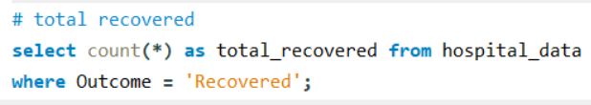
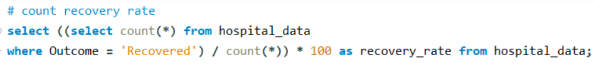

Total recovered and recovery rate of the hospital

Slide 7
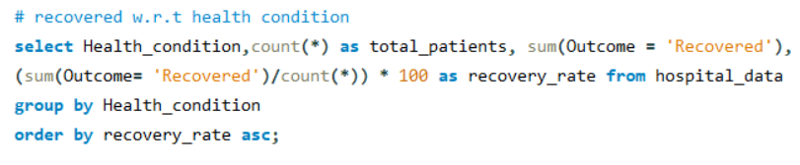
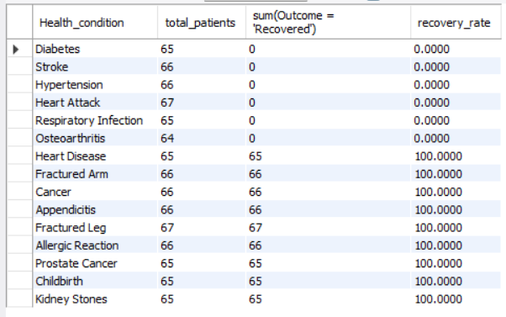
Recovery rate w.r.t health condition
As we can see that Diabetes, Stroke, Hypertension, Heart Attack, Respiratory Infection and Osteoarthritis has 0 recovery rate so the Hospital has to work on it.

Slide 8
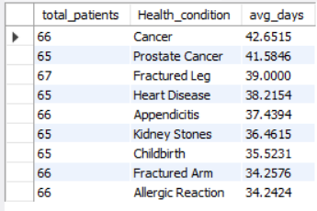
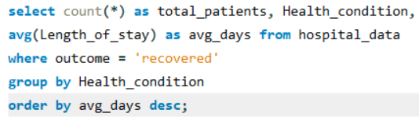
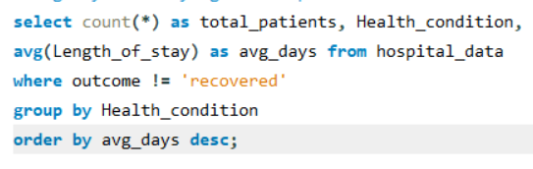
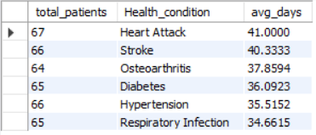
Avg days of staying of the patients who are recovered and not recovered

Slide 9
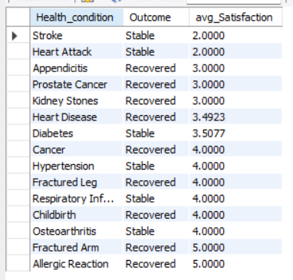
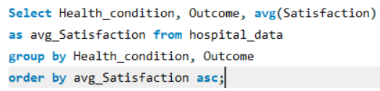
Satisfactory rate
As we can see, the satisfactory rate of Stroke and Heart Attack
Are very low and are below 3 out of 5.

Slide 10
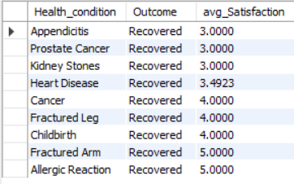
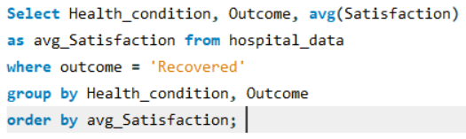
Satisfactory rate of patients after recovery
As we can see, average Satisfaction of appendicitis, Prostate cancer and kidney stones are not good even after recovery.

Slide 11
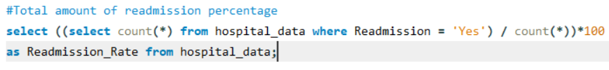

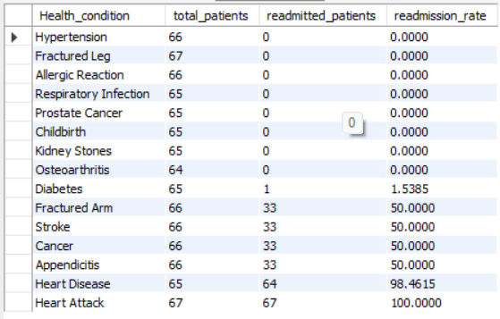
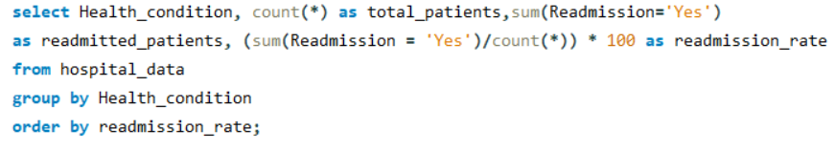
Readmission rate and readmission rate w.r.t health cond.

Slide 12
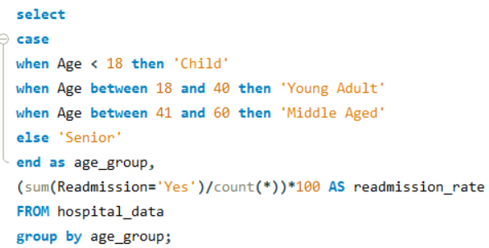

Readmission rate w.r.t age group
They need to focus on young adult patients because the readmission rate of them are low.

Slide 13
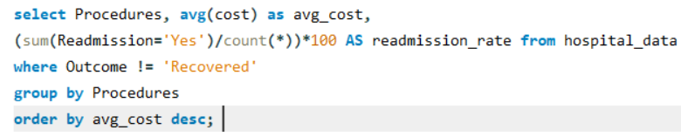
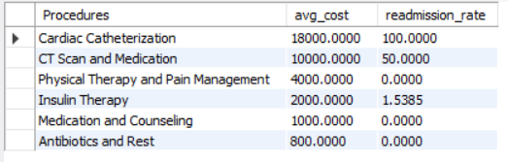
COSTS with readmission rate of procedures

Slide 14
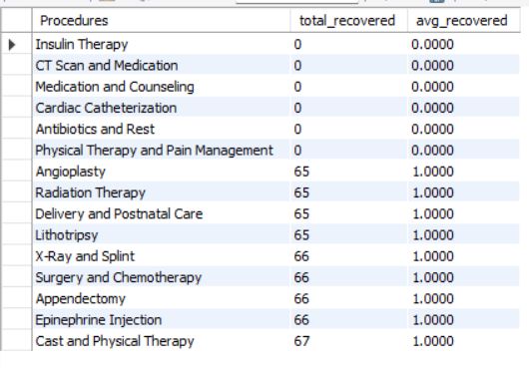
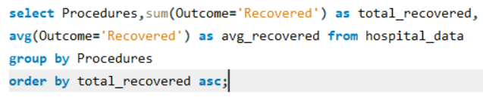
analysing procedures with there recovery

Slide 15
CONCLUSION
Diabetes, Stroke, Hypertension, Heart Attack, Respiratory Infection and Osteoarthritis has 0 recovery rate, Hospital needs to work on it.
The satisfactory rate of Stroke and Heart attack are very low and are below 3 out of 5.
Average Satisfaction of appendicitis, Prostate cancer and kidney stones are not good even after recovery.
They need to focus on young adult patients because the readmission rate of them are low.

