Slide 1

An Evaluation of Testing Frameworks for Continuous
Integration of Android Applications
Technical Presentation Milestone
Sahil Jain
Android Engineering Intern
Remind
2B Candidate for Bachelor of Software Engineering
July 22, 2015
Copyright © 2015 by Sahil Jain. All rights reserved.

Slide 2
Title of Presentation
TPPE 000 Technical Presentation Proficiency Examination
Given_name(s) Surname
Department of Electrical and Computer Engineering
University of Waterloo
2B/3A Candidate for B.A.Sc. in ElectricalComputer Engineering
Date of Presentation
Copyright © 20NN by Given_names(s) Surname. All rights reserved.
All red/italicized text on the title slide must
be replaced and changed to the appropriate
colour. Make sure all fonts are roman on the
title slide. (The term “roman” is the correct term
for what is sometimes referred to as “upright”;
that is, not italics.)

Slide 3
Outline
This is the outline slide:
  Bullet One
  Bullet Two
  Etc.
    Make sure to use appropriate indentation
    Otherwise it is very linear
  Keep it short...
Rename this presentation file to uwuserid_tpm.ppt
e.g., dwharder_tpm.ppt

Slide 4
Appropriate title
If necessary
  Bring everyone up to speed
  Your audience is second year students
  Don’t teach: give an overview
  Images are very useful here
If you don’t like the default typeface,
font size, etc., you can change it globally
on the Slide Master.
Please avoid typefaces with serifs and non-uniform
nibs (like this one); they are difficult to read at a distance.
They may “look” more professional; however, if
the only thing professional about your talk is
the typeface, you have other problems.

Slide 5
About Templates
Important quote:
  “If someone hands you a presentation template to use,
  then use it as a guideline but not as something carved
  in stone. Add to it, revise it, and make it your own.”
Consider visiting
http://docs.google.com/templates?type=presentations
  Personal opinion?
    Too flashy
    Perhaps the author is too dull
http://www.watkinsinstitute.org/article.cfm/id/324065

Slide 6
Another Title
You don’t have to use bullet points
Just make sure that your slides are organized
Just avoid using complete sentences. This becomes very tedious for the audience to read. They will ignore you and just read the slides. Most likely, you, too,
will simply read the slides.
If you don’t like black-on-white, yellow-on-blue
is the next best recommended font/background
colour combination.

Slide 7
Another Title
Custom Animations allow you to make text appear
  Open Slide Show→Custom Animation...
  Add with Effect→Entrance→1. Appear
Do not Blinds, Box, Checkerboard, etc.
Do not overuse—you will annoy the audience
Use Shift-Enter to break to the
next line with the same style
These template comments are too dense—reduce!
  Your voice carries the message

Slide 8
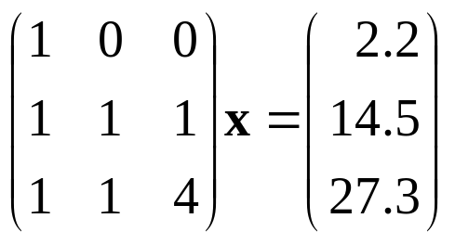
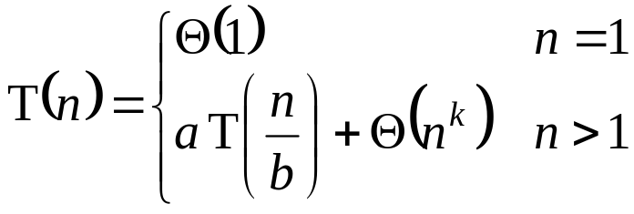
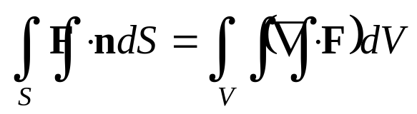
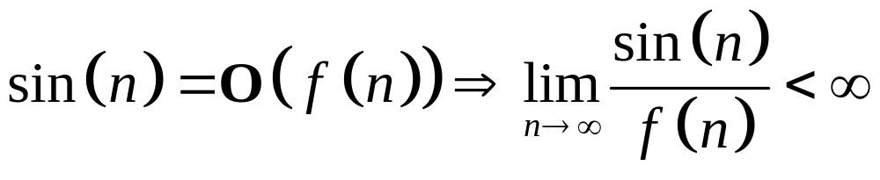
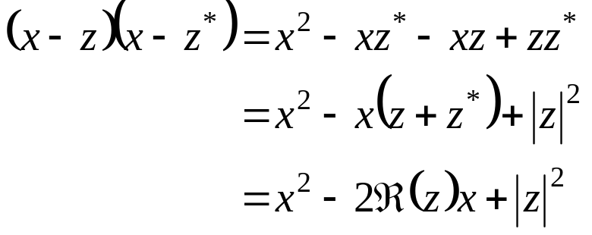
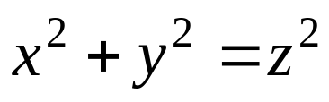
Another Title (Don’t Use Ellipses (...) in the Title)
Equations? Don’t overuse
  Insert→Object...
  Object Type: Microsoft Equation 3.0
  The font is Times New Roman
Vectors and matrices bold
Common functions and numbers roman
Variables and generic functions italicized

Slide 9
Another Title (Don’t Use “Continued” in the Title)
Tables are useful: Insert→Table...
  The Consolas typeface (0/O) is used in the 1st column
    Uses a slashed zero
    Nicer than Courier New (0/O)
  Title row is bold and centre aligned
Table 1. STL Container Properties
STL Container | Data Structure | Comments
deque | hybrid | random access
vector | array | random access
priority_queue | heap-as-array
list | doubly linked list | SGI STLs offer slist
set | binary search tree | SGI STL offers hash_set
map | binary search tree | associative SGI STL offers hash_map

Slide 10
Another Title (Don’t Use “Cont’d...”, Either)
Present data appropriately:
  Line up the decimal points—one number equals two spaces
  Use an en-dash (–) and not a hyphen (-)
  Use the same precision
Table 2. Presenting numbers.
Poor | Poor (m/s) | Better (m/s)
3.1415 m/s | 3.1415 | 3.141
10.5432553 m/s | 10.5432553 | 10.54
-5.45323 m/s | -5.45323 | –5.453
0.235 m/s | 0.235 | 0.2353
1.53254 m/s | 1.53254 | 1.533

Slide 11
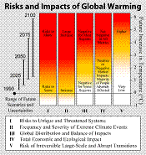
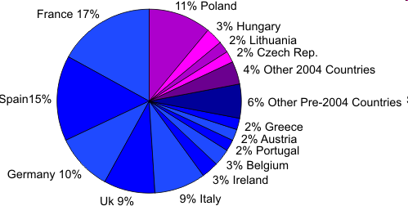
Another Title
Images/figures can be cut-and-paste into PowerPoint
Figure 1. Percentage of EU Farm Land by Country in 2004.
Figure 2. Use neither gifs nor expand small images.
Reference if you are not the author
modified from http://en.wikipedia.org/wiki/File:Risks_and_Impacts_of_Global_Warming.png

Slide 12
Another Title
Use vector graphics available in PowerPoint
  Use Ctrl–arrow-key to make small nudges
Line Style
Dash Style
Font Colour
Rectangles
Ovals
Arrow Style
Fill Colour and Line Colour

Slide 13





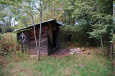
Another Title
To order objects (as to what is in front of others):
  Select the object
  Right click and from the pop-up menu select
    Order → Bring to front
    Send to back
    Bring forward
    Send backward
  This way, text can appearing in front of images or vice versa
  You must right
  click on the
  grey border of the text boxes...
porcupine

Slide 14
Review of Test Data Indicates Conservatism for Tile
Penetration
The existing SOFI on tile test data used to create Crater
was reviewed along with STS-87 Southwest Research data
  Crater overpredicted penetration of tile coating
  significantly
    Initial penetration to described by normal velocity
      Varies with volume/mass of projectile (e.g., 200ft/sec for
      3cu. In)
    Significant energy is required for the softer SOFI particle
    to penetrate the relatively hard tile coating
      Test results do show that it is possible at sufficient mass
      and velocity
    Conversely, once tile is penetrated SOFI can cause
    significant damage
      Minor variations in total energy (above penetration level)
      can cause significant tile damage
  Flight condition is significantly outside of test database
    Volume of ramp is 1920cu in vs 3 cu in for test
HOPEFULLY YOUR SLIDES DO NOT LOOK LIKE THIS
HOPEFULLY YOUR SLIDES DO NOT LOOK LIKE THIS
HOPEFULLY YOUR SLIDES DO NOT LOOK LIKE THIS
Parker et al., “Orbiter Assessment of STS-107 ET Bipod Insulation Ramp Impact”, January 23, 2003.

Slide 15
Another Title
You can introduce organization charts
  Not too much detail, please
Text
Text
Click to Edit

Slide 16
Another Title
Try to avoid the other “features”
  Especially
Word Art
Do you want to loose all credebility?
It doesn't even highlite your spelling errrs
If you like this in a presentation,
maybe you should consider a different degree

Slide 17
Another Title
Fill in a few more slides
  One slide per minute
To practice, press F5
Good luck!

Slide 18
Summary/Conclusions (as appropriate)
Put your summaries and conclusions here
  The audience will remember most what they read here
  Reiterate but do not simply repeat

Slide 19
References
[1] Edward R. Tufte, The Visual Display of Quantitative Information, 2nd Ed., Graphics Press LLC, Cheshire, Conneticut, 2001.
[2] Edward R. Tufte, Visual Explanations, Graphics Press LLC, Cheshire, Conneticut, 1997.
[3] Michael Alley, The Craft of Scientific Presentations, Birkhauser, 2003.
[4] Douglas Wilhelm Harder, “Guidelines for Technical Presentations”, University of Waterloo, 2009-04-03; http://ece.uwaterloo.ca/~tppe000/Guidelines/.
[5] W.M. Loucks PEng et al., “E&CE Work Term Report Guidelines”, University of Waterloo, 2009-04-03; http://ece.uwaterloo.ca/~wtrc/WrkTrmRpt.html#References
This template presentation was prepared by Douglas Wilhelm Harder.
Copyright © 2009-11 by Douglas Wilhelm Harder. All rights reserved.

