Slide 1

Comparing Testing Frameworks for Android Applications
Technical Presentation Milestone
Sahil Jain
Android Engineering Intern
Remind
2B Candidate for Bachelor of Software Engineering
July 22, 2015
Copyright © 2015 by Sahil Jain. All rights reserved.
Notes:
I’m Sahil. Worked at Remind last term. Edtech startup. Messaging app for teachers students and parents. Android team. Started workflow of executing tests before code gets merged in. Show how that was possible

Slide 2
Outline
  Goal of Presentation
  Background Information
    Types of tests
    How each framework works
    Pull request workflow
  Motivation Behind Testing
  Current Problems
  Solution Criteria
  Evaluation
  Recommendation
  Conclusion
  Questions

Slide 3
Goal of Presentation
  Highlight importance of testing
  Illustrate how each testing framework works
    Espresso vs. Robolectric
  Help audience decide which framework is right for their projects
Notes:
Want this presentation to be comprehensive, not just technical jargon. Applicable to anyone testing software anywhere

Slide 4
Types of Tests
Unit Tests:
  Assert properties of single programmatical function
  Stub functionality not related to function being tested
  Isolated in terms of code
Functional Tests:
  Assert completeness and correctness of single feature
  Harder to stub functionality
  Isolated in terms of business logic
Notes:
Tests divide app into pieces, and test each piece for correctness. These are two ways to divide an app. One is programmer friendly, the other is business friendly

Slide 5
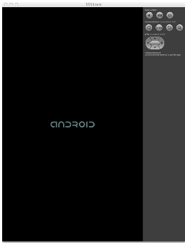
How Espresso Works
  Espresso decorates Android Instrumentation Test Framework
  Deploys packaged app to an Android device
  Performs UI commands based on timer
Emulator/Device
App.apk
Android Source Code
TestApp.apk
www.opencredo.com/2014/01/28
Notes:
Timer can be overridden. Timing is based on when screen stabilizes. Excels at functional testing, UI ops, test screen conditions.

Slide 6
How Robolectric Works
  Android OS is mocked in JVM
  OS-specific operations don’t happen, result is faked
  No real UI, screen operations are mocked
  Excels at unit testing
*.class
Android Source Code
*.class
Java Virtual Machine
*.class
*.class
Notes:
App compiled into class files, deployed on jvm on PC, no UI, everything mocked

Slide 7
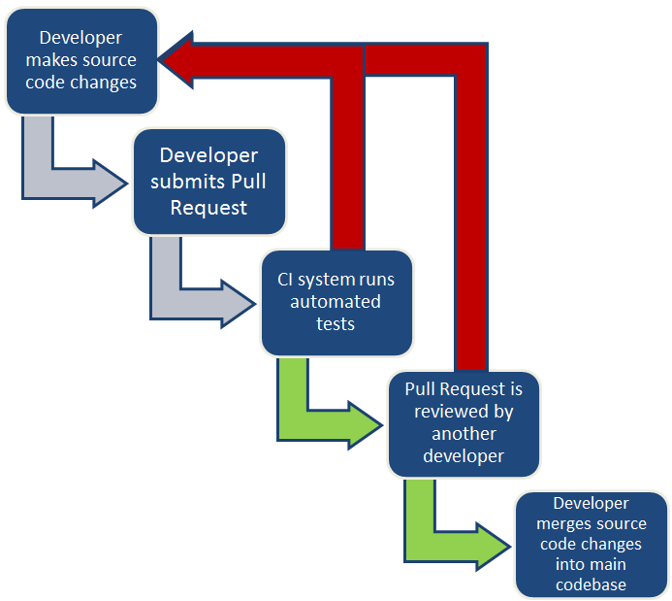
Pull Request Workflow
  Pull Request: a proposed list of changes to the source code
  Continuous Integration: upload source code multiple times/day

Slide 8
Motivation Behind Testing
  Flexibility
    Change code without fear
  Maintainability
    Tests act as documentation
  Reusability
    Each component works
“Only judge detailed enough to test code is code.”
Notes:
We can change code without fear that we are breaking something. Tests can run whenever code is about to change, so always in perfect state

Slide 9
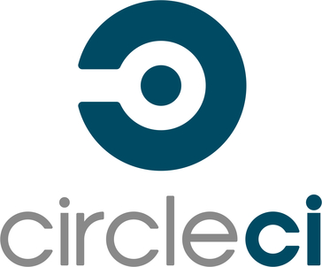

Current Problems with Espresso
  Cannot run Espresso tests in the cloud
    Espresso requires an emulator/device
  Test results unreliable
    Hypothesis: built-in timer is inaccurate
  Tests take too long to run
    Hypothesis: packaging app takes a long time
travis-ci.com
circleci.com

Slide 10


Solution Criteria
Quantitative | Qualitative
Speed (3 minutes or less) | Code complexity should not increase
Reliability (<5% false results) | Significant code coverage
vs.
developer.android.com
robolectric.org

Slide 11
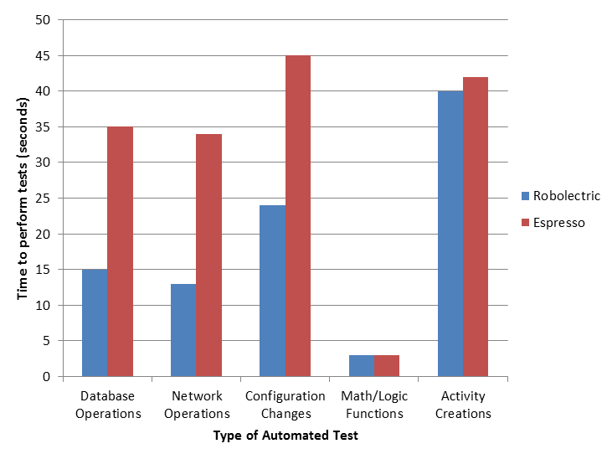
Speed Evaluation
  Long operations are mocked by Robolectric
Notes:
Robolectric simulating most time-consuming operations has improved speed
95 seconds to run Robolectric
159 seconds to run Espresso

Slide 12
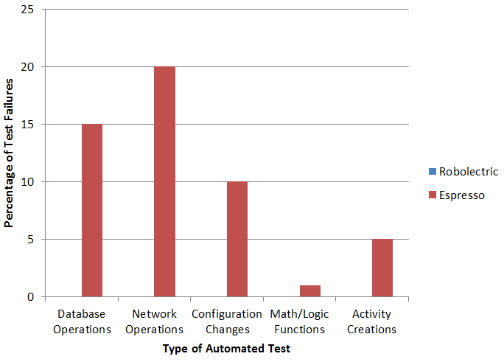
Reliability Evaluation
  Espresso unreliable due to timer-based system
  Robolectric reliable because operations are mocked out
Notes:
Fail due to timers in Espresso
Robolectric doesn’t actually perform these long operations, so they can’t fail

Slide 13
Code Coverage Evaluation
  Robolectric performs tests using shadow objects
  Robolectric ships new shadow objects regularly, but still behind
  Perpetual lag of shadow objects vs. actual objects
  Espresso has no such limitation
  Espresso favoured in this category
Notes:
Shadow objects take a long time to write

Slide 14
Code Complexity Evaluation
Similarities | Differences
Number of lines of code Readability of code Same set of assertions Both frameworks founded on JUnit | Robolectric requires boilerplate to set up activities
  Overall, both frameworks are very similar

Slide 15
Recommended Testing Framework
Multi-Criteria Decision Analysis:
Criterion | Weighting | Robolectric | Espresso
Reliability | 40% | 0.40 | 0.08
Speed | 30% | 0.30 | 0.18
Code Coverage | 20% | 0.15 | 0.20
Code Complexity | 10% | 0.10 | 0.10
Total (x100) | - | 95 | 56
  Robolectric better with reliability and speed
  Espresso better with code coverage
  Overall, Robolectric is the favourable solution

Slide 16
Conclusions
  Robolectric performs faster than Espresso
  Robolectric is more reliable than Espresso
  Robolectric lags behind Espresso in code coverage
  Trivial difference in code complexity
  Above results due to:
  Robolectric runs in JVM, Espresso runs on device
  Robolectric mocks Android OS

Slide 17
Summary
  Highlighted importance of testing
  Illustrated how each testing framework works
  Evaluated each framework in context of CI
  Recommended framework based on results

Slide 18
Questions?
“If you have tests, you do not fear making changes to the code! Without tests every change is a possible bug.” – Robert C. Martin, Clean Code

Slide 19
References
[1] N. M. Fraser and E. M. Jewkes, Engineering Economics: Financial Decision Making for Engineers. Toronto, Canada: Pearson Canada, 2012.
[2] D. T. Milano and P. Blundell, Learning Android Application Testing. Birmingham, UK: Packt Publishing, 2015.
[3] R. C. Martin, Clean Code: A Handbook of Agile Software Craftsmanship. Westford, MA: Prentice Hall, 2008.
All diagrams and photos that are not cited are my own work

