Slide 1
PROFESSIONAL PORTFOLIO
Sahil
Sahil Jaiswal
Jaiswal.
sahiljaiswal1908@gmail.com
+91 9321561338
Mumbai, India
Brand Management · Growth Marketing · Consumer Insights
PGDM Student
Crucible Institute
Mumbai
Crucible Institute of Management · PGDM · Batch 2025–27

Slide 2
ABOUT ME
Who I am · What I have done · Where I am now
YOUR
PHOTO
WORK EXPERIENCE
Accounts & Operations · SMJ Speed Logistic Solutions Pvt. Ltd.
Cement & steel bulk transport — managed a 250-vehicle fleet, 80 drivers, 50+ accounting entries/day, reduced garage holding time by 2 days.
Founder & Operator · Clutch Point — PS5 Gaming Parlour
Built from zero — customer acquisition, WhatsApp marketing, billing system. ~80 customers/week, ~30% repeat visit growth.
EDUCATION
Post Graduate Diploma in Management (PGDM) — Crucible Institute of Management · Ongoing
Bachelor of Commerce — University of Mumbai, Vidyavihar · Completed Mar 2025
S J
BEYOND WORK
Fitness enthusiast — gym is a non-negotiable part of my routine. Outside of that, films are my way to unwind — good storytelling across any genre.

Slide 3
WHAT'S INSIDE
01
About Me
02
Work Experience
Background, education & current work
Clutch Point · SMJ Speed Logistic
03
Personal Skills
04
Industry Projects
Built through doing, not classroom
6 live client & field engagements
05
Academic Projects
06
Contact
Term 1 & Term 2 — real briefs
LinkedIn · Email · Phone

Slide 4
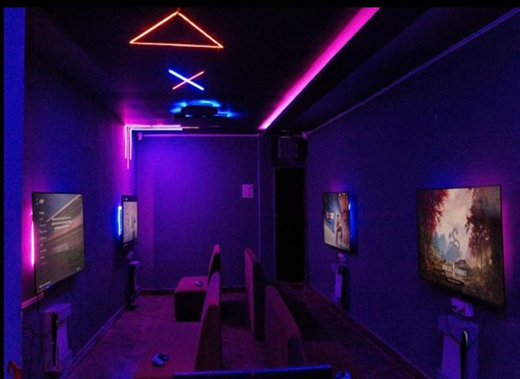

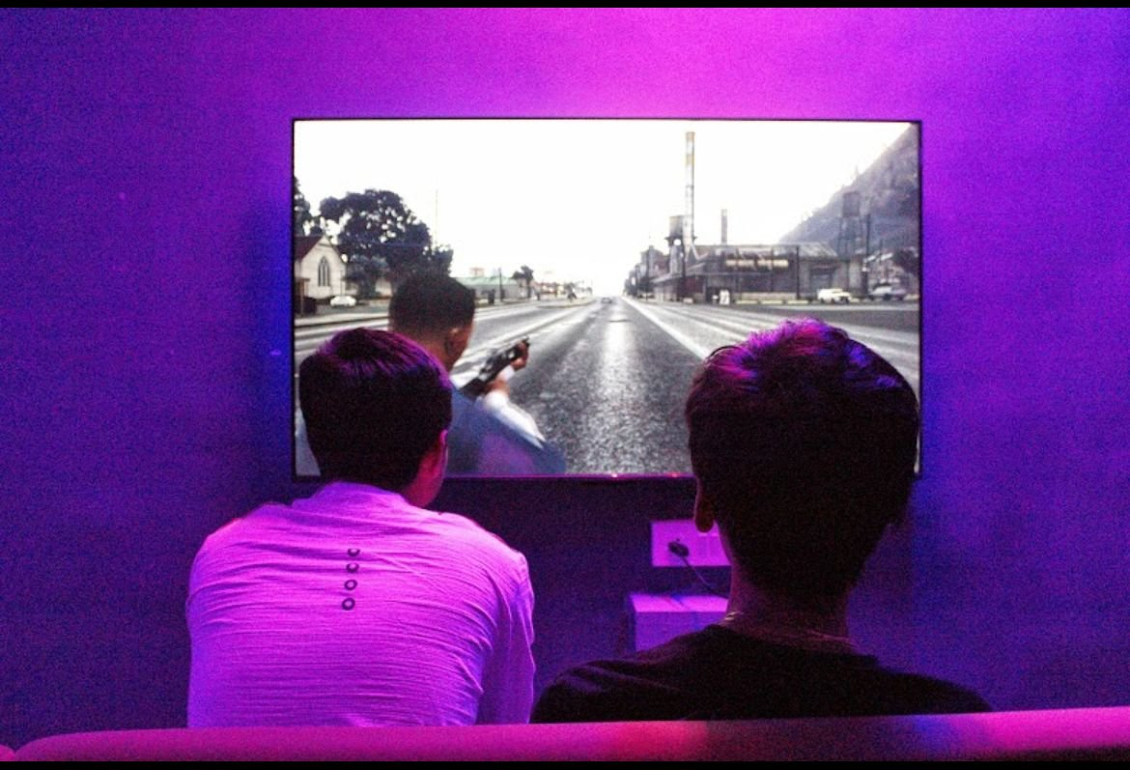
WORK EXPERIENCE
Clutch Point
Jan '25 – Now
Founder · PS5 Gaming Parlour · Jan 2025 – Present · Mumbai
Manage end-to-end daily operations of a PS5 gaming parlour serving ~80 customers/week
Enhanced the customer journey by curating a seamless booking and billing process for walk-in clients through gaming software, resulting in higher customer satisfaction and revenue growth
Increased repeat customer visits by ~30% through optimized slot management
Clutch Point · The Space · Customers Gaming
~80 customers/week · 30% repeat visit growth · Founder & Operator

Slide 5
WORK EXPERIENCE
SMJ Speed Logistic Solutions Pvt. Ltd.
Jun '24–Aug '25
Accounts & Operations · Cement & Steel Bulk Transport · Jun 2024 – Aug 2025 · Mumbai
ADD PHOTO / IMAGE
HERE
Managed daily operations for 250-vehicle bulk logistics fleet
Coordinated with 80 drivers and 10 vendors for dispatch, routing, and documentation
Processed and verified 50+ accounting entries/day across trip sheets, fuel logs, and vendor payments
+ Photo 2
+ Photo 3
Reduced garage holding time by 2 days, improving fleet readiness and lowering downtime
250-vehicle fleet · 80 drivers · 50+ entries/day · 2-day holding time reduction

Slide 6
PERSONAL SKILLS
Developed through live projects, fieldwork & business operations
RESEARCH & INSIGHTS
BRAND & MARKETING
Qualitative Research · Discussion Guides · Consumer Interviews · Quantitative Surveys · Market Readiness Studies
Brand Strategy · Brand Iceberg Framework · Digital Campaigns · Consumer Segmentation · Brand Positioning
BUSINESS & ANALYTICS
TOOLS & TECH
Financial Analysis · DRHP Reading · Advance Excel · Data Tracking & Interpretation · Operations Audit · Retail Field Research
Canva Magic Studio · AI tools (Loveable, Antigravity, etc.) · AI App Development · Dashboard Build · Digital Product Thinking

Slide 7
INDUSTRY PROJECTS
6 live engagements · real clients · real outcomes
01
Beyond Snacks
02
GrowFit
Retail Market Mapping
Market Readiness Research
Physical brand presence study across 150+ outlets
Consumer adoption barriers in the Mumbai market
03
Athena Global Logistics
04
Ajwani Group
Design Thinking & Systems
AI Tender Intelligence
Sales-to-leadership communication gap resolved
Manual tender monitoring replaced with AI dashboard
05
Vijay Sales
06
Uptrack App
Operations Immersion
App Development
8-day floor-level retail operations study
Concept & design of AI attendance tracking system

Slide 8
PROJECT 01 · INDUSTRY
Beyond Snacks
Field Researcher
Retail Market Mapping · Field Research
BUSINESS OBJECTIVE
ADD YOUR
IMAGE HERE
Map Beyond Snacks physical market presence across retail outlets to identify distribution gaps, shelf visibility issues, and expansion opportunities.
MY APPROACH
Personally visited and audited 150+ retail outlets — recording product placement, shelf share, visibility score, and presence vs. absence data at each outlet systematically.
Photo · Screenshot · Dashboard · Evidence
KEY LEARNINGS
Understood how a brand's physical shelf presence directly impacts consumer discovery. Learnt to read distribution patterns, identify white spaces, and translate field observations into structured brand insights.
+ Photo 2
+ Photo 3
Field Research
150+ Outlets
Market Mapping
Distribution

Slide 9
PROJECT 02 · INDUSTRY
GrowFit
Lead Researcher
Market Readiness Research · Consumer Insights · Mumbai
BUSINESS OBJECTIVE
ADD YOUR
IMAGE HERE
Assess Mumbai's market readiness for GrowFit's product — understanding consumer appetite, adoption barriers, and competitive landscape before a potential expansion.
MY APPROACH
Conducted a 50-response survey combined with on-ground consumer interviews. Probed barriers to adoption including reward opacity, delayed benefit perception, and app fatigue — using structured and open-ended methods.
Photo · Screenshot · Dashboard · Evidence
KEY LEARNINGS
Learnt how to design and execute end-to-end consumer research with real business stakes. Understood the difference between surface-level responses and deeper motivations uncovered through qualitative probing.
+ Photo 2
+ Photo 3
Consumer Research
50+ Interviews
Qual + Quant
Market Entry

Slide 10
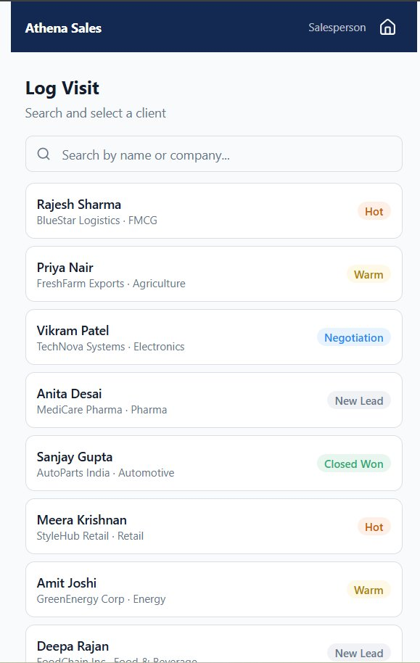
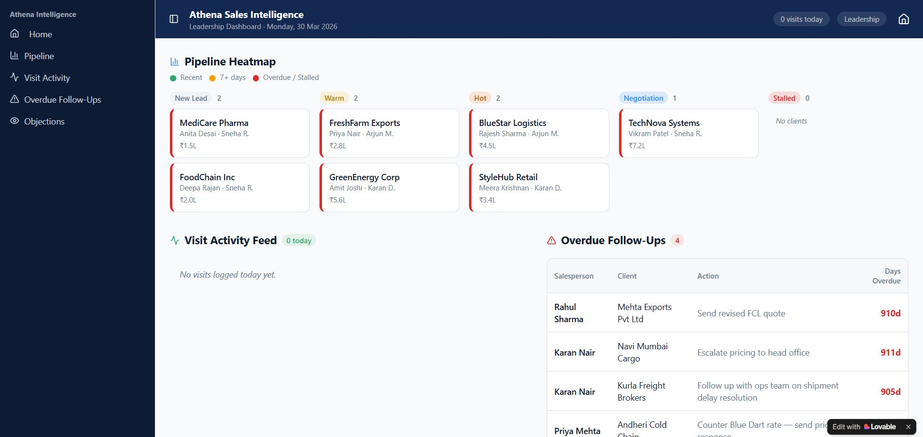
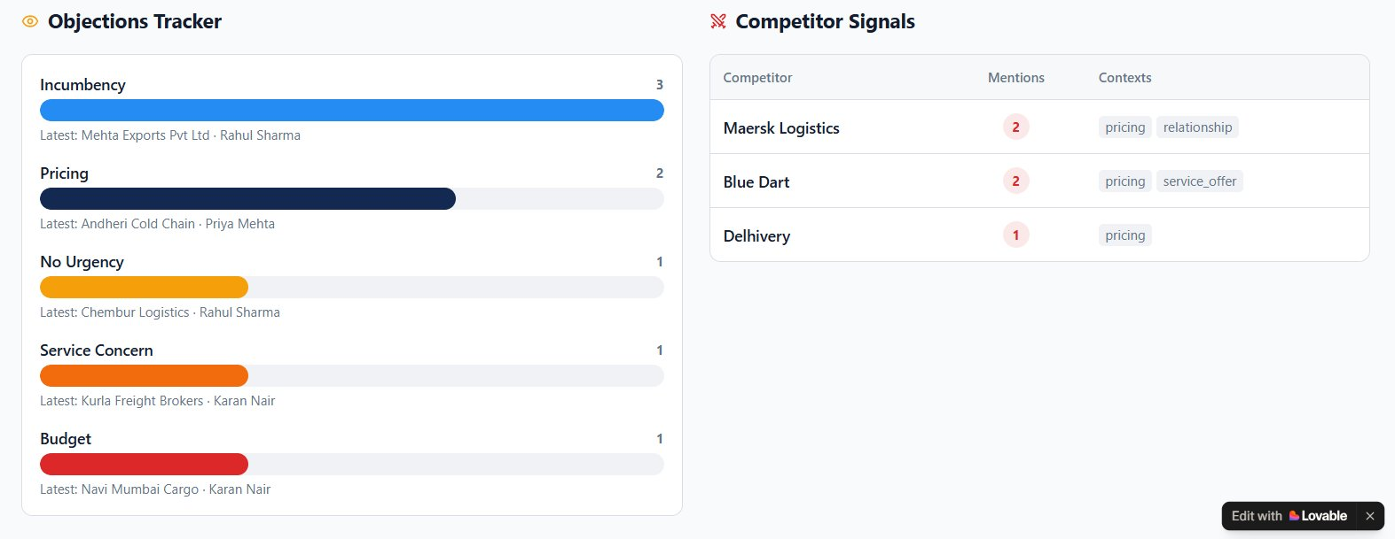
PROJECT 03 · INDUSTRY
Athena Global Logistics
Design Thinking Lead
Design Thinking · Sales Systems · Operations
BUSINESS OBJECTIVE
Identify the root cause of communication breakdown between Athena's field sales team and head office — and design a practical system to resolve it.
MY APPROACH
Spent 2 days immersed at Athena conducting structured interviews with both frontline salespeople and pricing teams. Mapped the broken workflow and co-designed a real-time field activity update system.
KEY LEARNINGS
Understood how to apply design thinking as a structured problem-solving method in a real business. Learnt that the best solutions come from speaking to both sides of a problem before designing anything.
Salesperson Log Visit · Leadership Pipeline Heatmap · Objections & Competitor Signals
Design Thinking
Field Immersion
Systems Design
Sales Ops

Slide 11
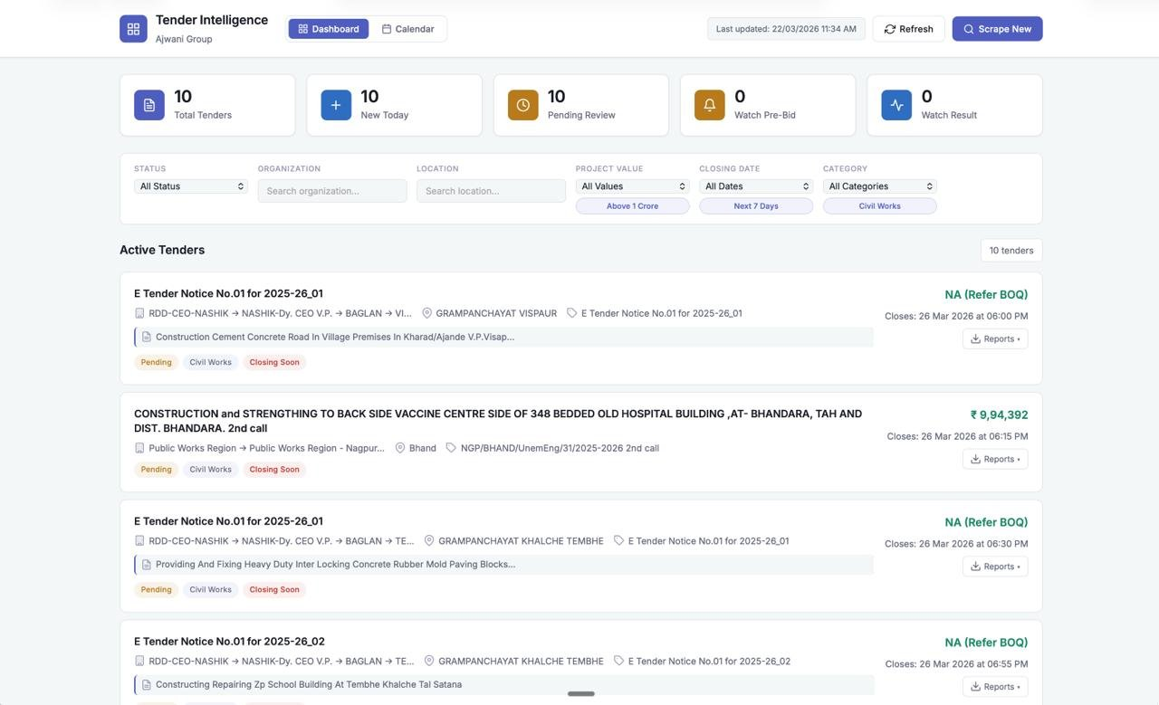
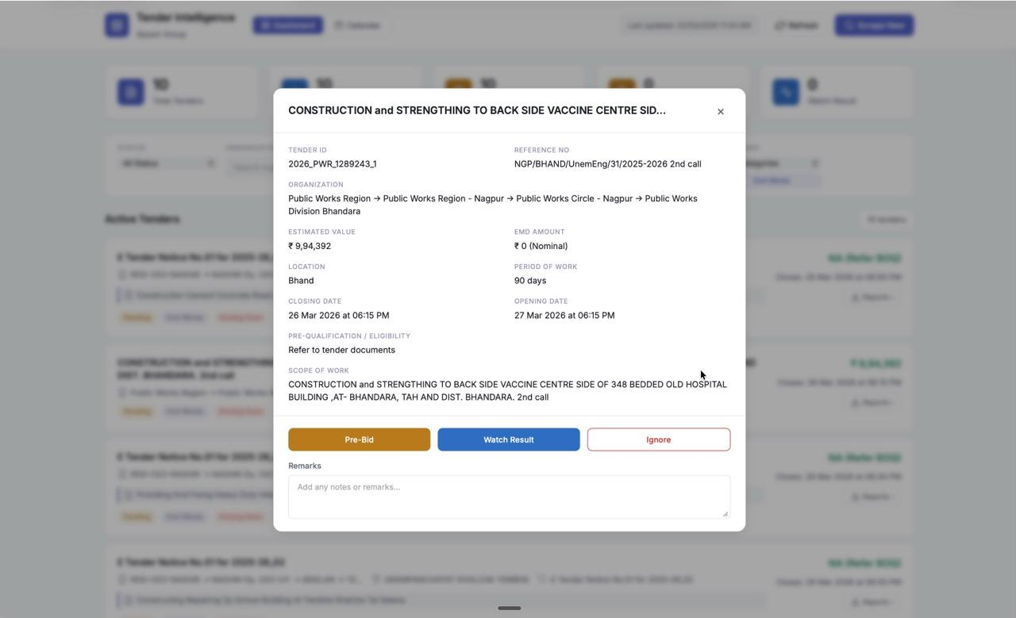
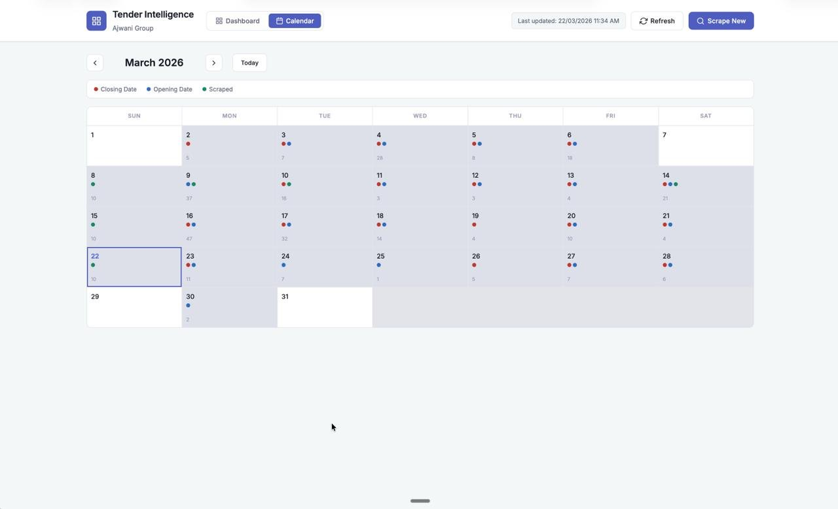
PROJECT 04 · INDUSTRY
Ajwani Group
Product Developer
AI Dashboard · Construction Sector · Business Development
BUSINESS OBJECTIVE
Eliminate manual monitoring of government portals for construction tender releases — ensuring no opportunity is missed due to human error or bandwidth constraints.
MY APPROACH
Conceptualised and built an AI-integrated dashboard that automatically captures, filters, and surfaces relevant government tender releases in real time — removing the need for daily manual checks.
KEY LEARNINGS
Learnt how to translate a real operational pain point into a product solution. Understood how AI can be applied practically in a traditional business — not just in tech companies.
Tender Intelligence Dashboard · Dashboard View · Tender Detail · Calendar View
AI Integration
Dashboard
Automation
Business Dev

Slide 12
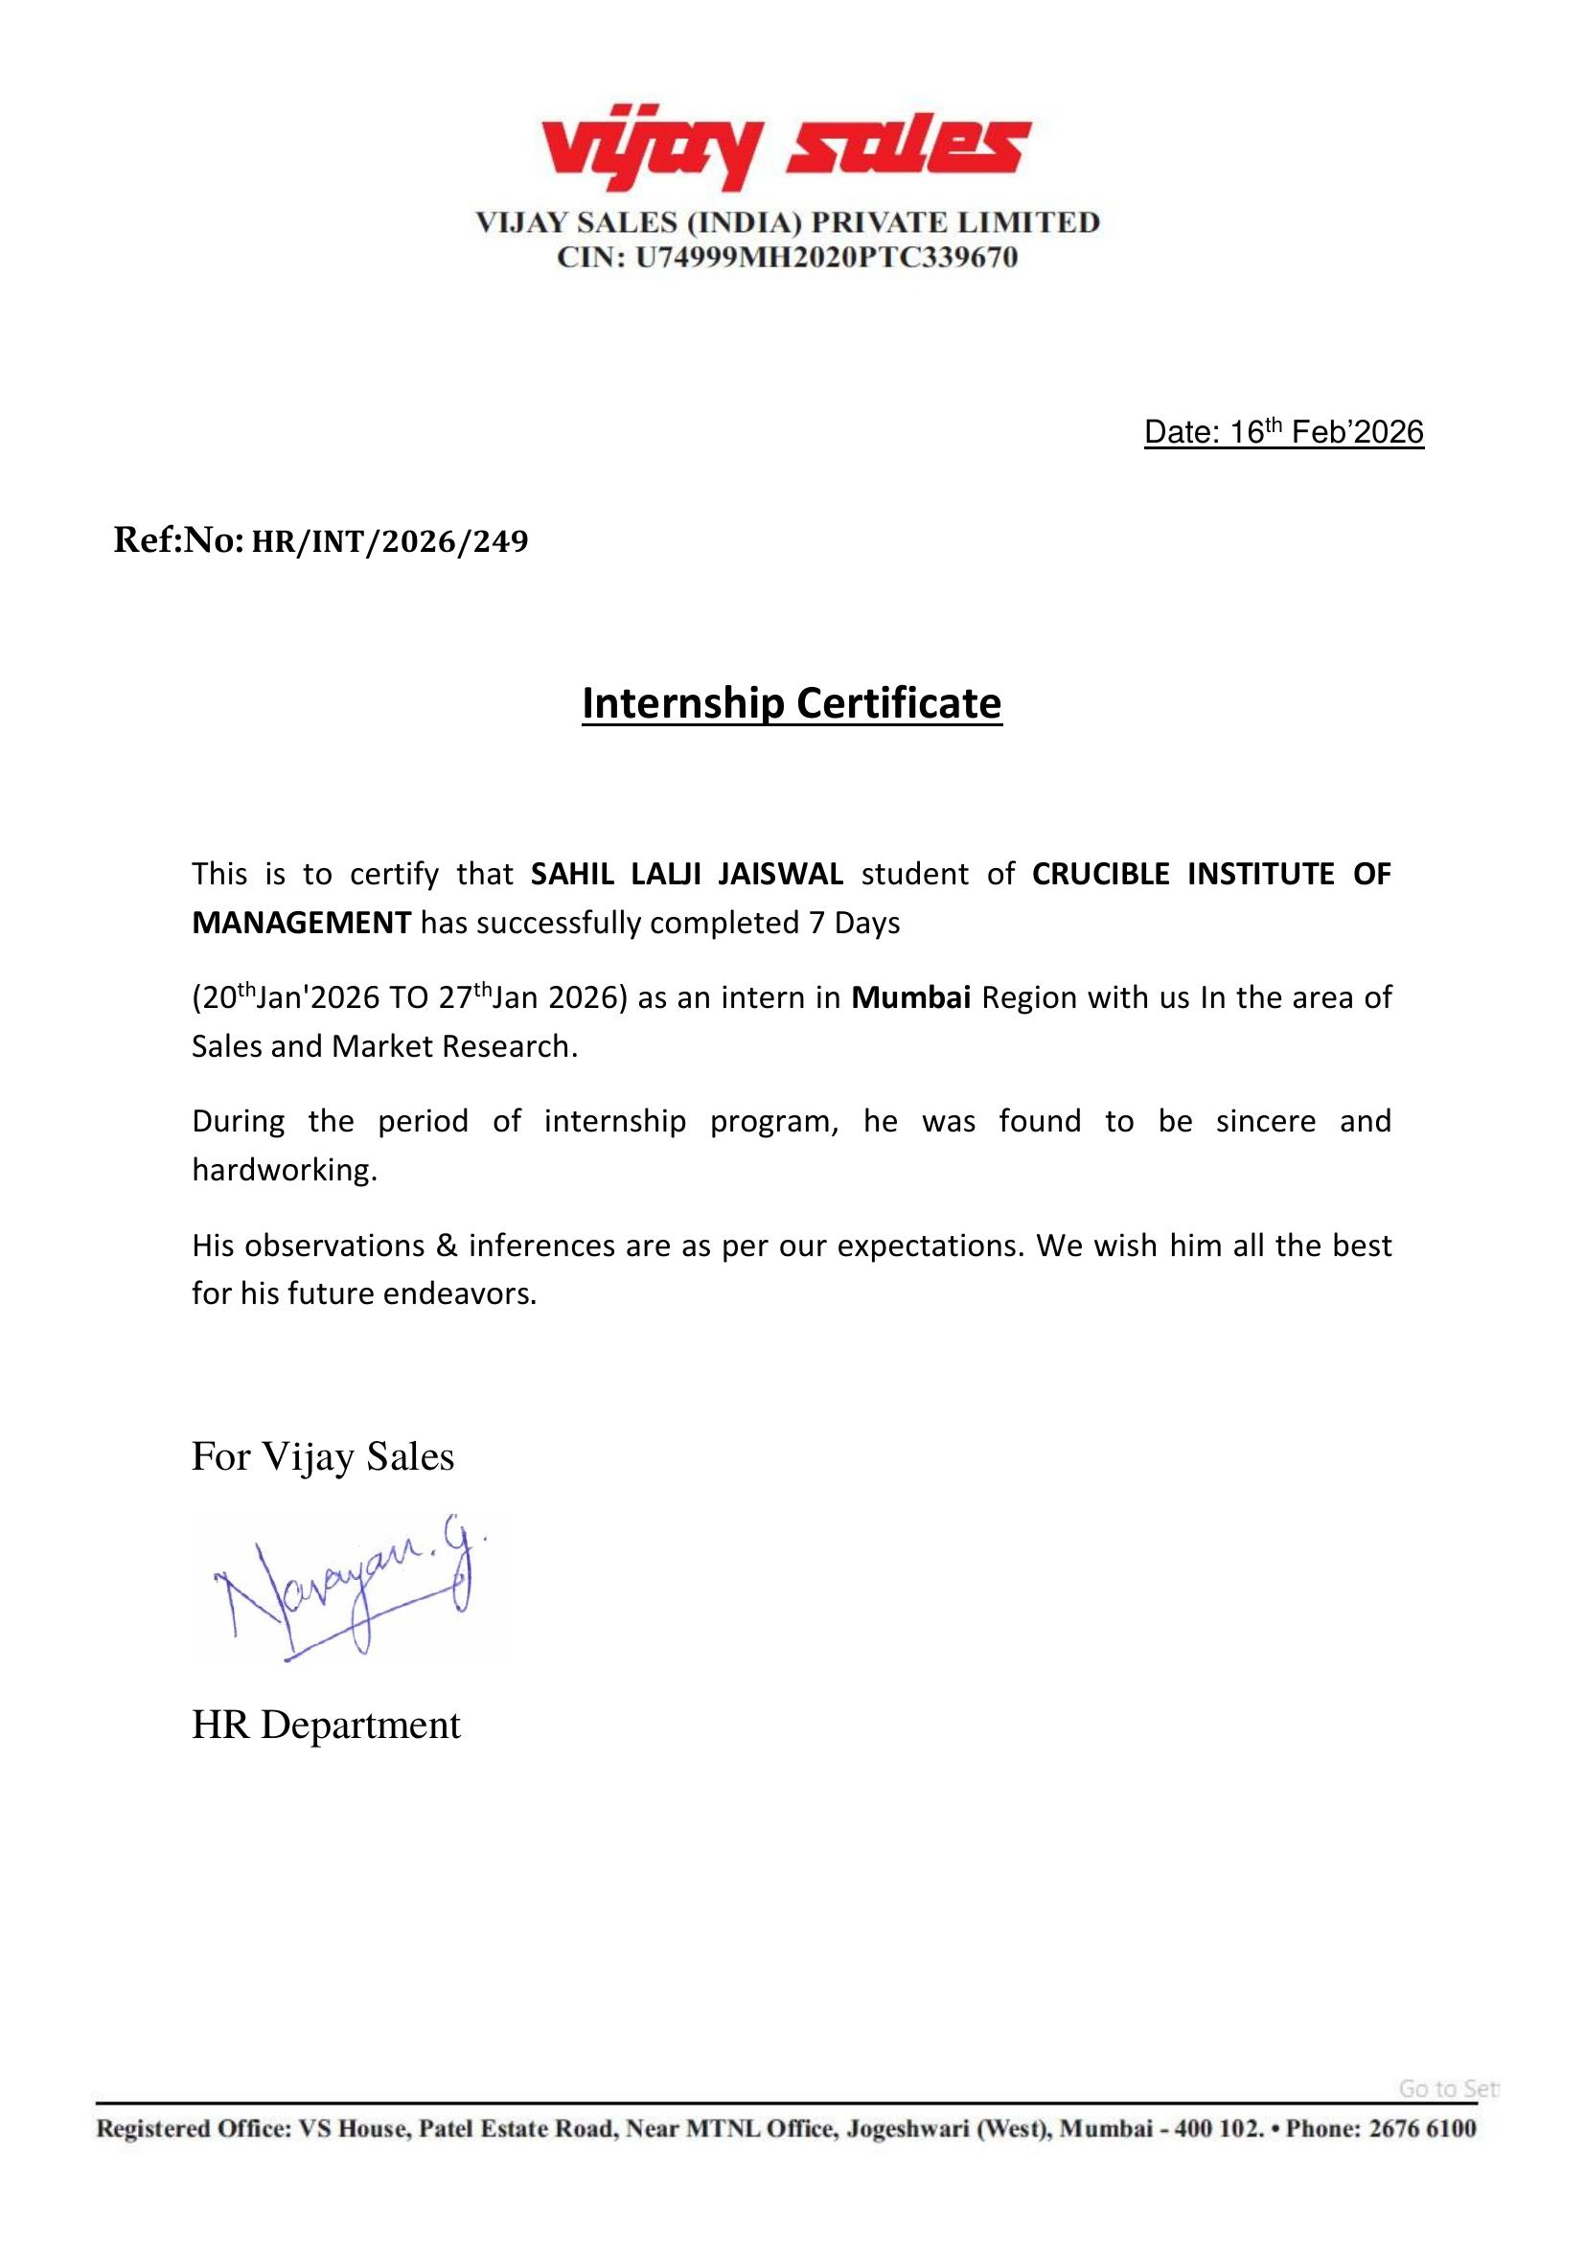
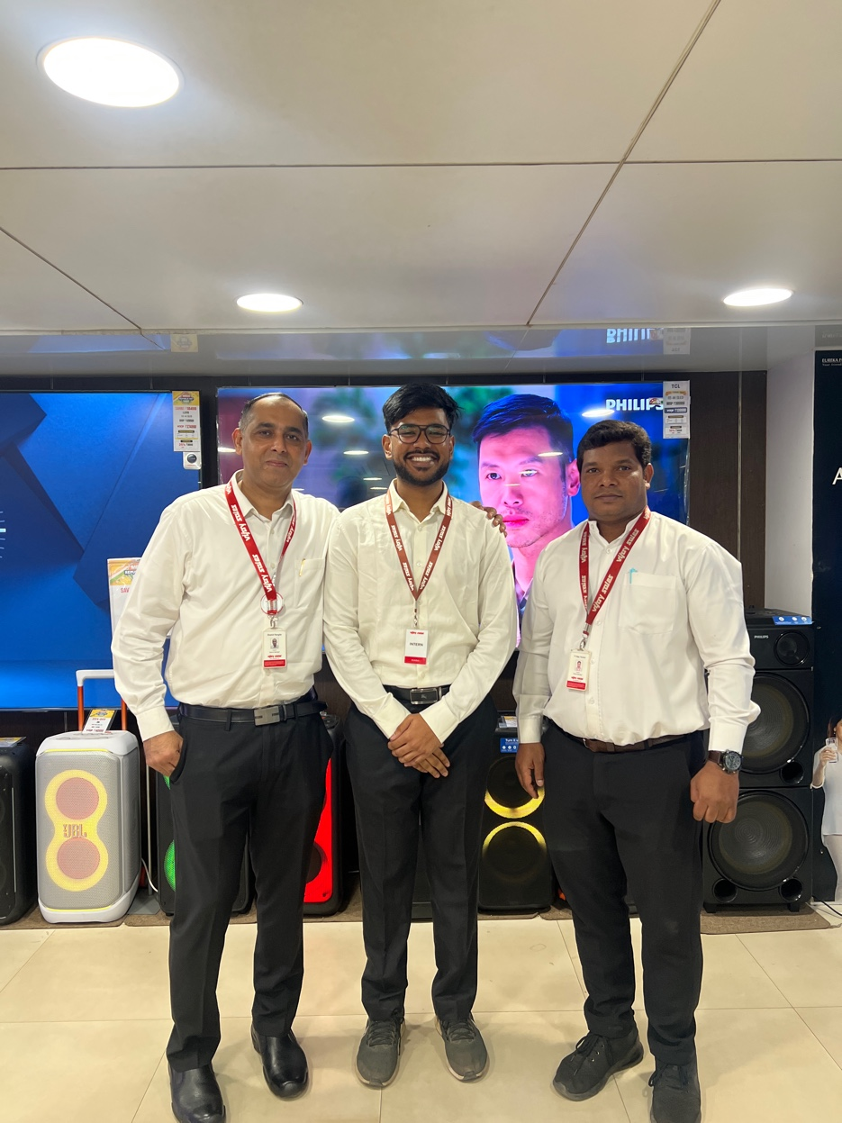
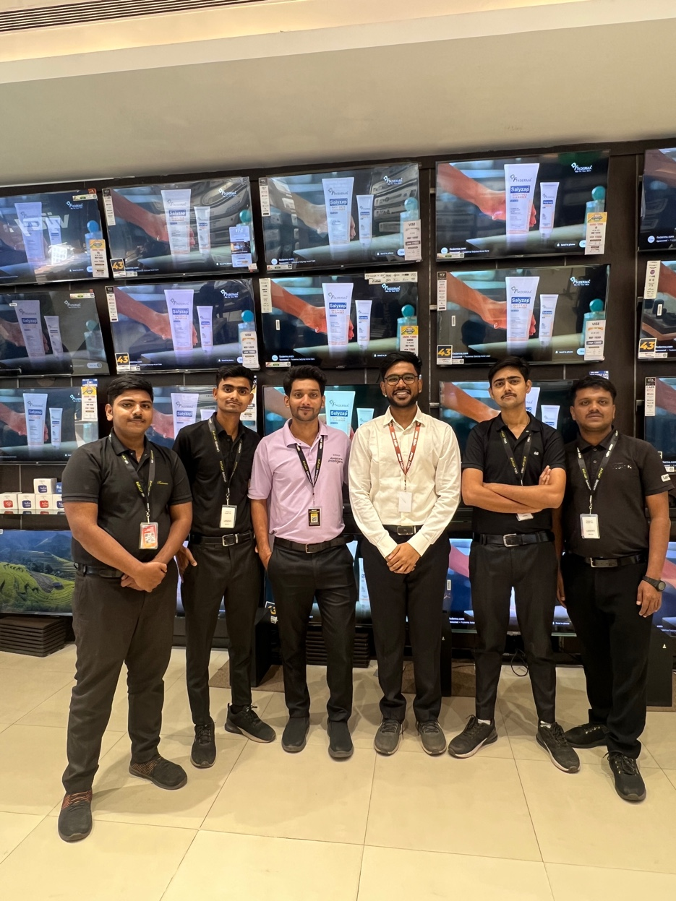
PROJECT 05 · INDUSTRY
Vijay Sales
Operations Analyst
Operations Immersion · Large-Format Retail · 8-Day Study
BUSINESS OBJECTIVE
Gain ground-level understanding of large-format retail operations — covering inventory, staffing, customer handling, and sales floor execution during a high-volume campaign.
MY APPROACH
Spent 8 consecutive days on the floor alongside a senior sales executive — observing purchase decision triggers, customer behaviour patterns, billing workflows, and day-to-day operational coordination.
KEY LEARNINGS
Understood how retail decisions are made at the floor level versus what is planned strategically. Developed an eye for consumer behaviour in high-footfall environments and what separates effective retail execution.
Project Visuals
Retail Ops
8-Day Immersion
Consumer Behaviour
Sales Floor

Slide 13
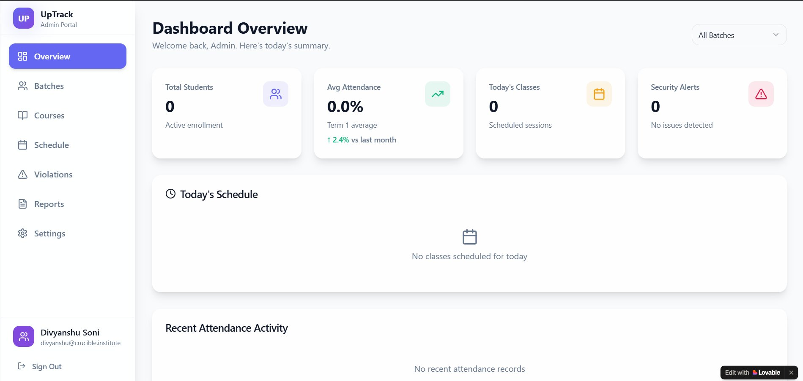
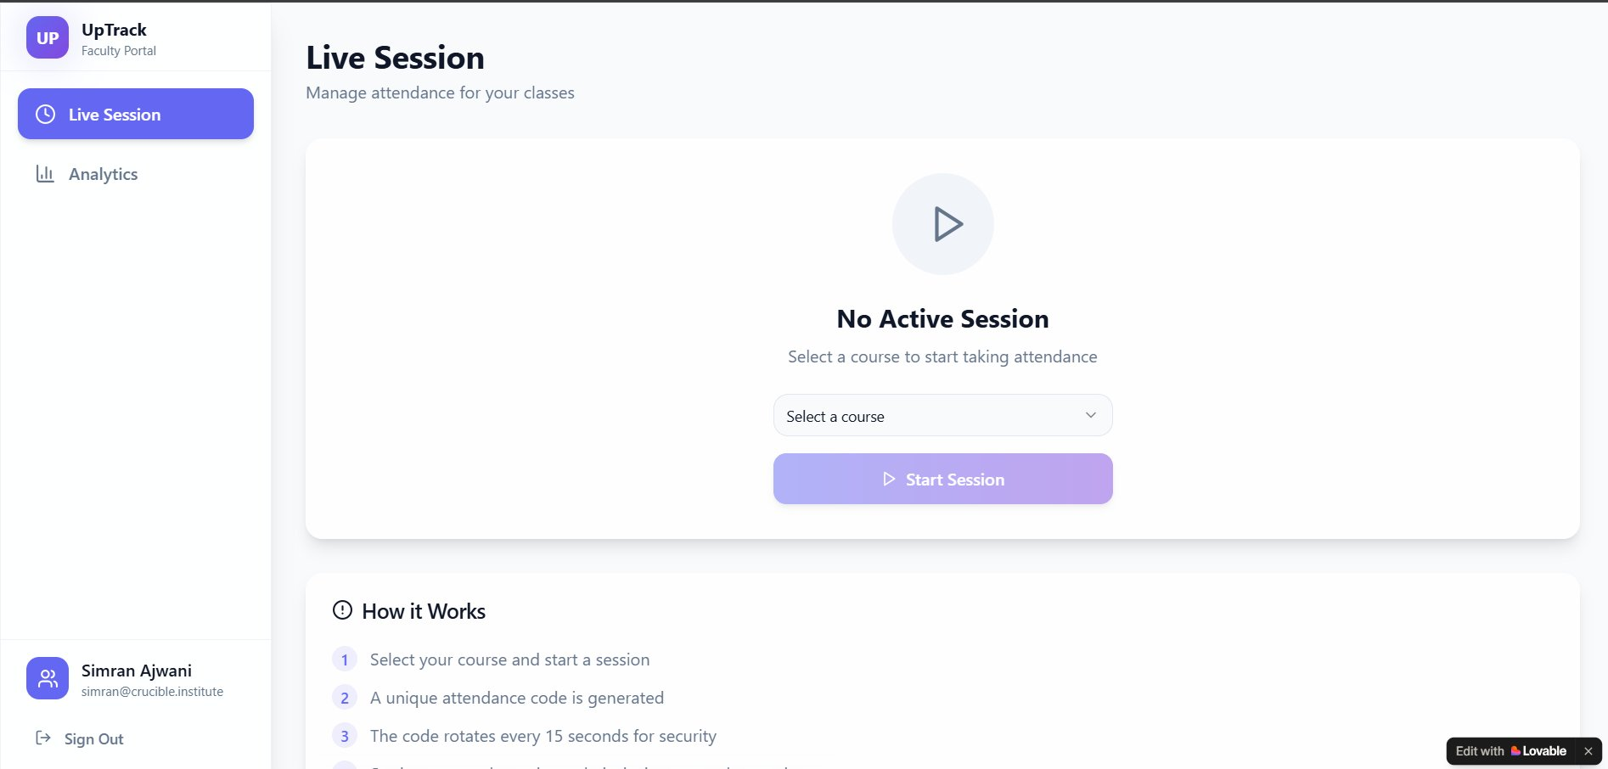
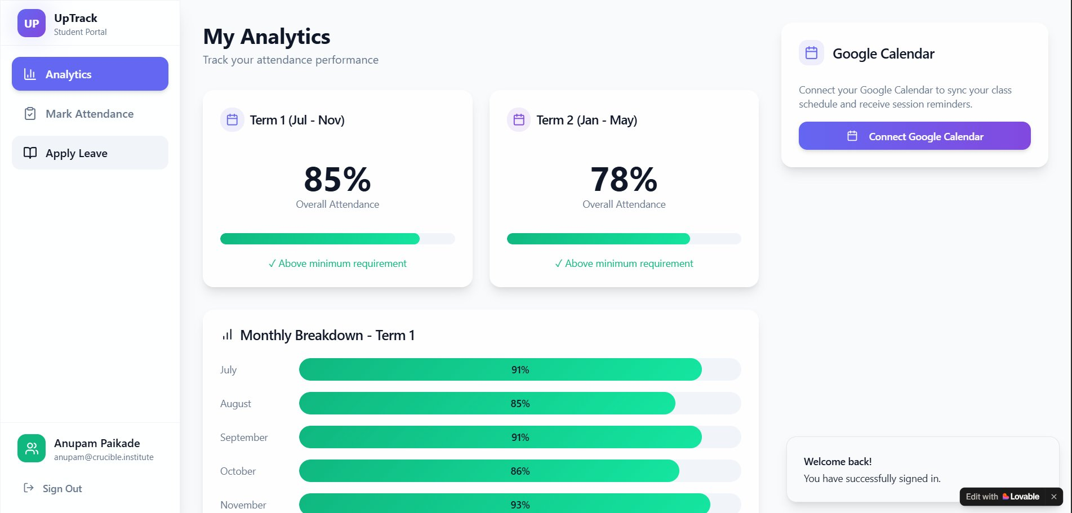
PROJECT 06 · INDUSTRY
Uptrack — Attendance App
Product Designer
Product Thinking · App Development · EdTech
BUSINESS OBJECTIVE
Design a mobile and web-based attendance tracking system that eliminates friction, reduces proxy, and automates a process that is currently manual and unreliable.
MY APPROACH
Mapped user journeys for both students and faculty, structured the platform logic, identified core features, and translated user needs into practical interface design.
KEY LEARNINGS
Learnt how to think like a product manager — starting from user pain, moving through problem definition, arriving at a structured feature set. Understood system-level thinking and balancing user needs against constraints.
Admin Dashboard · Faculty Live Session · Student Analytics
Product Thinking
User Journey
App Design
EdTech

Slide 14
ACADEMIC PROJECTS · TERM 1
May – Jul · 7 Courses · 180 Sessions
INTRO TO BUSINESS
INTRO TO BUSINESS
Garage Business Audit
₹1,000 Venture Sprint
Learnt to look at a business holistically — mapping functions, revenue model, and growth stage. First real exposure to cross-functional thinking.
Learnt that execution under constraint is a skill. Speed, customer mindset, and scrappiness matter more than perfect planning when resources are limited.
CONSUMER BEHAVIOUR
INTRO TO DATA
Purchase Decision Field Study
Personal Performance Analytics
Learnt that real consumer behaviour observed in the field is more valuable than any survey. Developed the habit of observing before concluding.
Learnt to collect, clean, and interpret self-generated data. Understood that data without context is meaningless — trends only make sense when you know what caused them.
FOUNDATION OF FINANCE
MANAGERIAL COMM.
DRHP Deep Dive
Situational Role Plays
Learnt to read a financial document like a business story. Built foundational financial literacy — understanding what a company discloses and why.
Learnt that communication is situational — the same message lands differently depending on tone, framing, and audience. Developed self-awareness under pressure.

Slide 15
ACADEMIC PROJECTS · TERM 2
Aug – Nov · 7 Courses · 175 Sessions
CONSUMER INSIGHTS 1
CONSUMER INSIGHTS 2
Max Protein — Qualitative Study
Café Behaviour Study
Learnt to design a research instrument from scratch and conduct consumer interviews without leading the respondent. The real insight is always one layer below the first answer.
Learnt that consumer decisions are driven by aspiration and social context as much as product. Understood the difference between functional needs and emotional motivations.
CONSUMER SEGMENTATION
BRAND MANAGEMENT
Multi-Brand Segmentation
Clutch Point — Brand Iceberg
Learnt that segmentation is not just demographics — it is about how different people relate to the same product differently. Understood how targeting shifts positioning.
Learnt that a brand is far more than its logo. The values, beliefs, and emotional promise underneath the visible layer are what actually build loyalty.
DIGITAL MARKETING
OPERATIONS MANAGEMENT
Live Campaign — Crucible Institute
Swiggy Instamart Dark Store Study
Learnt what it takes to run a real campaign end to end — from setting an objective to measuring what worked. Understood the gap between theory and live execution.
Learnt how quick commerce works from the inside. Understood that customer experience is a direct output of back-end operational decisions.

Slide 16
LET'S
CONNECT.
REACH OUT
EMAIL
sahiljaiswal1908@gmail.com
PHONE
+91 9321561338
LINKEDIN
Brand Management · Growth Marketing
D2C Startups · Youth Consumer Brands
linkedin.com/in/sahiljaiswal
LOCATION
sahiljaiswal1908@gmail.com
Mumbai, India
+91 9321561338
Hungry to build. Ready to contribute.

