Slide 1
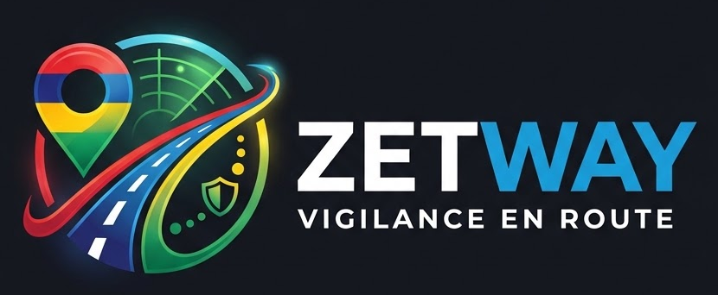
A commuter can see how dangerous their specific journey is — for how they travel, at the hour they travel — from the government’s own road-casualty data.
134
3,029
49.9%
people killed on Mauritian roads in 2024
injured or killed, from 39,485 reported accidents
of them were on two wheels or on foot
Source: Statistics Mauritius and Open Data Mauritius, via data.govmu.org
Notes:
Open with the number. In 2024, 134 people were killed on Mauritian roads and 3,029 were injured or killed, out of 39,485 reported accidents, on an island of 1.3 million.
The figure that shaped everything: 49.9% of casualties were riders or people on foot. Half the harm lands on the people with no metal around them.
Zetway is "Zet" from trajet, the journey. That is what it scores.

Slide 2
Half the harm falls on the least protected
649
casualty accidents in Pamplemousses and Riviere du Rempart in 2024 — the worst of the seven police districts, against 204 in the quietest
Who we built it for
A young motorcycle or auto-cycle rider commuting the northern corridor — Grand Baie and Goodlands down into Port Louis — riding home after dark.
357
of that district’s casualties were riders, the highest rider count on the island
They cannot see any of this before they set off.
The data exists. It sits in annual PDF digests and CSV tables that reach statisticians, not riders.
2.2×
as likely to be fatal in unlit darkness as in daylight — 8.2% of casualties against 3.7%
All figures: Open Data Mauritius, data.govmu.org. District data 2024; light conditions 2018, the latest published.
Notes:
Not "everyone in Mauritius" — one rider, one corridor, one moment.
Pamplemousses and Riviere du Rempart is genuinely the worst district: 649 casualty accidents against 204 in the quietest. 357 of its casualties were riders.
Darkness with no street lighting: 8.2% of casualties are fatal, against 3.7% in daylight. More than twice as deadly.
If asked why the light data is 2018: that is the most recent year the publisher has released. Every figure in the app carries its year.

Slide 3
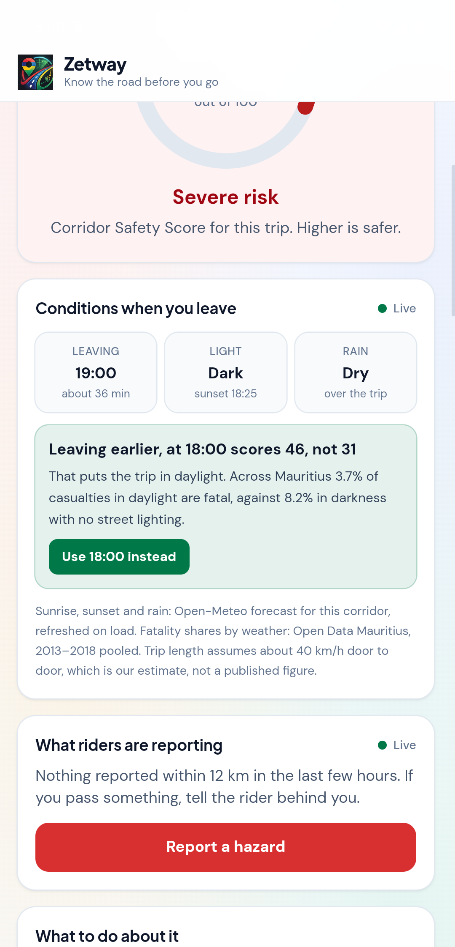
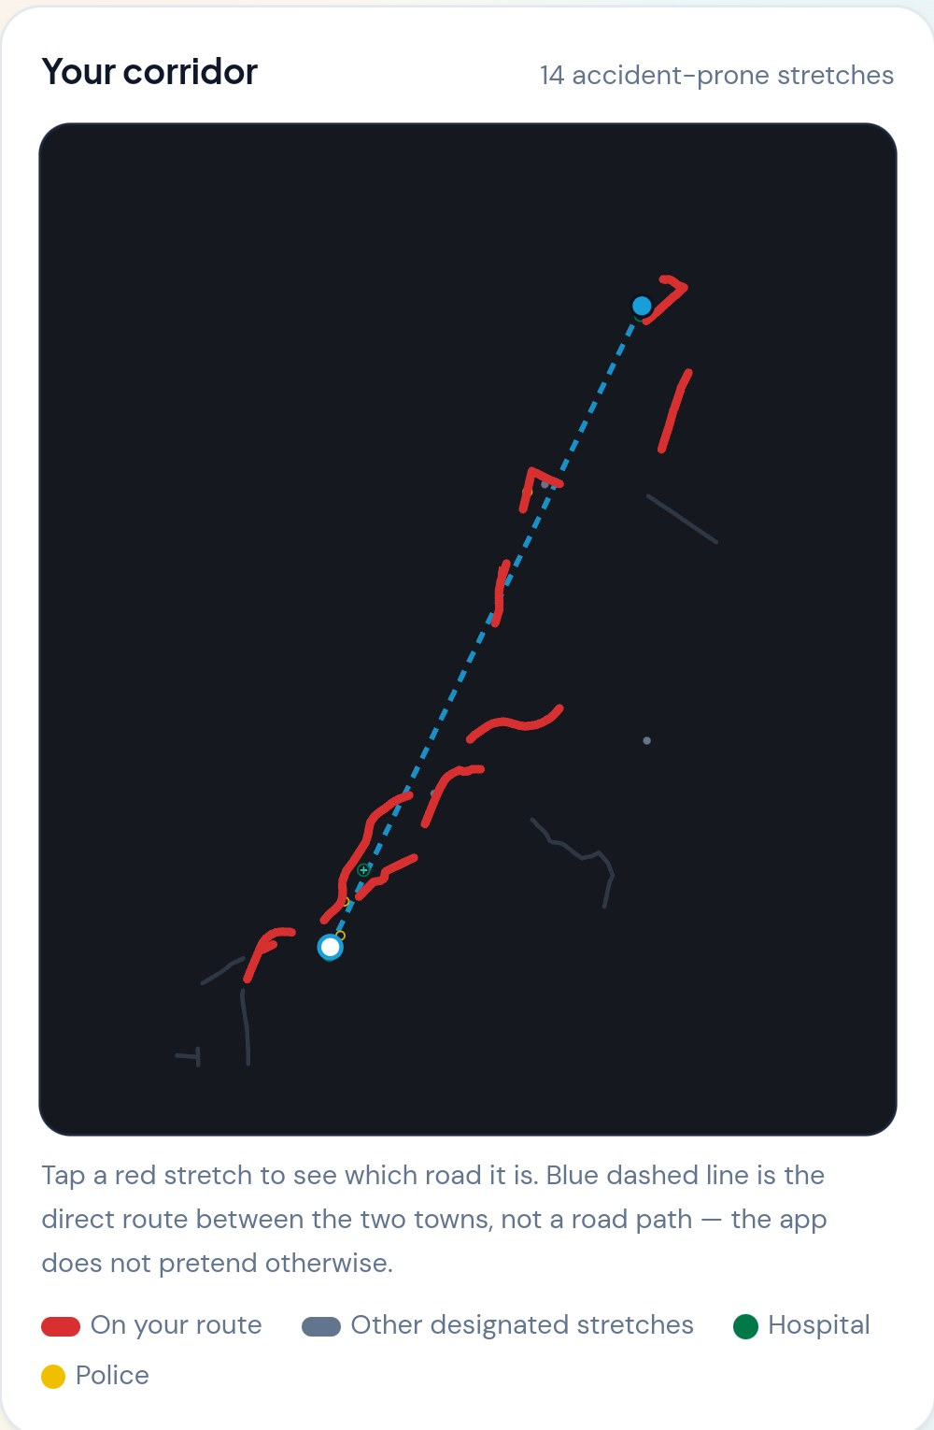
Before you ride, and when it goes wrong
A Corridor Safety Score from the official record — tap any factor for its figures and its table.
The 48 designated accident-prone segments — drawn on your corridor and named by road number — and the nearest of 241 hospitals and police stations with tap-to-call.
Live hazard reports from other riders, within seconds, on this corridor.
And when it goes wrong anyway — without touching the phone
Roadside guides: 7 for cars, 8 for motorcycles, written separately. Safety check first — on a main road it refuses to show repair steps at all.
Crash watch: a foreground service reads the accelerometer with the screen off. Over 3.1g it alarms and counts down 30 seconds.
Hands-free, because the rider cannot reach the phone. A shout alone arms it: loudness read straight off the microphone, no model, no language, no network, no Google services.
Or the words, in English, French and Kreol. Either one speaks a countdown the rider can stop — and during the crash countdown "I am fine" stands it down while "help" escalates at once.
Unanswered, the Android build texts every contact a map link and rings the first, with no tap. 114 stays one tap, because Android lets no app dial it.
14 of 48, on this corridor
Notes:
This is the live demo. backprop-pirates.vercel.app, open it on a phone.
Demo path: Grand Baie to Port Louis by motorcycle at 19:00 scores 31. The app says leave at 18:00 instead and it scores 46, because that puts the trip in daylight: 3.7% of casualties in daylight are fatal against 8.2% on an unlit road. Tap the button and watch the score move.
The map is drawn from the real geometry of those 48 segments, which ships with the app. No tiles and no requests — a tiled map would have been the one thing that went blank in airplane mode, on the slide where we claim it does not.
Then report a hazard live from a phone in the room and show it appear on another phone within seconds.
Say this about the alert, because it is the honest shape of it and somebody will wonder: a handset places one voice call at a time. That is the carrier's rule, not a limitation we chose. So every contact is texted at once, one of them is called, and the judges' page at /w/ZETW14 is a live feed, not an SMS. Nothing on this deck claims otherwise.
On Kreol, if asked: no phone ships a Morisyen model, so the recogniser is asked for French and "oskour" arrives as something near "au secours". Matching on roots rather than whole words is what makes that survivable. We are not claiming a Kreol speech model exists, because none does.
The shout trigger is the one that matters. It reads loudness straight off the microphone through AudioRecord: no model, no language, no network, no Google services, so it still works in a dead spot. Neither trigger dials anything on hearing a noise — both open a spoken, cancellable countdown, because a false alarm costs a real crew a real call-out.
If a judge pushes on false alarms, play crash-moto.mp4 from the laptop rather than spending a slide on it. It was rendered in Blender with Bullet rigid-body physics and an articulated, belted occupant — nothing keyframed — and it is the picture of why the alert corroborates rotation and change of speed rather than peak g alone.
On satellite, if asked — and this used to be on the slide: we evaluated it and rejected it on evidence, not effort. Seeing something car-sized needs sub-metre resolution, which means low orbit and about one pass a day; the satellites that watch continuously are weather satellites at 500 m a pixel, where a car does not exist. Mauritius is cloudy too. Resolution and revisit rate are a tradeoff you cannot escape, and Mauritius is cloudy. Weather models ingest satellite observations, so what we use is still remote-sensed, it just arrives as numbers.
Reports never move the score. The score cites government tables over years; an unverified report from a stranger is a different kind of claim, so it sits above the score instead of inside it.
If asked why 114 is not dialled automatically: Android refuses ACTION_CALL for emergency numbers from every third-party app and CALL_PRIVILEGED is closed to us, so no app on the Play Store can dial an ambulance by itself. Apple's own Crash Detection, with the hardware and the OS privileges, still counts down before calling. Our plugin asks the operating system whether a number is an emergency number and refuses rather than throwing mid-crash.
If asked about privacy or the law: we read the Data Protection Act 2017 and the Road Traffic Act rather than guessing. A voice recording is personal data, so the crash recording rests on the vital-interests basis the Act allows, is capped at 45 seconds, is announced on screen and never leaves the handset. Hand-held phone use while driving is an offence carrying penalty points, so everything the app asks of a rider happens before they set off or after they have stopped. There is a panel in the app that says all of this, and says we are students and not lawyers.

Slide 4
Twelve official tables, one of them mappable
What the other tables power
The find
The Accident Prone Areas table is not a list of place names. It holds 48 road segments as real geometry, named by road number.
Casualties by police district, 2013–2024 — district volume, and the split between people on foot, riders and vehicle occupants
Casualties by light condition — the time-of-day factor
Accidents by junction and road type — the junction and motorway advice
Accidents by weather, pooled 2013–2018 — the wet-road advice. Rain is 1.26 times as fatal, too small to score, so the app says it instead
169 health facilities and 72 police stations with coordinates — the help panel, and every town coordinate in the planner
Vehicles registered by type — the exposure denominator, so we can say riders are hurt 1.28 times as often per registered vehicle
"M1: Belle Village up to Caudan"
"A10: Lapeyre Hill to 16eme Mille, Forest Side"
So we name the black spots on your route, not a district average.
Nothing is hand-entered
Two scripts: one downloads the tables, one cleans them into the files the app loads. The raw downloads are committed, so anyone can re-run it and get the same numbers.
Tables: Open Data Mauritius (MDPA) and Statistics Mauritius, CC-BY-SA 4.0, via data.govmu.org. Live: Open-Meteo forecast, and reports from riders using the app.
Notes:
If asked how we got the data: data.govmu.org sits behind a bot check, so a script cannot fetch the CSVs. We used the Electric Sheep Africa mirror on Hugging Face, which carries the original CKAN package ID, resource ID and the data.govmu.org URL on every row. Provenance is intact and the app links to the original resource file.
The cleaning does real work: it repairs text the publisher saved in the wrong encoding, parses the MULTILINESTRING geometry, derives town coordinates from facility positions, and maps the 9 administrative districts onto the 7 police districts. That mapping is our assumption and we publish it inside places.json.
We downloaded 12 government tables and used the 10 that power a feature. If a judge taps Data sources in the app it says 9: the weather table is credited on the conditions panel instead of in that list. The 2 we did not use are committed in data/raw/json with the rest.

Slide 5
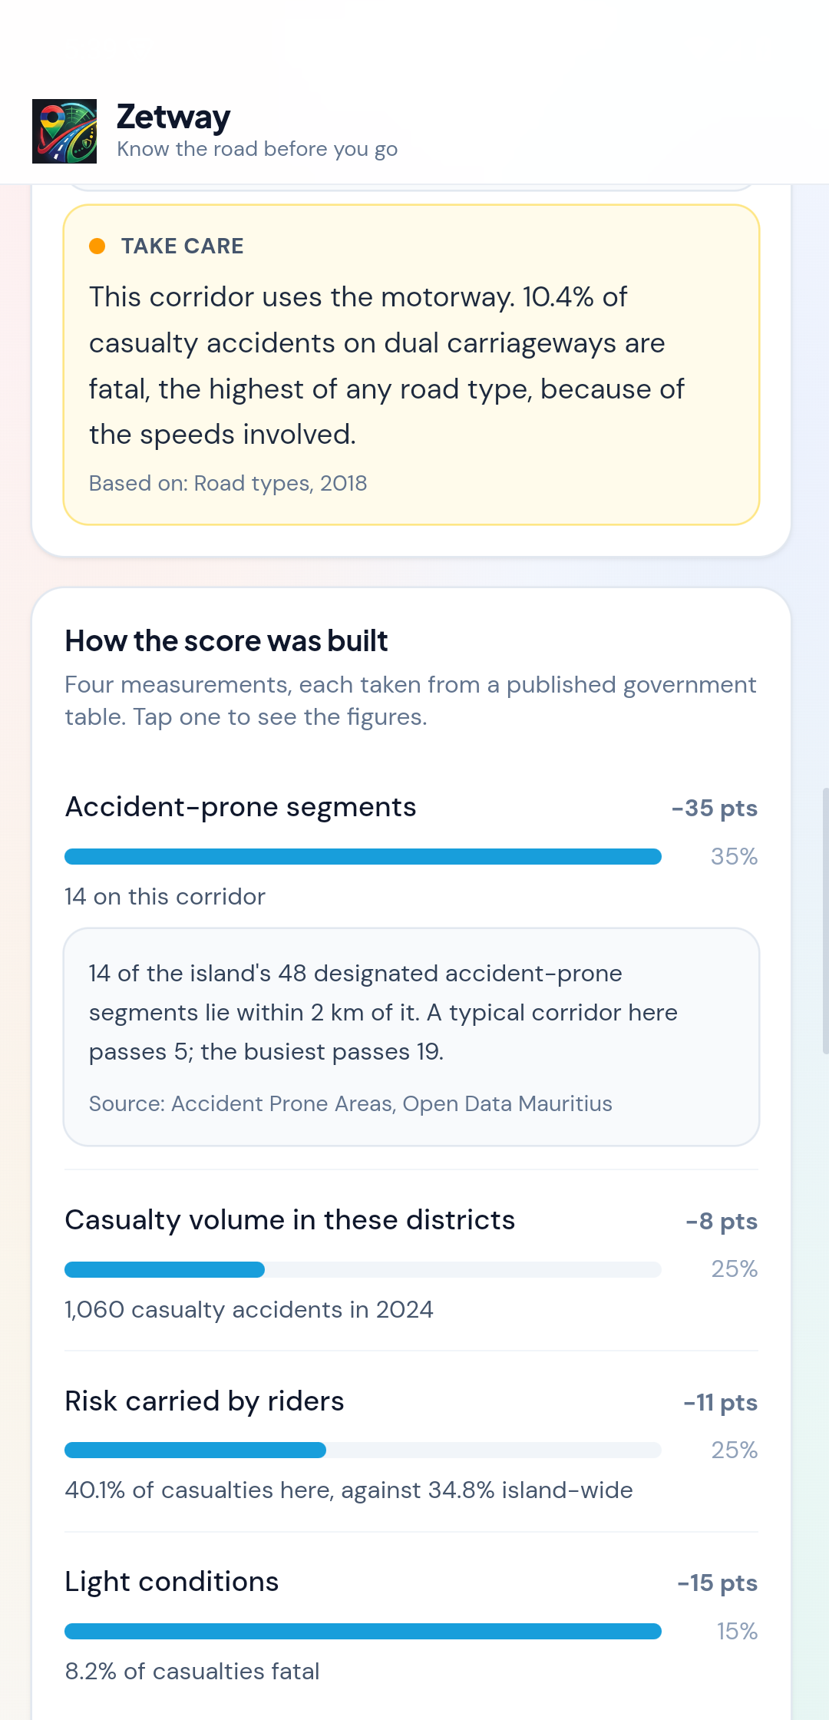
Every number traces to a government table
Four measurements, each a ratio between published figures
Accident-prone segments on the corridor — 35%
Casualty volume in the districts crossed — 25%
How this corridor treats people who travel as you do, against the national pattern — 25%
Share of casualties that are fatal in that light — 15%
Both ends of every scale come from the data — the worst district, the 90th-percentile corridor, the deadliest light condition. The only numbers we chose are the four weights, and the app prints them on screen.
We tested it, and the first version was wrong
Scoring all 5,200 route, mode and time combinations showed 70% came out "Severe" and nothing safe: vehicle occupants are always the largest casualty group, so every car trip was punished for being ordinary. We re-anchored each factor to the range the data spans. Scores now run 22 to 94.
And again, in the voice triggers. Found by reading our own matcher against real sentences: the app heard its own countdown through its own microphone and cancelled itself; the cancel list held "mo bon", which sits inside "mo Bondie"; apostrophes were flattened, so "I can’t move" matched nothing. 47 tests became 81.
Notes:
This is the slide to linger on. The first question a judge asks is "where does 31 come from" and the answer is in the app, not in the pitch.
Worked example on screen: 14 accident-prone segments costs 35 points, district volume 8, rider risk 11, unlit darkness 15. 100 minus 69 is 31. That is the capture beside you, taken from Grand Baie to Port Louis by motorcycle at 19:00 — the same trip you just ran live.
The calibration story matters because it shows we tested the model rather than the demo route. The check script is in the repo: scripts/check_score_spread.mjs.
The footnote underneath is eight seconds, not a minute. Three bugs, all found by running the matcher against sentences a hurt person would actually say, none by waiting for them to happen on stage. "Mo bon" is the one to say out loud if you only say one: it means "I am fine", it sits inside "mo Bondie", and "mo Bondie" is the commonest thing a hurt Mauritian says. A cry of pain was being read as a cancellation. scripts/test_sos_voice.mjs prints 81 passed, 0 failed; the version of that file from before the review ran 47 checks.
Be clear it is an exposure indicator, not a prediction. It cannot know about today's traffic, weather or the driver, and the app says so.

Slide 6
Who runs it, what it costs, where it goes
Runs on nothing
Reaches people now
Belongs to someone
Static JSON served from the edge, and two small functions on free tiers. The weather feed needs no key at all.
A data refresh is two scripts and a push.
A link first: it opens on any phone, no store, no install, nothing to fail before a demo.
And an APK from the same code, for the three things a browser forbids after a crash.
The Road Safety Unit or the police already publish this data.
Handing it over costs them a repo, not a procurement.
Surprise card
Offline Mode. We kept the Corridor Safety Score working with no internet — and it never needed the network. It is computed on the device from 278 KB of government tables, so a service worker storing them is all it took. The score, the 48 black spots, the emergency numbers and all 15 roadside guides work in airplane mode. The forecast and other riders’ reports cannot, are not cached, and the app says which is which. The APK already shipped those files inside it.
Next
Real road routing instead of straight lines · the Metro Express corridor · photos on reports · a signed release build so the APK installs without a warning
backprop-pirates.vercel.app
Notes:
Cost: it genuinely runs on nothing. Static JSON on a free tier and two small serverless functions, also on a free tier. The weather feed needs no key. The one key those functions carry is the project's public anon key, which is designed to ship in client bundles and is constrained by row-level security on two tables holding public hazard warnings and throwaway demo rooms. That matters for a public-sector handover.
Reach: a link works on any phone, with no store review and no install friction, and that is still what we demo from. The Android build is additive — it exists only because a browser may not text or call on its own after a crash — and inside the APK the data ships too, so the core works with no signal at all.
Who runs it: the people who publish this data already. Handing it over is a repo transfer, not a procurement exercise.
Limits, if asked: routes are straight lines between towns, not real road paths, and the app says so. Light and junction tables are 2018, the latest published. 26 towns, limited to places with an official health facility so the coordinates are real.
Surprise card, Offline Mode: the honest version of this answer is that we picked the one feature that never needed the network. The score is worked out in the browser from nine static files; the app only ever died offline because they had to be fetched. A service worker precaches them and the app's own bundle. Demo it by putting the phone in airplane mode and running a route — the score, the black spots, the emergency numbers and every roadside guide still work. The weather and other riders' reports genuinely cannot work offline, so they are not cached and not faked, and a banner names what is stored and what is waiting for signal. One trap worth mentioning if a judge is technical: on a first visit the page fetches its own JavaScript before the worker takes control, so runtime caching misses it and an offline reload is a blank page. Install reads index.html and caches what it references.

