Slide 2
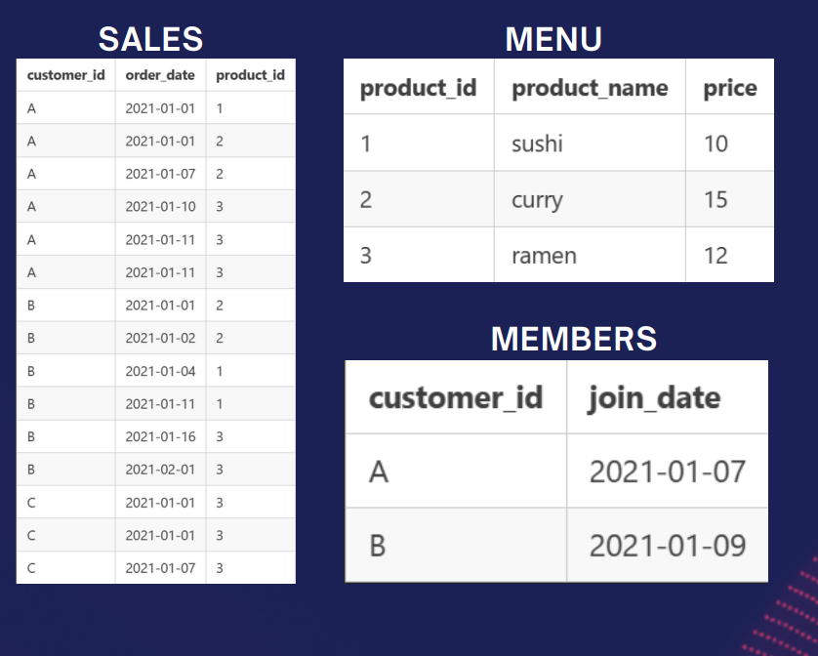

Slide 3

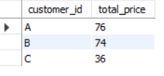
What is the total amount each customer spent at the restaurant?

Slide 4

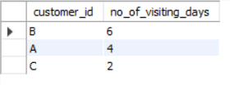
2.How many days has each customer visited the restaurant?

Slide 5

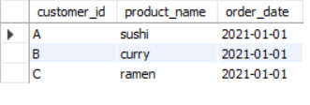
3.What was the first item from the menu purchased by each customer?

Slide 6

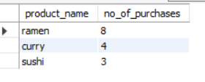
What is the most purchased item on the menu and how many times was it purchased by all customers?

Slide 7

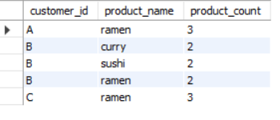
.Which item was the most popular for each customer?

Slide 8
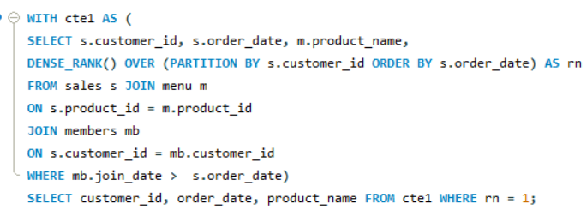

. Which item was purchased just before the customer became a member?

Slide 9


. What is the total items and amount spent for each member before they became a member?

Slide 10
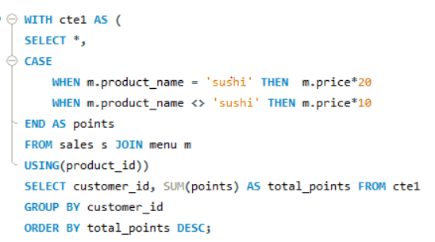
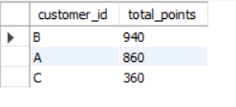
. If each $1 spent equates to 10 points and sushi has a 2x points multiplier - how many points would each customer have?

