Slide 1
CST8300: Ethical Debate
[Should workers be replaced by automated machine as much as possible]
Participating Project Team Members:​
[Sahil Kakadiya]​
[Kushal Kachhadiya]​
[Kunj patel]​
[RominKumar Patel]​
[Lucky Mark Bou]
[Utsav Jain]
Presented by Team #5

Slide 2
Overview of Ethical Issue
A clear overview of the ethical issue
Provide an understanding of what the issue is and why it is a relevant dilemma for people working in the computer industry
Pretend you are explaining to someone with no prior knowledge about the topic
All team members should collaborate to write an effective overview. It would be best to do this together, either in person or using a video conference tool such as Zoom, Microsoft Teams, Discord Video Call, etc.
This overview should not simply be a list of upcoming points that will be in your presentation. Your goal is to describe the ethical issue itself, and its relevance for people in the computer industry. Your goal is not to describe what is coming up in your presentation.
The overview should be approx. 200 words

Slide 3
Side A: Main Points
[The advantage of should be replaced by automated machine as much as possible]

Slide 4
Main Point #1
Main point to support Side A
Workers should be replaced by Automated machine as much as possible because some work is impossible for workers and that work can be done by only automated machine. This is possible in some condition and in some condition, this is not possible.
First, let’s talk about the condition in which this is possible. Weighing work in some work does not require a worker. Weighing work requires an automated machine.
Recently, the automated machine is operated by some small and big company; such as manufacturing companies, and automobiles companies.
Some worker is used to Automated machine in different field, like Mechanical engineering field and mechanical . Some students use automated machine for study. Some farmers also use automated machine to cultivate the land.
The advantage of this is that weighty work can easily go to any automobile company and the work is easily completed without the need of a worker. It can boost the company’s sales by improving the efficiency of the robot.
Slide prepared by: [Sahil Kakadiya]

Slide 5
Main Point #2
Main point to support Side A
As some work or tasks needs to be more accurate or precise and for that we need to work with more accuracy as well to be focused more and these can be achieved by replacing human-workforce with novel high-tech machines and software as much as possible thus Side A is more ethically correct.
Likewise, with the help of advanced automated machines, we can easily upsurge the pace of production and can be able to improve the quality of products for better
Moreover, while developing software or an applications if we get it done by machines it will perform accurately and consume least time as compared to human beings and able to fix bugs at a moment which sometimes seems impossible for human/programmer .
And most important point is that it can be cost-effective as we are not going to pay employee and it can get us better profit with excellent productions and by doing this it will also help to contribute to country’s GDP and increase rate of developing for developing countries .
While talking about automation in automobile industries it will check every safety measures and automatic driving system easily prevents from accidents and gets us better experience then human drivers.
Slide prepared by: [Kushal Kachhadiya]

Slide 6
Main Point #3
Main point to support Side A
First and foremost, the main reason to replace human worker with Artificial Intelligence is reduce the errors created by human workers in factories as it would lead to minimal losses to the companies. So , it would be cost efficient. Secondly , Artificial intelligence could also save much time which was consumed by workers as they would be programmed in such a way that they could complete task in repetition and rapidly. Finally It would save much more tedious work of employees and great amount of valuable time.
In addition to that , Artificial intelligence would decrease the number of accidents occurring in factories and outlets as it would strictly follow the safety procedures provided to it . It will also ensure safety of customers and other employees working in the company. Also it would be beneficial in companies producing pesticides and harmful chemicals for replacing employees to artificial intelligence as it would give them more span of life for not working in that environment. It will also lead to less chemical accidents in power plants. Also Artificial intelligence would be beneficial in emergency rescue teams like fire brigade , disaster management team because they could reach at places normal officers could not be able to reach.
Finally , Artificial Intelligence could produce itself in assembly line so we don’t need a crew for mass production of them which is required in human force in a company.
Slide prepared by: [Kunj Patel]

Slide 7
Main Point #4
Main point to support Side A
Workers should be replaced by Automated machines because its makes the work easier and faster.
In some of the factories the workers need more time to move the large heavy weighted materials from one place to another while machines can complete the same work more effectively and takes less time
Another point to support side A is wastage of the raw materials should be reduced.
Slide prepared by: [Rominkumar Patel]
]

Slide 8
Main Point #5
Main point to support Side A
Machines are made by humans to make a problem easier, faster and more efficient. Artificial Intelligence refers to any device that demonstrates qualities of the human mind.
Artificial Intelligence is important because firstly it reduces human error. Human beings make mistakes sometimes, but computers don’t when they are programmed properly. With artificial intelligence, choices are made based on information stored in the past. Therefore, errors are decreased and accurate to a certain level.
Secondly, AI helps in making fast decisions. Programmers can make computers make decisions and take actions faster than a person when AI is combined with other technology. Human beings are emotional and that can also affect our decision making while AI-powered machines follow their programming and outputs a result more quickly.
Machines are available 24 hours a day, 7 days a week and they labor nonstop. Humans are expected to take breaks to get ready for another day of work.
Slide prepared by: [Lucky Mark Bou]

Slide 9
Main Point #6
Main point to support Side A
Worker should be replaced by automated machine to make work more fluent and smooth.
If compared, worker takes more time than machine to complete a task so it’s good to replace worker by automated machine.
One of the biggest benefits is, by using machine the number of errors made by humans can be reduced and it can save a big amount of loss.
Machine can do the work with perfection which can make the product look good and indirectly because the well finished product, owner of factory can increase it’s demand in the market and eventually the company can make good profit.
If machines are used instead of worker than the production of the product can be increased in very well manner.
By using machine, heavy weighted products can be easily be lifted and placed at their place. And well organised machine is fast in making instant decisions and that can save us in critical situations.
Slide prepared by: [Utsav Jain]

Slide 10
Side A: Real-Life Examples
[The advantage of should be replaced by automated machine as much as possible]

Slide 11
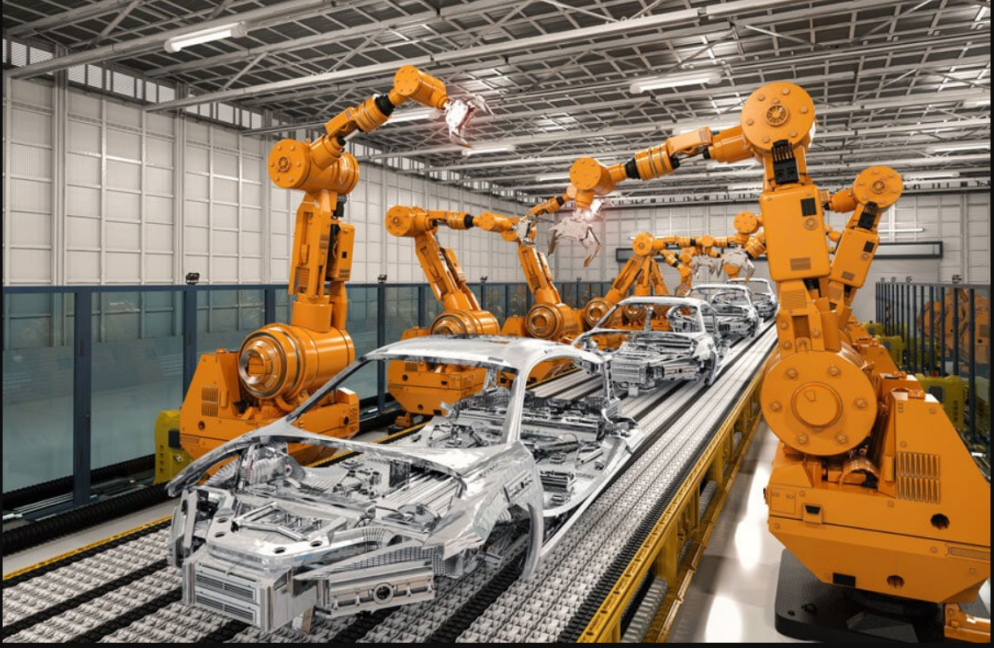
Example #1
Example to support Side A
There are many examples of in our country. Like some automobile company needs to Automated machine because there are many high weighting object like cars spare parts are very heavy and people can not lift the spare parts of car even when they are together. So, we use an automated machine.
Another example is that an automated machine is also used in milk packing. So that it can be easily accomplished. Some banks are also now using automated machines and there are many IT companies are using automated machines in their field work.
This is useful in certain conditions. And in some conditions this is unusual. For example, it is useful in overweight work. And in a bank-like job this behaves as unusual. This is because the use of over-automated machine in the work of the bank creates a shortage of workers.
[1]"The Impact of Robotic Process Automation on the Automotive Industry",
The Impact of Robotic Process Automation on the Automotive Industry, 2022.
[Online]. Available: The Impact of Robotic Process Automation on the Automotive Industry | by CiGen RPA | Medium.
[Accessed: 05- Jul- 2022].
Slide prepared by: [Sahil Kakadiya]

Slide 12
Example #2
Example to support Side A
Nowadays proper precise concentration of chemicals in medicines is to be needed to get rid from some dangerous dieses and pain such as Cancer and AIDS and it may be only done with help of super-tech machines, so we must replace as much as possible workers with super novel gadgets.
Like, preparing solution of some drug or a medicines we must calculate proportion, concentration, timing for fermentation, amount of light, heat and many more in a chemical reactions by using advanced software's, machines instead of traditional method of preparing antivirus or medicines/drug of diseases and may increase lifespan of us and these trend may consider as boon for mankind.
As when we approve to interfere workers in such process it may disturb such process (i.e.; workers cand sometime by mistake basic calculus mistakes and it may cause hazardous impact on environment) so sometimes it seems dangerous to not to involve machines instead of workers.
Slide prepared by: [Kushal Kachhadiya]

Slide 13
Example #3
Example to support Side A
There are some examples to support side A
As automate machines reduces time, in Agriculture sector this is more important. The cutting of crops and plants need more time if we do it by workers so machines must be used instead to overcome the time issues.
The raw materials like milk is used for making products like milk, cheese, etc. If this milk is transferred into the utensils for making this items by workers, there are more chances that some waste of milk will happen. But if we use automated machines, the wastage of milk is almost zero percent.
Slide prepared by: [RominKumar Patel]

Slide 14
Side B: Main Points
[The disadvantage of should be replaced by automated machine as much as possible]

Slide 15
Main Point #1
Main point to support Side B
There are all point against side of A means there are all point is disadvantages of should workers can be replaced by Automated machine as much as possible.
The first point is if we should be replaced by Automated machine, so people become jobless.
If we should be replaced by Automated machine, so the economic situation of the people collapses.
If we should be replaced by Automated machine. So many people become unemployed.
I know that if we use an automated machine instead of a men, the work is done easily; but because of this many people are deprived of employment. So, this is the biggest disadvantages.
Slide prepared by: [Sahil Kakadiya]

Slide 16
Main Point #2
Main point to support Side B
In contrast to side A, if workers get replaced by automated machines it’ll create a drastic unemployment in world, and it might lead world towards war, dishonesty and may crime ratio reach to its peak too and it may like curse to world.
Similarly, by implementing such trend, it may increase the risk for world to being controlled by robots in near future, like robots get started dominating in various sectors as well their advancement in weapon may be able to destroy world too.
Moreover, in some sectors humans are more efficient compared to machines, like while to develop logic the machines are not effective to do this as human has an ocean of it by gifted and machines too had been developed by human beings, so we have more skills and logic to perform any tasks.
Machines are created to help us, for our comfort but not to generate problem in human life so workers are not to be replace by advanced machines
All in all, if we replace more and more workers with machines, it has a lot of disadvantages compares to advantage, so we have to balance proper between them and we must consider our decision as per unemployment ratio.
Slide prepared by: [Kushal Kachhadiya]

Slide 17
Main Point #3
Main point to support Side B
In contrast, the artificial intelligence is beneficial in many ways but it also have some drawbacks which have significant effects on human life that are described in the following ways :
Firstly, It will snatch away a lot of employment opportunities of workers from industries which will lead to unemployment issues in the world that can create a havoc for whole community. This will lead to economic recession in many countries which depends on daily wage workers. Additionally , by replacing the worker with AI It also endangers the life of human the machines do not have the ability to think for other person or have feelings.
Secondly, in IT industry no matter how advanced AI would be but the logical program would only be created by a human as we are the only one who have ability to think and create a logical operation for a problem machine cannot execute a machine level code as they would not be able to create a logical solution they can only do tasks which are repetitive. Apart from this, the transition of replacing workers with AI can only possible with help of programmers who could write a machine code which will tell the robots to perform the given tasks.
Slide prepared by: [Kunj Patel]

Slide 18
Main Point #4
Main point to support Side B
Workers should be replaced by Automated machines because its makes the work easier and faster.
In some of the factories the workers need more time to move the large heavy weighted materials from one place to another while machines can complete the same work more effectively and takes less time
Another point to support side A is wastage of the raw materials should be reduced.
Slide prepared by: [RominKumar Patel]

Slide 19
Main Point #5
Main point to support Side B
AI is taking over.Machines are taking majority of jobs from humans and that reducing human involvement which will have a significant negative impact on employment standards
If most tasks are automated by the AI it will be make human dependent and lazy towards solving a problem and this can affect future generations
The Updating of Artificial Intelligence is necessary in order to meet up to the daily advancement and its very expensive. Machines requires costly repairs and maintenance to keep it running
Slide prepared by: [Lucky mark Bau]

Slide 20
Main Point #6
Main point to support Side A
In the first glance, if workers are replaced by the automated machines then worker will loose their jobs, and if this happens then their regular wages will decrease and by this it will eventually decrease per capita income of the country and it will directly affect the country’s GDP.
By using machine instead of worker it will increase the percentage rate of unemployment and if these happens then number of crimes and robberies, thefts will increase as worker will not have any kind of source for income and they will do wrong things to earn money.
Production of man made things will start to decrease and there will be less opportunity for worker to represent their talent.
If machines are being used then worker will become lazy. They will start to take less interest in doing hard works and won’t do their work with work with passion and dedication.
It can cause mental stress on worker’s mind. And there are somethings which should be done by worker only because only worker can do it with more perfection.
Investment is too much to implement machines and it’s hard to learn about the functions of machine, handling machine is not everyone’s cup of tea.
Slide prepared by: [Utsav Jain]

Slide 21
Side B: Real-Life Examples
[The disadvantage of should be replaced by automated machine as much as possible]

Slide 22
Example #1
Example to support Side B
There are so many examples which supports my points that are as follows:
For instance, in an oil company there petrochemical engineers who are working as employees who are working their entire work would be replaced by AI then there will be a unemployment problem for them apart from them there many industries which would changed drastically by replacement of AI for employees as that employees would not be having nothing to do .
Secondly , in IT industry there will always be opportunity as no matter how advanced technology be AI cannot create a logical execution of code so they can only be useful in doing simple and repetitive tasks.
AI would fail in creating logical solutions to the recurring problems they would only be beneficial for reducing the time in labour work and accidents in chemical power plants but they are not much useful in IT industry for creating problem solving tasks
Slide prepared by: [Kunj Patel]

Slide 23
Example #2
Example to support Side B
AI is extremely important for weather forecasting. Most of the human error has been decreased by Artificial Intelligence.
When playing some computer games like FIFA,COC,GTA and so on, you discovered there’s a difficult level that’s nearly impossible to beat because of the AI behind the game. A well-designed program makes decisions and carries out actions faster and quicker.
Applications like Google Map, Siri are used frequently. There’s no need to ask a person for directions you can used your mobile apps.
Healthwise AI help doctors predict illnesses at their earlier stages.
Slide prepared by: [Lucky mark Bou]

Slide 24
Example #3
Example to support Side B
Talking about the example, once I’ve faced these kind of situation in my real life.
This happened about 2 years ago, there was a friend of mine whose father was the owner of a factory that produce sugar. So at that time demand of machines were rising rapidly and everyone was willing to use machines instead of workers and so my friend’s father did. He removed many workers from his factory to implement machine instead of workers.
He implemented plenty of machines and one of my friends was also working in that factory and he also got fired because of implementation of machines. When he got fired he was not having any kind of job to do. He lost his source of income. And after some months he wasn’t able to get a new job even after trying so hard for it. He got in mental pressure because he was unemployed and to earn money he decided to choose wrong path to earn money. He started to do small robberies and thefts which was not a good idea at all. To save him from this situation we helped him and gave him a job in my father’s factory.
In the end, I would like to say that it can be kind of bad and risky for people and a person himself too.
Slide prepared by: [Utsav Jain]

Slide 25
References

Slide 26
References
Side A : Real life example
[1]"The Impact of Robotic Process Automation on the Automotive Industry",
The Impact of Robotic Process Automation on the Automotive Industry, 2022.
[Online]. Available: The Impact of Robotic Process Automation on the Automotive Industry | by CiGen RPA | Medium.
[Accessed: 05- Jul- 2022].

Slide 27
References
Please use IEEE format

