Slide 1
TRACK A / NGO / SOCIAL IMPACT
JAIPUR / PILOT RUN
URGENT
Surplus-to-
2–6
Shelter
HOURS
Real-time algorithmic food rescue engine.
SPOILAGE WINDOW
Solving the 2–6 hour spoilage bottleneck with live capacity-matching & automated ESG receipts.
LATE
TEAM
DEPLOYMENT
SURPLUS
SHELTER
TechCypher
Live Netlify Web App
01 / 06

Slide 2
ANATOMY / OF A FAILING HANDOFF
THREE BOTTLENECKS / ONE SUPPLY CHAIN
Why good cooked food
still
becomes waste.
The missing ingredient is not supply, capacity, or goodwill. It is a clock that beats faster than WhatsApp, a gate we cannot see, and a margin that points the wrong way.
01 / 03
02 / 03
03 / 03
2–6
0
₹0
H
/n
/kg
The spoilage window.
The capacity blind spot.
Cost goes the wrong way.
Cooked food decays faster than manual coordination can run. WhatsApp forwards lose the thread. Calls die on hold. By the time a driver would arrive, the tawa is cold.
Shelters have free cold-storage slots we never see. A 30kg delivery to a shelter with 8kg of room is a re-dump an hour later, at the next chowk.
The dustbin is one tap away. Donating is twenty-five. No automated receipt, no 80G paper trail, no finance committee recognition. The trolley rolls past the donation shelf.
The gap is not distance. It is a missing 30-second data bridge.
Context / UNEP Food Waste Index 2024: 1.05B tonnes wasted globally in 2022 · 132 kg per capita · ~1/5 of food available to consumers.
SURPLUS-TO-SHELTER / TECH CYPHER
PROBLEM / ANATOMY OF A FAILING HANDOFF
02 / 06

Slide 3
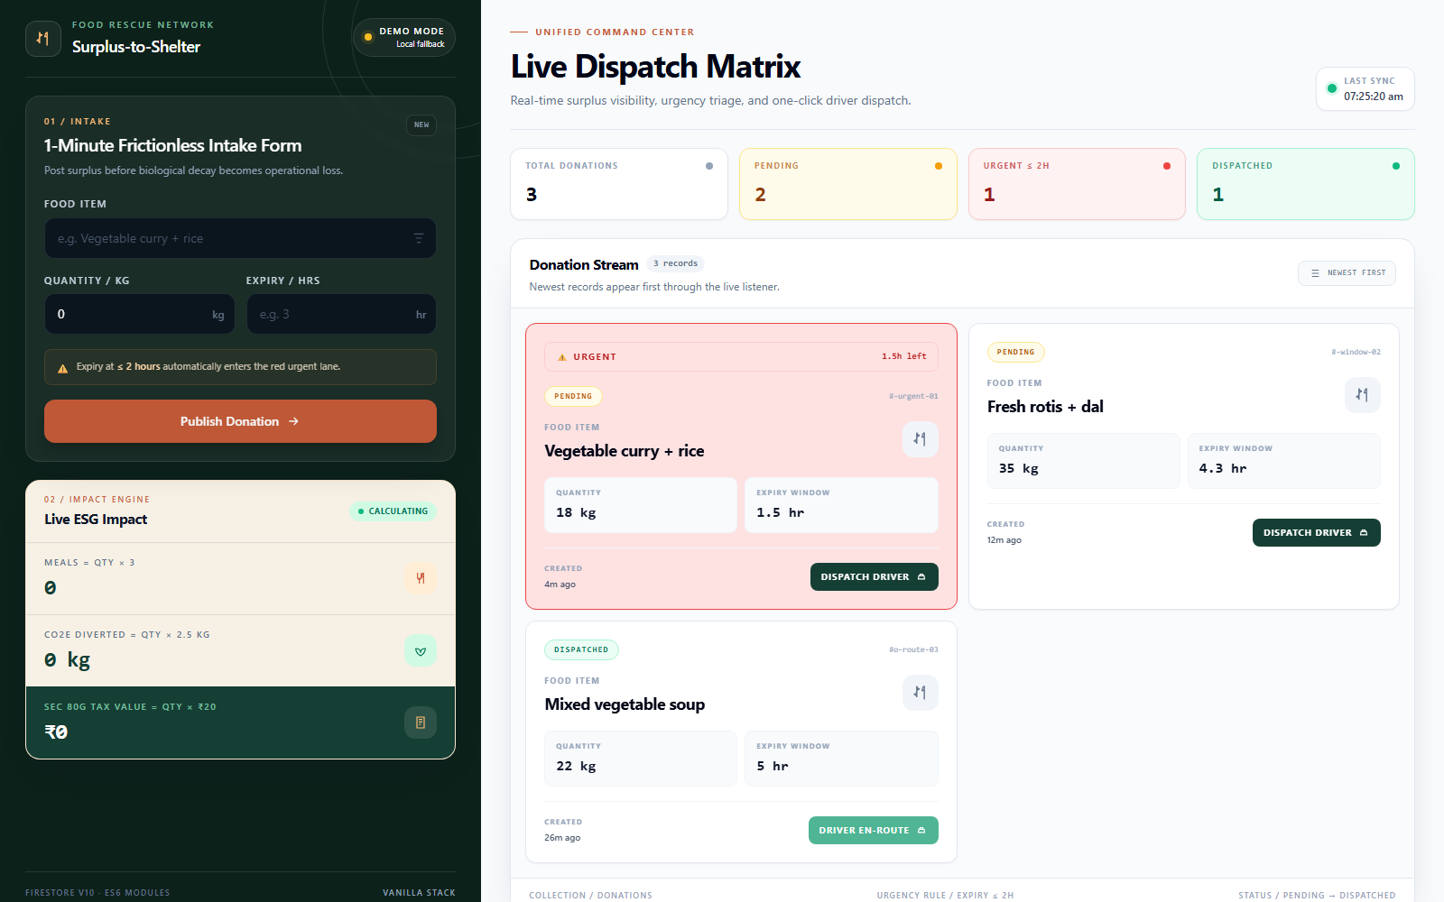
PRODUCT / UNIFIED COMMAND CENTER
LIVE NETLIFY WEB APP / FIREBASE
The web app turns a rescue into a live dispatch decision.
MVP FLOW
01 / INTAKE
< 3 MIN
Food item, kg, expiry window
02 / TRIAGE
< 2 HRS
Urgent food flags in red
03 / DISPATCH
50 KG CAP
Capacity-aware route; status flips to DISPATCHED
LIVE / DATA
LIVE SYNC
onSnapshot real-time sync without page reloads
BUILT WITH VANILLA HTML · TAILWIND CDN · FIREBASE FIRESTORE V10 · LOCAL FALLBACK READY
SURPLUS-TO-SHELTER / TECH CYPHER
PRODUCT / INTAKE → TRIAGE → DISPATCH
03 / 06

Slide 4
CORE SOLUTION / PIPELINE
ONE EVENT / ONE STATE / ONE LIVE BOARD
A pipeline that
beats biological decay.
The product turns a donor handoff into a timed, capacity-aware decision.
DONOR INTAKE
EXPIRY TRIAGE
CAPACITY MATCH
DRIVER DISPATCH
01 / FEATURE
02 / FEATURE
03 / FEATURE
< 3 MIN
< 2 HRS
50 KG CAP
Frictionless donor intake form.
Expiry triage engine flags urgent food in red.
Capacity-aware dispatch prevents secondary dumping.
A 1-minute intake captures food item, quantity, and expiry window.
The 2–6 hour spoilage window becomes a red, time-stamped decision lane.
The cap keeps one shelter from receiving a bag it cannot safely store.
FAILURE HANDLING
Spoilage Cut-off
Capacity Triage
0-Lag Architecture
Auto-cancel dispatch if shelf-life drops under 45 mins. Zero liability.
Dynamic routing cascades to the next NGO if the 50kg limit is hit.
Firebase real-time sync without page reloads.
SURPLUS-TO-SHELTER / TECH CYPHER
SOLUTION / PIPELINE THAT BEATS DECAY
04 / 06

Slide 5
IMPACT / BUSINESS MODEL IN ONE SLIDE
ESG / SEC 80G / CSR
A live
Sec 80G
certificate, printed on
every rescue.
Every kilogram that flows through the system produces an auditable handoff — and three real numbers the finance team can write into the next CSR return.
THE COMPUTATION / PER KILOGRAM RESCUED
WORKED EXAMPLE / 10 KG RESCUE
IMMUTABLE AUDIT TRAIL
Meals = Qty × 3
30
01
02
03
meals
Posted
Matched
Dispatched
CO₂e = Qty × 2.5 kg
25 kg
CO₂e diverted
Tax value = Qty × ₹20
Each handoff is time-stamped and linked. The 80G certificate is generated from the same audit trail.
₹200
impact value
80G NOTE / ₹20 per kg is a configurable impact-value proxy. Actual deduction depends on the qualifying donation and recipient status.
Tax reference / Income Tax Department, Section 80G deduction guidance. Product note / the ₹20/kg value is a declared impact proxy, not a statutory tax rate.
SURPLUS-TO-SHELTER / TECH CYPHER
IMPACT / EVERY RESCUE BECOMES A RECEIPT
05 / 06

Slide 6
SCALE / TWO LOOPS, ONE FLYWHEEL
PILOT SCORECARD / NEXT 30 DAYS
From a Jaipur pilot to a
repeatable rescue network.
The product earns its place when both sides of the handoff get something measurable.
RESTAURANTS / KITCHENS
SHELTERS / NGOS
THE FLYWHEEL
Donating becomes a 20-five tap process, not a twenty-five call.
Predictable inflow beats dropped bags at odd hours.
LIVE DATA
SURPLUS
Auto-issued ESG receipts give finance teams a clean CSR attachment and a reason to repeat the behavior.
Menu planning becomes predictable; every delivery is time-stamped and linked to a safe handoff.
MATCH
AUDIT
MEAL
30-DAY PILOT TARGETS
≤ 3 MIN / intake
< 2 HRS / urgent response
0 / dropped bags
100% / logged handoffs
Pilot success = a measurable reduction in spoilage, a reliable NGO handoff, and a CSR-ready record for every kilogram.
Context / UNEP Food Waste Index 2024 · Product / Firebase Firestore real-time listeners · Tax / Income Tax Department Section 80G · Safety / FSSAI verification is a deployment requirement.
SURPLUS-TO-SHELTER / TECH CYPHER
SCALE / MAKE THE RIGHT HANDOFF THE EASY HANDOFF
06 / 06

