Slide 1


Learn German

Slide 2

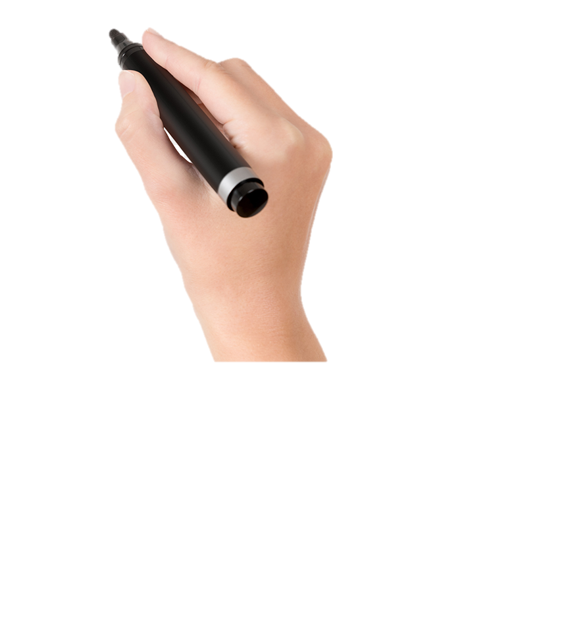
ALL IN ALL :-
MOST IMPORTANT OR SOMEONE/SOMETHING THAT IS VERY IMPORTANT .

Slide 3

IN SENTENCE
AFTER KEEPING AN ARGUS EYE OVER COUNTRY’S EMPLOYMENT RATE, WE HAVE CONCLUDED THAT ALMOST 70% OF YOUTH IS AT A LOOSE END. AS COVID-19 IS AT LARGE- EVERYTHING IS AT SIXES AND SEVENS AS ALL IN ALL COMPANIES ARE GETTING BANKRUPT.
IT’S FUN, ISN’T IT ?

