Slide 1
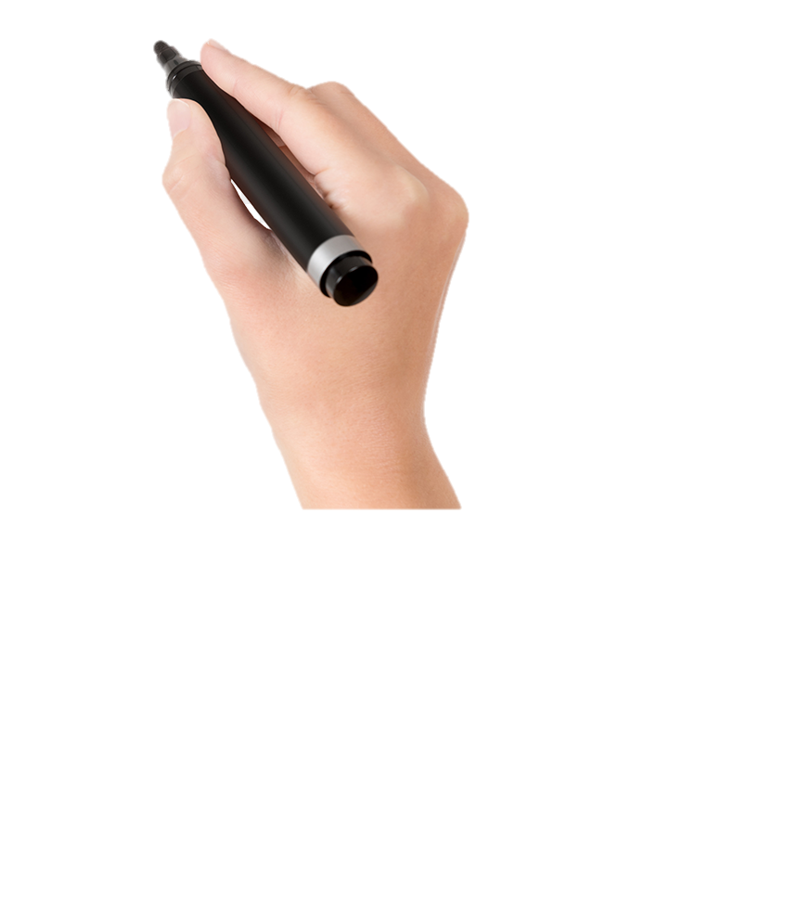
{{WORD}}
DIFFICULTY: {{DIFFICULTY}}
{{IMAGE}}
MEAN: {{MEANING}}
TOPIC: {{TOPIC}}
SYNONYMS: {{SYNONYMS}}
SENTENCE: {{GERMAN_SENTENCE}}
TRANSLATION: {{ENGLISH_TRANSLATION}}
TIP : {{MEMORY_TIP}}

