Slide 1
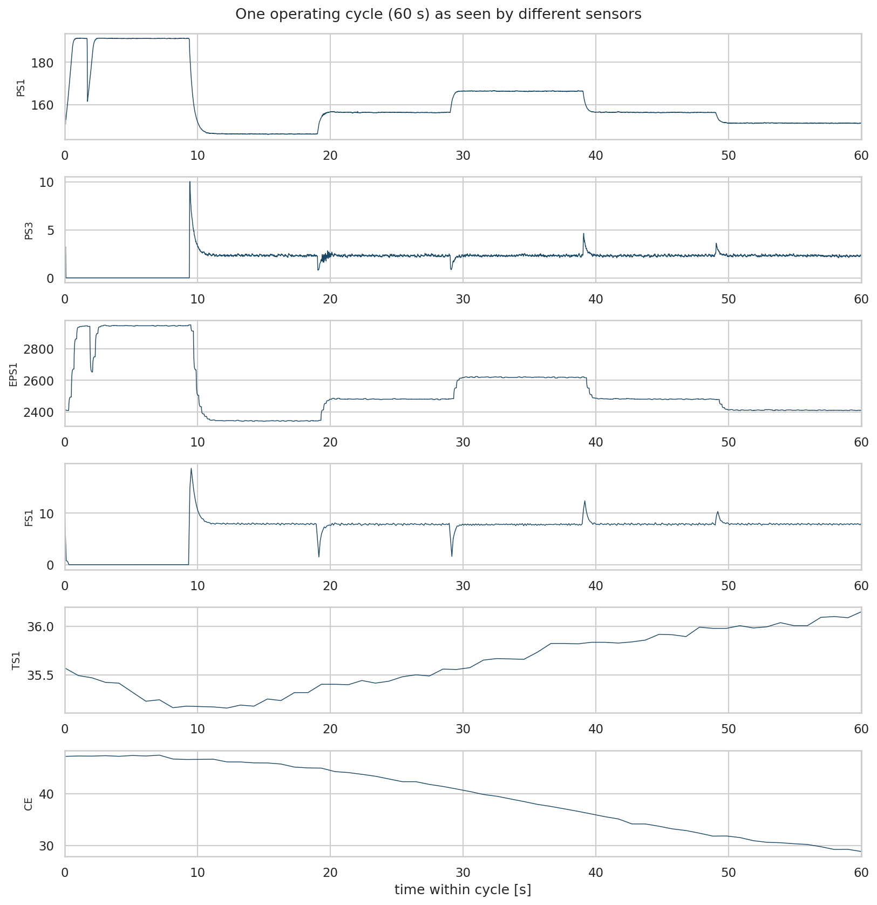
CAPSTONE PROJECT · FEATURE ENGINEERING
Predictive Maintenance of Industrial Hydraulic Systems
Turning 43,680 raw sensor values per cycle into features an engineer can read
Sahil Khan Pathan · 24AD1199
Vedant Mali · 24AD1145
Sejal Zende · 24AD1158
One 60-second cycle as seen by six sensors
Guide: Prof. ____________________
Dept. of AI & Data Science Engineering, DY Patil University, Navi Mumbai
Notes:
Introduce the team and the goal: detect the health of four hydraulic components from sensor data. The focus of this project is feature engineering - converting raw multi-rate signals into compact, physically meaningful features.

Slide 2



43,680 numbers per cycle, only 2,205 cycles
UCI Condition Monitoring of Hydraulic Systems · ZeMA test rig
2,205
17
43,680
4
operating cycles (60 s each)
sensors at 100, 10 and 1 Hz
raw values per cycle
components to diagnose
Far more columns than rows
Channels are not time-aligned
Faults live between channels
43,680 raw values vs 2,205 cycles - any model would overfit.
Sample k of a 100 Hz pressure is not the same instant as sample k of a 1 Hz temperature.
A leaking pump changes power vs flow; a fouled cooler changes temperature differences.
Notes:
Explain why raw samples cannot be fed to a classifier: the p >> n problem, three different sampling rates, and the fact that fault signatures are relationships between channels. These three problems motivate feature engineering.

Slide 3





Five feature blocks: 626 engineered features
Each cycle becomes one row; every feature has a readable name
Statistical
mean, std, RMS, skewness, kurtosis, quartiles, CV
Time-domain
slope, first-difference stats, zero crossings, peaks
Rolling (1 s window)
local mean / std, window sized from each sensor's rate
Frequency (FFT)
dominant frequency, centroid, log-spaced band energies
Hydraulic domain
pressure differentials, efficiency, cooling conductance
Notes:
Walk through the five blocks. Key design choices: the rolling window is fixed at one second and converted per sensor rate; FFT bands are log-spaced because the load programme changes on a scale of tens of seconds, so linear bands would put almost all energy in the first band.

Slide 4




Encoding hydraulic physics as features
96 domain features target specific faults
Hydraulic power
Electro-hydraulic efficiency
Pₕ [kW] = p [bar] · Q [l/min] / 600
η = 1000 · Pₕ / EPS1
Targets: Pump, valve
Targets: Pump wear and leakage
Pressure differentials
Cooling conductance
Δp = p̄ₐ − p̄ᵦ for all 15 pairs of PS1–PS6
CP / |ΔT| and CP / CE
Targets: Valve lag, internal leakage
Targets: Cooler degradation
Example: a leaking pump draws the same power but delivers less flow, so efficiency drops even when each raw signal looks normal.
Notes:
This is the part generic libraries cannot do. Each domain feature is a physical relationship between channels that a specific fault changes. Use the leaking-pump example to make it concrete.

Slide 5


From 43,680 to 40: cleaning and selection
Valve model shown; every learned step is fitted inside the pipeline
43,680
626
553
238
119
40
›
›
›
›
›
raw values
engineered
after cleaning
correlation
|r| > 0.95 removed
mutual
information top 50 %
tree
importance top 40
Label-free cleaning
Leakage-safe pipeline
4 constant, 4 near-zero-variance and 65 duplicate columns removed. No labels are used, so no target leakage.
Selection uses labels, so it runs inside one scikit-learn Pipeline and is re-fitted on every training fold.
Notes:
Explain the funnel. Emphasise the difference between label-free cleaning, which is safe on all data, and label-based selection, which must be fitted inside the cross-validation folds to avoid leakage.

Slide 6
What feature engineering bought
Logistic regression cannot build features itself, so its gain is the representation's effect
+0.319
valve macro-F1 (0.672 → 0.991)
+0.334
accumulator macro-F1 (0.642 → 0.977)
0.529 → 0.989
SVM on the valve
Notes:
Headline result. For the valve and accumulator, engineered features turn a weak linear model into a near-perfect one. The cooler is already solved by sensor means because the cooling channels separate its levels directly, so engineering adds nothing there - say this honestly. Tree ensembles gain 2 to 3 points because they build non-linear combinations internally.

Slide 7
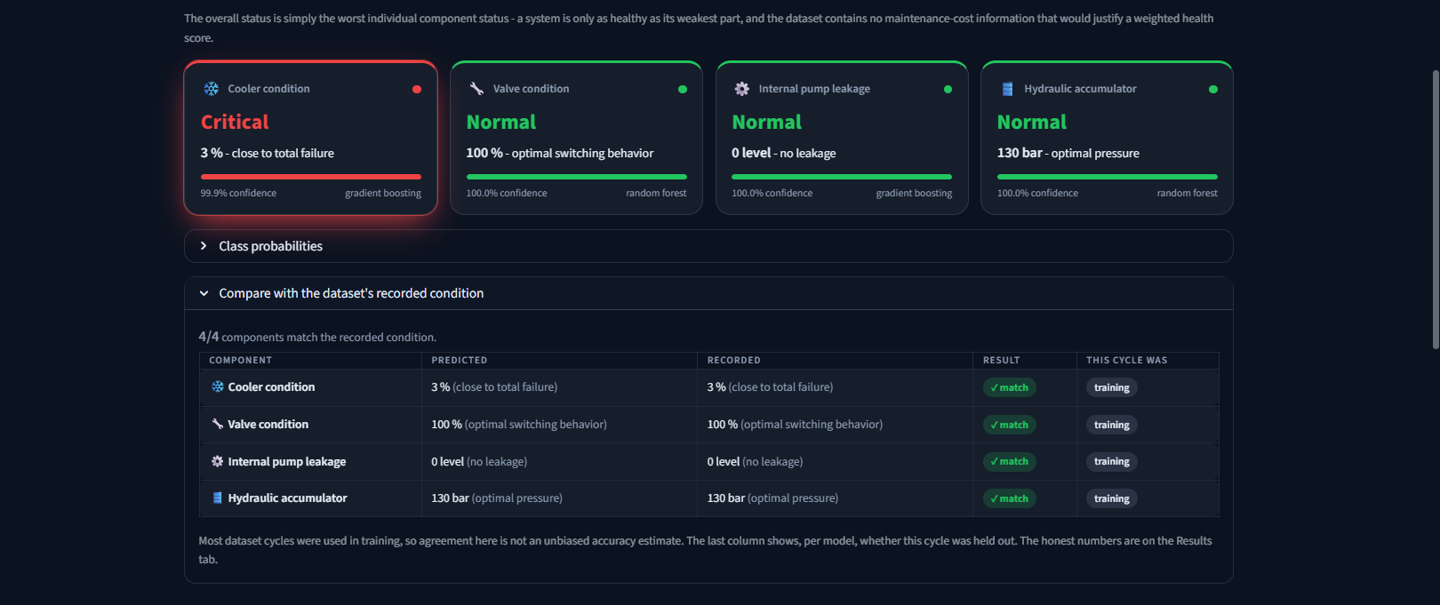

Deployed dashboard and conclusions
Physics beats raw data
626 named features replace 43,680 raw values (70× smaller).
Selection keeps accuracy
40 selected features match the full 553 on every target.
Streamlit dashboard: per-component status, confidence and comparison with the recorded condition
Honest numbers
Blocked CV: 0.995 / 0.984 / 0.968 / 0.916 - the accumulator is hardest.
Future scope: transient features around each load step, validation on other machines, and run-to-failure data for Remaining Useful Life.
Notes:
Show the live dashboard if possible. Close with the three takeaways and be ready to explain why the blocked-CV numbers are lower than the test scores: neighbouring cycles are near-duplicates, so a random split is optimistic.

