Slide 1
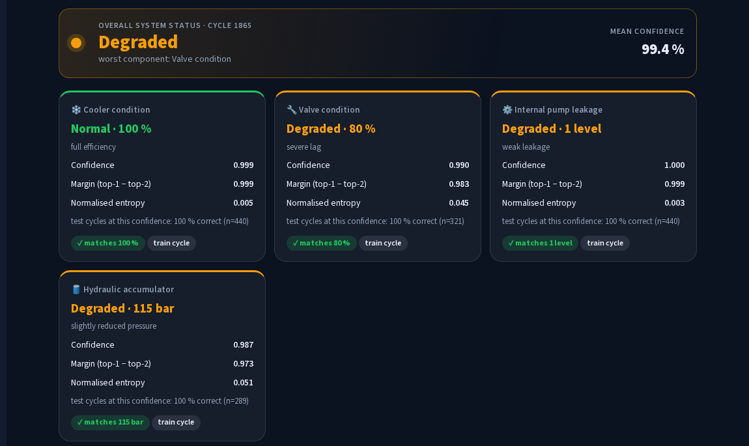
MACHINE LEARNING · MODEL EVALUATION
Supervised ML for Multi-Component Condition Classification
Four classifiers, 48 configurations, and an honest look at generalisation
ML Studio: live prediction with confidence, margin and entropy
Sahil Khan Pathan · 24AD1199
Vedant Mali · 24AD1145
Sejal Zende · 24AD1158
Vedika Singh · 24AD1147
Guide: Prof. ____________________
Dept. of AI & Data Science Engineering, DY Patil University, Navi Mumbai
Notes:
Introduce the ML side of the project: four supervised multiclass problems on the UCI hydraulic dataset, a controlled comparison of four classifier families, and an evaluation that goes beyond a random train/test split.

Slide 2




Four independent multiclass problems
One classifier per component · 2,205 labelled cycles · macro-F1 as the headline metric
Cooler
Valve
Pump leakage
Accumulator
3 classes
3 / 20 / 100 %
4 classes
73 / 80 / 90 / 100 %
3 classes
none / weak / severe
4 classes
90 / 100 / 115 / 130 bar
imbalance 1.01
imbalance 3.13
imbalance 2.48
imbalance 2.03
Why separate models: the joint label has 144 combinations, most seen in only 10 cycles. Why macro-F1: three targets are imbalanced, and the rare severe-fault classes matter most.
Notes:
Frame the task. Each component is its own classification problem. Point out the imbalance ratios and why macro-F1, which weights every class equally, is the right headline metric rather than accuracy.

Slide 3




Four model families, one fair protocol
Hyperparameters held fixed so differences come from model family and representation
1
Stratified 80 / 20 split per target: 1,764 train, 441 test
2
5-fold stratified CV on the training set only: 48 configurations
Logistic regression
Random forest
linear baseline · L2, C = 1
300 trees · class-weighted
3
Pick the best mean macro-F1; ties go to the simpler model
4
Refit once, score the untouched test set exactly once
XGBoost
SVM (RBF)
5
Blocked CV (25-cycle blocks) as a leakage check
300 trees · depth 5 · η 0.1
C = 10 · γ = scale
Notes:
Explain the protocol step by step. Stress that the test set was used only once, after selection, and that class weights are computed inside each training fold. The blocked CV is the extra honesty check that most papers on this dataset skip.

Slide 4
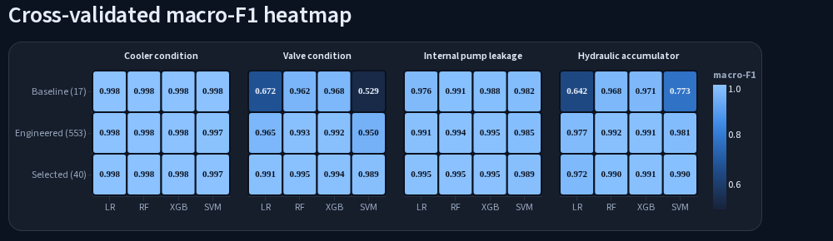
48 configurations compared
Cross-validated macro-F1 on the training set (from the ML Studio dashboard)
Tree ensembles are robust
Linear models need good features
Top models are statistically tied
RF and XGBoost exceed 0.96 even on 17 sensor means.
LR on the valve: 0.672 → 0.991 with engineered features.
Top three per target sit within about one fold std.
Notes:
Read the heatmap row by row. Winners: cooler XGBoost on 17 means, valve random forest on 40 selected, pump XGBoost on 40 selected, accumulator random forest on all 553. Mention that differences below about 0.002 are within fold noise.

Slide 5
Test scores vs a realistic estimate
Neighbouring cycles are near-duplicates, so a random split is optimistic
1.000
test macro-F1: cooler, valve, pump
0.916
accumulator under blocked CV
7.6 pts
largest random-split optimism
Y-axis starts at 0.88. Blocked CV holds out 25 consecutive cycles at a time.
Notes:
This is the most important slide for the viva. Perfect test scores are an upper bound because the test set was drawn randomly and shares near-duplicate neighbours with training. Blocked CV is the realistic estimate. The accumulator is clearly the hardest target.

Slide 6
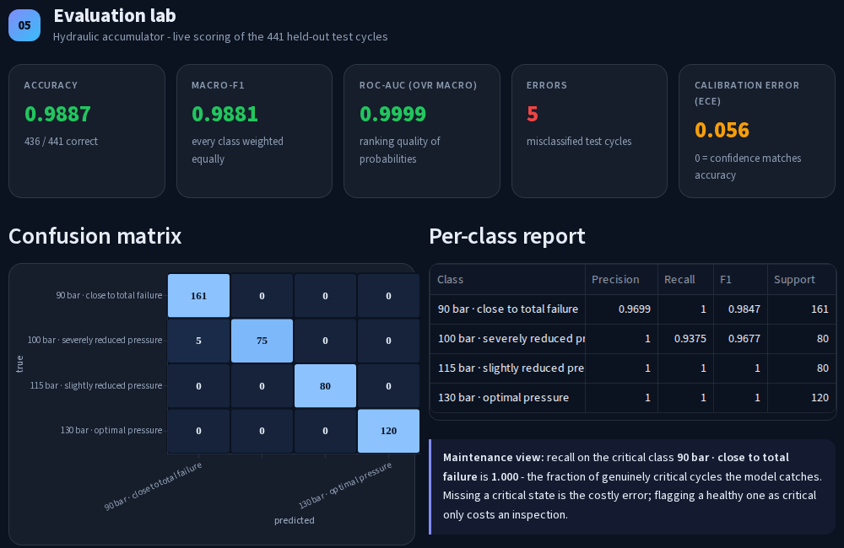
Where the models fail, and why they decide
Top feature per model
Cooler
CP mean (cooling power)
heat removal
Valve
PS2 coefficient of variation
switching lag
Pump
FS1 75th percentile flow
leakage cuts flow
Accumulator
spread over many features
correlated inputs
Accumulator on its 441 test cycles: all 5 errors are 100 bar predicted as 90 bar
The accumulator errors are conservative: they overstate degradation, so they trigger an early inspection, not a missed failure.
Notes:
The only test errors are between the two lowest accumulator pre-charge levels, which produce very similar pressure transients. Then explain importance: each top feature has a physical reason. For the accumulator, 553 correlated inputs spread the importance thinly, so permutation importance looks flat.

Slide 7

ML Studio and conclusions
Right model per task
Tree ensembles win; linear models only compete with engineered features.
Report the honest number
Blocked CV is 0.3 to 7.6 points below random-split scores.
Know the weak spot
Accumulator 90 vs 100 bar is the one real confusion.
Nine tabs: predict, model arena, pipeline inspector, evaluation lab, generalisation, error analysis, explainability and robustness
Future work: select models by blocked CV, add feature selection to the accumulator, and test transfer to other machines.
Notes:
Demo ML Studio if possible: score cycle 499 to show the low-confidence accumulator error, then open Error analysis. Close with the three conclusions and future work.

