Slide 1
Matrix Reduction in Persistent Homology: Theory, Examples, and Applications
Sahil Kumar, PhD in Mathematics and AI
Yeshiva University

Slide 2
Abstract
Matrix reduction is a fundamental computational process in persistent homology, a key method in topological data analysis (TDA) for studying the shape of data.
It simplifies boundary matrices to reveal topological features such as connected components, loops, and voids.
Applications span biology, image processing, and network science.

Slide 3
Introduction to Persistent Homology
Topological Data Analysis (TDA) applies algebraic topology to study data structures.
Persistent Homology identifies features like loops and voids across scales, relying on matrix reduction to simplify computations.
Goal: Efficient extraction of topological invariants.

Slide 4
Matrix Reduction and Its Role
Matrix reduction simplifies boundary matrices, revealing topological features and enabling efficient computation of Betti numbers.
Homology Groups: Measure topological features using cycle and boundary groups.

Slide 5

Euler-Poincaré Formula
The Euler characteristic is defined as the alternating sum of Betti numbers
where np represents the number of p-dimensional simplices in the complex.
χ: Euler characteristic
β_p: Betti numbers (connected components, loops, voids)

Slide 6
Boundary Matrices
Boundary matrices encode relationships between simplices.
Rows represent (p-1)-simplices, and columns represent p-simplices.

Slide 7
Smith Normal Form
Definition: Diagonalization of boundary matrices.
Key Insights: Extraction of Betti numbers, simplification of homology computation.
Example: Matrix before and after transformation.

Slide 8
Reduction Algorithm
Steps of the reduction algorithm:
1. Row and column swaps.
2. Eliminate non-diagonal entries.
3. Recursive simplification.

Slide 9
Worked Example: Tetrahedron
For the tetrahedron:
- β_0 = 1: One connected component.
- β_1 = 0: No independent loops.
- β_2 = 0: No voids.
- β_3 = 0: No higher-dimensional voids.

Slide 10
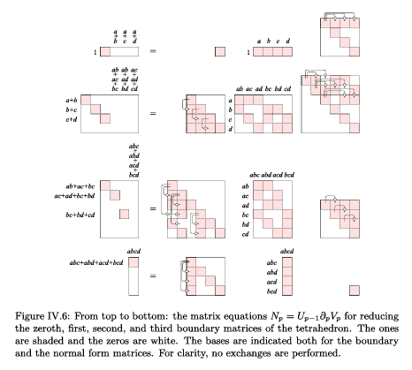

Slide 11
Python Implementation
The matrix reduction algorithm is implemented in Python. Boundary matrices are reduced, and Betti numbers are computed. The complete implementation is available on GitHub:
https://github.com/sahilkumar15/computational_topology

Slide 12
Applications of Matrix Reduction
Matrix reduction is applied in:
- Point cloud analysis for clustering and void detection.
- Time-series analysis for trend identification.
- Image processing for structural feature extraction.

Slide 13
Conclusion
Matrix reduction bridges algebraic theory and practical applications in TDA.
It enables efficient computation of topological invariants, offering insights across diverse domains.

Slide 14
References
Kannan, R. & Bachem, A. (1979). Polynomial algorithms for computing the Smith and Hermite normal forms of an integer matrix. SIAM J. Comput., 8, 499–507.
Lakatos, I. (1984). Proofs and Refutations: The Logic of Mathematical Discovery. Cambridge Univ. Press, Cambridge, England.
Munkres, J. R. (1984). Elements of Algebraic Topology. Addison-Wesley, Redwood City, California.

Slide 15
Thank you!

