Slide 1
Student Performance Prediction
Predicting a student's final marks with Machine Learning
Name: Shahil Alam Thakuria
Student Code / Roll No.: BWU/BCA/24/092
Department: BCA, Brainware University
Subject: Machine Learning
Subject Code: BCA57205
Notes:
Introduce yourself and the project in one line: this project predicts a student's final marks from their earlier marks and study habits using machine learning.

Slide 2
Introduction and Problem Statement
395
Introduction
A student's final result depends on more than one exam. Earlier marks, absences, study habits and background all play a part. This project uses machine learning to learn that pattern from real student records and to predict a student's final marks (G3, out of 20).
students in the dataset
33
attributes per student
Problem Statement
Teachers often learn that a student is struggling only after the final exam. There is no simple way to estimate the final result early from the data already available. This project builds a model that predicts final marks from academic and behavioural factors, and shows which factors matter most.
20
point marks scale (G3)
Notes:
The dataset has 395 students from two schools, each described by 33 columns. The problem: we want to estimate the final marks early, so that a student who is likely to score low can be helped in time.

Slide 3
Objectives and Scope
Objectives
Coverage
Predicts the final mark (G3, out of 20) of a maths student. The app asks 6 easy questions; the model itself is trained on all 32 other attributes.
Collect and clean student data.
Analyse the data using graphs.
Train different Machine Learning models.
Compare their performance.
Identify the most important factors affecting marks.
Create a simple web application for prediction.
Target users
Teachers, mentors and students who want an early estimate of expected performance.
Limitations
Small dataset (395 students, two schools). Accuracy depends mostly on earlier exam marks. No screen-time or sleep data.
Notes:
Be honest about the limitations: only 395 students, two Portuguese schools, and the model leans heavily on the earlier exam marks G1 and G2.

Slide 4
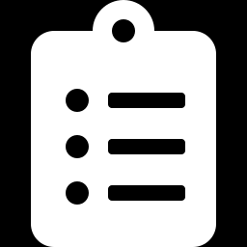
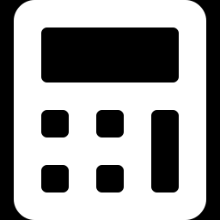
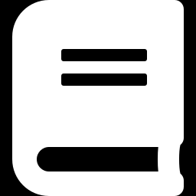
Literature Review and Existing System
Manual tracking
Simple statistics
Published research
Teachers compare marks and attendance by hand or in spreadsheets.
Averages and basic linear regression on past marks.
Cortez and Silva (2008) applied decision trees, random forests, neural networks and SVMs to this dataset.
Limitation: Slow and subjective, and it gives no prediction.
Limitation: Assume a straight-line relationship and miss complex patterns.
Limitation: Research code with no easy interface for non-technical users.
Gap we address: an easy-to-use system that predicts final marks, compares models and shows which factors matter.
Notes:
Cortez and Silva (2008) is the original paper for this dataset. They found that earlier grades were the strongest predictors, which our results also show.

Slide 5


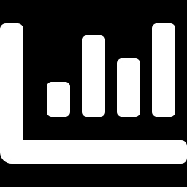
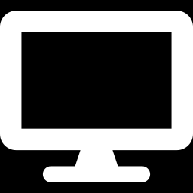

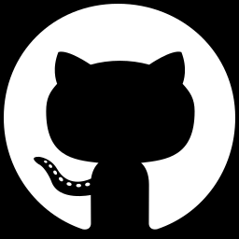
Proposed System
Clean, ready data
Two models compared
Shows what matters
Checks missing values and duplicates, and converts text columns into numbers.
Linear Regression and Random Forest are tested on the same unseen students.
Feature importance reveals which factors drive the prediction.
Easy web interface
Prediction with range
Open and reproducible
Six simple questions and one button give the expected marks.
Shows the predicted marks and a likely range based on the model's error.
Code, data and README are on GitHub so anyone can run the project.
Notes:
These six points are what make the project more than just a model: cleaning, comparison, explanation, a usable interface, and a public GitHub repository.

Slide 6
Project Methodology
Development approach
Tools and technologies
1
Load Read the Kaggle CSV into a table
Component | Used
Language | Python 3
Data handling | Pandas, NumPy
Visualisation | Matplotlib, Seaborn
Machine learning | Scikit-learn
Web interface | Streamlit
Environment | Google Colab, VS Code
Version control | GitHub
Data source | Kaggle CSV file (no database)
2
Clean Check missing values and duplicates
3
Explore Plots to see patterns (EDA)
4
Split 80% to train, 20% to test
5
Train Linear Regression and Random Forest
6
Test Measure error with MAE and R²
7
Explain Find the most important features
Notes:
Remember the steps with: Load, Clean, Explore, Split, Train, Test, Explain. There is no database, the data is a single CSV file.

Slide 7
Project Internal Structure
Kaggle CSV dataset (395 × 33)
Check missing values and duplicates
Explore with plots (EDA)
Convert text columns to numbers
Data module
Prepare the data
Split data 80% train, 20% test
Train Linear Regression and Random Forest
Evaluate with MAE and R²
Keep Random Forest, get feature importance
Model module
Learn and evaluate
User answers 6 questions
Fill other columns with typical values
Random Forest predicts final marks (G3)
Show marks and likely range
App module
Predict for a user
Notes:
Three modules: the data module prepares the CSV, the model module trains and tests, and the app module takes the user's six answers and returns the predicted marks. The columns we do not ask about are filled with the typical (median) student values.

Slide 8
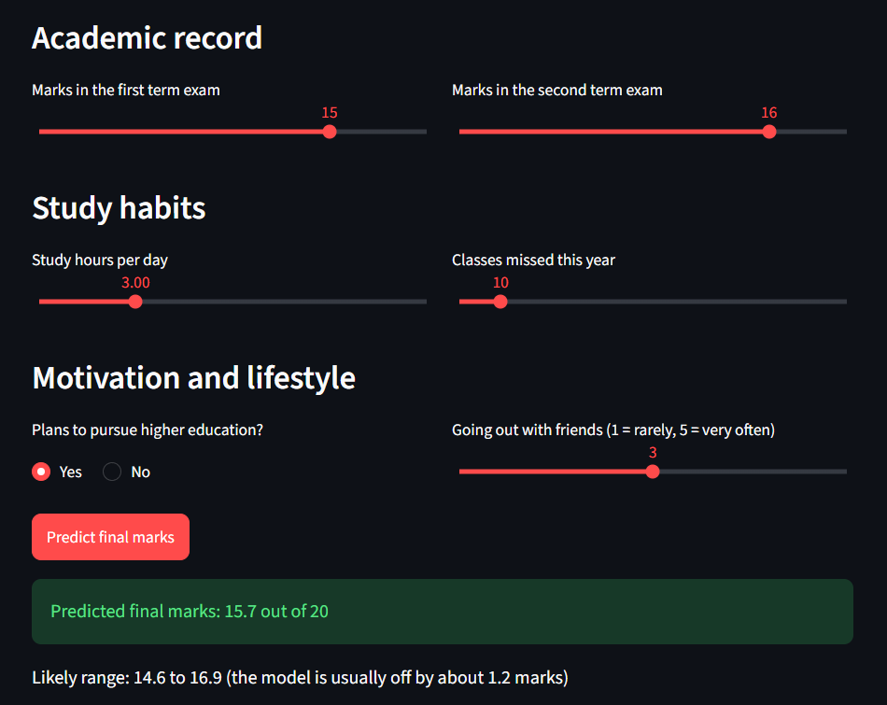
Implementation
Training module
Training (excerpt)
Loads the CSV, encodes it, splits it and trains Random Forest on start.
X = df.drop("G3", axis=1)
y = df["G3"]
X_train, X_test, y_train, y_test = \
train_test_split(X, y,
test_size=0.2, random_state=42)
rf = RandomForestRegressor(
n_estimators=100, random_state=42)
rf.fit(X_train, y_train)
Input module
Sliders and a yes/no choice with built-in limits for every answer.
Prediction (excerpt)
row = typical.copy()
row["G1"] = g1
row["G2"] = g2
row["studytime"] = weekly_range(
daily_hours)
row["absences"] = absences
pred = model.predict(row)[0]
Prediction module
Streamlit interface: six inputs and the predicted marks with a likely range
Builds one row, predicts, then shows marks and a likely range.
Notes:
The app trains the Random Forest when it starts, so there is no separate model file. The screenshot shows a student with 15 and 16 in the two exams getting a predicted 15.7 out of 20. Code is shortened to the key lines.

Slide 9
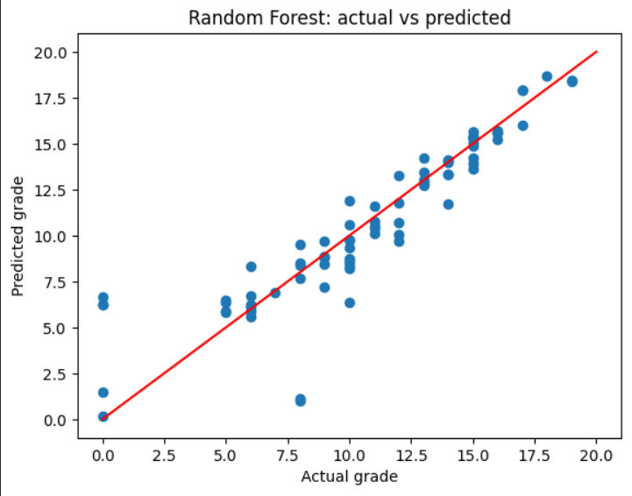
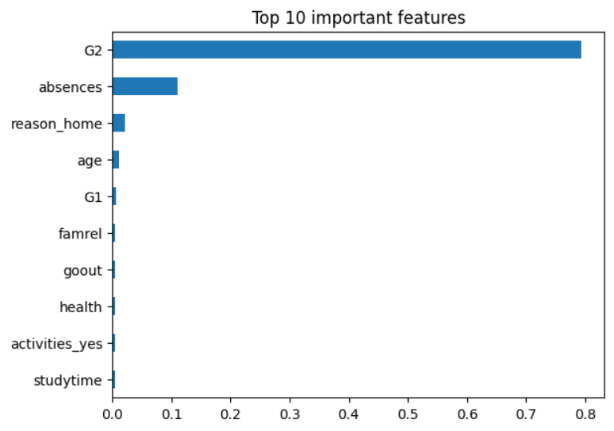
Testing and Results
Model | MAE | R²
Linear Regression | 1.65 | 0.72
Random Forest | 1.16 | 0.81
Sample prediction
First exam 15, second exam 16
15.7 / 20
Actual vs predicted marks (Random Forest)
Top 10 important features
Likely range: 14.6 to 16.9
Tested on 79 students the model had never seen.
Random Forest is off by about 1.2 marks on average and explains about 81% of the variation in final marks.
G2 (second exam marks) is by far the strongest factor, followed by absences. Points close to the red line are accurate predictions.
Notes:
MAE is the average mistake in marks, lower is better. R squared is how much of the ups and downs in marks the model explains, closer to 1 is better. The model does so well mostly because G2 is such a strong clue. A few students who scored 0 were predicted around 6, which the data cannot explain.

Slide 10
Conclusion, Future Scope and References
Conclusion
Future Scope
References
A working system that predicts final marks with an average error of about 1.2 marks (R² 0.81).
All objectives are met: cleaning, exploration, two models, evaluation, feature importance and a web interface.
Earlier marks (G2) and absences are the key factors.
Add features such as daily screen time, sleep and attendance records.
Train on more students, schools and subjects.
Try and tune more models, such as gradient boosting.
Predict without G1 and G2 to flag at-risk students earlier.
Host the app online for teachers.
P. Cortez and A. Silva, Using Data Mining to Predict Secondary School Student Performance, FUBUTEC, 2008.
UCI Machine Learning Repository, Student Performance dataset (archive.ics.uci.edu).
Kaggle, Math Students dataset by Janio Martinez Bachmann.
L. Breiman, Random Forests, Machine Learning 45(1), 2001.
Scikit-learn documentation (scikit-learn.org).
Streamlit documentation (docs.streamlit.io).
Notes:
Close by linking back to the objectives: each one was completed. For future scope, mention screen time as an extra feature that this dataset does not have, and predicting without the earlier marks.

