Slide 1

DeepSpeech Therapy: A Hierarchical Deep Learning Framework for Real-Time Speech Therapy Assessment
Presented by:
Sahil Sawant | sahilshi
Fagun Patel | fagunnir
Instructor: Dr. Alina Vereschaka
CSE 676 Deep Learning

Slide 2

Introduction
  This project aims to develop a Deep Learning based speech-language therapy system that helps individuals with difficulty in speaking & pronunciation
  Improve users speech through interactive and personalized feedback.
  Inspired by platforms like Duolingo, the system leverages deep learning models to evaluate spoken input, detect pronunciation errors, and offer real-time corrective feedback.
Notes:
This project aims to develop a Deep Learning based speech-language therapy system that helps individuals
with difficulty in speaking & pronunciation improve through interactive and personalized feedback.
Inspired by platforms like Duolingo, the system leverages deep learning models to evaluate spoken input,
detect pronunciation errors, and offer real-time corrective feedback.

Slide 3
Objectives
  Develop DL model to evaluate if a speech is clear or faulty.
  Classify clear vs. faulty speech using reconstruction error.
  For faulty speeches, determine if its a stutter or not
  Provide simple, actionable feedback to the speaker to improve their speech.
  Integrate LLM‑based encouragement
Notes:
Build a deep learning model that can check how well a person says a word or sound.
• Teach the model to know if a word was said correctly or incorrectly using features from the audio.
• Give simple and helpful feedback to the user to improve their speaking.
• Make the learning fun by adding points, rewards, and levels like a game.
• Create a simple app that people can use on their phones to practice speaking anytime.
• Plan to use a language model in the future to give friendly and encouraging messages to the user.

Slide 4

Datasets

Slide 5
LibriSpeech train clean 100
  Used the LibriSpeech train-clean-100 subset
  Consists of approximately 100 hours of clean, read English speech from 251 speakers.
  Contains .flac audio files and corresponding .trans.txt transcript files.
  Each audio sample is assumed to be correctly pronounced, making the dataset ideal for modeling clear speech in an unsupervised manner.
  Goal is to detect deviations from clean speech since no labeled “incorrect” examples are introduced in the dataset using autoencoders
Dataset links Download link for train-clean-100: http://www.openslr.org/resources/12/train-clean-100.tar.gz
Download link for train-clean-360 (used for unseen evaluation): http://www.openslr.org/resources/12/train-clean-360.tar.gz
Notes:
We used the LibriSpeech train-clean-100 subset, which consists of approximately 100 hours of clean, read
English speech from 251 speakers. The dataset contains .flac audio files and corresponding .trans.txt
transcript files. Each audio sample is assumed to be correctly pronounced, making the dataset ideal for
modeling clear speech in an unsupervised manner.
Our goal is to detect deviations from clean speech since no labeled “incorrect” examples are introduced
in the dataset.

Slide 6
SEP-28k Stuttering Events in Podcasts Dataset
  SEP-28k Stuttering Events in Podcasts Dataset, augmented with data from FluencyBank.
  This combined dataset provides a large and diverse collection of audio clips sourced from real-world podcasts featuring people who stutter.
  Total Data: 32,000 3-second audio clips. After cleaning and removing files with poor audio quality, music, or no speech, we obtained a working set of 26,098 usable audio clips.
  Data Format: The data is provided as a set of .wav audio files and corresponding CSV files containing metadata and labels.
  Labels and Classes: Each clip is annotated by multiple raters for the presence of specific disfluencies.
Dataset Download link : https://www.kaggle.com/datasets/ikrbasak/sep-28k/code
Notes:
For this task, we utilized the SEP-28k Stuttering Events in Podcasts Dataset, augmented with data from
FluencyBank. This combined dataset provides a large and diverse collection of audio clips sourced from
real-world podcasts featuring people who stutter.
• Total Data: The dataset contains metadata for approximately 32,000 3-second audio clips. After
cleaning and removing files with poor audio quality, music, or no speech, we obtained a working
set of 26,098 usable audio clips.
• Data Format: The data is provided as a set of .wav audio files and corresponding CSV files
containing metadata and labels.
• Labels and Classes: Each clip is annotated by multiple raters for the presence of specific
disfluencies. For our multi-class classification task, we identified six primary classes:
o Block: Abrupt pauses or inability to produce sound.
o Prolongation: Elongation of a sound or syllable.
o SoundRep: Repetition of a single sound (e.g., "p-p-p-prepare").
o WordRep: Repetition of a whole word or phrase.
o Interjection: Use of filler words like "um" or "uh".
o NoStutteredWords: Fluent speech with no disfluencies.

Slide 7
PreProcessing Pipeline

Slide 8
Data Acquisition & Processing
  Developed in a Google Colab environment.
  Data Acquisition: Dataset downloaded using the Kaggle API.
  Data Cleaning: Combined the label files from SEP-28k and FluencyBank. Constructed the full file path for each audio clip
  Concatenated the Show, EpId, and ClipId fields from the metadata.
  Filtered out any entries for which the corresponding .wav file did not exist on disk.
  Label Processing: Dataset provides counts from multiple annotators for each label.
  Selected the class with the highest annotator count for each clip (idxmax function).
  Handling Class Imbalance: Significant class imbalance, with NoStutteredWords being the dominant class. Implemented a weighted loss function. The sklearn.utils.class_weight.compute_class_weight function was used to calculate weights that give higher importance to minority classes (like Block and SoundRep) during training, preventing the model from simply defaulting to the majority class.
Notes:
The entire pipeline was developed in a Google Colab environment.
• Data Acquisition: The dataset was downloaded directly into the notebook environment using the
Kaggle API. This method is efficient and reproducible, avoiding manual uploads.
• Data Cleaning: We combined the label files from SEP-28k and FluencyBank. We then
constructed the full file path for each audio clip by concatenating the Show, EpId, and ClipId fields
from the metadata. A crucial step was filtering out any entries for which the corresponding .wav
file did not exist on disk. Label Processing: The dataset provides counts from multiple annotators for each label. To create
a single ground-truth label for our multi-class problem, we selected the class with the highest
annotator count for each clip (idxmax function).
• Handling Class Imbalance: A preliminary analysis revealed a significant class imbalance, with
NoStutteredWords being the dominant class. To address this, we implemented a weighted loss
function. The sklearn.utils.class_weight.compute_class_weight function was used to calculate
weights that give higher importance to minority classes (like Block and SoundRep) during training,
preventing the model from simply defaulting to the majority class.

Slide 9
Audio Loading & Resampling
  All audio files are loaded using torchaudio.
  Any audio not sampled at 16 kHz is resampled to 16,000 Hz for consistency.
  We extract Mel-Frequency Cepstral Coefficients (MFCCs), which capture the short-term power spectrum of the audio.
  MFCCs mimic how the human ear perceives sound, focusing on perceptually relevant frequencies.
  They are effective for modeling phoneme-level information while reducing noise and irrelevant variations.

Slide 10
Problem Setup &
Workflow

Slide 11
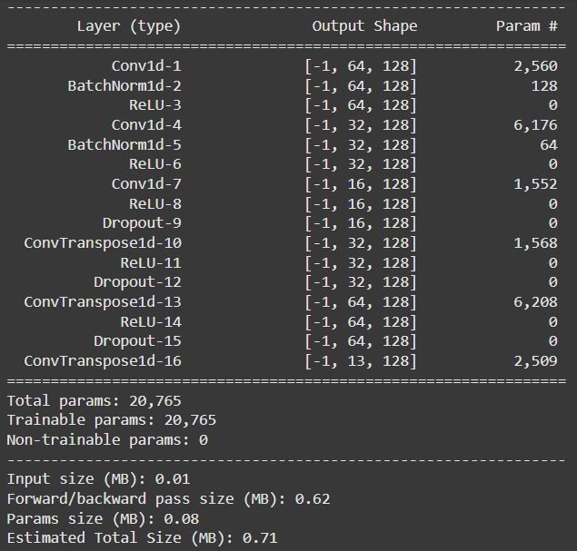
Conv1D Autoencoder Overview - Classify clear and faulty speech
Takes MFCC input of shape [batch, 13, 128],
where 13 = MFCC features and 128 = time steps.
Encoder compresses the input through 3 Conv1D layers: 13 → 64 → 32 → 16 channels, using ReLU activations, BatchNorm, and Dropout.
Decoder mirrors the encoder using ConvTranspose1D layers: 16 → 32 → 64 → 13 channels, restoring the input shape.
Maintains temporal resolution (128 frames) throughout the network via padding=1.
Lightweight architecture with just ~20k trainable parameters ideal for fast training and real-time inference.
Notes:
Input: MFCC features [batch, 13, 128] (13 coefficients, 128 time frames)
Encoder:
3 Conv1D layers: 13 → 64 → 32 → 16 channels
Uses ReLU, BatchNorm, Dropout
Decoder:
3 ConvTranspose1D layers: 16 → 32 → 64 → 13
Reconstructs input shape
Temporal shape (128) preserved via padding=1
Model Size:
~20k trainable params
Total memory: ~0.71 MB
fast training & real-time ready
Compact and efficient

Slide 12
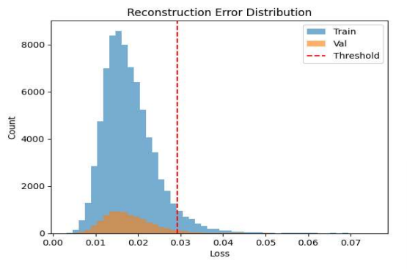
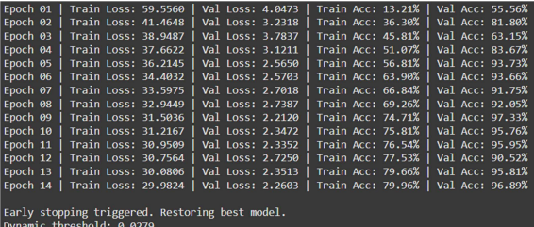
Conv1D Autoencoder Overview - Evaluation & Thresholding
After training, errors are computed across the train and validation datasets. A dynamic threshold is set based on the 95th percentile of the training reconstruction errors, ensuring that 95% of clean speech samples are classified as "clear." Samples with errors above this threshold are flagged as "faulty or mispronounced

Slide 13
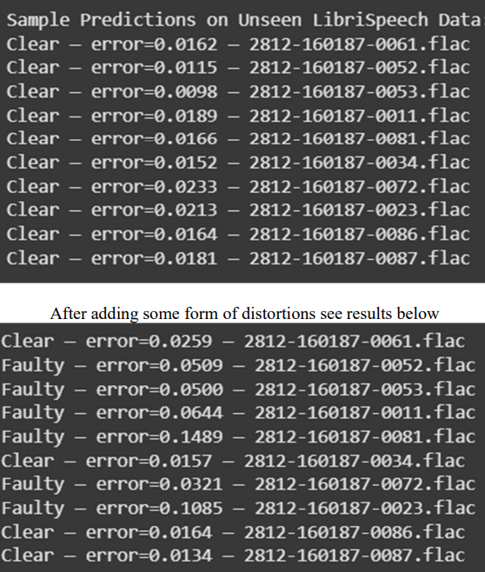
Conv1D Autoencoder Overview - Evaluation & Thresholding
  Evaluation on Unseen Clean Speech:
  Tested on LibriSpeech train-clean-360 (unseen set).
  All samples classified as “clear” with errors below threshold, confirming generalization.
  Evaluation on Synthetic Faulty Speech:
  Introduced noise, pitch, speed, and volume distortions to simulate real-world faults.
  Model reported high reconstruction errors and flagged most samples as “faulty”.
  Demonstrated strong sensitivity to speech degradation, validating use in speech therapy/assessment.

Slide 14
Model performance comparisons

Slide 15
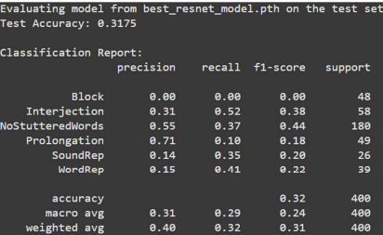
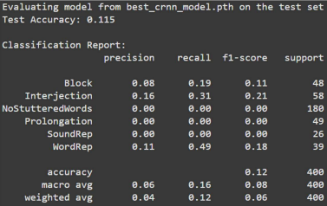
Multiclass classification of stuttering speech
ResNet
Test Accuracy: 31.75%
Performed well compared to random guessing.
Successfully began learning features for Interjection and Word Repetition.
Demonstrated the benefit of transfer learning using pretrained image features.
Training-validation curves showed clear overfitting.
Struggled to generalize due to class imbalance in the dataset.
CRNN (ResNet18 + BiLSTM)
Test Accuracy: 11.50%
Underperformed compared to ResNet and even random guessing.
CRNN architecture is data-intensive and needs longer training to be effective.
Failed to learn temporal speech patterns within 3 epochs.
Did not converge properly on the small training subset.
Highlighted the risk of using complex models with limited data and time.

Slide 16
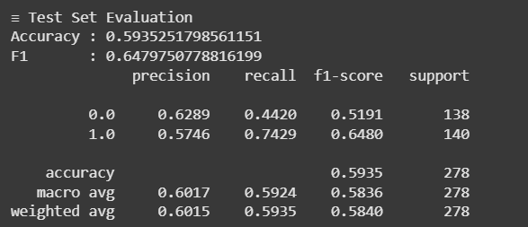
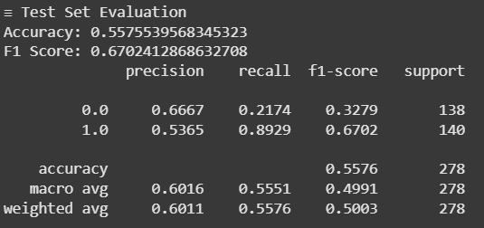
Multiclass classification of stuttering speech
CNN with Attention Mechanism
  Test Accuracy: 59.35%
  Final F1 Score: 0.6480 (on class 1), indicating decent performance in detecting disfluent speech.
  Best validation F1 Score: 0.694, achieved at epoch 5.
  Validation accuracy peaked at 65.34%, showing strong generalization with early stopping.
  Attention mechanism allowed the model to focus on time frames carrying disfluency cues.
  Recall for class 1 (faulty) was high at 0.7429, but class 0 (clear) suffered with only 0.4420 recall.
Conv1D Autoencoder (with Transformer Classifier)
  Test Accuracy: 55.76%
  Final F1 Score: 0.6702 (on class 1), indicating strong detection of faulty speech.
  Pretraining loss steadily decreased from 32.45 to 4.78, confirming solid feature learning from clean speech.
  Classifier training showed consistent improvement in F1 score (from 0.516 to 0.651 on train, and up to 0.702 on val).
  Excellent recall on positive class (0.8929), but poor recall on negative class (0.2174), leading to imbalance.

Slide 17
LLM based feedback

Slide 18
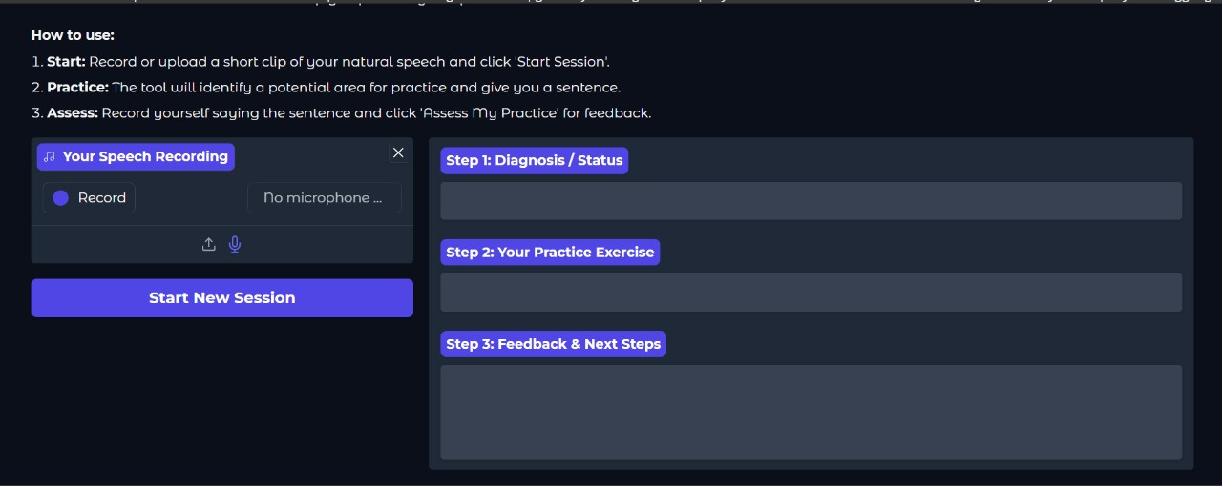
LLM based feedback

Slide 19
Conclusion

Slide 20
  Built a multi-stage pipeline for stuttering detection using clean and faulty speech data.
  Explored traditional and advanced models including CNN, ResNet, CRNN, Transformer, and Autoencoders.
  Demonstrated that deeper models need larger datasets and longer training to realize their potential.
  Highlighted class imbalance as a critical challenge affecting model performance
  In future, focus can be put on detecting more speech disorders such as
    DYSPHONIA
    APRAXIA
    DYSARTHRIA
    TBI
    DEMENTIA
    DYSPHAGIA

