Slide 1
Requirement Modelling
Domain Modelling
Notes:
1

Slide 2
UML Software
MS Visio
Huge library images
Not Free
Draw.io https://www.draw.io/
Syncs with Google drive or Dropbox
Lots of options
Creately https://creately.com
No Registration Required

Slide 3
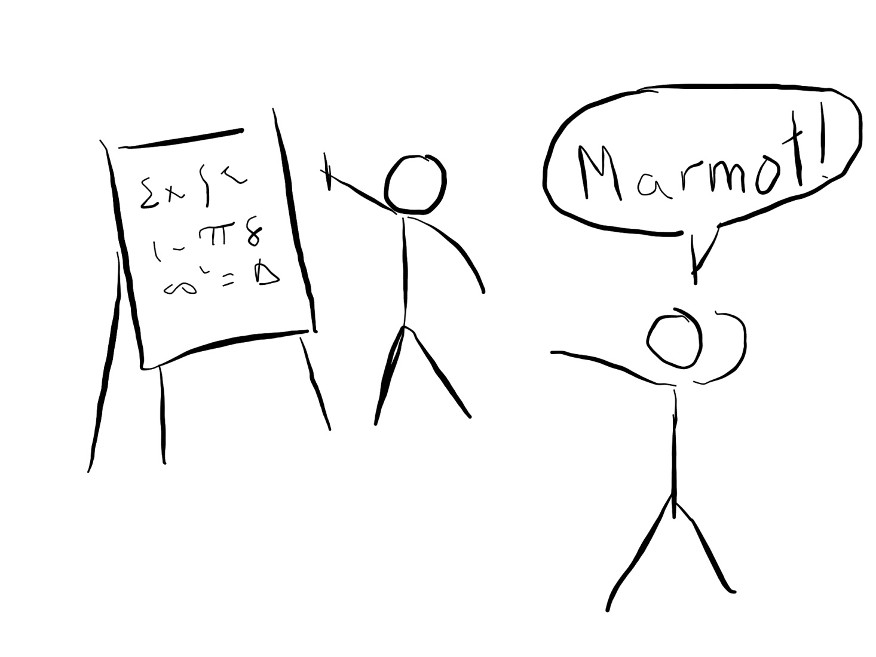
Domain Modelling
Explaining a problem using Pictures

Slide 4
Domain Modeling
Domain Modeling is a way to model (explain) a problem in the real world using diagrams
A Domain Model is not a class Diagram
Notes:
Image obtained from:
http://www.codeproject.com/Articles/330447/Understanding-Association-Aggregation-and-Composit
4

Slide 5
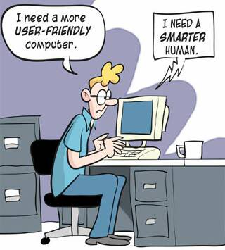
Use Cases
Describing user actions
Notes:
Photo credit: http://i717.photobucket.com/albums/ww173/prestonjjrtr/Funny/userfriendly.jpg
5

Slide 6
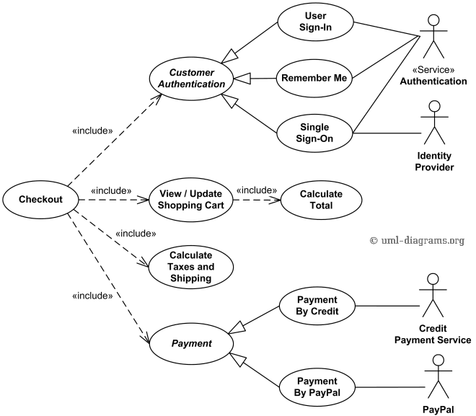
Use case Diagrams
Actors
Use Cases
Relationships
Notes:
6

Slide 7
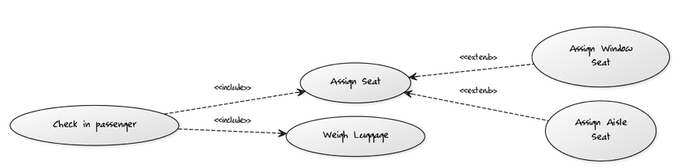
Include vs extend
Include: When one action requires another. Reuse an action
Extend: When one action can be replaced by another (inheritance)
Notes:
7

Slide 8
Exercise
The VP Communication of ECSESS needs a new way to send the livewire newsletter to the students in EE, SE and CE. Currently students send him emails and subsequently he sends an email blast to many people including those who do not wish to receive the live wire.
What he would like is system where ECSE students can login to their MyMcGill account and post their announcements or campus events, these news items can be edited or removed. Those news events would come up on a news feed that students can view in their MyMcGill page. Of course, he would like to have administrative rights in order to prevent abuse. This would allow him to edit and remove abusive posts.
Draw a use case Diagram to represent the user interface for this scenario. Be sure to have more than one actor and the correct relations between the actions and the actors.
Notes:
8

Slide 9
Use Case Description
Describes a use case in the following manner:
Goals
Entry conditions
Flow of events
Exit condition
Notes:
9

Slide 10
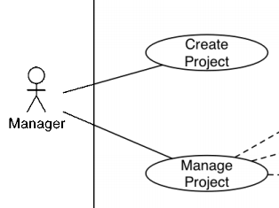
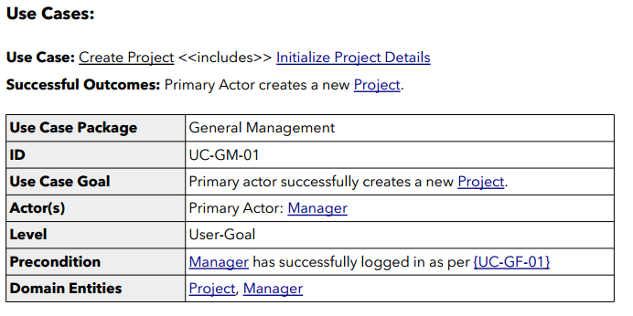
Use Case Description
Notes:
10

Slide 11
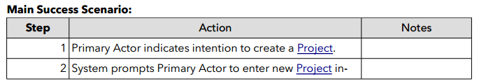
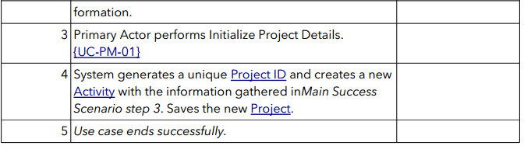
Use Case Description
Notes:
11

Slide 12
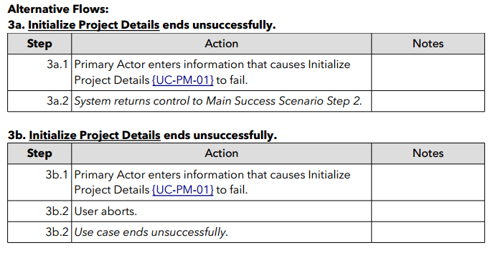
Use Case Description
Notes:
12

Slide 13
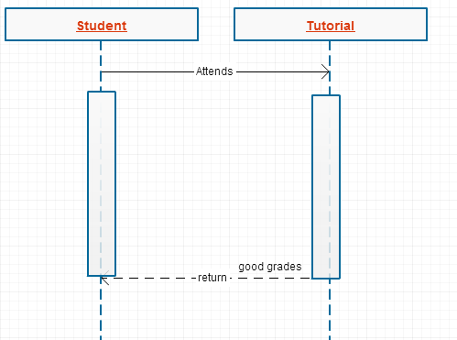
Sequence Diagrams
It can describe sequences of events

Slide 14
UML Sequence Diagrams
Describes interaction between objects
Also indicates timing and order between those interactions
Notes:
14

Slide 15
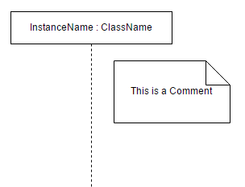
UML Sequence Diagrams (Basics)
Notes:
15

Slide 16
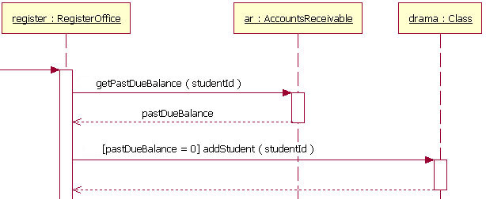
UML Sequence Diagrams (Parts)
Life Lines
Messages
Return Values
Conditions
Notes:
Image obtained from: http://www.ibm.com/developerworks/rational/library/content/RationalEdge/feb04/3101_figure7.jpg
16

Slide 17
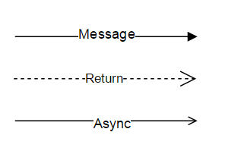
UML Sequence Diagrams (Arrows)
Message
Return value
Asynchronous message
Notes:
Image obtained from: http://www.ibm.com/developerworks/rational/library/content/RationalEdge/feb04/3101_figure7.jpg
17

Slide 18
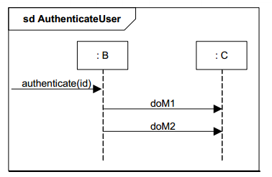
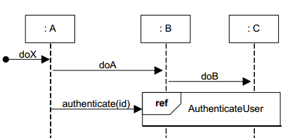
UML Sequence Diagrams (Abstraction)
Abstract away complicated interactions
Use frames to reference to other interactions
Notes:
Image obtained from: http://www.ibm.com/developerworks/rational/library/content/RationalEdge/feb04/3101_figure7.jpg
18

Slide 19
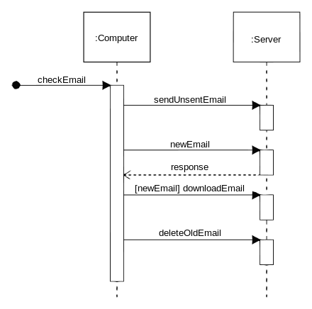
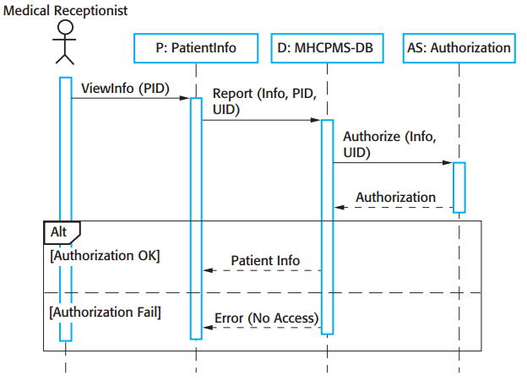
Simple Example
Notes:
Taken from http://upload.wikimedia.org/wikipedia/commons/thumb/9/9b/CheckEmail.svg/440px-CheckEmail.svg.png
19

Slide 20
Exercise
McGill University is “upgrading” its room booking services for students. Students can now use an online portal to book all rooms at anytime for a “small” fee.
To request a room the student will input the time at which to make the booking and the amount of students the room needs to hold. This information will be sent the booking system which will find a room that fits all the students at the requested time, if it such a room exists. The booking system will hold the room in pending for 5 business days for inconvenience's sake. Then, the booking system will also send an invoice to the requester’s student account charging them for the booking along with a confirmation email to the student’s mail.mcgill.ca email.
Draw a sequence diagram using software mentioned above to represent the events described above. Be sure to have at least 2 classes, the relevant arrows and conditions. Make any assumptions necessary for a plausible scenario.
Notes:
Image obtained from: http://www.ibm.com/developerworks/rational/library/content/RationalEdge/feb04/3101_figure7.jpg
20

Slide 21
References
http://www.ibm.com/developerworks/rational/library/3101.html
http://www.objectmentor.com/resources/articles/umlClassDiagrams.pdf
http://www.ibm.com/developerworks/rational/library/content/RationalEdge/sep04/bell/
http://en.wikipedia.org/wiki/Class_diagram
http://slides.com/dominiccharleyroy/

Slide 22
References
http://www.codeproject.com/Articles/330447/Understanding-Association-Aggregation-and-Composit
http://aviadezra.blogspot.ca/2009/05/uml-association-aggregation-composition.html

