Slide 1
ECSE 321 Tutorial 2
Git and Github

Slide 2
Today's plan
 Creating a Github profile
 Configuring Git
 Basics of Git
 Putting our code in the cloud

Slide 3
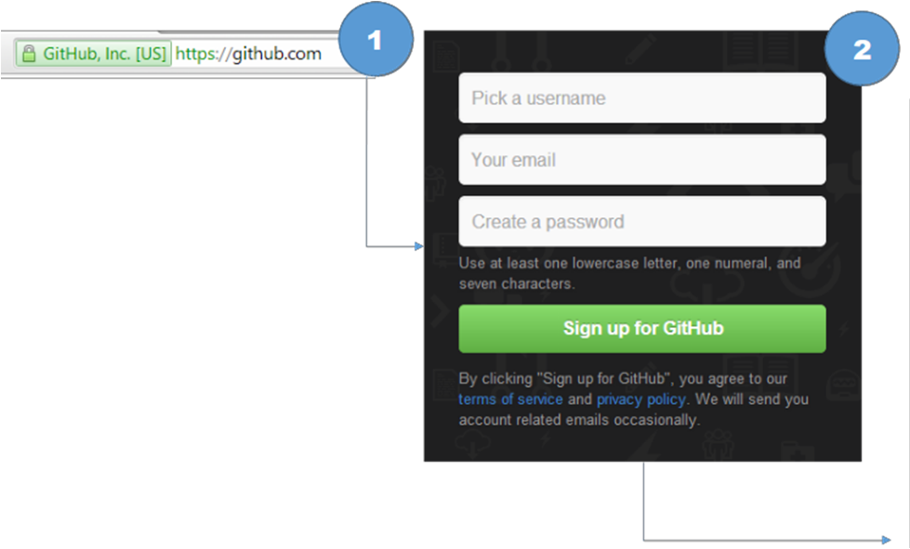
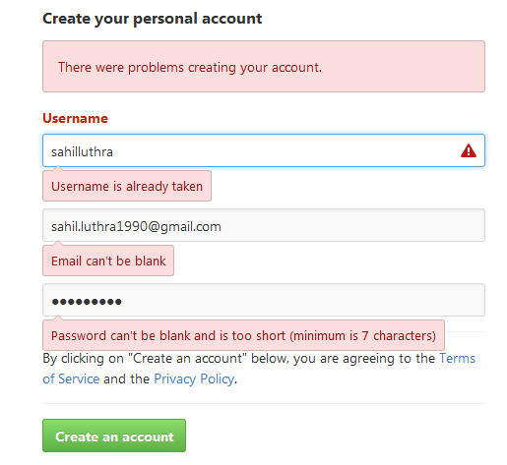
Register for Github

Slide 4

What is Version Control
 Version Control software is a tool used to keep track of different versions of files
 Revert to an old version
 Branch to create multiple versions
 Merge two different versions together
 Synchronize files on different machines

Slide 5
Why are you going to use git
 You need it for this class
 It’s a great way to sync your code with your team
 I will post code examples on my Github

Slide 6
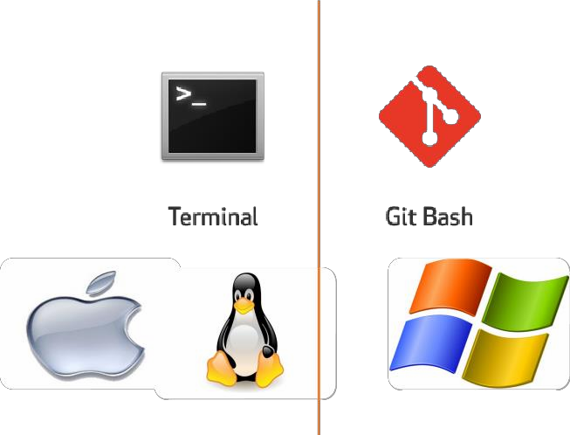
Did I install it correctly?

Slide 7
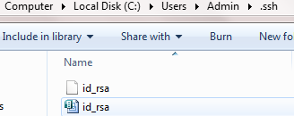

Making git work with GitHub
https://help.github.com/articles/generating-an-ssh-key/
1. Checking for existing SSH Keys (id_dsa.pub , id_ecdsa.pub, id_ed25519.pub, id_rsa.pub)

Slide 8


Making git work with GitHub(Contd….)
2. Generating a new SSH key
3. Adding the SSH key to the SSH agent
SSH agent is enabled :
SSH key added to the SSH-agent:

Slide 9

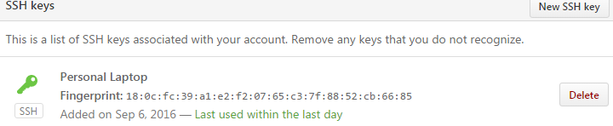
Making git work with GitHub
Adding a new SSH key to your GitHub account
Copy the SSH key to your clipboard
In the top right corner of GitHub page, click your profile photo, then click Settings.
Click SSH and GPG keys → New SSH key
In the "Title" field, add a descriptive label for the new key.
Paste your key into the "Key" field.
Click Add SSH key.
If prompted, confirm your GitHub password.

Slide 10
Making git work with GitHub
5. Testing your SSH connection

Slide 11
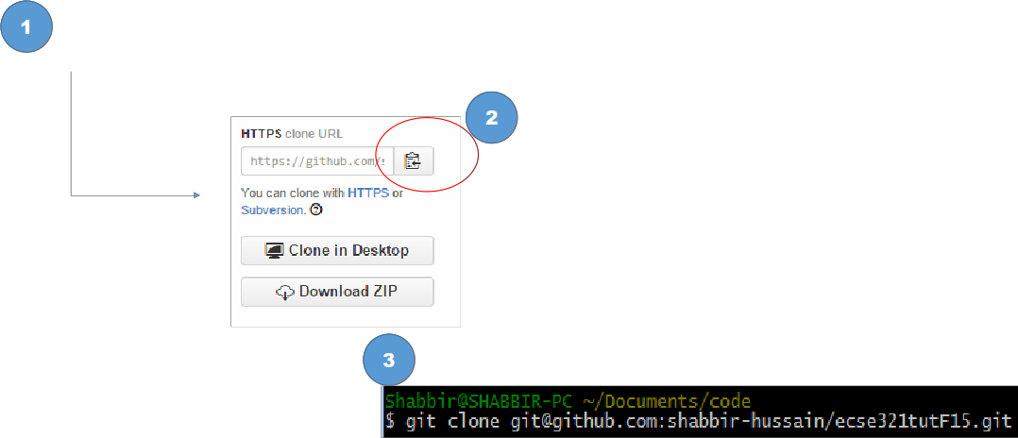

Getting the tutorial notes

Slide 12
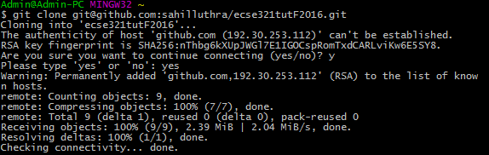
Done correctly

Slide 13

Glossary

Slide 14
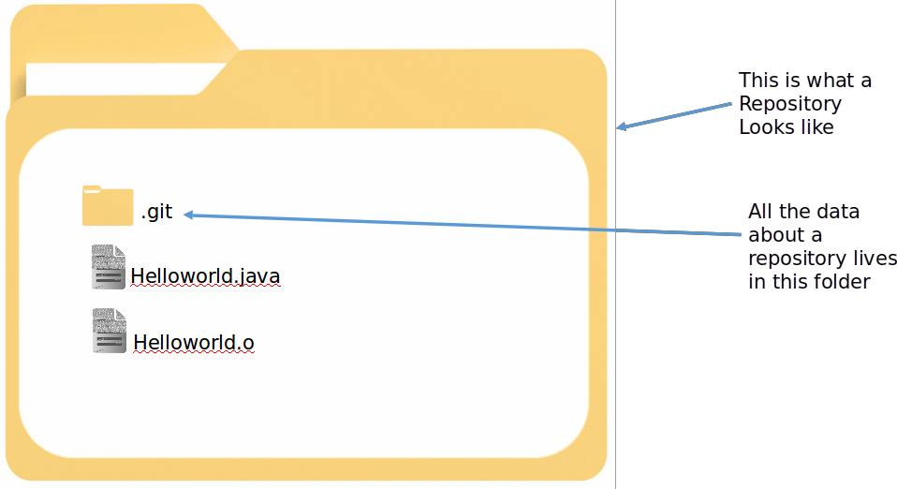
What is a repository
A central location in which the data is stored and managed

Slide 15
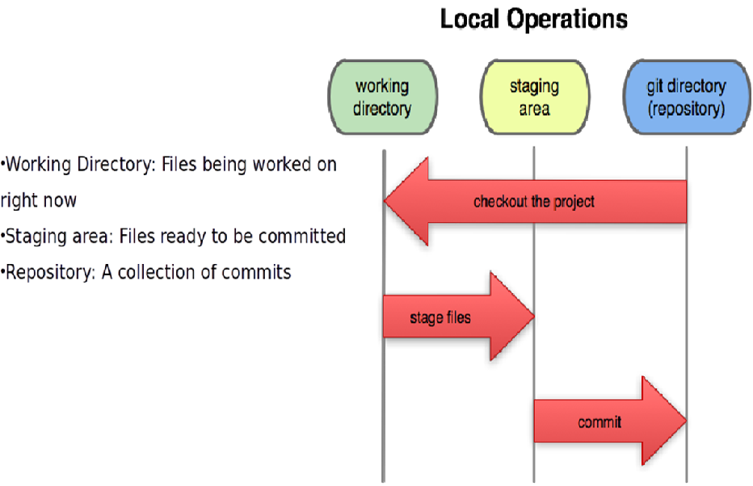
Inside a Repository

Slide 16
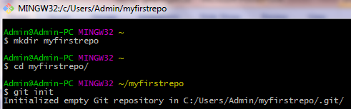
Creating our first Repo

Slide 17


Creating and committing a file
Commit - Data is safely stored in your local database
Create a file
2.
3.

Slide 18

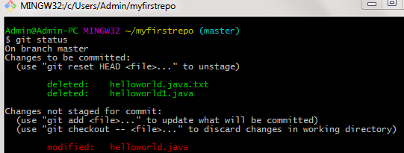
File status update

Slide 19

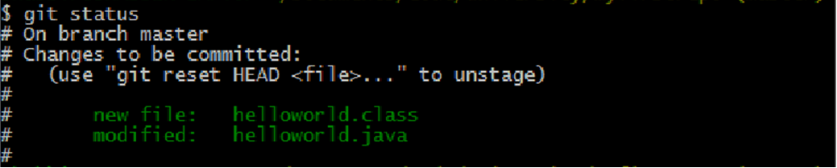
Staging and Unstaging files

Slide 20
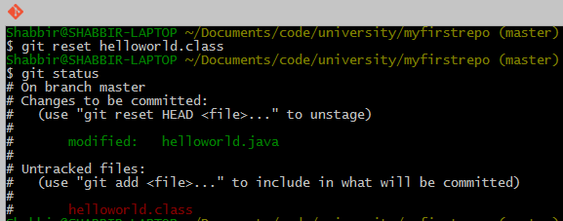

Staging and unstaging files

Slide 21
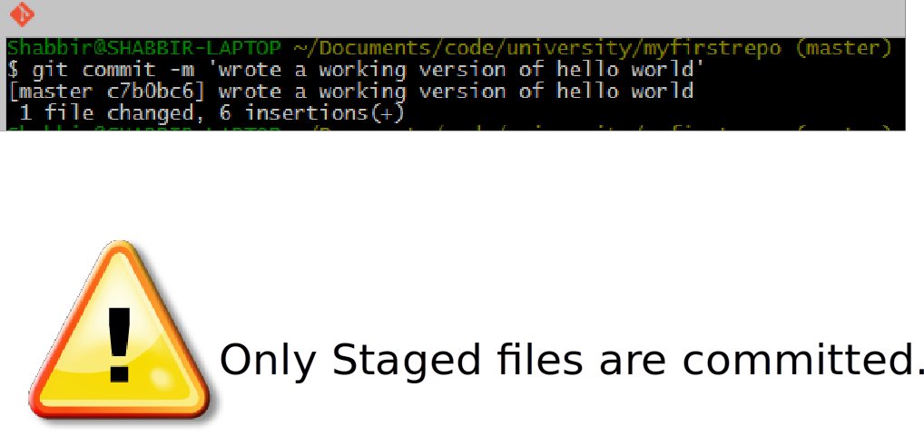
Committing (cont.)

Slide 22
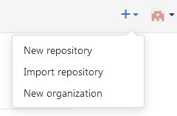
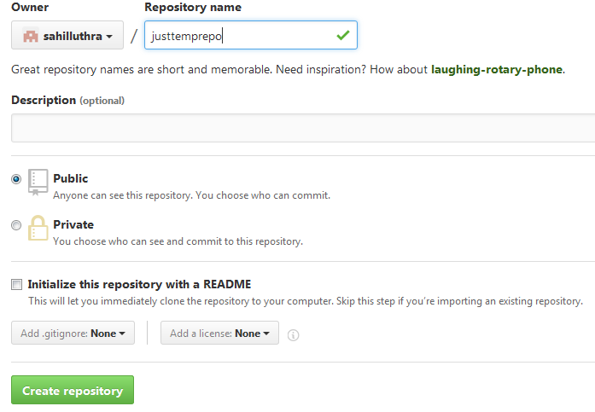
Putting our code in the cloud

Slide 23
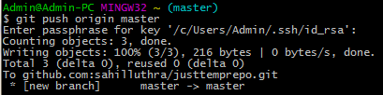
Putting our code in the cloud (cont.)
git commit -m 'initial commit' git push origin master
git commit -m 'initial commit' git push origin master
In case of any errors, you may try the following:
git commit -m 'initial commit‘ OR touch README
git push origin master git add README
git add .
git commit -m 'reinitialized files‘
git push origin master

Slide 24
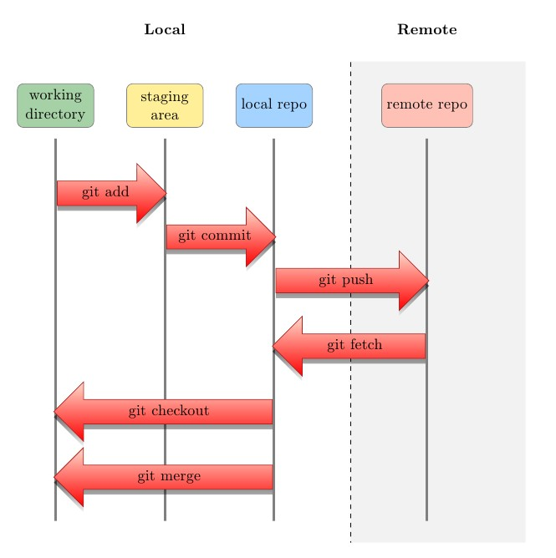
Revisiting the model

Slide 25
Extra Resources
 Try github Interactive Tutorial: https://try.github.io/levels/1/challenges/1
 Visual Explanation: http://www.wei-wang.com/ExplainGitWithD3/

Slide 26
References
 Vogella Reference: http://www.vogella.com/tutorials/Git/article.html
 SSH keys tutorial: https://help.github.com/articles/generating-ssh-keys
 Git Reference: http://gitref.org/

Slide 27
See you next week!

