Slide 1
Intro to Swing
Using Java Swing

Slide 2
Today's Overview
Git Exercise
Swing basics
Swing Exercise
More Downloads!!
Notes:
2

Slide 3
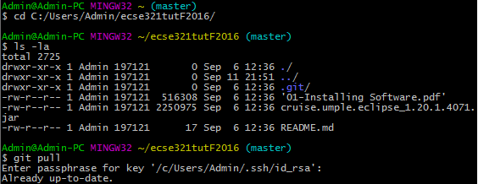
Get the latest material
Travel to tutorial folder
Check that you are in the Repo
Get latest files

Slide 4
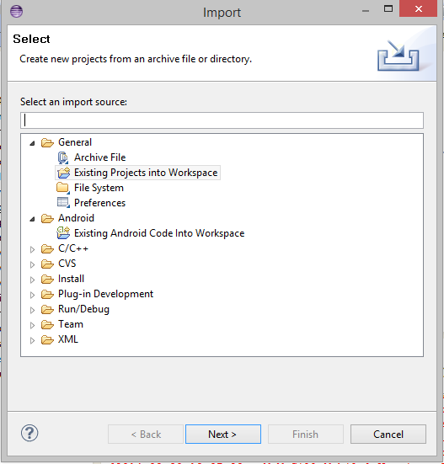
Importing a project
File -> Import -> Existing project into Workspace -> Browse for project

Slide 5

Java Swing
The very basics

Slide 6
Java Swing
Library used to make Graphical user interfaces in Java
Notes:
6

Slide 7
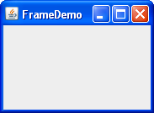
Swing Basics - JFrame
A JFrame object is your window

Slide 8
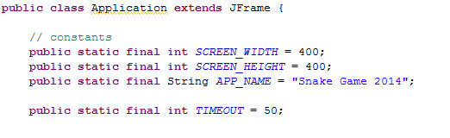
Swing Basics - JFrame

Slide 9
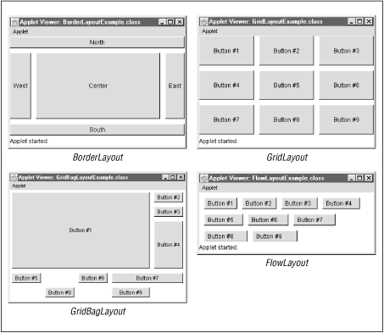
Swing Basics - Layouts
A layout is how components are placed

Slide 10
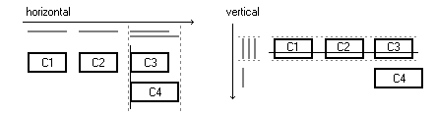
Swing Basics - Layouts

Slide 11
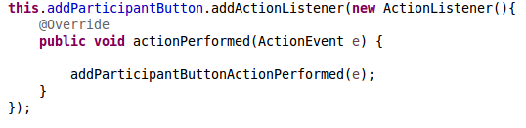
Swing Basics – Action Listener
Action Listener calls a method when a particular action takes place

Slide 12
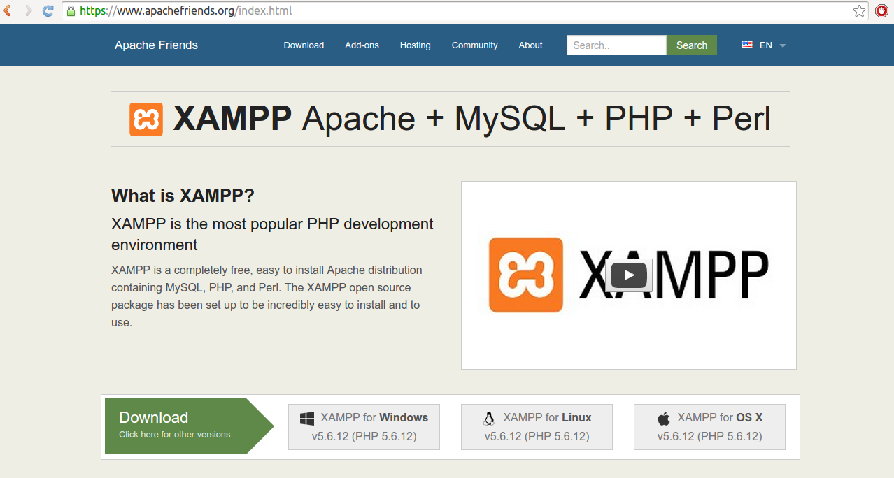
Get XAMPP
Go to www.apachefriends.org

Slide 13



The World Wide Web
Notes:
13

Slide 14
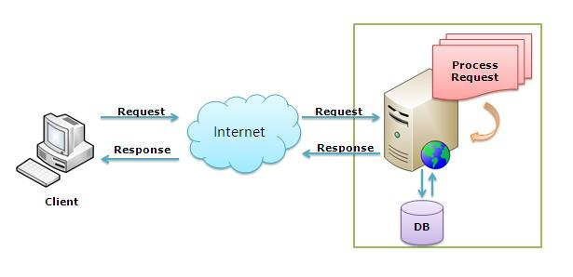
The World Wide Web
Notes:
14

Slide 15
References
Java Game Tutorial: http://zetcode.com/tutorials/javagamestutorial/
Java Group layout: https://docs.oracle.com/javase/tutorial/uiswing/layout/group.html

