Slide 1
STATISTICAL ANALYSIS
AND MACHINE LEARNING-BASED
PREDICTION OF WINE QUALITY
WINE
QUALITY
Using Physicochemical Properties
Data Analytics Coursework Project
Dataset: UCI Wine Quality – Red Wine Dataset
1,599 original observations → 1,359 unique observations
Presented by: ____________________ Roll No.: __________

Slide 2
Presentation Roadmap
From data → inference → prediction
• Dataset & preprocessing
• Descriptive statistics
• Confidence intervals & hypothesis tests
• Quality-group comparison
• Correlation & visual analysis
• Repeated sampling & sample-size effects
• 5-fold cross-validation & model comparison
• Key findings, limitations and conclusion
DATA
INFERENCE
1,599 → 1,359
α = 0.05
240 exact duplicates removed
CIs + t-tests + correlation
SAMPLING
ML
n = 50–1,000
5-Fold CV
30 repetitions per n
Linear Regression vs Random Forest
Central question:
How do wine properties relate to quality, and how does sample size affect statistical certainty?
Wine Quality | Data Analytics Project
2

Slide 3
1. Dataset & Data Quality
UCI Wine Quality – red wines
11 physicochemical predictors + 1 quality score
ORIGINAL
DUPLICATES
Variable group | Examples
Acidity | fixed acidity, volatile acidity, citric acid
Sugar / salts | residual sugar, chlorides
Sulfur dioxide | free SO₂, total SO₂
Physical properties | density, pH
Other | sulphates, alcohol
Target | quality score (3–8 in this data)
1,599
240
rows
exact duplicate rows
CLEANED
MISSING
1,359
0
unique rows
missing values
Preprocessing choice
Exact duplicates were removed so identical records would not disproportionately weight the analysis.
Important: duplicate removal is a project-level methodological choice.
Wine Quality | Data Analytics Project
3

Slide 4
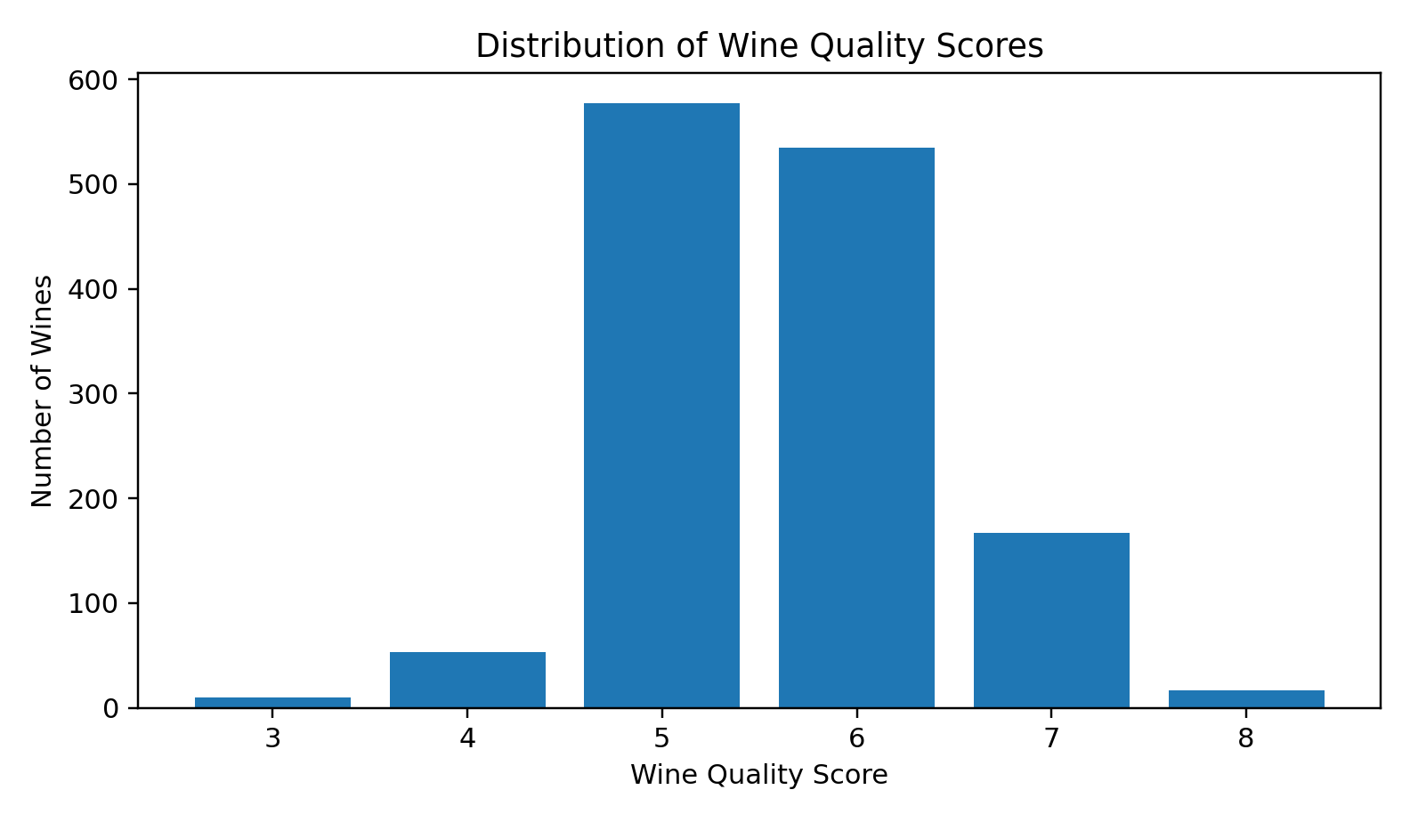
2. Wine Quality Profile
Quality scores are concentrated around 5 and 6
Quality | Count
3 | 10
4 | 53
5 | 577
6 | 535
7 | 167
8 | 17
Key observation
Scores 5 and 6 dominate the dataset, while extreme scores 3 and 8 are rare.
Wine Quality | Data Analytics Project
4

Slide 5
3. Descriptive Statistics
Central tendency and variability
Feature | Mean | Median | Std Dev | Min | Q3 | Max | CV %
Fixed acidity | 8.3106 | 7.9000 | 1.7370 | 4.6000 | 9.2000 | 15.9000 | 20.90
Volatile acidity | 0.5295 | 0.5200 | 0.1830 | 0.1200 | 0.6400 | 1.5800 | 34.57
Citric acid | 0.2723 | 0.2600 | 0.1955 | 0 | 0.4300 | 1.0000 | 71.80
Residual sugar | 2.5234 | 2.2000 | 1.3523 | 0.9000 | 2.6000 | 15.5000 | 53.59
Chlorides | 0.0881 | 0.0790 | 0.0494 | 0.0120 | 0.0910 | 0.6110 | 56.03
Free SO₂ | 15.8933 | 14 | 10.4473 | 1 | 21 | 72 | 65.73
Total SO₂ | 46.8260 | 38 | 33.4089 | 6 | 63 | 289 | 71.35
Density | 0.9967 | 0.9967 | 0.0019 | 0.9901 | 0.9978 | 1.0037 | 0.19
pH | 3.3098 | 3.3100 | 0.1550 | 2.7400 | 3.4000 | 4.0100 | 4.68
Sulphates | 0.6587 | 0.6200 | 0.1707 | 0.3300 | 0.7300 | 2.0000 | 25.91
Alcohol | 10.4323 | 10.2000 | 1.0821 | 8.4000 | 11.1000 | 14.9000 | 10.37
Takeaway: relative variability is highest for citric acid / sulfur-dioxide-related measures, while alcohol has comparatively low relative variability.
Wine Quality | Data Analytics Project
5

Slide 6
4. Confidence Interval & Hypothesis Test
Alcohol content as the main inferential example
MEAN ALCOHOL
95% CONFIDENCE INTERVAL
SAMPLE SIZE
10.4323%
10.3747% – 10.4899%
1,359
cleaned dataset
margin of error = 0.0576
t-critical = 1.9617
One-sample t-test
Interpretation
Item | Result
H₀ | μ = 10%
H₁ | μ ≠ 10%
t-statistic | 14.7284
p-value | 1.16 × 10⁻⁴⁵
Decision | Reject H₀ at α = 0.05
The evidence is overwhelmingly strong that the mean alcohol content in the cleaned dataset differs from 10%.
This is an inference about the dataset's represented population—not a claim about every wine.
Wine Quality | Data Analytics Project
6

Slide 7
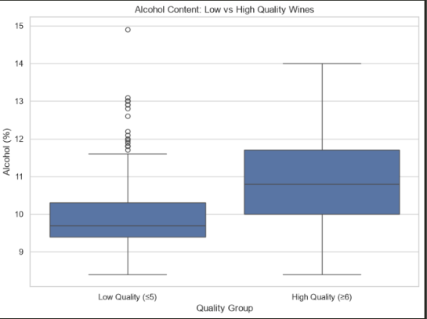
5. Low vs High Quality Wines
Does alcohol differ between quality groups?
Group | n | Mean Alcohol | Std Dev
Low quality (≤5) | 640 | 9.9208% | 0.7735
High quality (≥6) | 719 | 10.8876% | 1.1141
MEAN DIFFERENCE
+0.9669 percentage points
High quality − Low quality
Welch t | p-value | 95% CI
−18.7427 | 1.80 × 10⁻⁶⁹ | [0.8657, 1.0681]
Conclusion: reject H₀ of equal mean alcohol content.
Wine Quality | Data Analytics Project
7

Slide 8
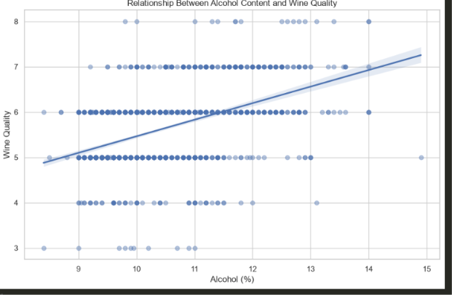
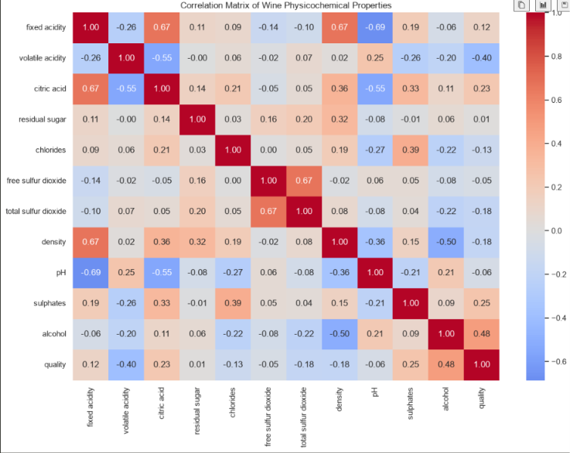
6. Correlation: Alcohol vs Quality
A moderate positive linear relationship
Other notable relationships:
volatile acidity ≈ −0.40 with quality; sulphates ≈ +0.25; citric acid ≈ +0.23.
PEARSON r
p-value
0.4803
2.28 × 10⁻⁷⁹
moderate positive association
statistically significant
Wine Quality | Data Analytics Project
8

Slide 9
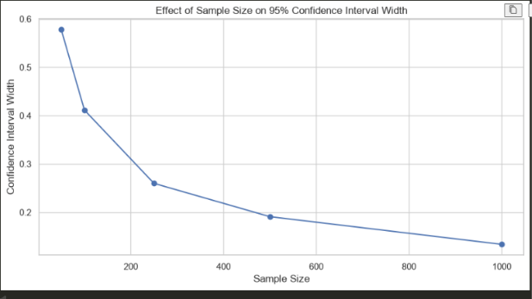
7. Effect of Sample Size
Larger samples produce narrower confidence intervals
n | Mean CI width | SD of sample means | H₀ rejection
50 | 0.6205 | 0.1626 | 83.33%
100 | 0.4177 | 0.1137 | 100%
250 | 0.2695 | 0.0691 | 100%
500 | 0.1893 | 0.0445 | 100%
1,000 | 0.1340 | 0.0160 | 100%
Main statistical lesson:
As n increases, estimates become more stable and uncertainty shrinks.
Wine Quality | Data Analytics Project
9

Slide 10
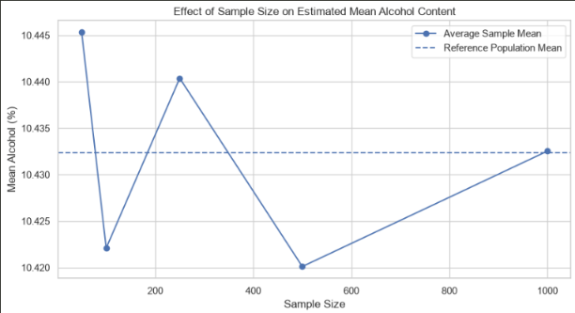
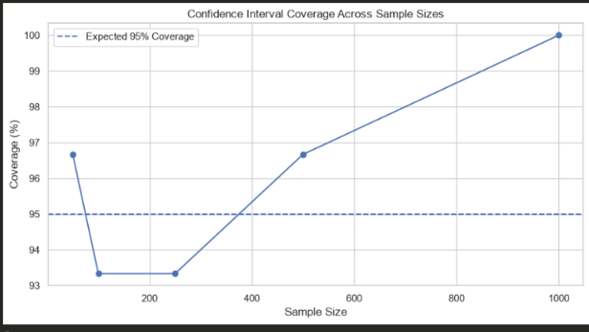
8. Repeated Sampling Experiment
30 repetitions at each sample size
Mean estimates converge toward the cleaned-data reference mean (10.4323%).
Coverage fluctuates around the theoretical 95% level because only 30 repetitions were used.
Wine Quality | Data Analytics Project
10

Slide 11
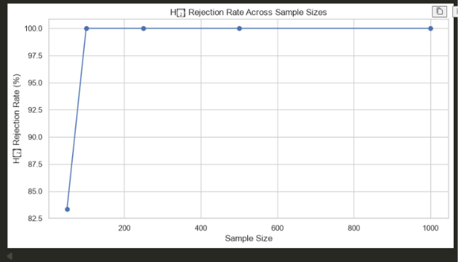
9. Statistical Power Across Sample Sizes
Detecting the difference from μ = 10
What happens as n grows?
• At n = 50, H₀ was rejected in 83.33% of repetitions.
• At n ≥ 100, H₀ was rejected in all 30 repetitions.
• Larger samples reduce standard error.
• Smaller standard errors make a real difference easier to detect.
This illustrates increasing statistical power in the repeated experiment.
Wine Quality | Data Analytics Project
11

Slide 12
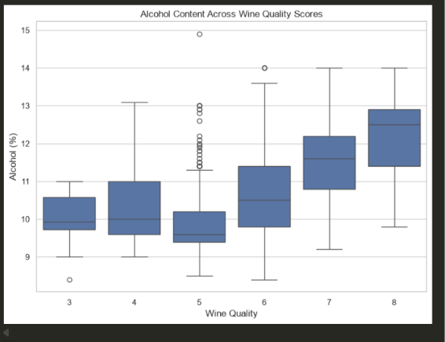
10. What the Visualizations Tell Us
Turning numbers into patterns
Quality-score boxplots show an overall upward shift in alcohol as quality increases.
The low-vs-high comparison makes the group-level alcohol difference especially clear.
Wine Quality | Data Analytics Project
12

Slide 13
11. Machine Learning: 5-Fold Cross-Validation
Predicting quality from physicochemical properties
Models evaluated
5-fold CV
• Shuffle data with random_state = 42.
• Train on 4 folds and validate on 1 fold.
• Repeat until every fold is used for validation.
• Compare MAE, MSE, RMSE and R².
MODEL 1
MODEL 2
Linear Regression
Random Forest
baseline linear model
nonlinear ensemble model
Model | MAE ↓ | MSE ↓ | RMSE ↓ | R² ↑
Linear Regression | 0.5118 | 0.4417 | 0.6645 | 0.3465
Random Forest | 0.4931 | 0.4150 | 0.6440 | 0.3853
Random Forest performs better on every reported metric.
Wine Quality | Data Analytics Project
13

Slide 14
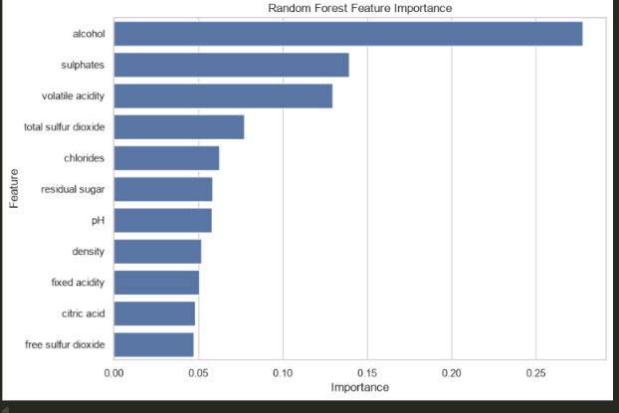
12. What Drives the Random Forest?
Feature importance
Feature | Importance
Alcohol | 0.2777
Sulphates | 0.1392
Volatile acidity | 0.1295
Total SO₂ | 0.0770
Chlorides | 0.0623
Residual sugar | 0.0583
pH | 0.0578
Density | 0.0520
Fixed acidity | 0.0506
Citric acid | 0.0483
Free SO₂ | 0.0475
Alcohol is the dominant predictor in the Random Forest, consistent with the statistical correlation and group-comparison results.
Wine Quality | Data Analytics Project
14

Slide 15
13. Key Findings
What should the class remember?
DATA
INFERENCE
GROUP EFFECT
1,359 unique wines
Alcohol: 10.4323%
+0.9669 pp
after removing 240 exact duplicates
95% CI = [10.3747%, 10.4899%]
high-quality vs low-quality mean alcohol
CORRELATION
SAMPLE SIZE
BEST MODEL
r = 0.4803
CI width: 0.6205 → 0.1340
Random Forest
positive, highly significant
n = 50 → 1,000
RMSE 0.6440 | R² 0.3853
• Wine quality is related to multiple physicochemical properties—not one variable.
• Alcohol is the strongest and most consistent signal in this analysis.
• Larger samples provide more precise statistical estimates.
• Prediction is useful, but the moderate R² shows that quality remains only partly explained.
Wine Quality | Data Analytics Project
15

Slide 16
14. Limitations & Interpretation
What we should NOT conclude
• Correlation does not imply causation.
• Quality is a sensory score and may contain subjectivity.
• Exact-duplicate removal is a methodological choice.
• The quality distribution is concentrated around scores 5 and 6.
• Repeated samples come from the same finite dataset.
• Only 30 repetitions per sample size were used.
• Random Forest feature importance is model-specific.
• R² = 0.3853 means substantial quality variation remains unexplained.
Best interpretation
The results identify
statistical associations,
uncertainty and predictive
patterns within this dataset.
They are not causal claims.
Wine Quality | Data Analytics Project
16

Slide 17
15. Conclusion
From descriptive statistics to prediction
A complete data-analytics workflow was demonstrated:
1
2
3
4
5
Describe
Infer
Compare
Sample
Predict
Distributions & variability
CIs & hypothesis tests
Quality groups & correlation
Precision vs sample size
5-fold ML validation
Bottom line: alcohol is strongly associated with wine quality in this dataset, larger samples improve statistical precision, and Random Forest provides the strongest predictive baseline among the two tested models.
Wine Quality | Data Analytics Project
17

Slide 18
THANK YOU
Questions?
Statistical Analysis & Machine Learning-Based Prediction of Wine Quality
Presented by: ______________________________
Data Analytics Coursework Project

