Slide 1
Statistical Analysis and Machine Learning-Based
Prediction of Wine Quality
Physicochemical properties • statistics • hypothesis testing • sampling • machine learning
ORIGINAL DATA
CLEAN DATA
PREDICTORS
BEST MODEL
1,599
1,359
11
Random Forest
observations
after 240 duplicates
physicochemical variables
RMSE 0.6440
Primary dataset: UCI Red Wine Quality — dataset page
1

Slide 2
1. Dataset and Preprocessing
What we started with and what we changed
ROWS
COLUMNS
MISSING VALUES
DUPLICATES
1,599
12
0
240
original
11 features + target
no imputation
exact duplicate rows
Cleaning decision
Dataset definition
• No missing values → no imputation.
• 240 exact duplicate rows removed to avoid repeated identical records receiving extra weight.
• Final analytical dataset = 1,359 observations.
• Duplicates were not automatically assumed to be errors.
• 11 physicochemical variables + quality score.
• Quality is numerical, so the main ML task is regression.
• Quality scores are concentrated around 5 and 6; scores 3 and 8 are rare.
Primary dataset: UCI Red Wine Quality — dataset page
2

Slide 3
2. Statistics and Hypothesis Testing
What we observed and what the tests changed
MEAN ALCOHOL
95% CI
ONE-SAMPLE TEST
CORRELATION
10.4323%
10.3747–10.4899
t = 14.7284
r = 0.4803
cleaned data
95% confidence
p = 1.16×10⁻⁴⁵
alcohol vs quality
Test | H₀ | Result | Decision
One Sample Two tailed t-test | μ = 10% | p = 1.16×10⁻⁴⁵ | Reject H₀
Two Sample two tailed t-test | μlow = μhigh | p = 1.80×10⁻⁶⁹ | Reject H₀
Low vs high quality
What did we learn from increasing sample size?
• Low (≤5): mean alcohol = 9.9208%
• High (≥6): mean alcohol = 10.8876%
• Difference = 0.9669 percentage points
• Larger samples give more stable estimates.
• Confidence intervals become narrower.
•It becomes easier to detect a difference from 10%.
3

Slide 4
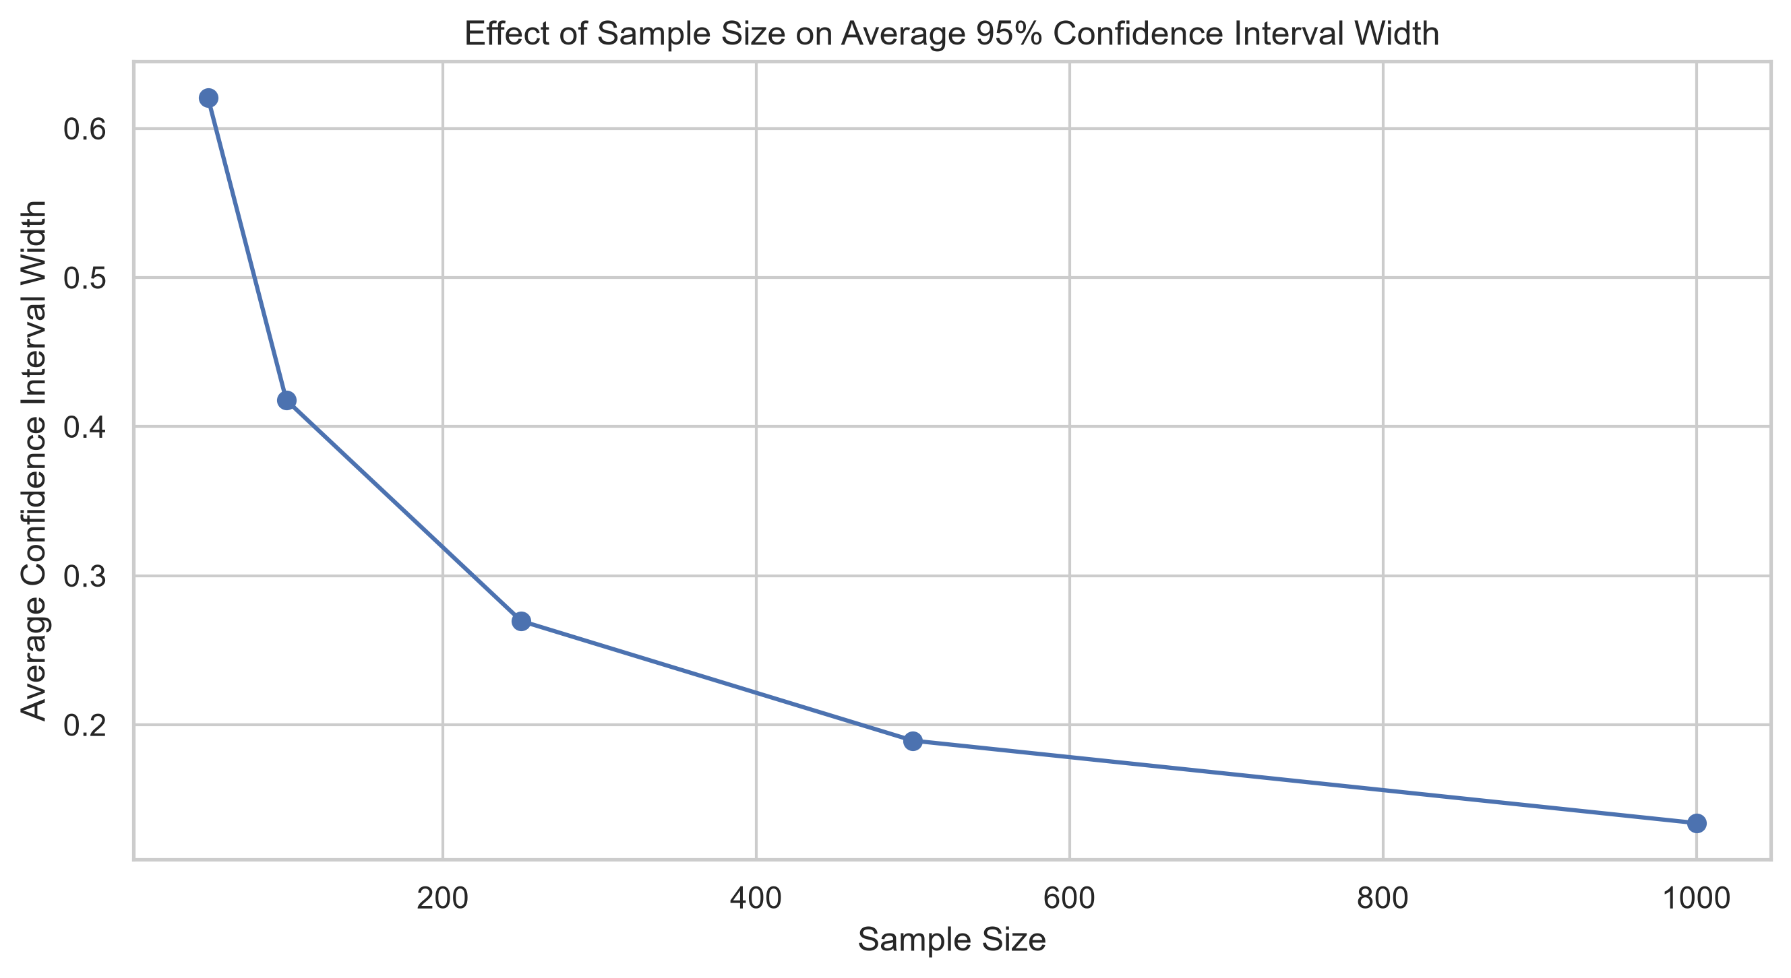
3. Sampling: Population Signal vs Random-Sample Variation
Repeated sampling from the cleaned dataset
What can we conclude?
n | Mean of sample means | SD of sample means | Avg. CI width
50 | 10.4453 | 0.1626 | 0.6205
100 | 10.4221 | 0.1137 | 0.4177
250 | 10.4404 | 0.0691 | 0.2695
500 | 10.4201 | 0.0445 | 0.1893
1000 | 10.4325 | 0.0160 | 0.1340
• Sample means vary because random samples are different.
• Variation shrinks strongly as n increases.
• The sample means center near the cleaned-data mean of 10.4323%.
• Therefore, sampling randomness explains differences among individual samples.
4

Slide 5
4. Machine Learning Performance
Predicting quality with 5-fold cross-validation
Model | MAE ↓ | MSE ↓ | RMSE ↓ | R² ↑
Linear Regression | 0.5118 | 0.4417 | 0.6645 | 0.3465
Random Forest | 0.4931 | 0.4150 | 0.6440 | 0.3853
Best model
Random Forest
RMSE = 0.6440
R² = 0.3853
Random Forest feature importance
Observations
Feature | Importance
Alcohol | 0.2777
Sulphates | 0.1392
Volatile acidity | 0.1295
Total sulfur dioxide | 0.0770
Chlorides | 0.0623
• Random Forest outperformed Linear Regression on all four metrics.
• It can capture nonlinear relationships and interactions.
• Alcohol is the strongest model feature.
• R² = 0.3853 is not 38.5% prediction accuracy.
5

Slide 6
5. Conclusions, Limitations and Recent Research
What the project ultimately tells us
Main conclusions
• Alcohol is positively associated with quality and is the most important Random Forest feature.
• Both hypothesis tests reject H₀ at α = 0.05.
• Larger samples give more stable means and narrower CIs.
• Random Forest performs better than Linear Regression.
Recent study — 2025
Khan et al. (2025/2026), “Improved machine learning framework with feature engineering and SHAP analysis for predicting wine quality”
Discover Applied Sciences. Published online 29 December 2025. The study uses the UCI wine-quality data and identifies alcohol, sulfur dioxide and volatile acidity among influential predictors.
Limitations
Why it matters here
• Observational data → no causal claim.
• The UCI dataset is not automatically the entire real-world population.
• R² = 0.3853 leaves substantial variation unexplained.
Our project reaches a compatible feature-level observation: alcohol is strongly related to quality and is the top Random Forest feature.
Primary dataset: UCI Wine Quality - dataset page
Project Repository – Github link
Cortez et al. (2009) — original UCI wine-quality study.
6

