Slide 1
DATA ANALYTICS PROJECT
Statistical Risk Analysis
& Machine Learning for Credit Card Default
UCI Default of Credit Card Clients dataset
STATISTICS
SAMPLING
PREDICTION
Descriptive analysis, confidence intervals & hypothesis tests
How sample size changes estimation precision
Four classifiers evaluated on imbalanced data
A combined statistical and predictive study of next-month default risk
1/6

Slide 2
Dataset & analysis workflow
DATASET
PREDICTORS
CLASS IMBALANCE
UCI credit-card default records
29,965 observations after duplicate removal
Binary target: Default = 0 / 1
9 selected variables
Credit limit, age, repayment status,
bill amounts and payment amounts
Default rate ≈ 22% in repeated samples
Non-default is the majority class
Accuracy alone can be misleading
1
2
3
4
5
Clean data
Describe
Test
Sample
Predict
Remove ID / duplicates
Means, SD, SE, 95% CI
Welch t-tests
n = 100, 250, 500
4 models + 5-fold CV
All the 9 predictors were found to be statistically significant according to their p values.
2/6

Slide 3
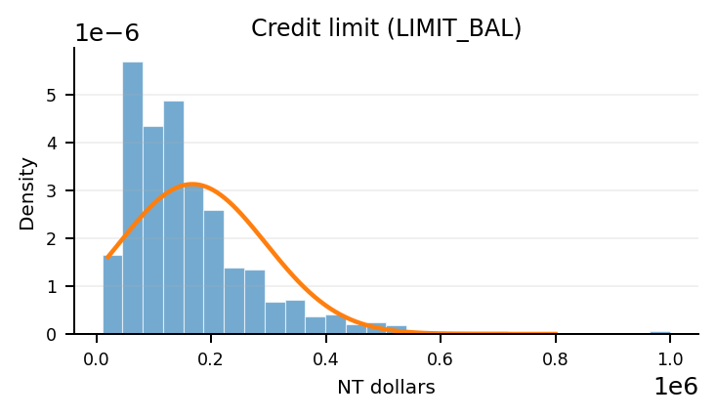
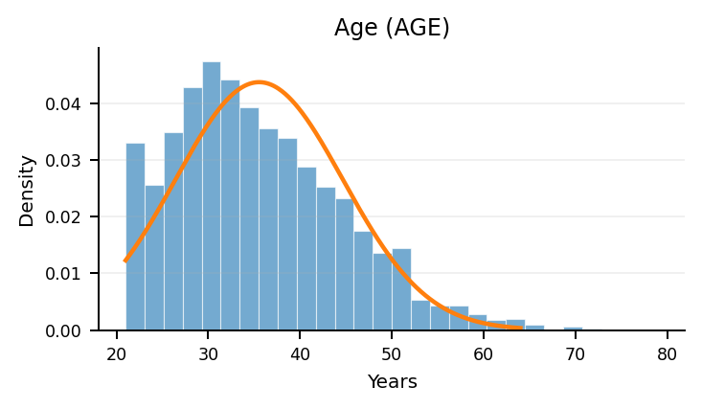
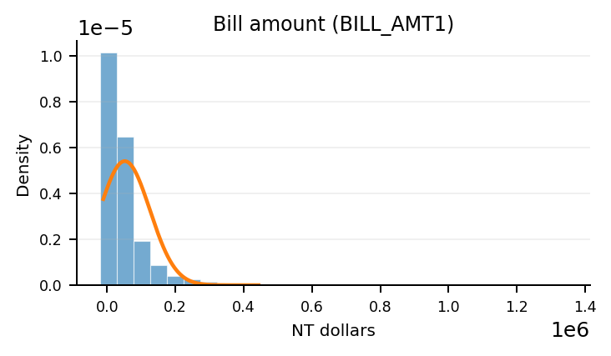
Statistical findings & distribution analysis
CREDIT LIMIT · RIGHT-SKEWED
AGE · MILD ASYMMETRY
BILL AMOUNT · STRONG RIGHT TAIL
Most limits are lower or mid-range; a smaller number of high limits create a long right tail.
Compare the bars with the bell curve: uneven tails or a peak away from the centre indicate non-normality.
A few very large bills stretch the distribution to the right, so the mean can exceed the median.
STATISTICAL FINDINGS
WELCH'S T-TESTS
Credit limit: mean NT$167,442 (SD 129,760) | Age: mean 35.49 years (SD 9.22).
All 9 selected variables were significant at unadjusted α = 0.05. Statistical significance does not prove causation.
Normal curve = reference fitted using mean and SD.
3/6

Slide 4
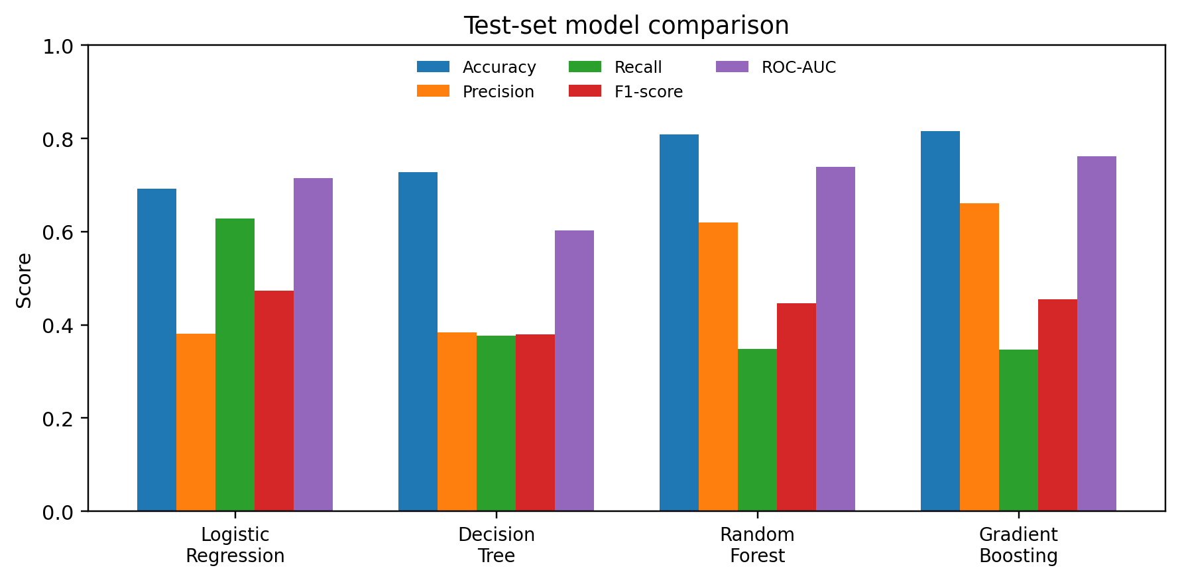
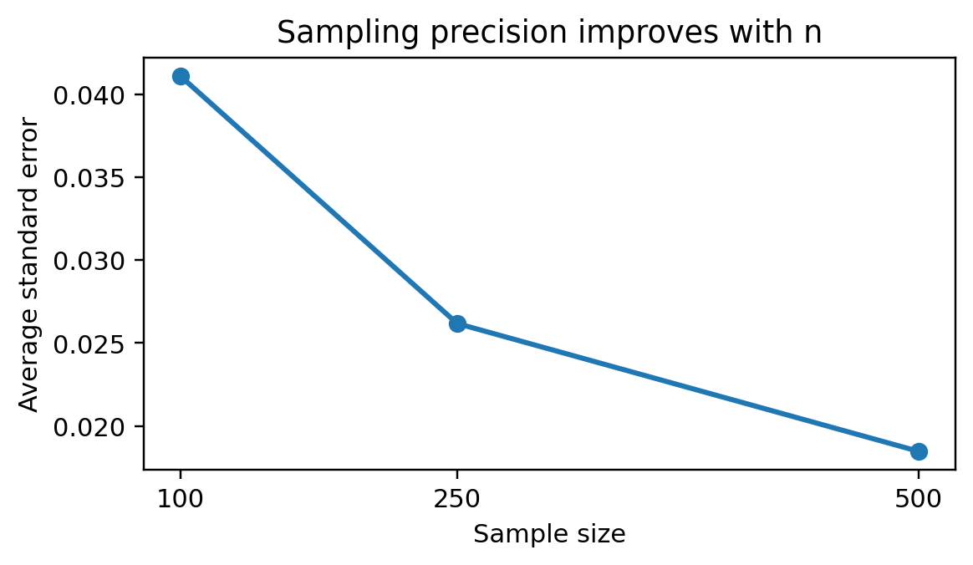
Sampling precision & model performance
REPEATED SAMPLING
Average default rate ≈ 22%
30 repetitions at each sample size
Best by test accuracy / ROC-AUC: Gradient Boosting
Best by test recall / F1 and CV F1: Logistic Regression
Mean CI width: 0.1595 (n=100) → 0.0722 (n=500)
Larger samples generally produce more precise estimates.
Model choice depends on the cost of missed defaults vs. false alarms.
4/6

Slide 5
Key observations & conclusion
STATISTICAL SIGNAL
MODEL TRADE-OFF
SAMPLING
All 9 variables showed significant mean differences between default and non-default groups at the unadjusted 5% level.
Gradient Boosting: test accuracy 81.61%, ROC-AUC 0.7622.
Logistic Regression: recall 62.82%, F1 0.4740.
Average SE fell from 0.0411 at n=100 to 0.0185 at n=500; mean CI width narrowed.
WHAT THE RESULTS MEAN
• Statistics explains patterns and quantifies uncertainty; ML evaluates predictive performance.
• Accuracy alone is insufficient for an imbalanced target; recall and F1 reveal default detection.
• Results are internal to this dataset; audit feature timing and validate on independent / later data before deployment.
Conclusion: there is no universal best model—the choice must match the evaluation objective.
5/6

Slide 6
References
DATASET
Yeh, I.-C. (2009). Default of Credit Card Clients [Dataset]. UCI Machine Learning Repository. https://doi.org/10.24432/C55S3H
RECENT STUDY (2025)
Bhandary, R., & Ghosh, B. K. (2025). Credit Card Default Prediction: An Empirical Analysis on Predictive Performance Using Statistical and Machine Learning Methods. Journal of Risk and Financial Management, 18(1), 23.
https://doi.org/10.3390/jrfm18010023
WHY IT IS RELEVANT
The 2025 study compares statistical and machine-learning approaches for credit-card default using the UCI dataset and reports metrics including precision, F1-score and AUC—closely aligned with this project’s model comparison.
Thank you
6/6

