Slide 1

Stack Based Calculator
Presented by: Sahil Mallick (23CSU271)
Sarthak Sabharwal (23CSU284)
This presentation will delve into the world of stack-based calculators, exploring the concept of stacks, their operations, and applications. Join us as we unveil the power and versatility of this fundamental data structure.

Slide 2
Introduction to Stacks
Stacks are a fundamental data structure in computer science. They function on the principle of Last-In, First-Out (LIFO), where the last element added is the first to be removed.
Think of a stack of plates. You can only add or remove plates from the top. The last plate added is the first one you'll take off.

Slide 3




What is a Stack?
Data Structure
1
A stack is a linear data structure that follows a specific order of operations.
LIFO
2
Last-In, First-Out (LIFO): The last element added is the first to be removed.
Operations
3
Common operations include push, pop, peek, and isEmpty.
Applications
4
Used in various scenarios, including function call management, expression evaluation, and undo/redo functionality.

Slide 4

Operations on Stack: Pop, Push, Peek, Is Empty
Push
Pop
Adds an element to the top of the stack.
Removes and returns the top element from the stack.
Peek
IsEmpty
Returns the top element of the stack without removing it.
Checks if the stack is empty. Returns true if empty, false otherwise.

Slide 5
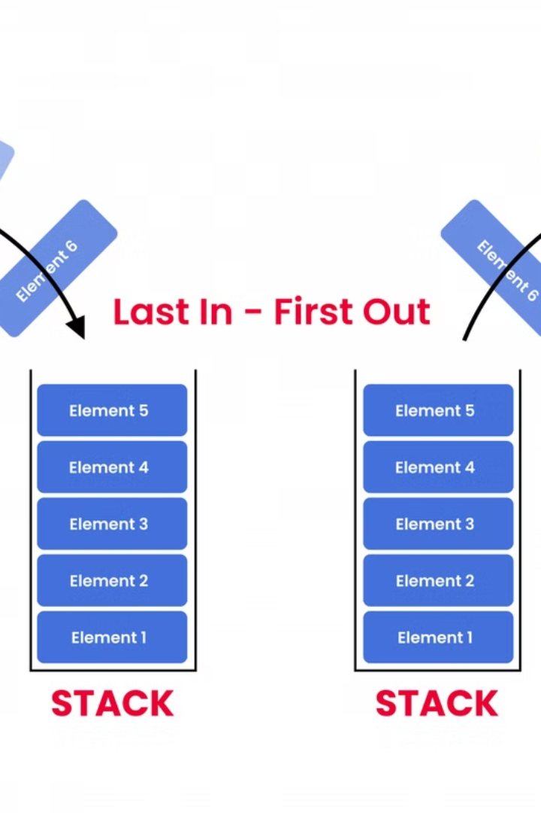
Applications of Stacks
1
Function Call Management
Stacks manage function calls and their associated data.
2
Expression Evaluation
Stacks are crucial in converting infix expressions to postfix and evaluating them efficiently.
3
Undo/Redo Functionality
Stacks enable users to revert or redo actions in text editors or other applications.

Slide 6

Conclusion and Key Takeaways
Stacks are a fundamental data structure with numerous applications. Understanding their LIFO principle, operations, and implementation is essential in computer science.
From function call management to expression evaluation, stacks play a vital role in various software development aspects.

Slide 7
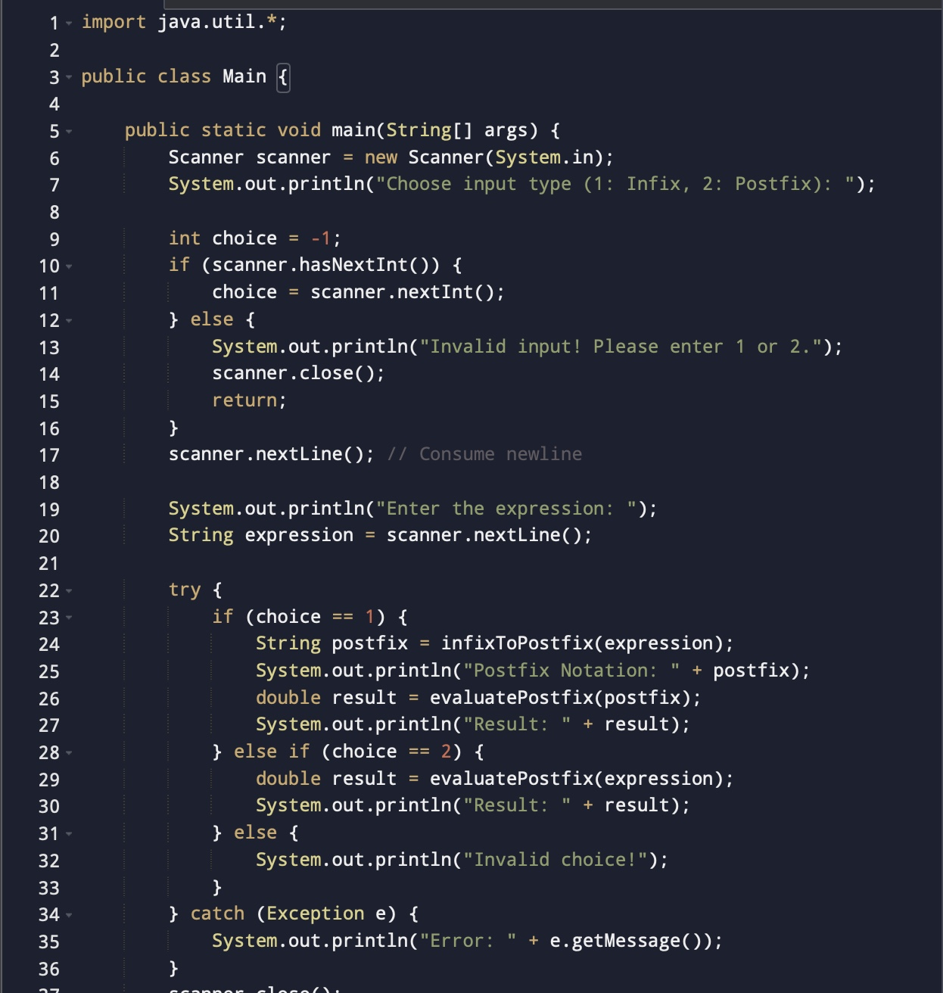

Slide 8
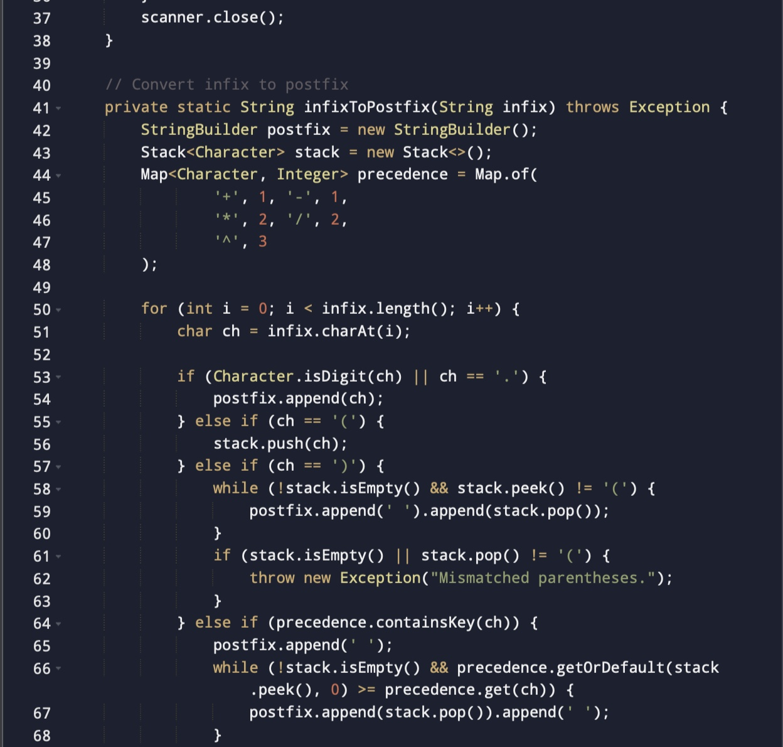

Slide 9
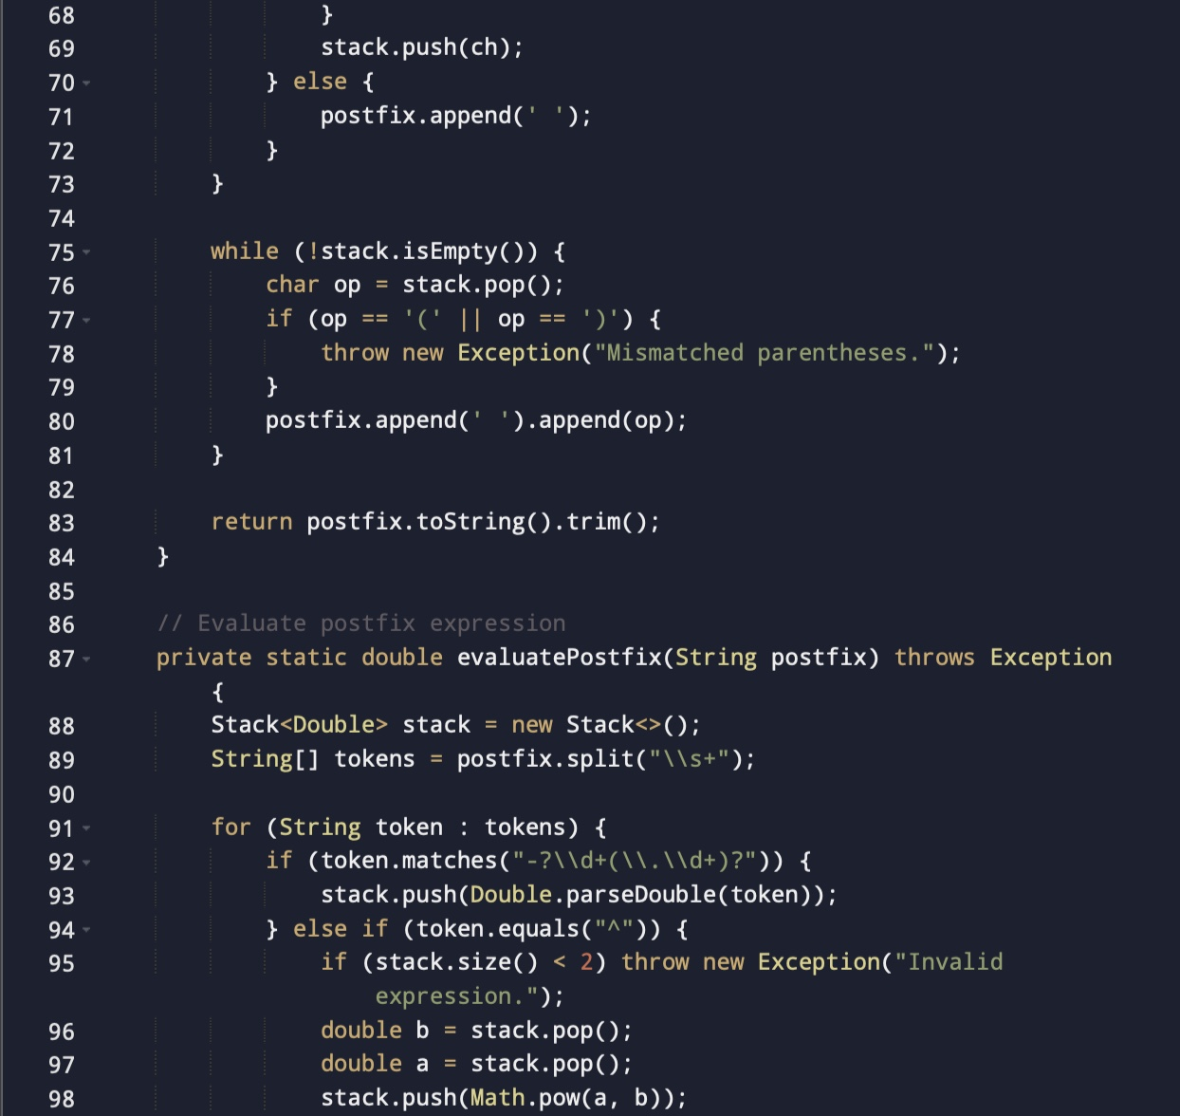

Slide 10
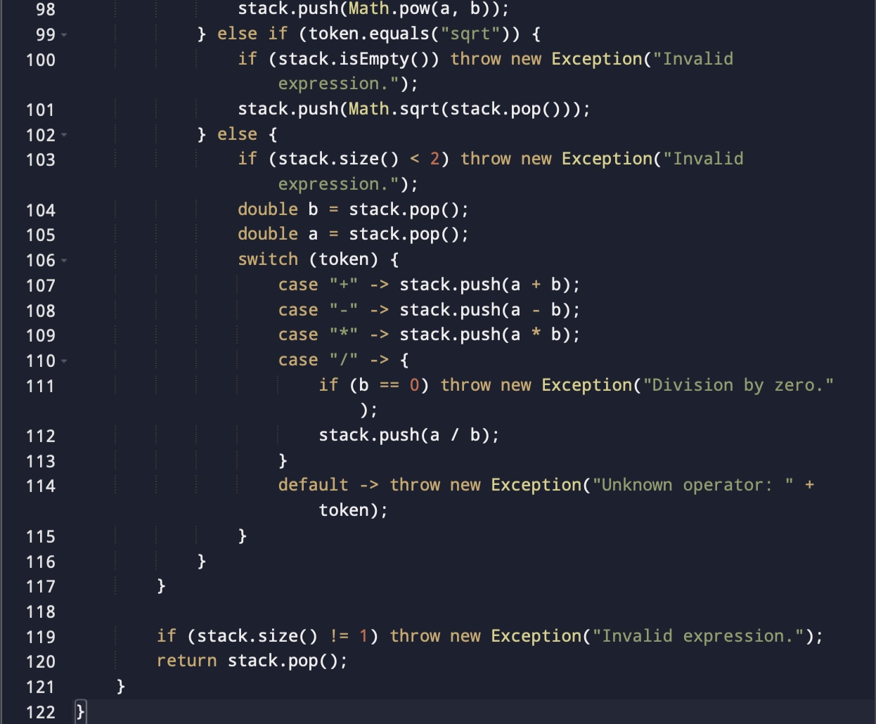

Slide 11
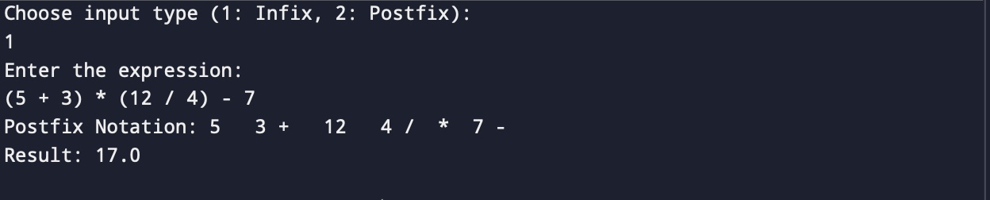

Slide 12
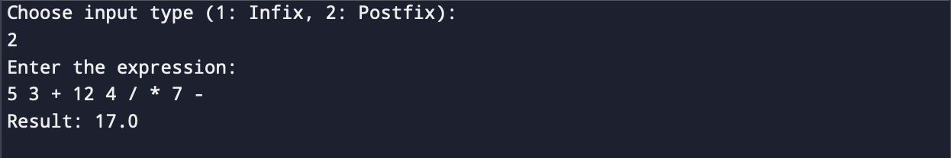

Slide 13
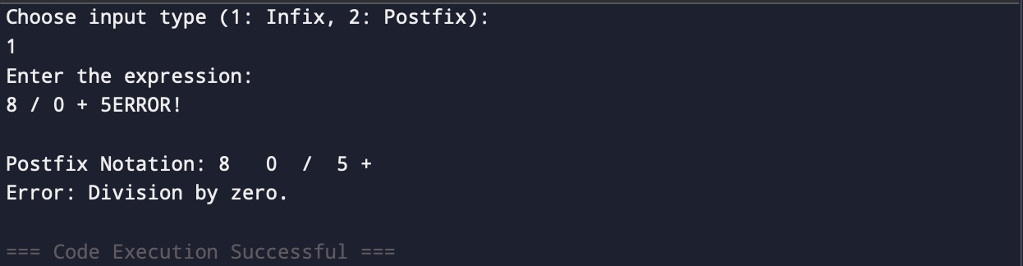

Slide 14


