Slide 1
3D to 2D Transformation
Dimensionality Reduction / Projection Classroom visual deck

Slide 2
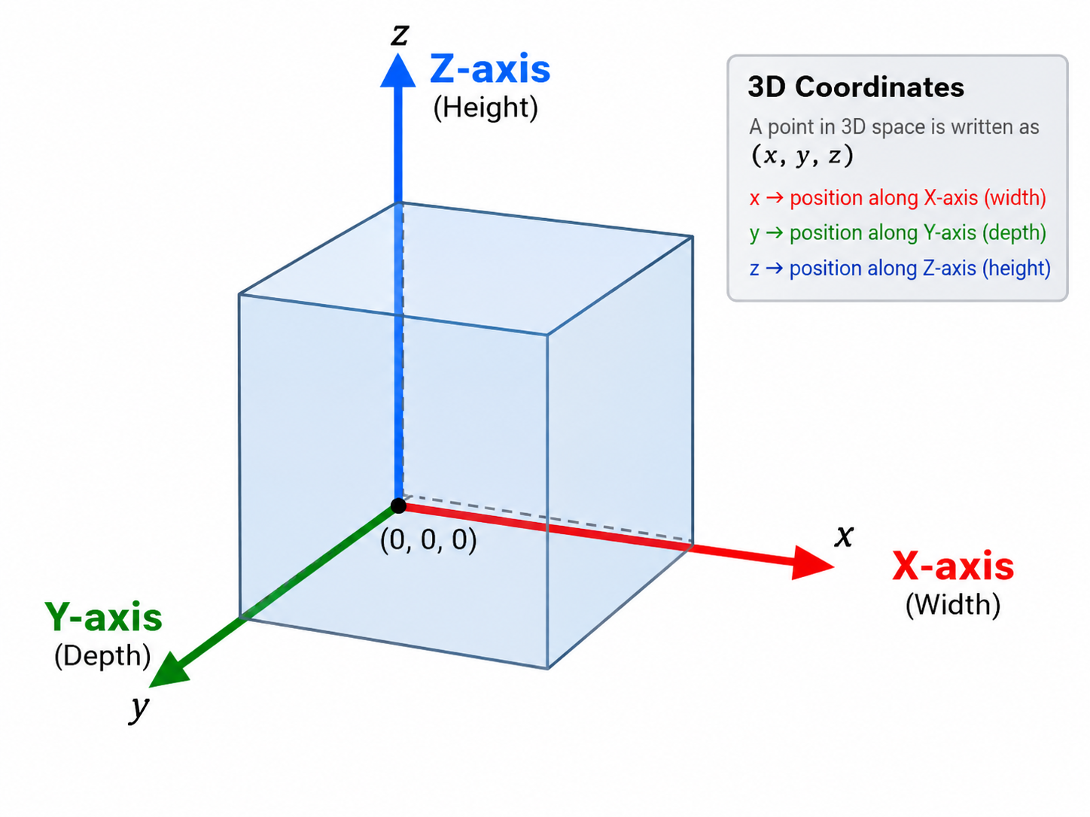
3D Coordinates and Major Axes

Slide 3
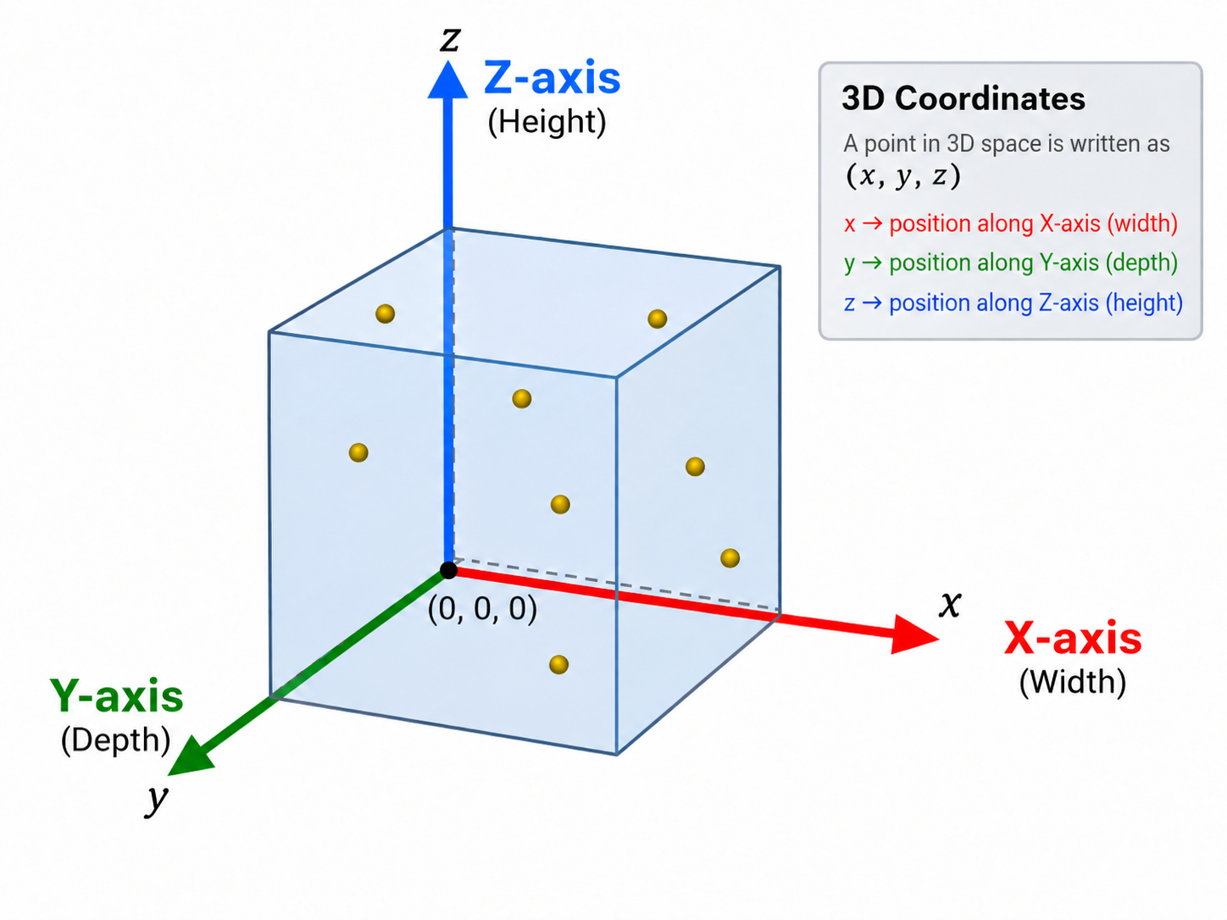
3D Cube with Data Points

Slide 4
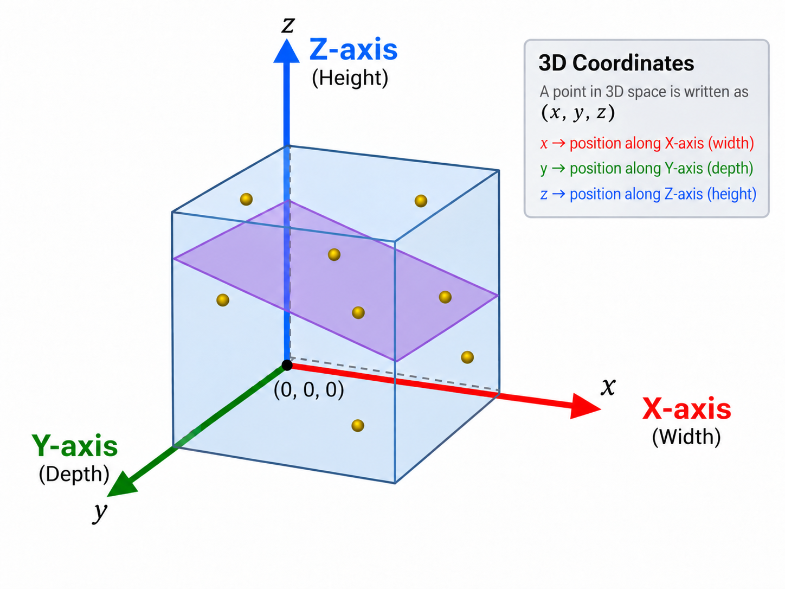
A 2D Plane Inside the 3D Cube

Slide 5
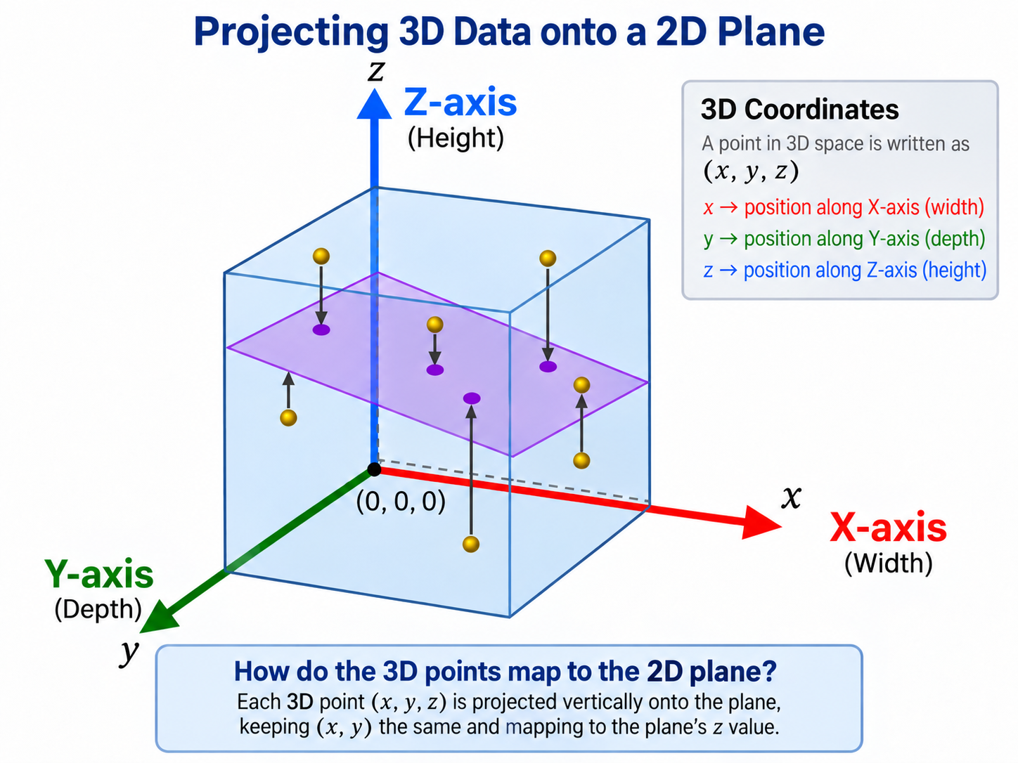
Projecting 3D Points onto the 2D Plane

Slide 6
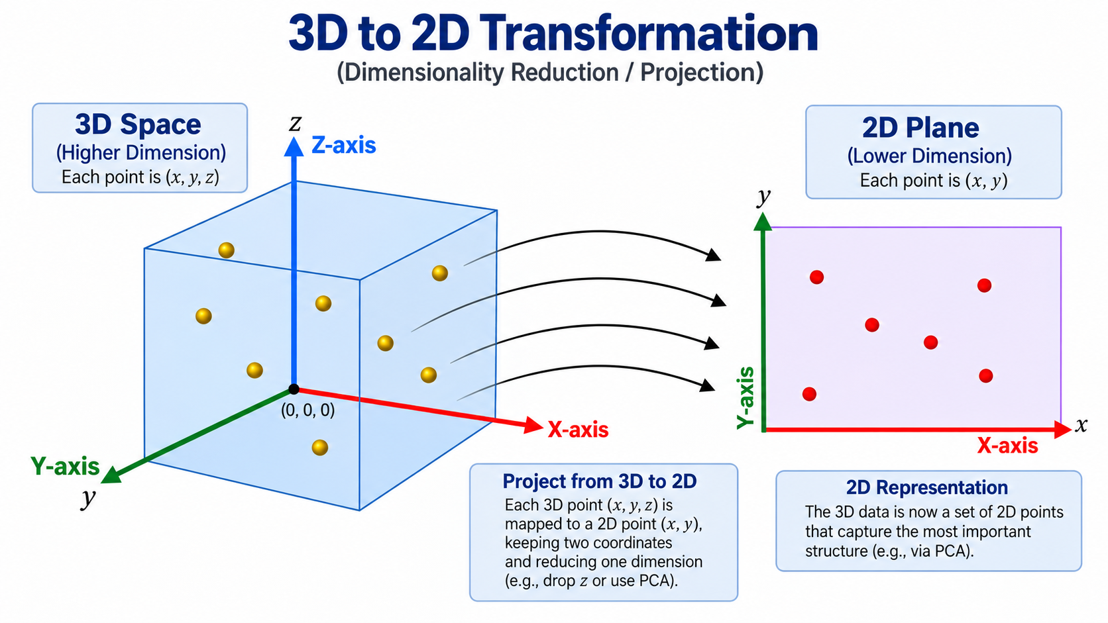
3D to 2D Transformation Overview

Slide 7
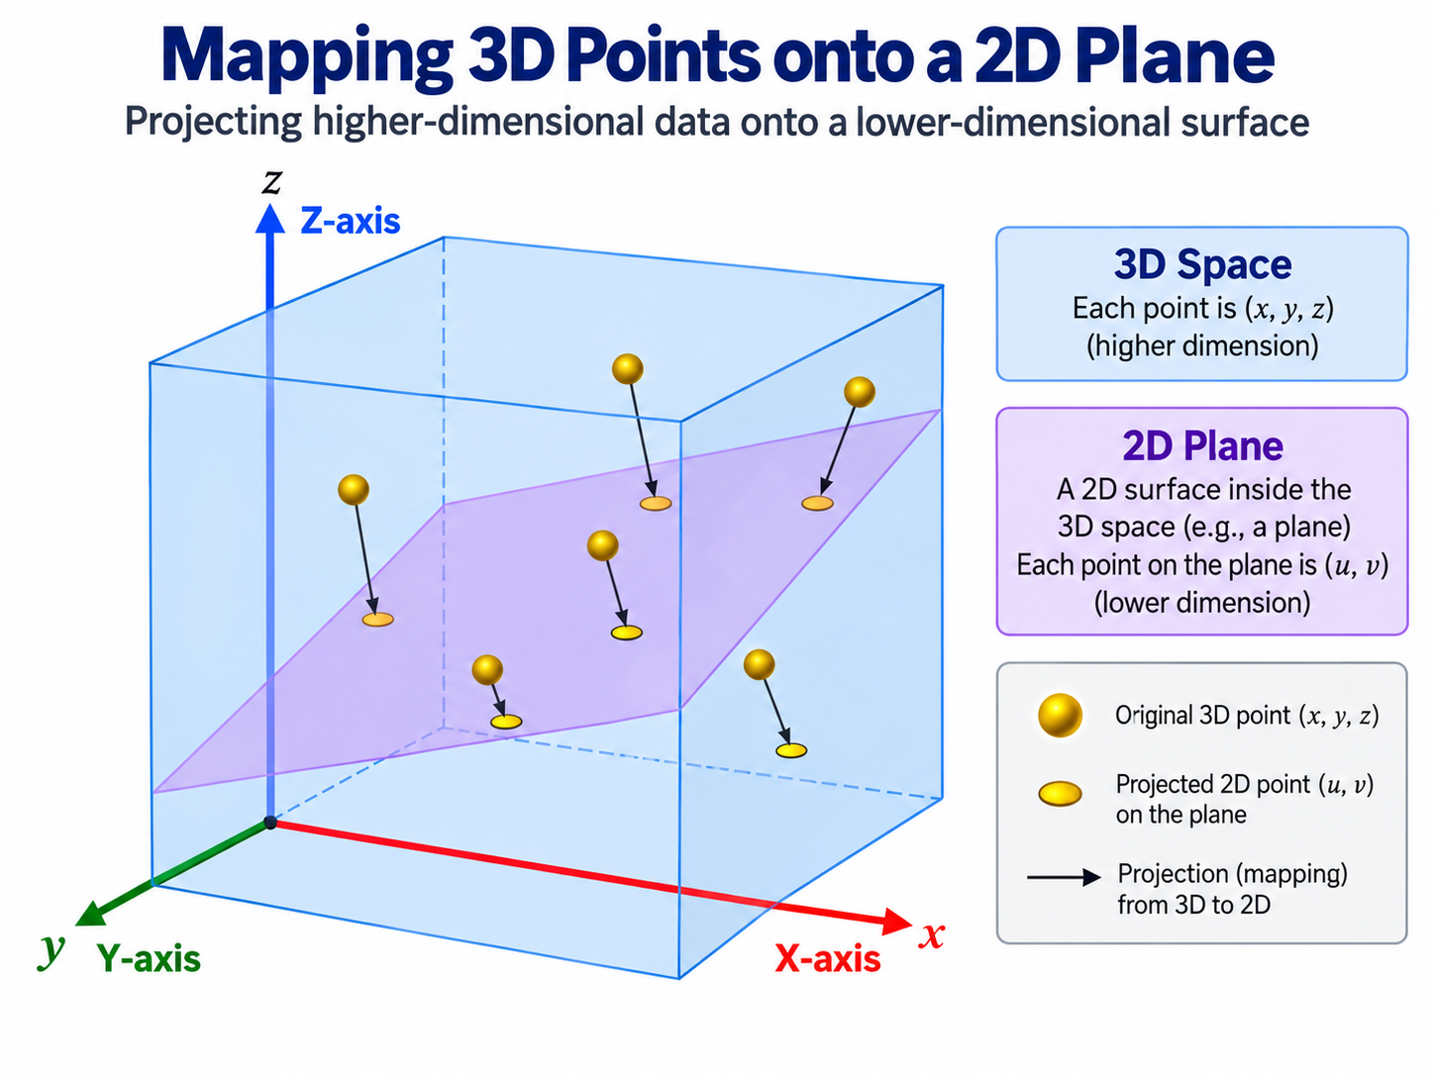
Mapped Yellow Points on the 2D Plane

