Slide 1
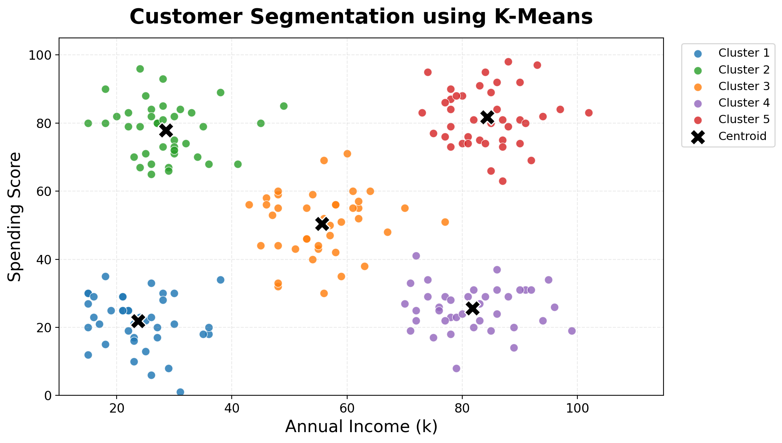
K-Means Clustering: Income vs Spending
Customer segmentation example: group similar customers without using labels

