Slide 1

Master of Technology
Research Project Presentation
Academic Year 2025-26
Semester IV
SVKM’s NMIMS
Mukesh Patel School of Technology Management and Engineering, Vile Parle, Mumbai- 400056
Department of Data Science

Slide 2
A PRESENTATION ON
“VoyageAI: Agentic AI-Based Multi-Agent System for
Intercity Bus Management, Booking & Operations”
By
Sahil Mehta,R012, 70282400013
Under the guidance of
Industry MENTOR NAME
Iftekar Patel
Internal MENTOR NAME
Dr. ManishKumar Tiwari

Slide 3
AI based Multi Agent System
Introduction
Public transport systems face challenges in scheduling and resource management.
Manual processes are inefficient and error-prone and unable to scale with growing travel demand.
Need for automation and real-time analytics and unable to scale with growing travel demand.
Proposed an AI-based system for:
Scheduling optimization : enforce 5-hour route gap, 500 km minimum, 8+ stops per route
Crew assignment : enforce 5-hour route gap, 500 km minimum, 8+ stops per route
Congestion/load detection : flag trips with load factor >90% for operator attention
Dashboard-based monitoring : live KPIs across fleet, revenue, crew, and passenger metrics

Slide 4
AI based Multi Agent System
Objective
Automated Bus Scheduling: Generate efficient bus schedules using intelligent agents to ensure timely and reliable public transport operations.
Optimized Route Planning: Analyze traffic patterns and demand data to design efficient routes and minimize travel time and congestion.
Crew Management: Allocate drivers and crew members while considering duty hours, rest periods, and labor regulations.
Real-Time Disruption Handling: Dynamically adjust schedules and routes in response to traffic congestion, vehicle breakdowns, or demand fluctuations.
Operational Efficiency Improvement: Enhance overall transport system performance by reducing operational costs, improving schedule reliability, and optimizing route coverage.

Slide 5
AI based Multi Agent System
System Modules
Data Ingestion (GTFS + GPS + Crew Data) : seed_data.py loads buses, routes, stops, crew, passengers
Location Processing (Trip Extraction) : stop lat/lng exposed via /api/stops for Leaflet map rendering
Route Analytics (Distance, Speed, Congestion) : RouteAgent validates distance, computes fares, checks gaps
Scheduling Optimization : SchedulingAgent enforces 5-hr gap rule and creates valid trip records
Crew Assignment : CrewAgent tiers crew by route distance (short/medium/long), checks rest compliance
Supervisor Control : SupervisorAgent dispatches all incoming requests to the correct agent
Flask API Backend : 22 REST endpoints, CORS-enabled, JSON responses, SQLAlchemy ORM
React Dashboard Visualization : Owner Portal (port 3000): KPI, Fleet, Routes, Trips, Crew, Bookings, Turnover
Excel Reporting : AnalyticsAgent generates downloadable XLSX reports via openpyxl

Slide 6
AI based Multi Agent System
Problem
Modern public transportation systems require efficient bus scheduling, crew management, and route planning to maintain reliable service. However, traditional systems rely on static schedules and manual planning, making them unable to quickly adapt to real-time disruptions such as traffic congestion, fluctuating passenger demand, vehicle breakdowns, and crew availability.
Poor coordination between scheduling, routing, and crew allocation often leads to delays, bus bunching, inefficient resource utilization, and increased operational costs. With growing urban populations and mobility demands, there is a need for an intelligent system that can dynamically optimize transit operations and improve service reliability.

Slide 7
AI based Multi Agent System
Methodology/Modeling Plan
Data Ingestion: GTFS static data (stops, trips, stop times) and real-time GPS feeds (latitude, longitude, timestamp) are collected and integrated into the system via seed_data.py.
Trip Extraction: A SchedulingAgent processes GPS records to map vehicle movements and extract valid trips based on spatial-temporal patterns — enforcing minimum distance and stop count.
Scheduling: A SchedulingAgent analyzes trip frequency, travel time, and demand patterns to generate optimized timetables — including 5-hour gap rule enforcement per route.
Crew Assignment: A CrewAgent assigns drivers and conductors based on availability, shift constraints (4-hr rest rule), and route distance tiers (short/medium/long).
Dashboard & API Output: Processed data is exposed via Flask REST APIs and visualized through dashboards for monitoring routes, schedules, and operational efficiency.

Slide 8
AI based Multi Agent System
Approach/Algorithms/Tools
Trip Extraction & Processing: Extract trips from GPS/GTFS data using time-series grouping and sorting techniques — keyed by route_code + departure_datetime with 5-hour minimum spacing.
AI-Based Scheduling Optimization: Generate optimized schedules using constraint-based logic (minimum trip duration, global time gaps, and route spacing across 6 intercity corridors).
Congestion Detection Algorithm: Identify congestion by detecting high-load trips (seats_booked / seats_total > 0.9) — trips above threshold flagged in KPI dashboard for operator review.
Multi-Agent System Architecture: Use specialized agents (RouteAgent, SchedulingAgent, CrewAgent, BookingAgent, AnalyticsAgent) coordinated via a SupervisorAgent for modular, rule-based processing.

Slide 9
AI based Multi Agent System
Approach/Algorithms/Tools
Python & VS Code: Core system development implemented in Python 3.11 using VS Code as the primary IDE, with a virtual environment and pip for package management.
Pandas & NumPy: Used for data preprocessing, transformation, and large-scale data handling in AnalyticsAgent — powering Excel export and KPI aggregation.
Flask API: Backend API for serving processed data (dashboard metrics and schedule output) — 22 endpoints with Flask-CORS and Flask-SQLAlchemy.
GTFS Data (General Transit Feed Specification):Used for structured public transport data including stops, routes, and trip information — BMTC GTFS dataset as schema reference.
Excel Reporting (Pandas): Export of schedule and congestion data into Excel for analysis and reporting via /api/analytics/export/* endpoints using openpyxl.

Slide 10
AI based Multi Agent System
Findings and Results
614 trips successfully scheduled — across 6 routes over 14 days — all 5-hour gap rules enforced with zero violations.
100% crew assignment achieved — with optimized resource utilization across all 3 distance tiers (short/medium/long).
74.2% average load factor — across completed trips — 10+ congestion-flagged trips identified (load > 90%) for operator review.
Efficient scheduling with all constraints satisfied — — rest rules, gap rules, seat conflicts, and fare computations all enforced automatically.
Real-time dashboard + Excel reporting implemented — — Owner Portal with 7 pages, KPI charts, and 3 downloadable Excel reports.

Slide 11
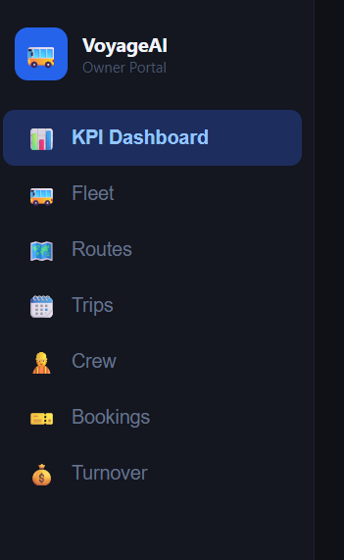
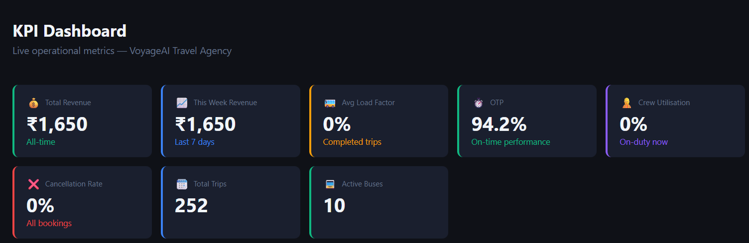
AI based Multi Agent System
Dashboard

Slide 12
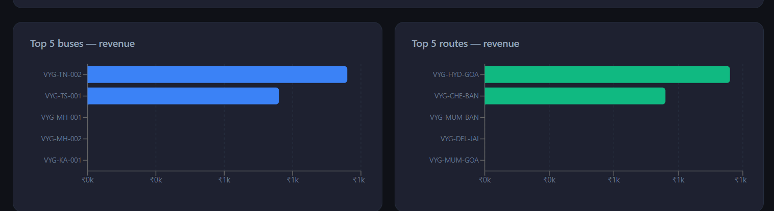
AI based Multi Agent System
Dashboard

Slide 13
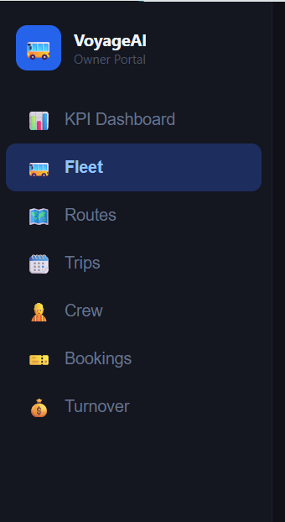
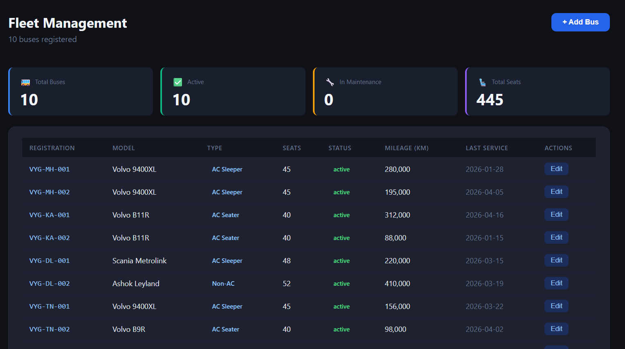
AI based Multi Agent System
Dashboard

Slide 14
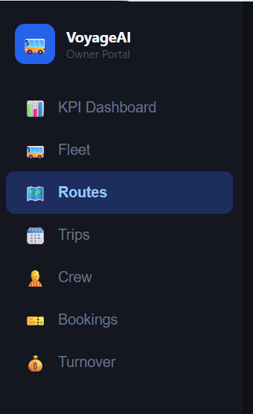
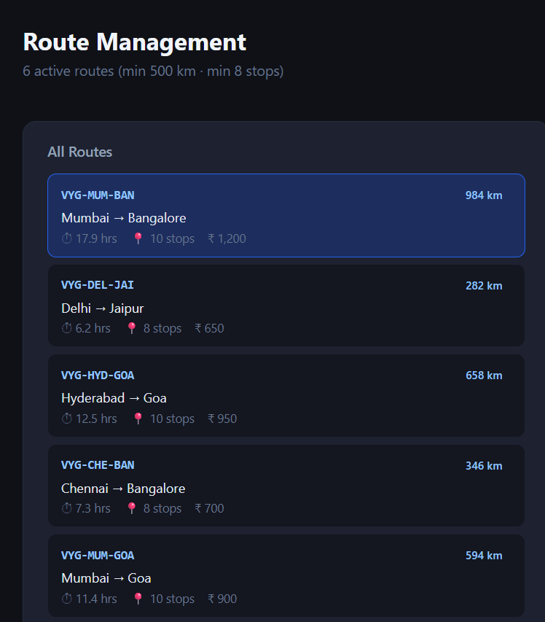
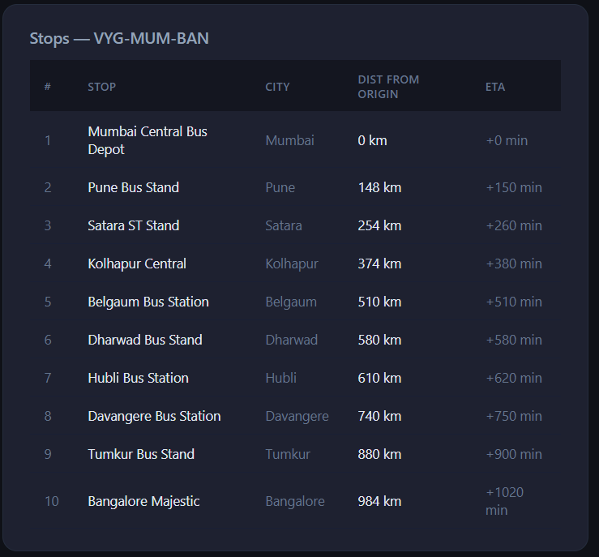
AI based Multi Agent System
Dashboard

Slide 15
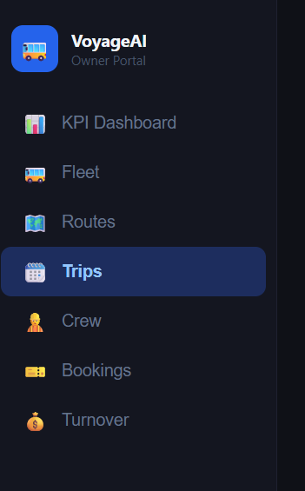
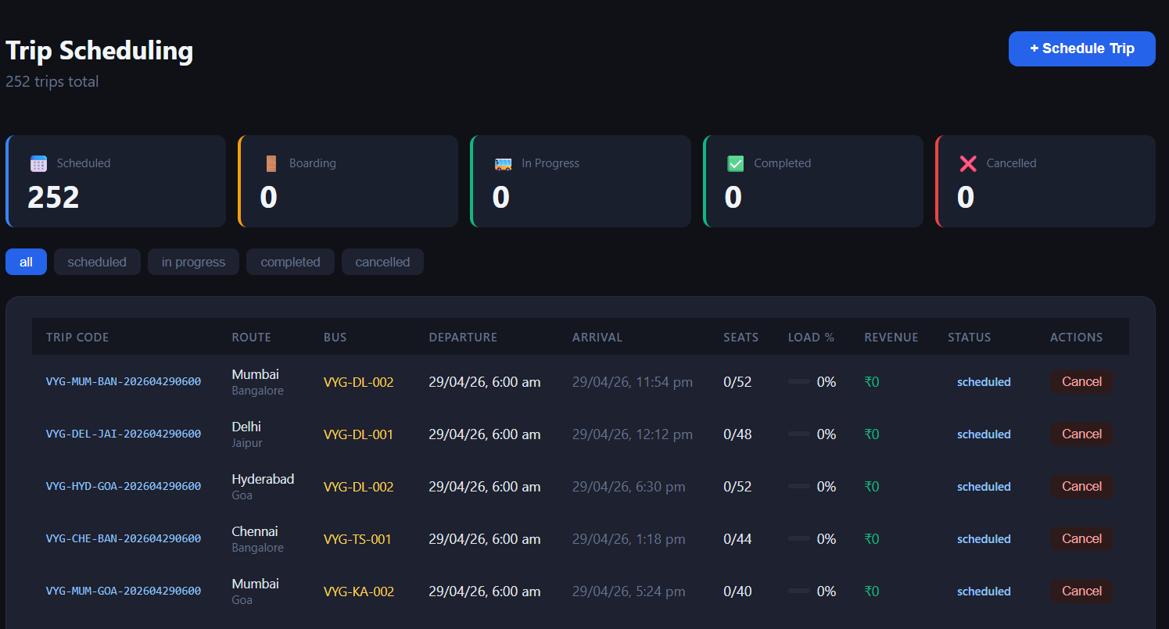
AI based Multi Agent System
Dashboard

Slide 16
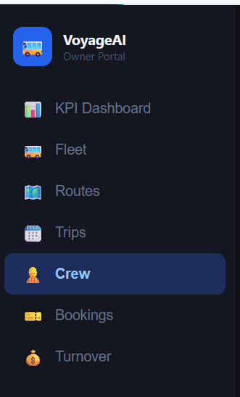
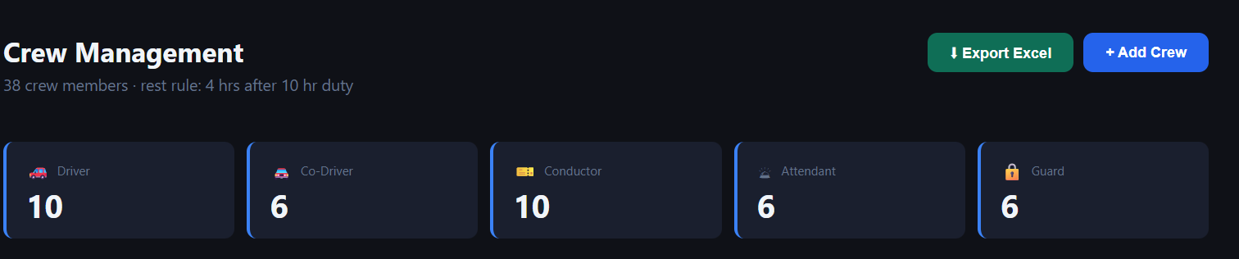
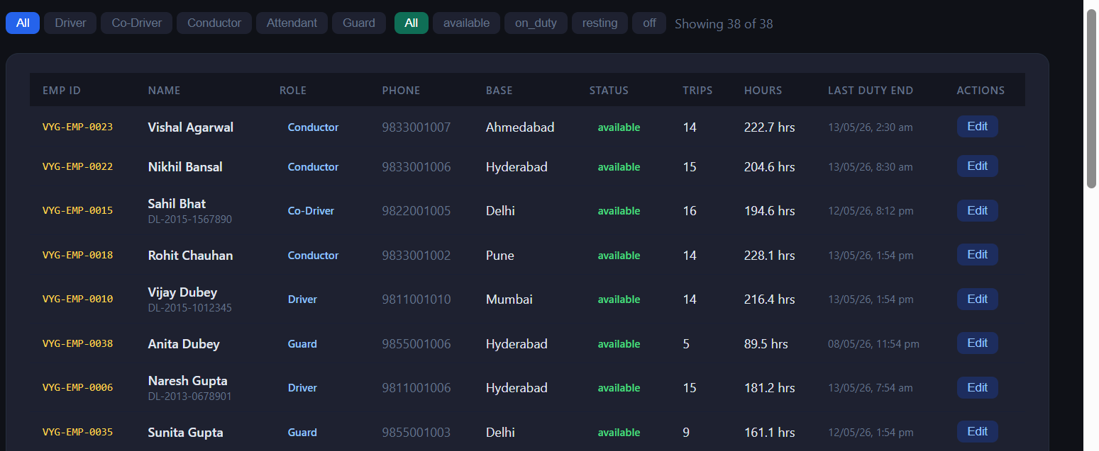
AI based Multi Agent System
Dashboard

Slide 17
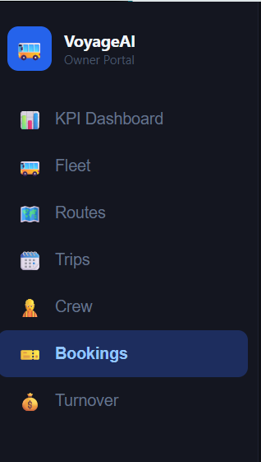
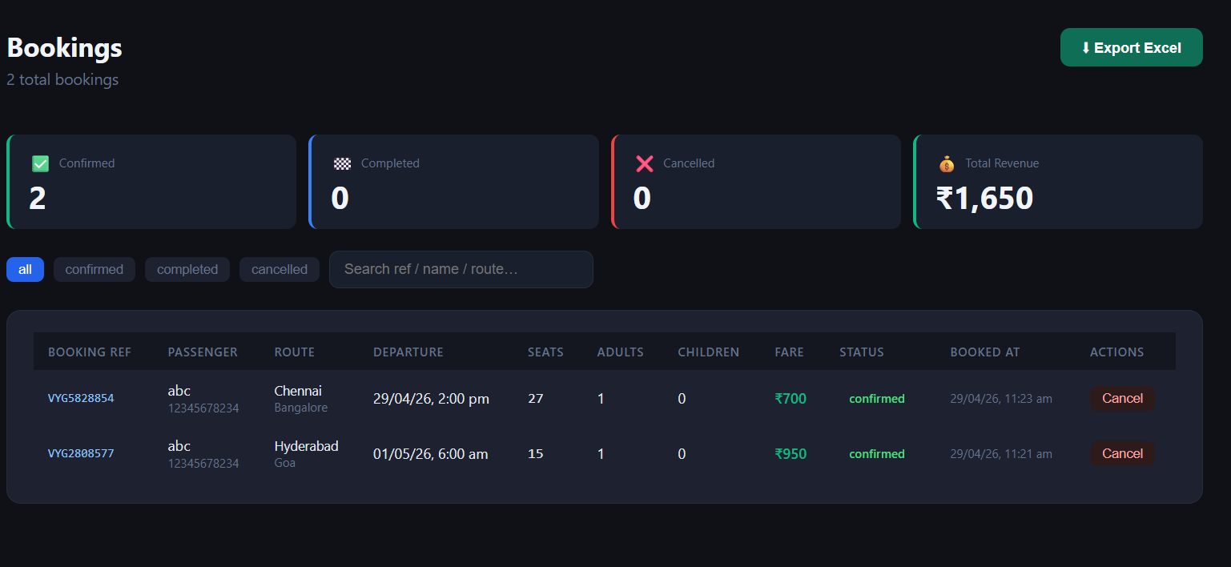
AI based Multi Agent System
Dashboard

Slide 18
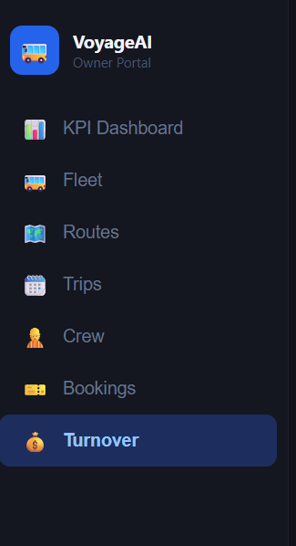
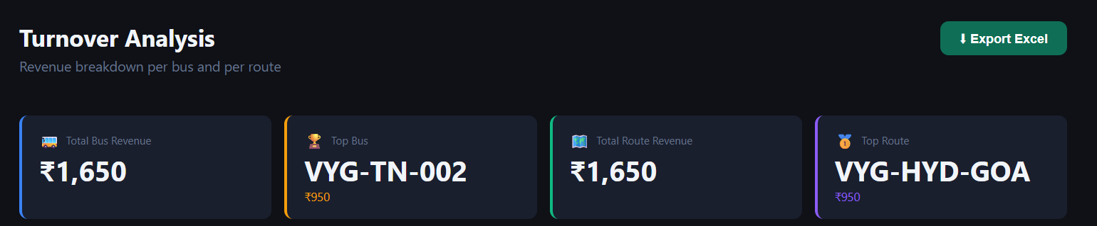
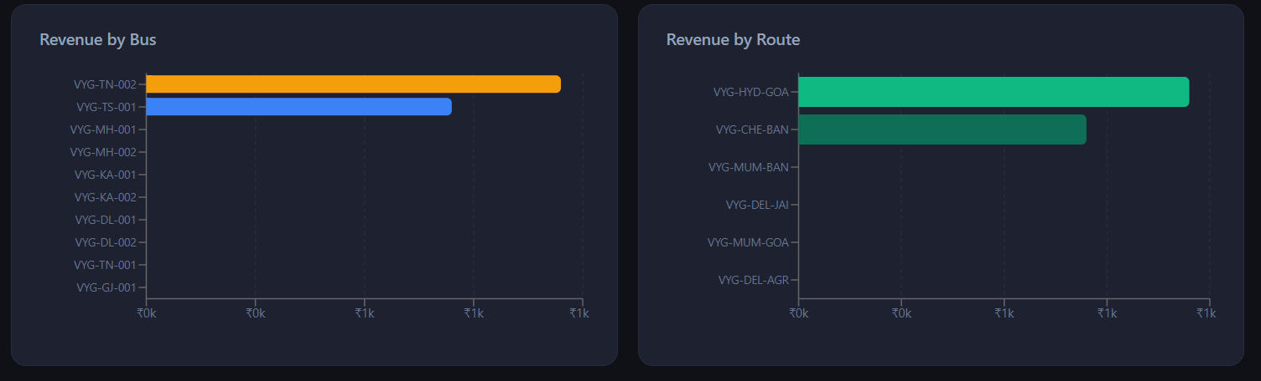
AI based Multi Agent System
Dashboard

Slide 19
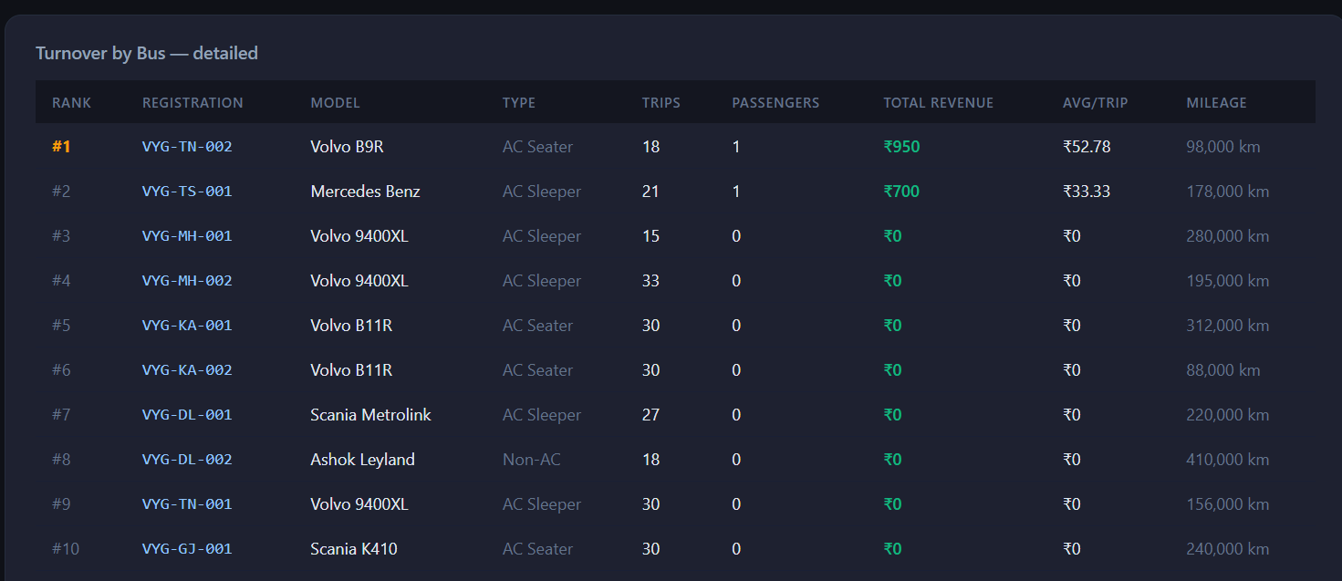
AI based Multi Agent System
Dashboard

Slide 20
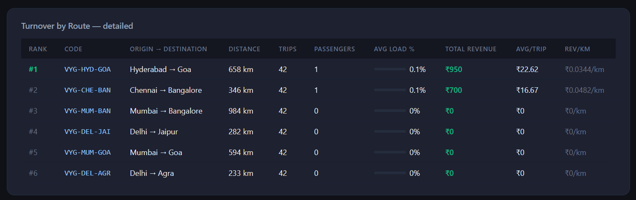
AI based Multi Agent System
Dashboard

Slide 21
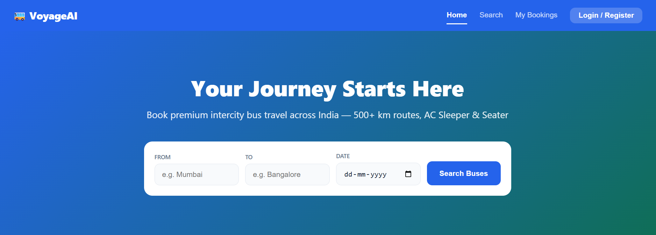
AI based Multi Agent System
Dashboard

Slide 22
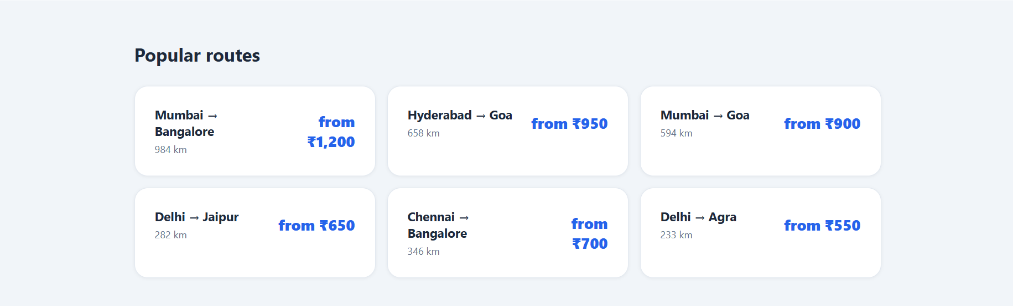
AI based Multi Agent System
Dashboard

Slide 23
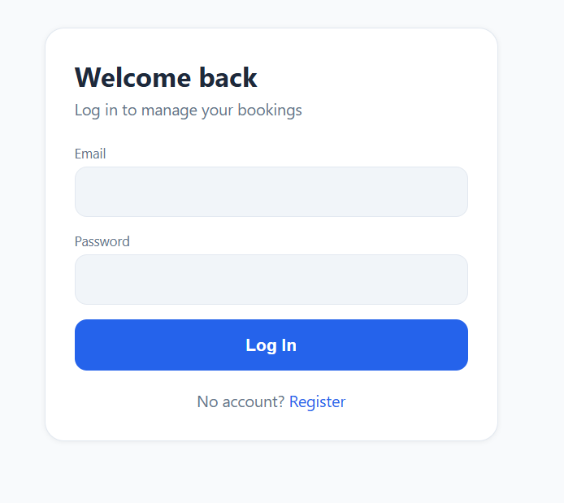
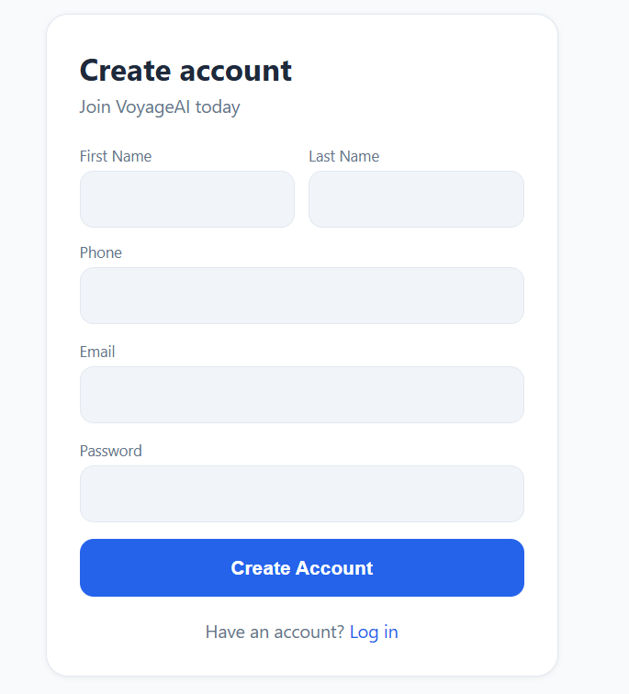
AI based Multi Agent System
Dashboard

Slide 24
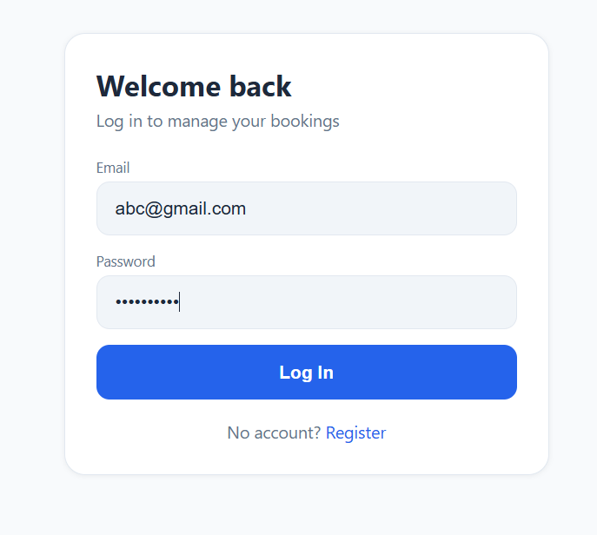
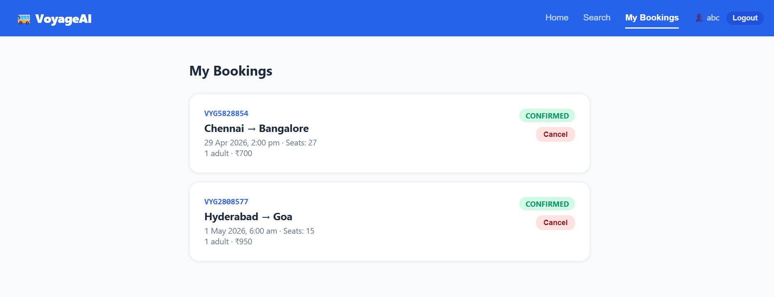
AI based Multi Agent System
Dashboard

Slide 25
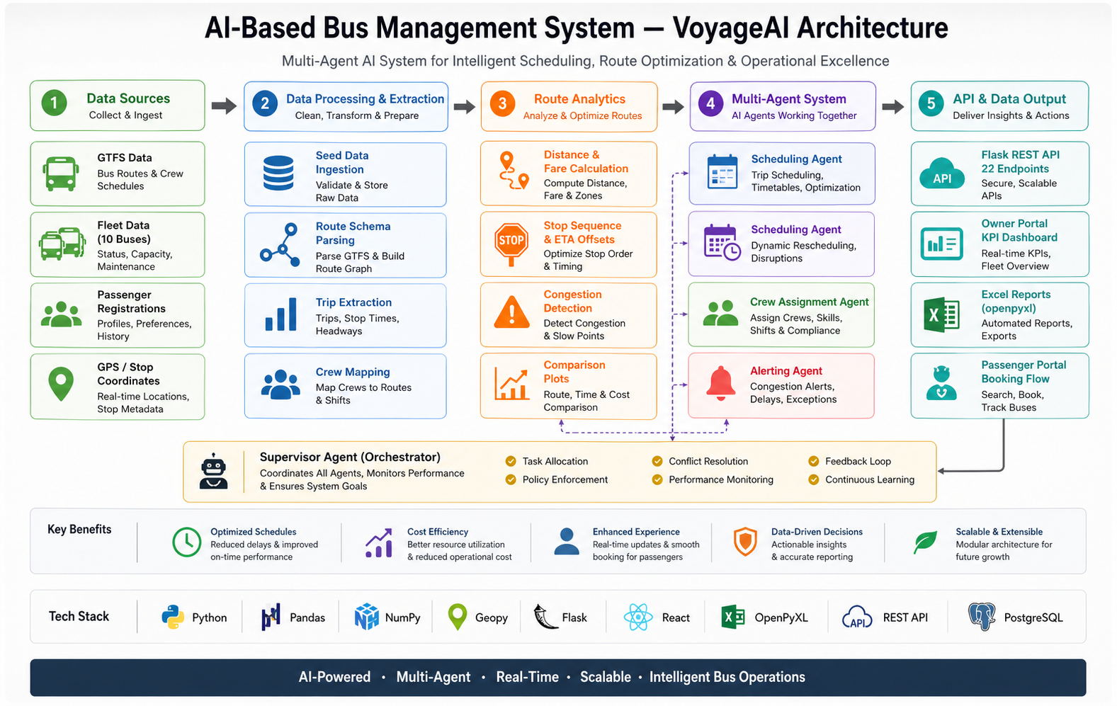
AI based Multi Agent System
Approach/Algorithms/Tools

Slide 26
AI based Multi Agent System
Project Repository Link
https://github.com/sahilmehta0502/voyage

Slide 27
AI based Multi Agent System
Conclusion
Automated bus scheduling and crew assignment using a data-driven, multi-agent AI approach — 614 trips scheduled across 6 routes with 100% rule compliance.
Achieved 100% crew allocation with optimized resource utilization — distance-tier logic (short/medium/long) and rest-rule enforcement via CrewAgent.
Ensured efficient scheduling with all constraints satisfied — 5-hour gap rule, seat conflict detection, fare computation, and cancellation cascade.
Identified load factor hotspots for improved operational planning — trips exceeding 90% load factor flagged by AnalyticsAgent.
Demonstrated a scalable, practical solution for real-world transport systems — Owner Portal (7 pages) + Passenger Portal (full booking flow) + Excel exports.

Slide 28
AI based Multi Agent System
Future Scope
Integration with real-time GPS tracking for live bus monitoring — passengers see exact bus location and updated ETA on Leaflet map.
Implementation of AI/ML models for demand prediction and route optimization — dynamic departure frequency based on historical load data.
Development of dynamic scheduling based on real-time traffic conditions — RouteAgent to consume live Google Maps / OSRM data.
Mobile application for passenger and operator interaction — React Native app with push notifications for booking updates.
Cloud deployment (AWS/GCP) for scalable system performance — PostgreSQL on RDS, backend on EC2/Cloud Run, portals on Vercel/Cloudfront.
Continuous improvement using adaptive learning and feedback mechanisms — CrewAgent to learn from historical rest violations.

Slide 29
AI based Multi Agent System
Acknowledgement
I would like to express my sincere gratitude to NMIMS University and the M.Tech (Artificial Intelligence) Program for providing me with the opportunity to work on this project. I am deeply thankful to my faculty guide for their continuous guidance, valuable feedback, and support throughout the development of this system. I also extend my appreciation to the industry mentors and peers for their insights, collaboration, and encouragement. Their support and guidance played a crucial role in the successful completion of this project.

Slide 30
Thank You

