Slide 1


M.Tech Program
Advanced Industry Integrated Programs
Jointly offered by University and LTIMindTree
Agentic AI-Based Multi-Agent System for Automated Bus Scheduling, Crew Management, and Route Optimization
By
Sahil Mehta
Knowledge partner | Implementation partner

Slide 2
AI based Multi Agent System
Problem Statement
Modern public transportation systems require efficient bus scheduling, crew management, and route planning to maintain reliable service. However, traditional systems rely on static schedules and manual planning, making them unable to quickly adapt to real-time disruptions such as traffic congestion, fluctuating passenger demand, vehicle breakdowns, and crew availability.
Poor coordination between scheduling, routing, and crew allocation often leads to delays, bus bunching, inefficient resource utilization, and increased operational costs. With growing urban populations and mobility demands, there is a need for an intelligent system that can dynamically optimize transit operations and improve service reliability.

Slide 3
AI based Multi Agent System
Objective
Automated Bus Scheduling: Generate efficient bus schedules using intelligent agents to ensure timely and reliable public transport operations.
Optimized Route Planning: Analyze traffic patterns and demand data to design efficient routes and minimize travel time and congestion.
Crew Management: Allocate drivers and crew members while considering duty hours, rest periods, and labor regulations.
Real-Time Disruption Handling: Dynamically adjust schedules and routes in response to traffic congestion, vehicle breakdowns, or demand fluctuations.
Operational Efficiency Improvement: Enhance overall transport system performance by reducing operational costs, improving schedule reliability, and optimizing route coverage.

Slide 4
AI based Multi Agent System
Datasets used
GTFS Data (BMTC / Transport Data)
Stops
Trips
Stop times
Location Records
Latitude
Longitude
Timestamp
Crew Dataset
Availability
Base locations

Slide 5
AI based Multi Agent System
Methodology/Modeling Plan
Data Ingestion: GTFS static data (stops, trips, stop times) and real-time GPS feeds (latitude, longitude, timestamp) are collected and integrated into the system.
Trip Extraction: A LocationAgent processes GPS records to map vehicle movements and extract valid trips based on spatial-temporal patterns.
Scheduling: A SchedulingAgent analyzes trip frequency, travel time, and demand patterns to generate optimized timetables.
Crew Assignment: A CrewAgent assigns drivers and conductors based on availability, shift constraints, and base locations.
Dashboard & API Output: Processed data is exposed via APIs and visualized through dashboards for monitoring routes, schedules, and operational efficiency.

Slide 6
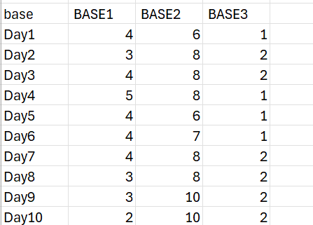
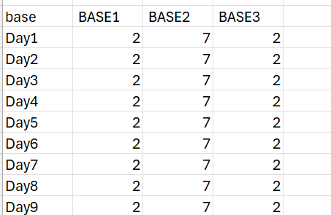
AI based Multi Agent System
Initial Data (Crew)

Slide 7
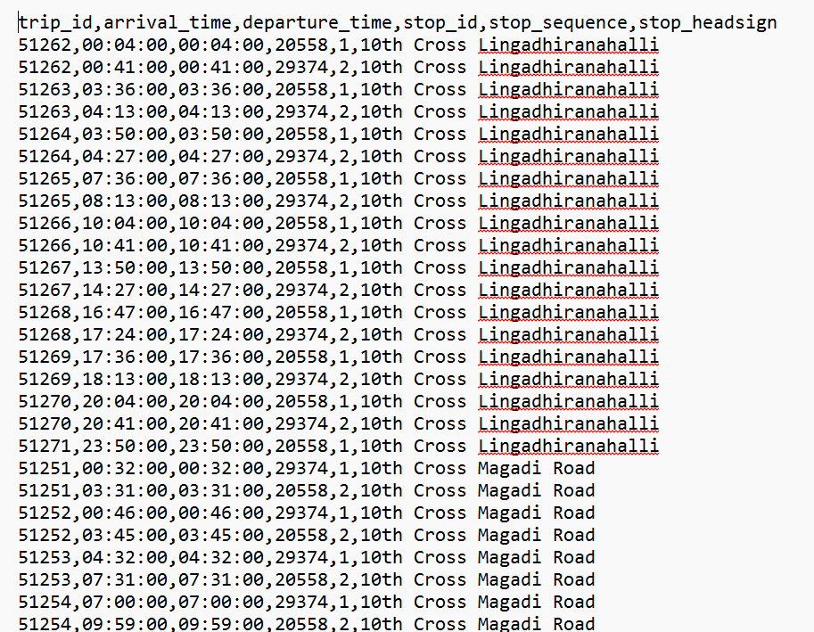
AI based Multi Agent System
Initial Data (location/trips)

Slide 8
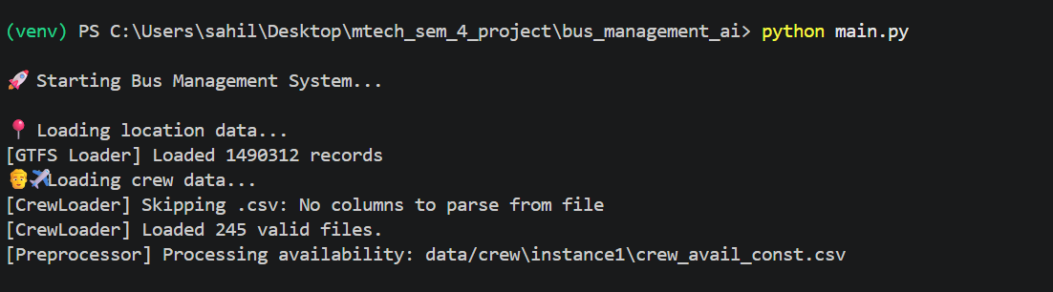
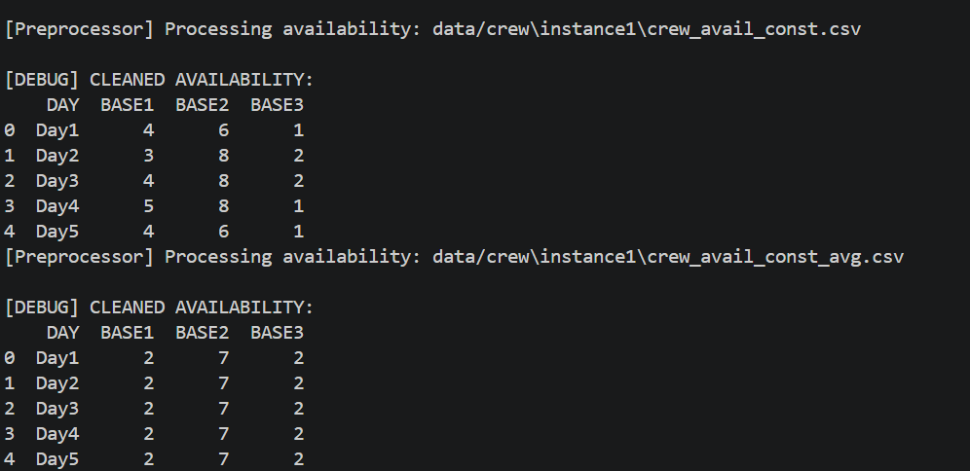
AI based Multi Agent System
Implementation

Slide 9
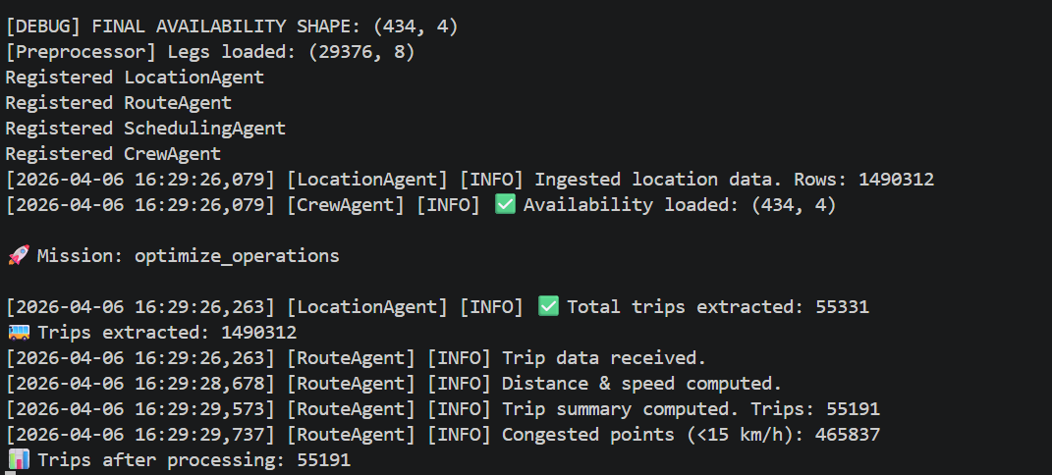
AI based Multi Agent System
Implementation

Slide 10
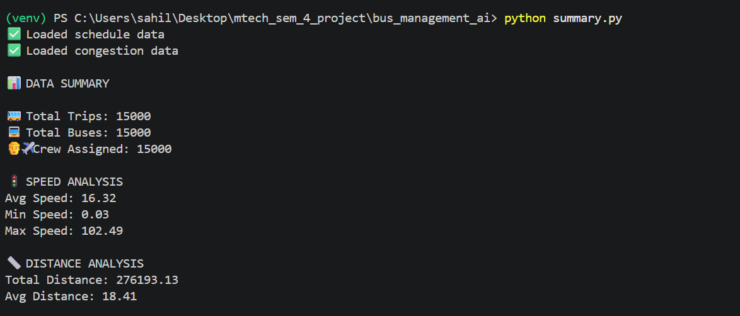
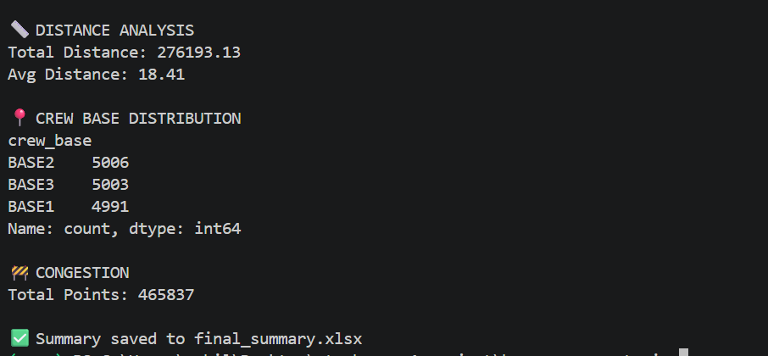
AI based Multi Agent System
Summary

Slide 11
AI based Multi Agent System
Approach/Algorithms/Tools
Trip Extraction & Processing: Extract trips from GPS/GTFS data using time-series grouping and sorting techniques.
AI-Based Scheduling Optimization: Generate optimized schedules using constraint-based logic (minimum trip duration, global time gaps, and route spacing).
Congestion Detection Algorithm: Identify traffic congestion by detecting low-speed segments (threshold-based filtering, e.g., < 15 km/h).
Multi-Agent System Architecture: Use specialized agents (LocationAgent, RouteAgent, SchedulingAgent, CrewAgent) coordinated via a SupervisorAgent for modular processing.

Slide 12
AI based Multi Agent System
Approach/Algorithms/Tools
Python & VS Code: Core system development implemented in Python using VS Code as the primary IDE.
Pandas & NumPy: Used for data preprocessing, transformation, and large-scale data handling
Flask API: Backend API for serving processed data (dashboard metrics and schedule output)
GTFS Data (General Transit Feed Specification): Used for structured public transport data including stops, routes, and trip information.
Excel Reporting (Pandas): Export of schedule and congestion data into Excel for analysis and reporting

Slide 13
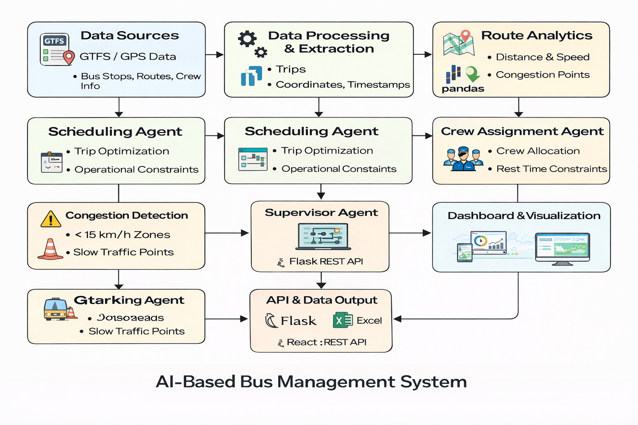
AI based Multi Agent System
Approach/Algorithms/Tools

Slide 14
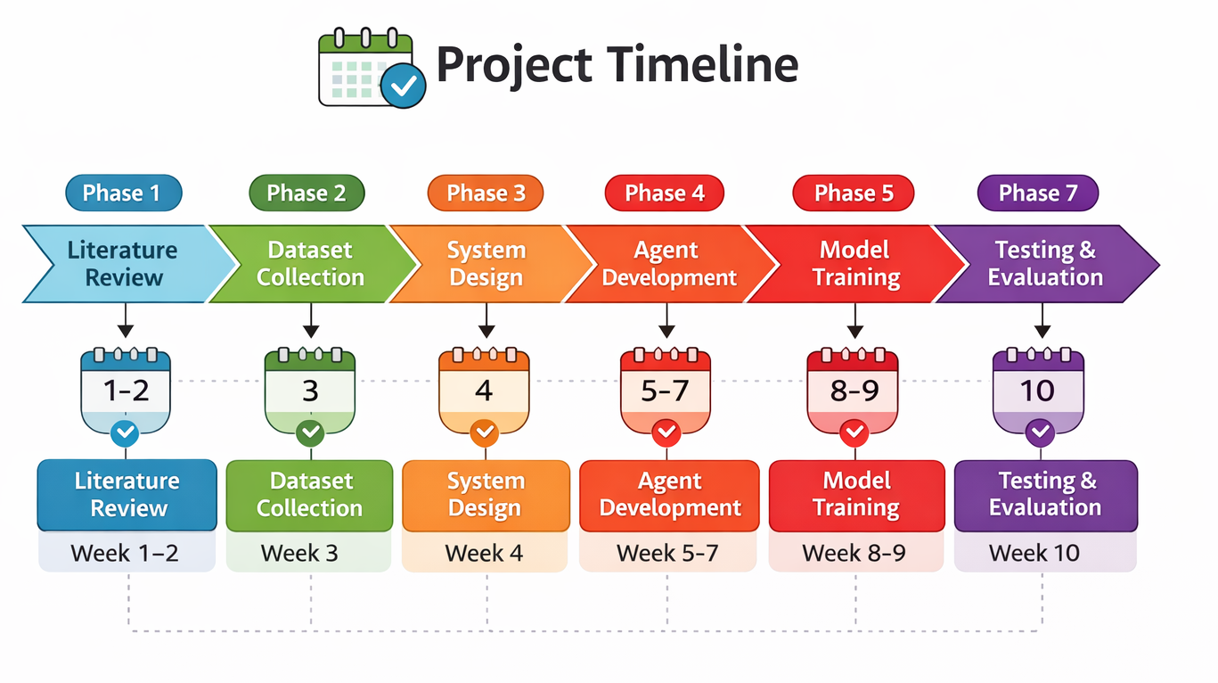
AI based Multi Agent System

Slide 15
Thank You

