Slide 1
CS118 Project 2 Demo
By Arpit Jasapara and Sahil Gandhi

Slide 2
Implementation Description
Implemented basic 1-packet send via UDP
Implemented multiple packet file send and file reconstruction
Created TCP Header
Using windows on both sides, send packets with headers
Added retransmission and timeouts to combat packet loss
Set up TCP handshake and closing
(EXTRA CREDIT) Added congestion control by detecting packet loss and adjusting window size

Slide 3
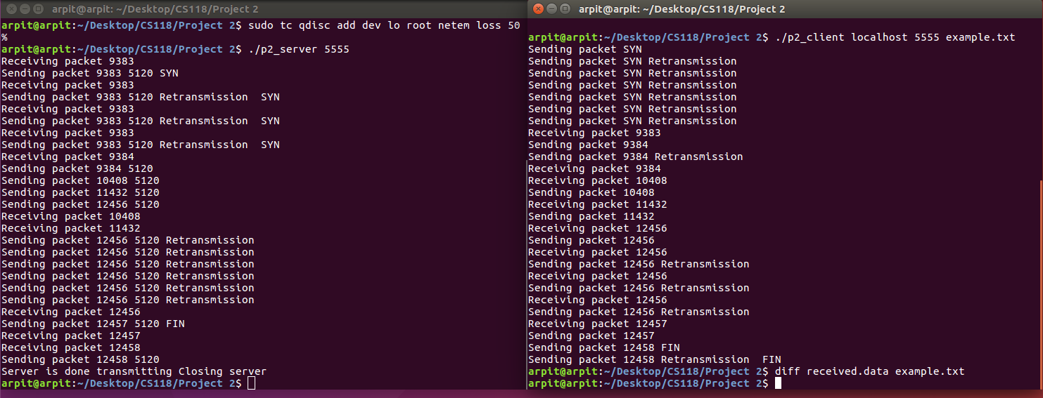
Program in Action with Retransmission

Slide 4
Difficulties we faced
Retransmission
Delayed/duplicate packets
Missing ACKs
Out-of-order packets
Congestion control
Detecting congestion
Communicating with client so both windows adjusted
Changing window size

Slide 5
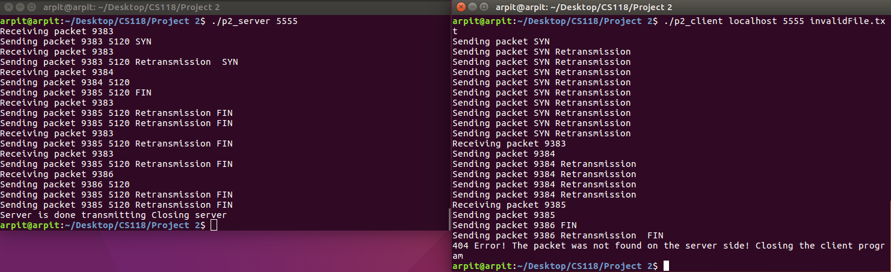
Additional Screenshots

Slide 6
Experiences Gained
Using GIT to manage workload
Doing socket communication in C++ (barely touched on this before in other classes)
Debugging very very large programs
Incremental design

Slide 7
Lessons Learned and Suggestions
Lessons learned:
Start early!
Plan carefully
Make lots of helper functions and abstract code out (make it clean)
Future Suggestions:
Discard the regular credit and just do the EC (the actual congestion control)
More assistance and planning during discussions sections?
Balance of projects between P1 and P2 perhaps

Slide 8
Questions?

Slide 9
Thank you for your time!

