Slide 1
Vehicle to Vehicle Communication Protocols: Creating a Safer Commute
By: Sahil Gandhi
Lab 4, Fall 2016
TA: Thuy Vu

Slide 2
Problem
94% of all crashes due to human error [1]
Difficult to train human beings to:
Not look at phone
Not get distracted
Not be stressed
Not be intoxicated
Semi-autonomous makes it worse
Even less focus on road

Slide 3
Solution
Constant factor on road – the car
Press pedal = accelerate
Press brake = slow/stop
Turn steering = turn left/right
Far easier to control -> V2V comm.
Dedicated Short Range Communication (DSRC)
Exchange data (speed, location, etc.)
10 messages per car per second up to 1000 feet [1]

Slide 4
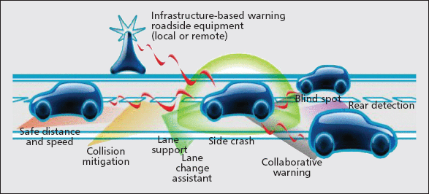
Pros of V2V Comm.
Collision Detection -> Car A colliding into Car B:
Slow Car A, speed Car B to avoid hit
Accident Mitigation:
Use above step to avoid accident
Else: signal cars behind to slow down
Assist in changing lanes to block a jam
Reduce commute times greatly in cities
Even more benefits to be found!

Slide 5
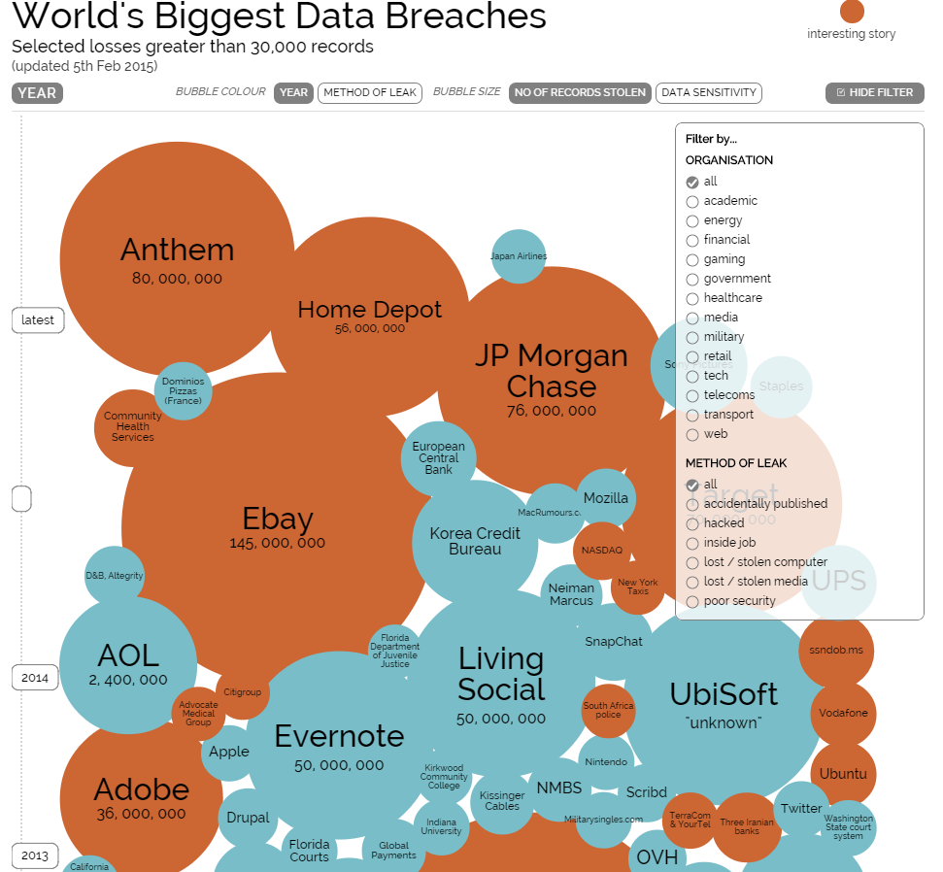
Cons of V2V Comm.
More connected devices = more security needed
Difficult to maintain security -> Latest IOT Hack is example!
Lots of data generated and transmitted
Can be an intrusion of privacy
Other unintended side effects
People more distracted than ever
Can control be passed to user safely?

Slide 6
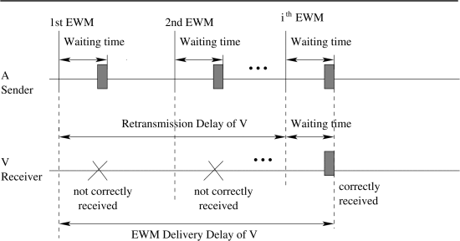
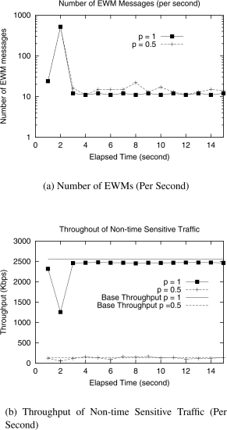

Current Research
Dealing with signal propagation delay:
Hardware plus software can create these delays
Modeled by: $λ=arrival rate of messages,$
$μ=rate at which channel can process messages$
$Delay_{wait}=\frac{1}{μ−λ}+\frac{1}{μ}$ [4].
Separate queues for different messages
EWMs in a priority queue [4]
Deal with EWMs first till event is over
Sensitive information processed first
Safer handling + less delays

Slide 7
Conclusion
V2V still needs much research
Obstacles: Privacy + Security
Benefits: Safer roads, less accidents!
Google, Tesla, Uber, etc. working on it!
Semi-autonomous/autonomous != V2V!

Slide 8
Questions?

Slide 9
References
[1] Peng, Huei. "Saving Lives by Letting Cars Talk to Each Other." The Conversation. N.p., 11 Sept. 2016. Web. 16 Nov. 2016. <https://theconversation.com/saving-lives-by-letting-cars-talk-to-each-other-59221>
[2] Papadimitratos, Panos, et al. "Vehicular communication systems: Enabling technologies, applications, and future outlook on intelligent transportation." IEEE Communications Magazine 47.11 (2009): 84-95. <http://ieeexplore.ieee.org/document/5307471/?arnumber=5307471> DOI = 10.1109/MCOM.2009.5307471
[3] Sander, Jason. "History’s Worst Data Breaches." CloudTweaks. N.p., 23 Feb. 2015. Web. 20 Nov. 2016. <http://cloudtweaks.com/2015/02/historys-worst-data-breaches/>.
[4] Yang, Xue, et al. "A vehicle-to-vehicle communication protocol for cooperative collision warning." Mobile and Ubiquitous Systems: Networking and Services, 2004. MOBIQUITOUS 2004. The First Annual International Conference on. IEEE, 2004. <http://ieeexplore.ieee.org/document/1331717/?arnumber=1331717&tag=1> DOI = 10.1109/MOBIQ.2004.1331717

