Slide 1

FROM RAW DATA
to a clean,
analysis-ready dataset
AUDIBLE
DATA CLEANING
A 9-point Power Query case study covering text standardization, author and narrator splitting, dates, durations, prices, ratings and column merging.
Power Query • Excel • Data Preparation
A practical transformation project turning raw audiobook fields into consistent, analysis-ready data.
09 CLEANING TASKS
POWER QUERY
READY
All case-study requirements completed.
Repeatable transformation workflow.
Structured fields for analysis.
Project presentation

Slide 2
Project Overview
Audible • Power Query
02
Project objective
Clean and standardize the Audible audiobook dataset so inconsistent text, dates, durations, prices and ratings become reliable fields for analysis.
INPUT
TRANSFORM
OUTPUT
Raw audiobook data containing mixed formats and embedded information.
Power Query operations: Format, Split, Extract, Replace, Custom Column, Merge and Data Type.
Consistent, analysis-ready columns with appropriate data types.
What the project demonstrates
• Standardizing text without manual row-by-row editing
• Separating combined values using delimiters
• Using locale-aware date conversion
• Converting descriptive durations into structured values
• Handling errors before numeric analysis

Slide 3
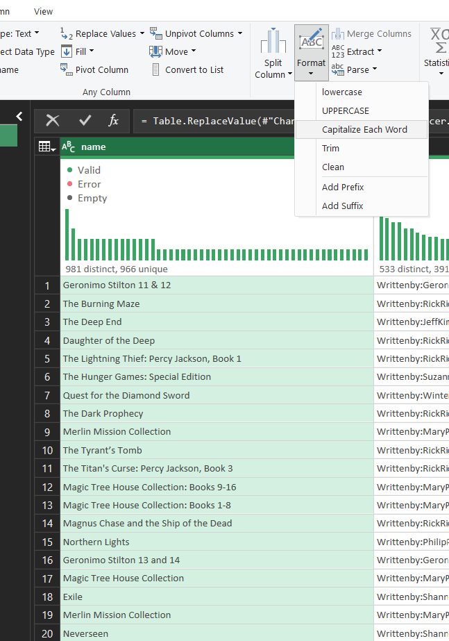
01 • Standardize the Name Column
Text formatting
03
What was done
The name field was standardized with Capitalize Each Word so book titles follow a consistent title-case convention.
WHY IT MATTERS
Consistent casing improves readability and prevents the same title from appearing as different text values because of capitalization.
POWER QUERY OPERATION
Book names now follow a consistent presentation standard, making filtering, grouping and reporting cleaner.
RESULT
Format → Capitalize Each Word

Slide 4
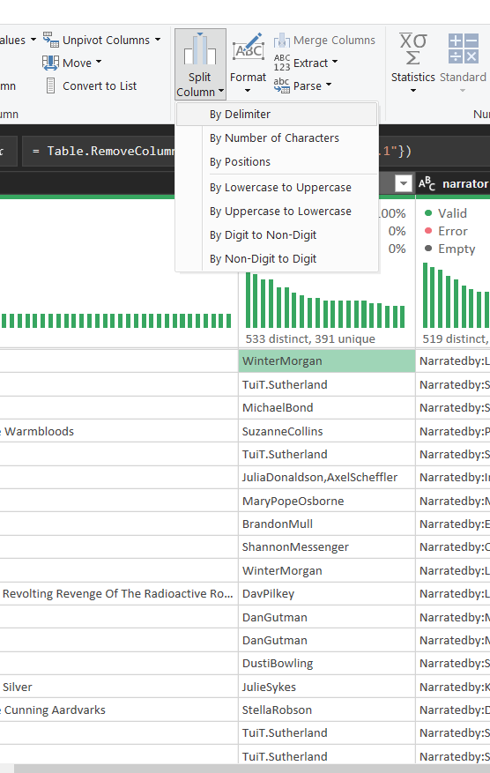
02 • Separate Multiple Authors
Step 1 — choose the split method
04
What was done
The author column was selected and Split Column → By Delimiter was used. This is the correct approach when multiple authors are encoded inside one text field.
WHY IT MATTERS
A delimiter-based split converts a combined field into separate columns instead of leaving several contributors embedded in one string.
POWER QUERY OPERATION
The first step defines how Power Query should break the author string.
RESULT
Split Column → By Delimiter

Slide 5
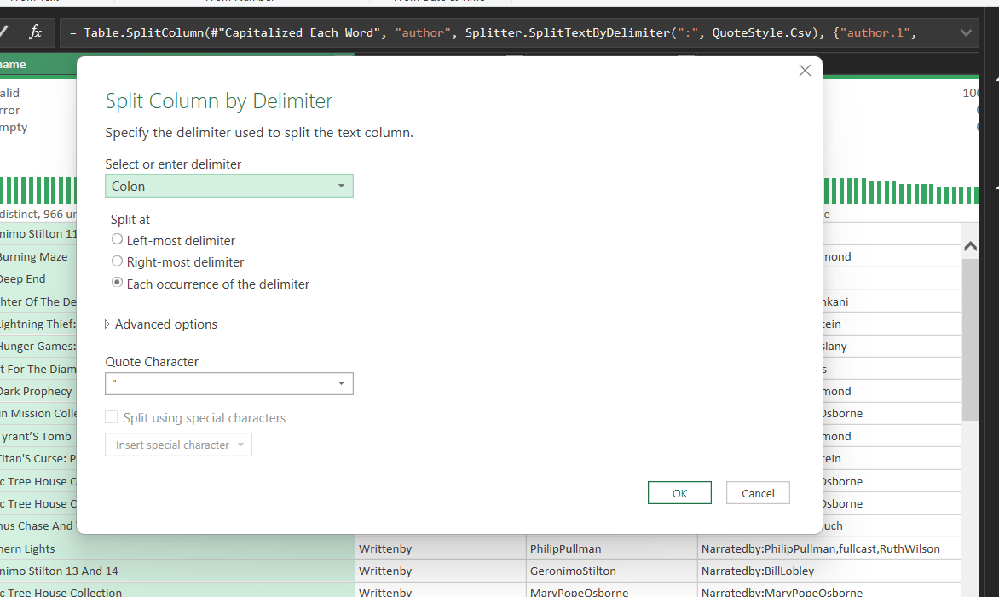
02 • Separate Multiple Authors
Step 2 — use the colon delimiter
05
What was done
The delimiter was set to a colon (:), matching the structure of the author values in the dataset.
WHY IT MATTERS
Choosing the delimiter that actually separates contributors is essential; the wrong delimiter would fragment names incorrectly.
POWER QUERY OPERATION
Power Query identifies each colon as a boundary between author entries.
RESULT
Delimiter = Colon

Slide 6
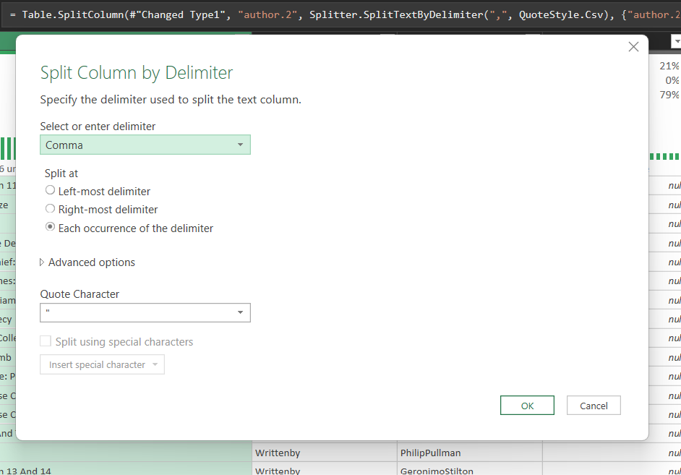
02 • Separate Multiple Authors
Step 3 — create separate author fields
06
What was done
The split operation produces separate author columns such as author.1, author.2, author.3 and author.4 where values exist.
WHY IT MATTERS
Separate fields make each contributor independently filterable and easier to profile or analyze.
POWER QUERY OPERATION
Combined author information is normalized into multiple analysis-friendly columns.
RESULT
Split at each occurrence of the delimiter

Slide 7
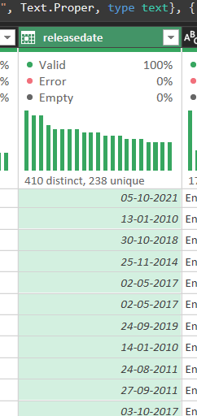
03 • Standardize Release Dates
Locale-aware date conversion
07
What was done
The releasedate column was checked after cleaning. The values are already standardized in the required DD-MM-YYYY format, so no further date-format conversion is needed.
WHY IT MATTERS
A consistent DD-MM-YYYY format makes the date field easy to read, sort, filter and use in analysis.
POWER QUERY OPERATION
Result: no additional transformation is required because the cleaned values already follow DD-MM-YYYY.
RESULT
Format check → DD-MM-YYYY already present

Slide 8
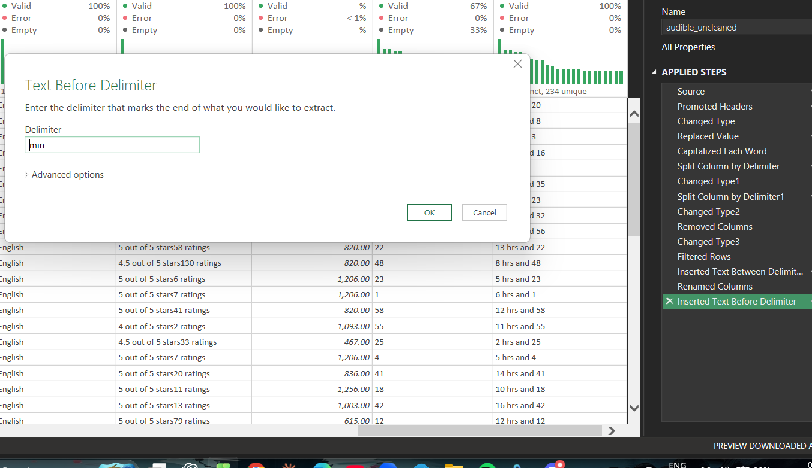
04 • Convert Time Text into Duration
Step 4 — merge the duration components
08
What was done
The extracted components were combined into a single merged duration representation, producing values that Power Query can recognize as time/duration data.
WHY IT MATTERS
Once structured, durations can be sorted, compared and used in analysis instead of remaining plain text.
POWER QUERY OPERATION
The dataset contains a dedicated structured time-duration field.
RESULT
Merge Columns + Duration data type

Slide 9
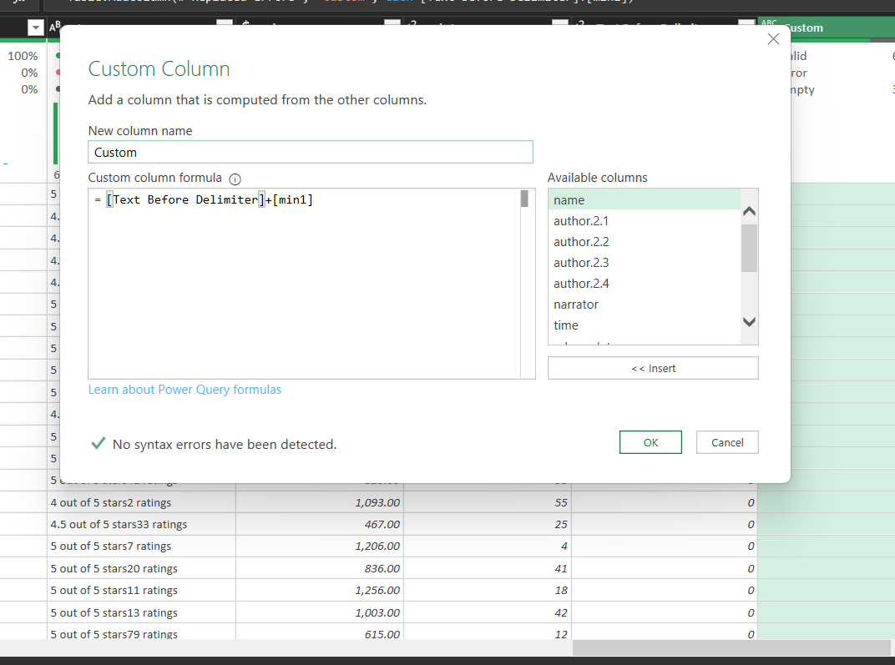
04 • Convert Time Text into Duration
Step 1 — build the hour component
09
What was done
The raw time text was transformed using a Custom Column. The hour portion was extracted and combined with the minute component being prepared.
WHY IT MATTERS
Descriptive text such as “2 hrs and 20 mins” cannot be reliably calculated until its components are structured.
POWER QUERY OPERATION
A structured intermediate value is created for the final duration transformation.
RESULT
Custom Column

Slide 10
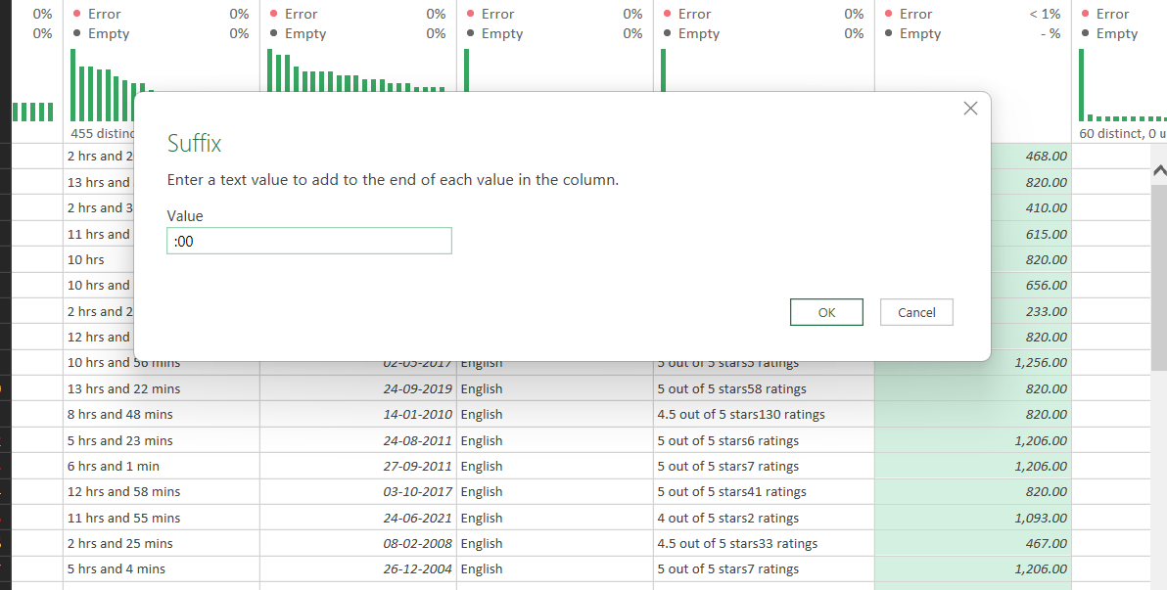
04 • Convert Time Text into Duration
Step 2 — add the seconds component
10
What was done
A “:00” suffix was added to complete the time-style structure, supplying the seconds component.
WHY IT MATTERS
Adding the missing component creates a consistent machine-readable time pattern.
POWER QUERY OPERATION
The intermediate text now follows a consistent time representation.
RESULT
Format → Add Suffix

Slide 11
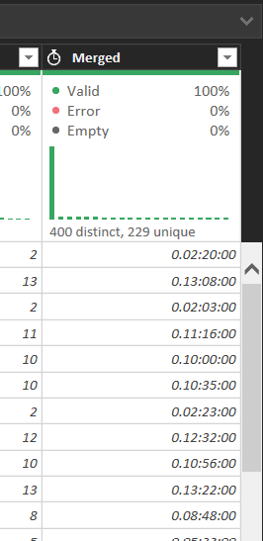
04 • Convert Time Text into Duration
Step 3 — extract the minute component
11
What was done
The minute portion was extracted from the original descriptive string using Text Before Delimiter with “out” as the delimiter in the transformation shown.
WHY IT MATTERS
This separates the numeric component from surrounding words so it can be combined into a duration value.
POWER QUERY OPERATION
The minute value is isolated for use in the final duration field.
RESULT
Extract → Text Before Delimiter

Slide 12
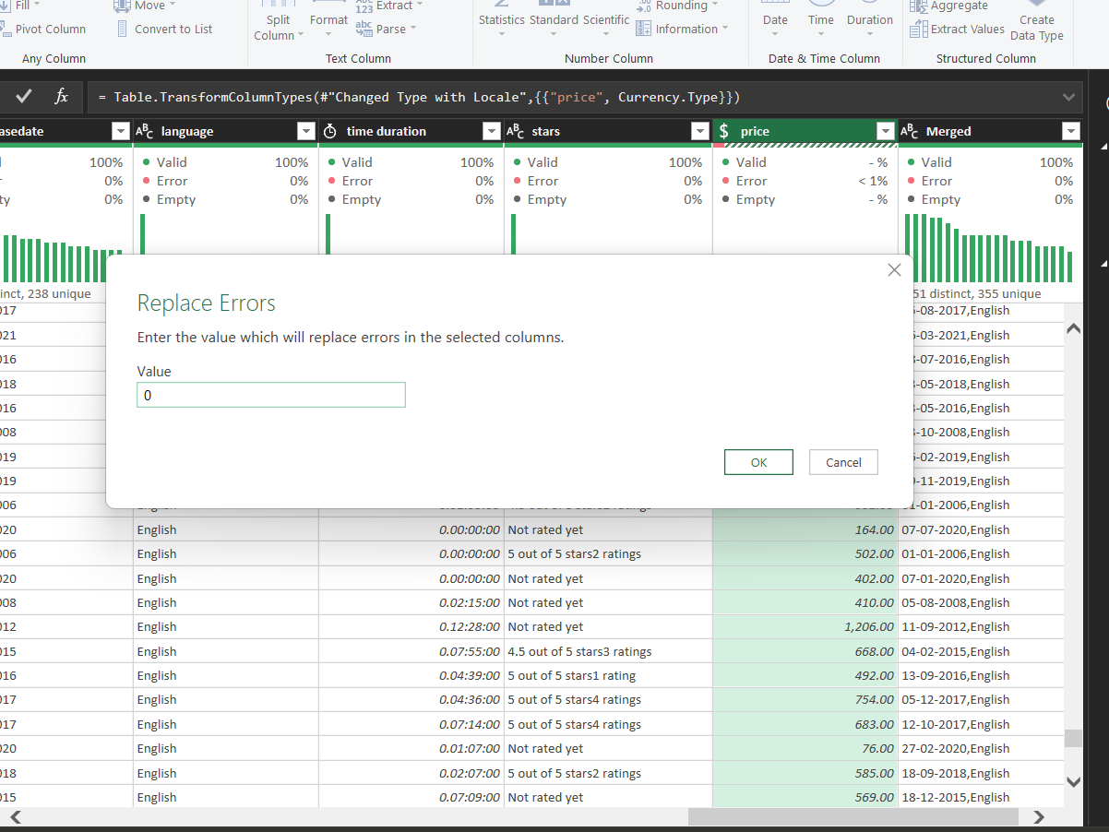
05 • Clean the Price Column
Numeric conversion & error handling
12
What was done
The price field was converted toward a numeric/currency-compatible type. Conversion errors were identified and handled rather than leaving mixed text and numeric values.
WHY IT MATTERS
Numeric typing is required for totals, averages, sorting and other financial calculations.
POWER QUERY OPERATION
The price column is prepared as a numeric field and invalid entries are explicitly handled.
RESULT
Change Data Type + Replace Errors

Slide 13
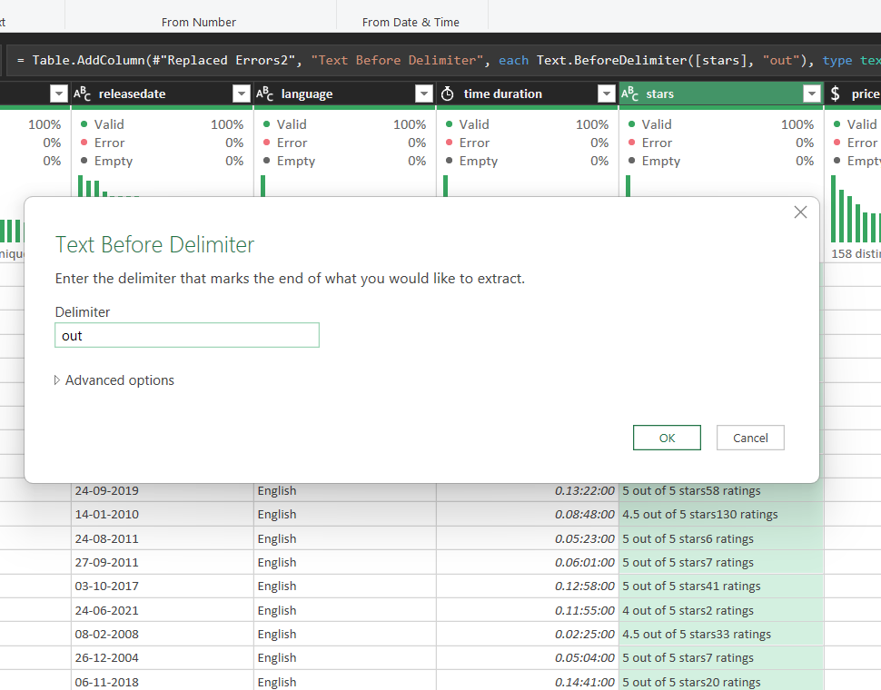
06 • Convert Star Ratings to Numbers
Step 1 — extract the numeric rating
13
What was done
The original stars field contains descriptive text such as “5 out of 5 stars…”. Text extraction was used to isolate the rating value.
WHY IT MATTERS
Analysis needs the numeric rating itself, not the surrounding descriptive phrase.
POWER QUERY OPERATION
The rating portion is separated from the descriptive text.
RESULT
Text Before Delimiter

Slide 14
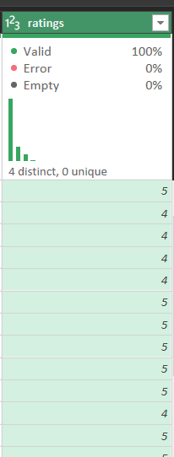
06 • Convert Star Ratings to Numbers
Step 2 — confirm the numeric result
14
What was done
The resulting rating field contains numeric values such as 4 and 5, with the column shown as a numeric type.
WHY IT MATTERS
Numeric ratings can now be averaged, grouped and compared statistically.
POWER QUERY OPERATION
The stars field is analysis-ready as a numeric rating.
RESULT
Data Type → Whole Number

Slide 15
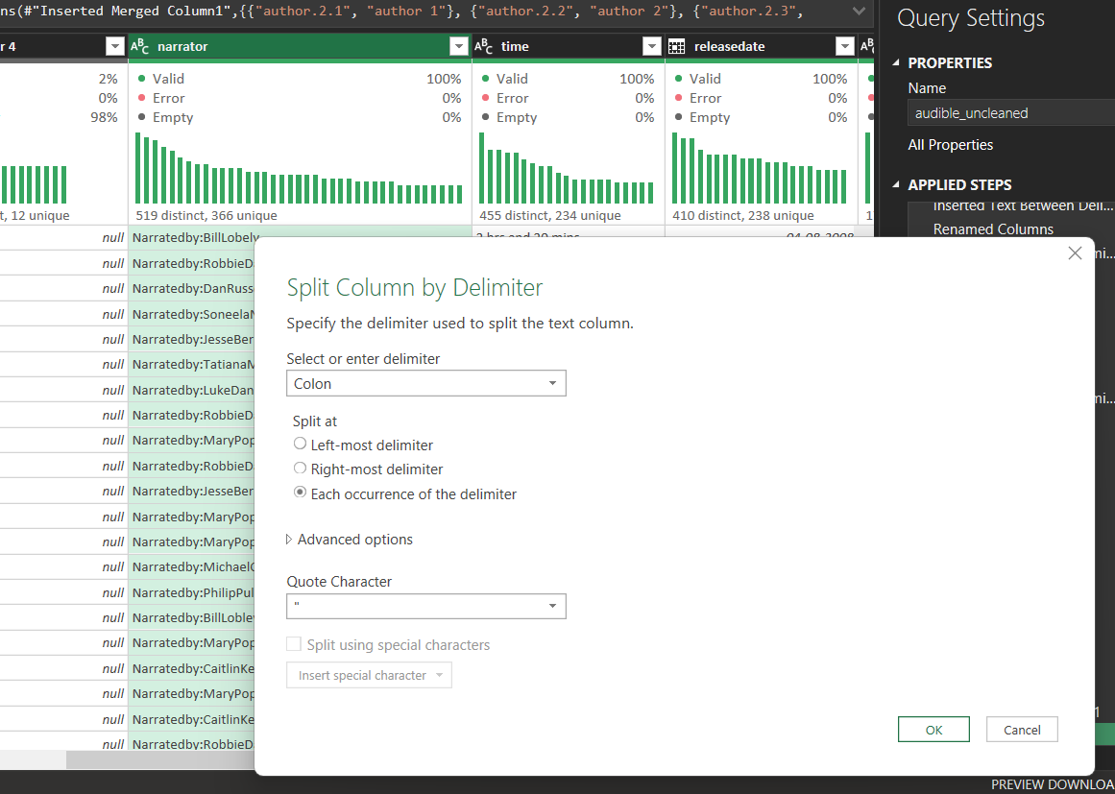
07 • Split the Narrator Column
Normalize multiple narrators
15
What was done
The narratedby field was split using its delimiter so multiple narrators are stored in separate columns.
WHY IT MATTERS
One narrator per field makes the dataset easier to filter, count and analyze without parsing a long combined string.
POWER QUERY OPERATION
Narrator 1, Narrator 2, Narrator 3 and Narrator 4 fields can be handled independently.
RESULT
Split Column → By Delimiter (Colon)

Slide 16
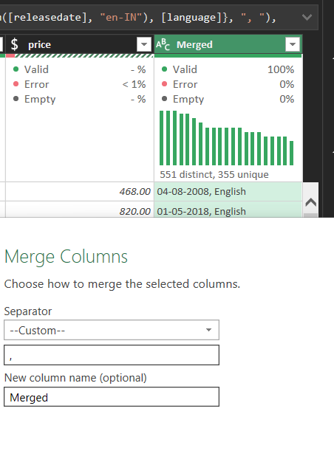
08 • Create the Release Info Column
Merge date + language
16
What was done
The releasedate and language columns were merged into one new field named releaseinfo.
WHY IT MATTERS
A combined descriptive field provides a compact way to display release date and language together while the original fields can remain available.
POWER QUERY OPERATION
The target structure is DD-MM-YYYY, Language — for example, “04-08-2008, English”.
RESULT
Merge Columns → Custom separator

Slide 17
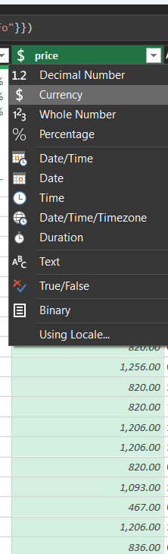
09 • Apply the Final Price Data Type
Numeric / currency formatting
17
What was done
After error handling, the price field was assigned an appropriate numeric data type. Currency is suitable when the values represent monetary amounts.
WHY IT MATTERS
Correct typing ensures the column participates correctly in calculations, sorting and analysis.
POWER QUERY OPERATION
The final price field is typed consistently and ready for downstream analysis.
RESULT
Data Type → Currency / Decimal Number

Slide 18
PROJECT COMPLETE
TEXT
Standardized and split
A cleaner dataset.
A stronger foundation for analysis.
DATE / TIME
Typed and structured
The nine cleaning requirements were addressed through a reproducible Power Query workflow rather than manual edits.
NUMERIC
Errors handled
COLUMNS
Merged / normalized
Audible Data Cleaning Project • Power Query • Excel

