Slide 1
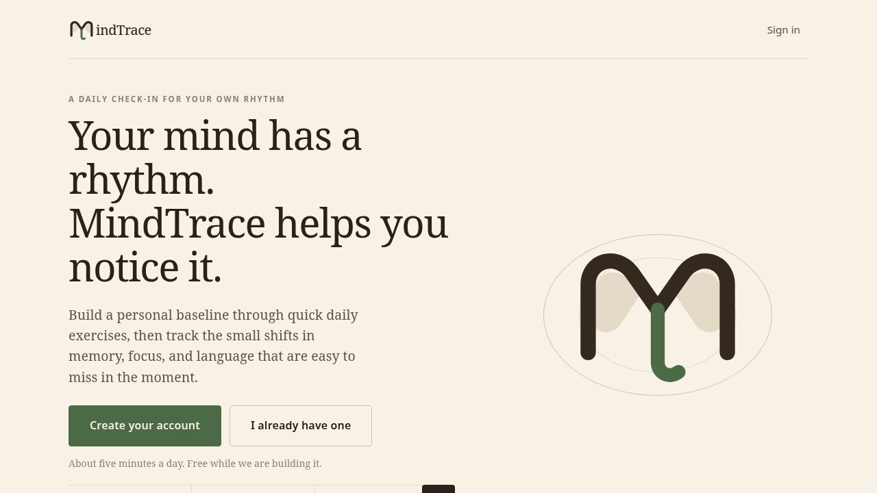
MINDTRACE
Your mind has
a rhythm.
A five-minute daily cognitive check-in that compares you to you — not to a population average.
PRODUCT PITCH
Problem · Product · Market · Model
MindTrace is a wellness tracker, not a diagnostic tool.
MindTrace
01

Slide 2
THE PROBLEM
People notice changes long before they have evidence.
The current choices do not answer the question: “Is this different from how I usually am?”
01
02
03
IGNORE IT
ASK A DOCTOR
TRY A BRAIN APP
Most people wait, normalize the change, and carry the worry alone.
A one-time screen is designed to catch impairment, not explain everyday variation.
Practice makes the score rise, so improvement may measure familiarity rather than cognition.
The missing product: consumer-accessible tracking that separates a bad day from a sustained personal pattern.
MindTrace
02

Slide 3
THE SOLUTION
A daily check-in built around personal context.
MindTrace combines how you feel with how you perform, then tracks the pattern over time.
1
Check in
Sleep, mood, stress, energy & caffeine
2
Play
Three short cognitive games
3
Understand
See today in the context of your own history
Live MVP
Accounts, daily check-ins, games, dashboard, achievements, friends and export.
Five minutes. Once a day. Private by design.
MindTrace
03

Slide 4
THE GAME
Three quick tasks create a fuller picture.
Each game probes a different cognitive domain; one is enough, all three are better.
01
02
03
SYMBOL MATCH
WHAT’S IN A SYMBOL?
WORD FILL
Focus + processing
Short-term memory
Language + context
Find the one symbol shared across two changing cards.
Remember which symbols appeared a moment ago.
Complete ordinary sentences with the word that fits.
Designed to measure consistency, not to “train” a score upward.
MindTrace
04

Slide 5
WHY IT WORKS
The comparison is personal — not population-based.
Daily context helps explain ordinary dips before they become alarming.
BASELINE BUILDING
ACTIVE TRACKING
1
2
3
4
5
6
7
8
9
10
11
12
13
14
15+
Days 1–7
Days 8–14
Day 15 onward
Practice settles
Personal range forms
Compare against you
Context first
Conservative patterns
Calibrated language
Sleep, mood and stress can explain an off day.
Repeated changes matter more than one result.
“Below your usual range” — never a diagnosis.
MindTrace
05

Slide 6
MARKET
A large consumer need with a focused initial segment.
Bottom-up US estimates from the attached MindTrace business case.
TAM
SAM
SOM · Y3
$1.8B
$180M
$11.0M
30M concerned adults × $60/year
3.0M able and willing to pay
150k subscribers + 250 sites
WHO WE START WITH
Adults 55–75
Adult children
Institutions
The “worried well” with family history
Buying reassurance for a parent
Libraries, senior living and senior centres
MindTrace
06

Slide 7
BUSINESS MODEL
Free baseline. Paid value after there is something to show.
A hybrid B2C + B2B2C model balances direct demand with trusted distribution.
FREE
PLUS
FAMILY
INSTITUTION
$0
$59.99 / yr
$99 / yr
$800–$3,600 / yr
14-day baseline
30-day history
Unlimited history
Trends, flags & export
3 profiles
Consent-based sharing
On-site accounts
Training & reporting
ARPU
$54/yr
Gross margin
88%
LTV / CAC
4.3×
Paywall
Day 15
MindTrace
07

Slide 8
GO-TO-MARKET
Start where trust and routine already exist.
Libraries and senior-living communities can lower acquisition cost and help users reach day 15.
CHANNEL
ROADMAP
1
Pilot
3 libraries + 2 communities
12 weeks · 20–40 participants each
NOW
Working MVP
Accounts, persistence, check-ins, games and dashboard
NEXT
Demand validation
Interviews + waitlist + retention test
2
Prove retention
Success: ≥60% reach day 15
≥40% active at week 10
4–8 MO
Institution pilots
5 sites · 150 participants · 12 weeks
3
Scale references
6–15 MO
Validate & launch
200-person study → first paid contracts
Institutional proof → consumer trust
and repeatable site sales
MindTrace
08

Slide 9
THE ASK
Help us turn a working game
into validated peace of mind.
Pilot partners
Clinical guidance
User learning
Libraries and senior-living communities
A neuropsychologist + validation partner
Adults 55–75 who will complete 14 days
“We are not diagnosing anyone.”
We are helping people build the evidence to have the right conversation earlier.
MindTrace · mindtrace.app · Thank you
MindTrace
09

