Slide 1
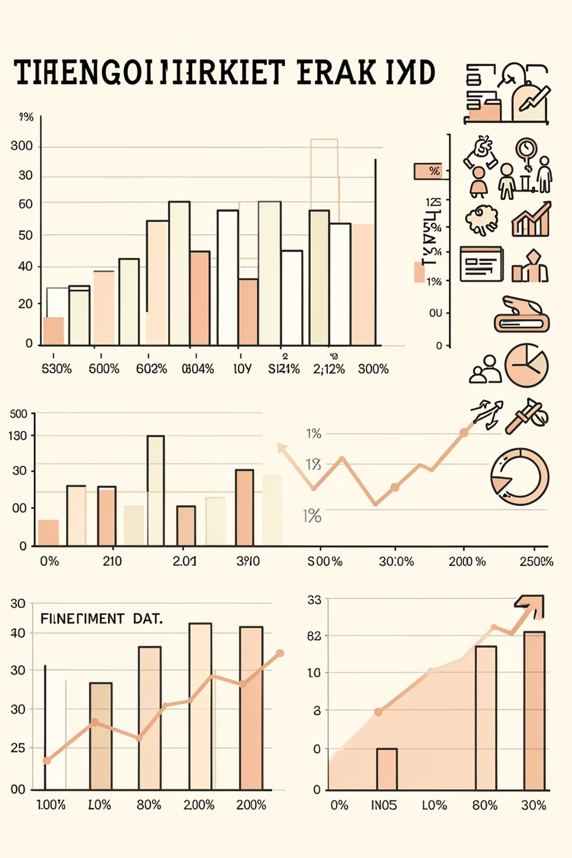
Trader Behavioral Analysis: The Sentiment Gap
How market emotions drive trading decisions, risk appetite, and profitability in crypto markets

Slide 2
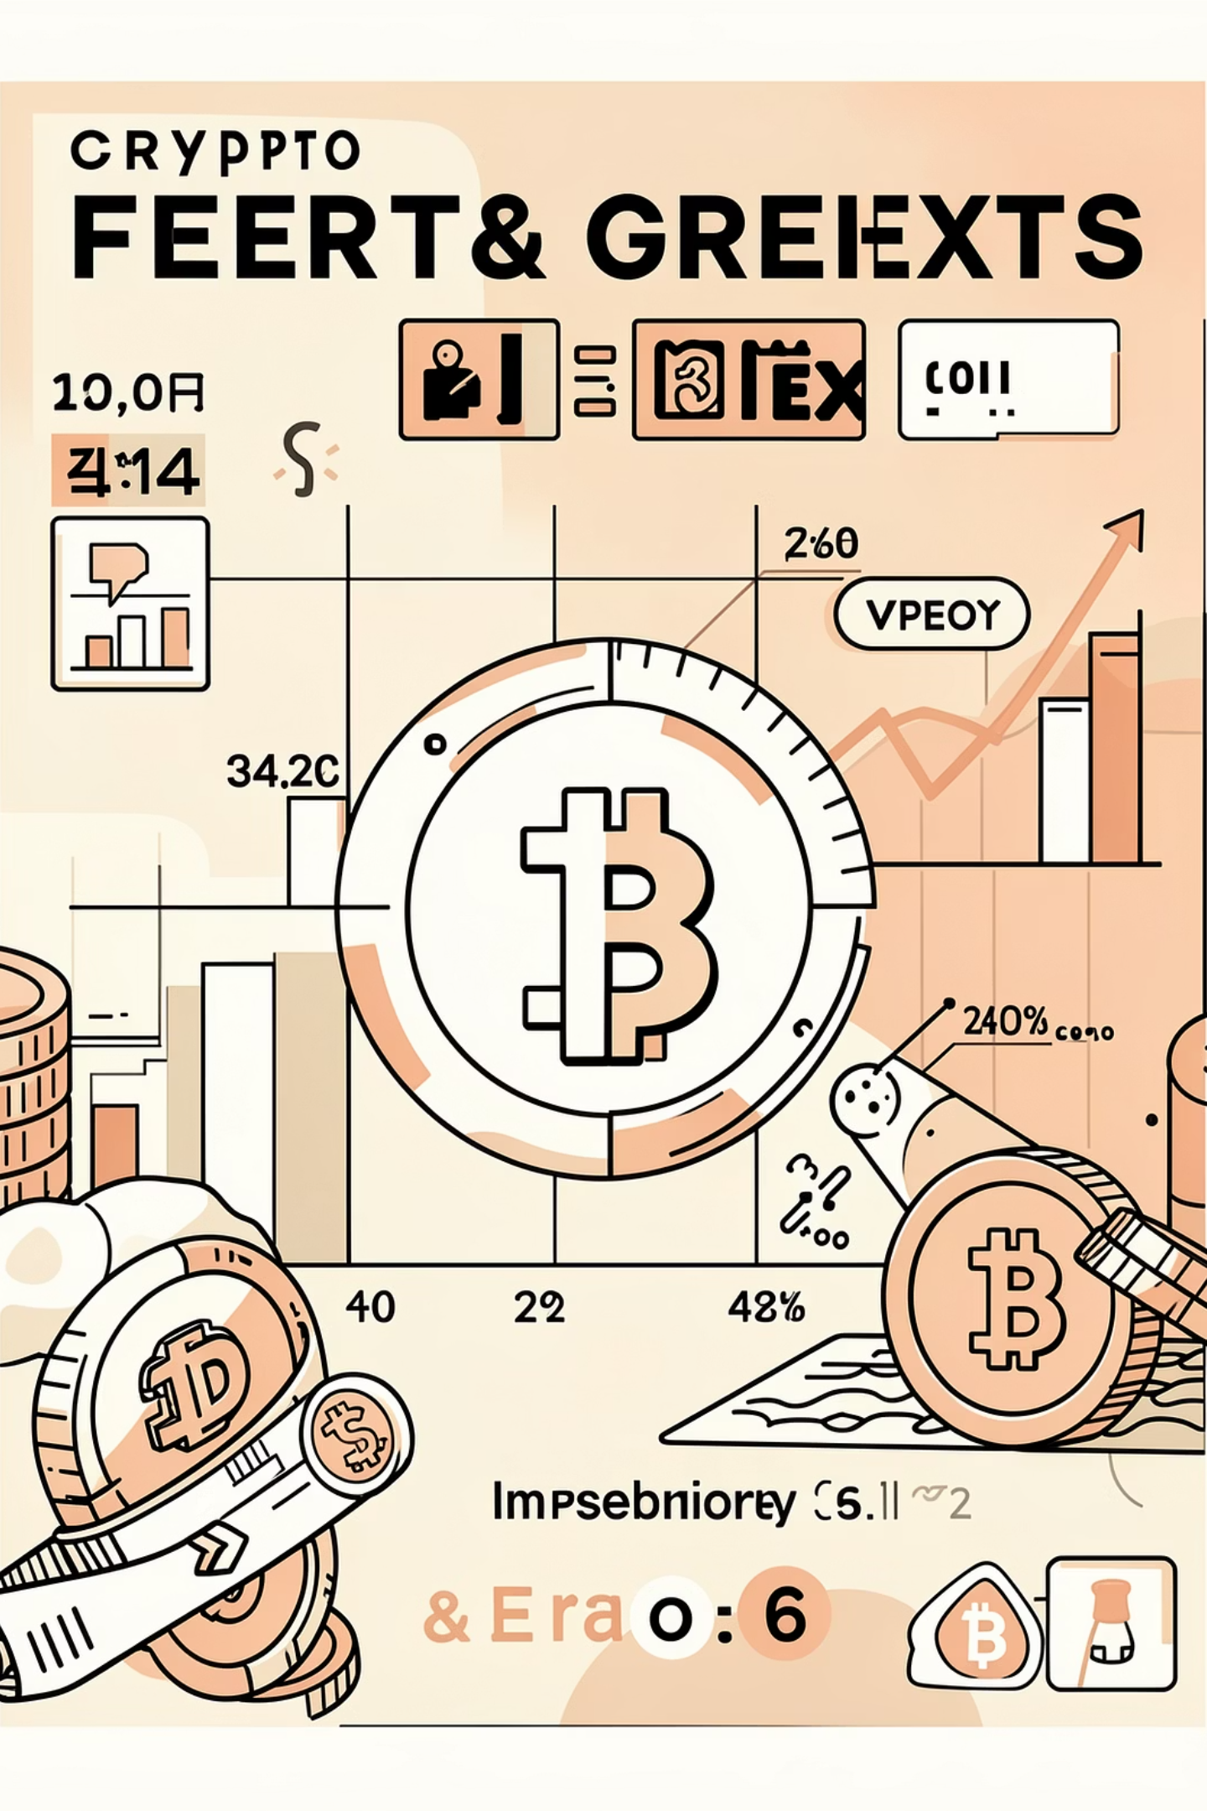
Executive Summary
This analysis examines 211,224 trades against historical Fear & Greed Index data, revealing how trader emotions influence market behavior. Key findings challenge conventional wisdom: traders are most profitable during fear, exhibit persistent bullish bias regardless of sentiment, and show paradoxical activity spikes during high-stress conditions.
Three distinct trader archetypes—Whales, Frequent Retail, and Occasional Retail—demonstrate markedly different performance patterns under emotional market stress.

Slide 3
Research Methodology
01
02
Data Preparation
Metric Engineering
Normalized 211,224 trade timestamps (IST) to daily grains, enabling linkage with Crypto Fear & Greed Index values
Calculated daily PnL, win rates, long/short ratios, and sentiment buckets (Fear: 0-40, Neutral: 41-60, Greed: 61-100)
03
04
Trader Segmentation
Performance Analysis
Classified users into behavioral archetypes based on position size and trade frequency distributions
Correlated sentiment buckets with profitability metrics across all trader segments

Slide 4
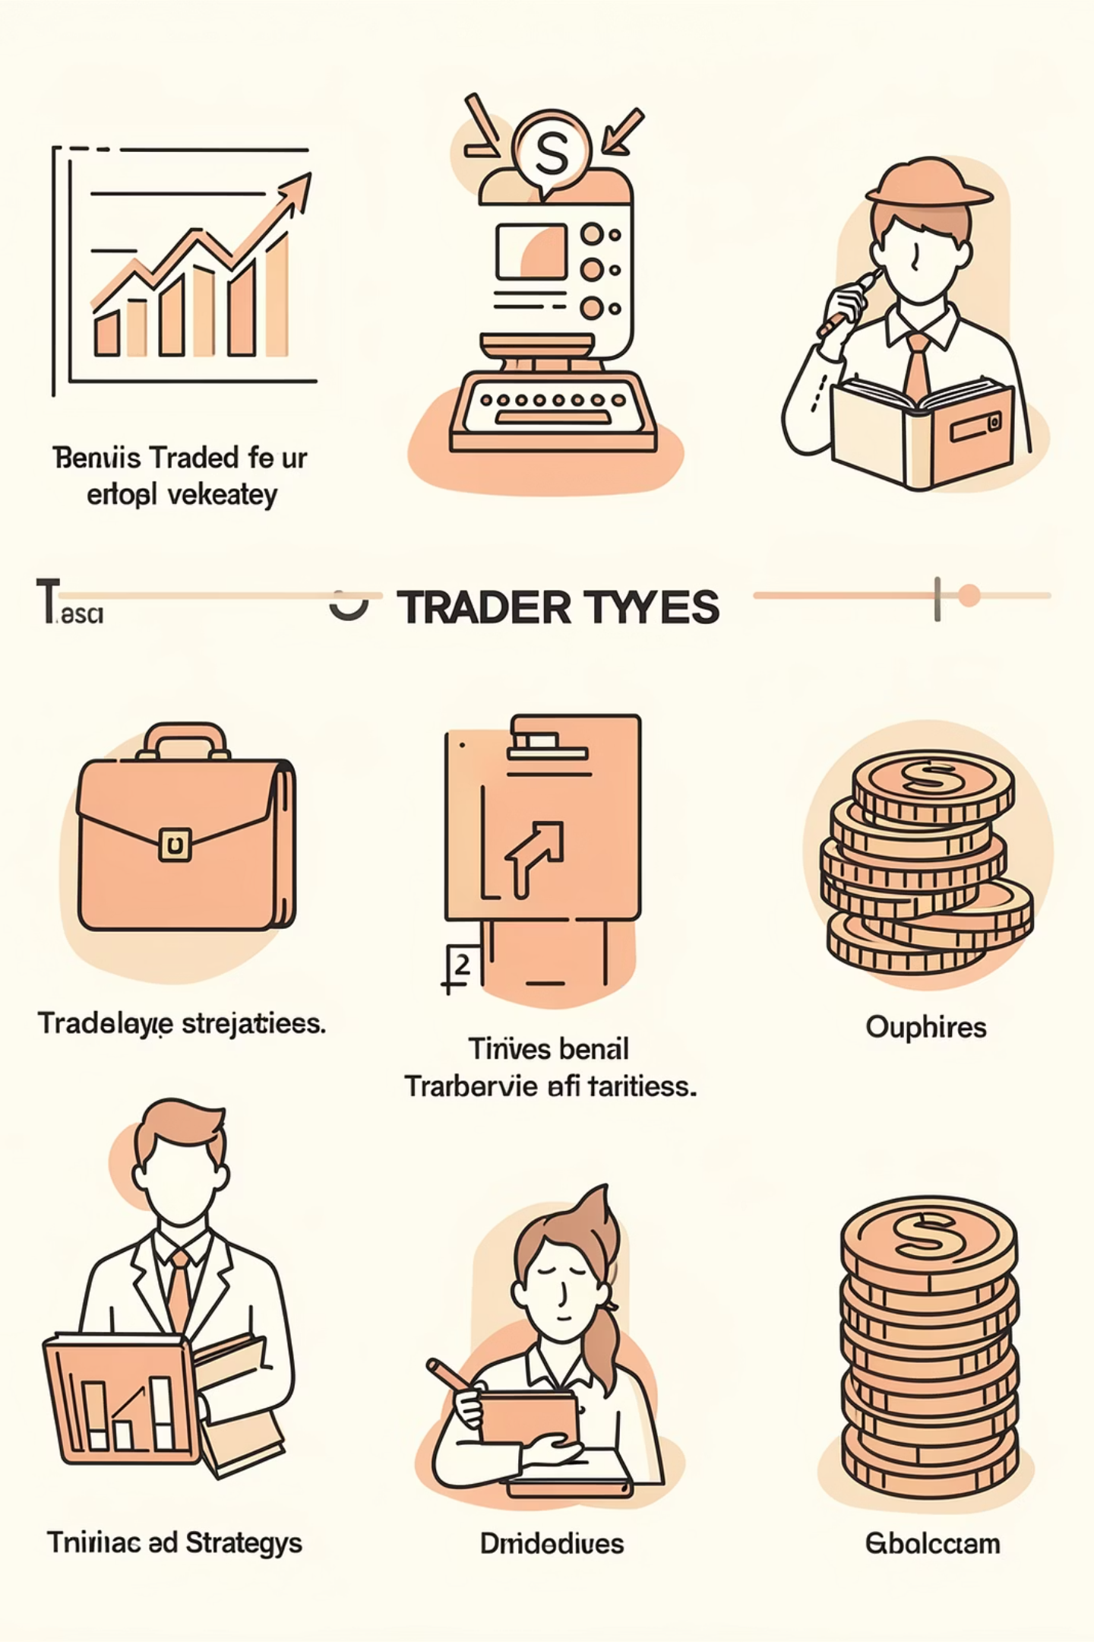



Trader Archetype Classification
Whales
Frequent Retail
Top 25th percentile by average position size
High trade frequency (>10 trades/day) with smaller position sizes
Large capital deployment
Strategic timing
Market-moving capacity
Active engagement
Shorter holding periods
Emotional decision-making
Occasional Retail
Low frequency trading with small position sizes
Opportunistic entries
Longer time horizons
Limited market exposure

Slide 5
The Panic-Trading Paradox
Activity Spikes During Fear
Key Insight
Trading frequency and average position sizes increase by approximately 37% during Fear days compared to Greed conditions. This counterintuitive behavior suggests high-stress "dip-buying" or "revenge trading" patterns emerge precisely when emotional stress peaks.
As sentiment deteriorates, trading activity paradoxically accelerates, revealing behavioral patterns that contradict rational risk management principles.
Traders exhibit increased activity during negative sentiment—potentially driven by FOMO, desperation to recoup losses, or contrarian positioning—despite elevated risk environments.

Slide 6
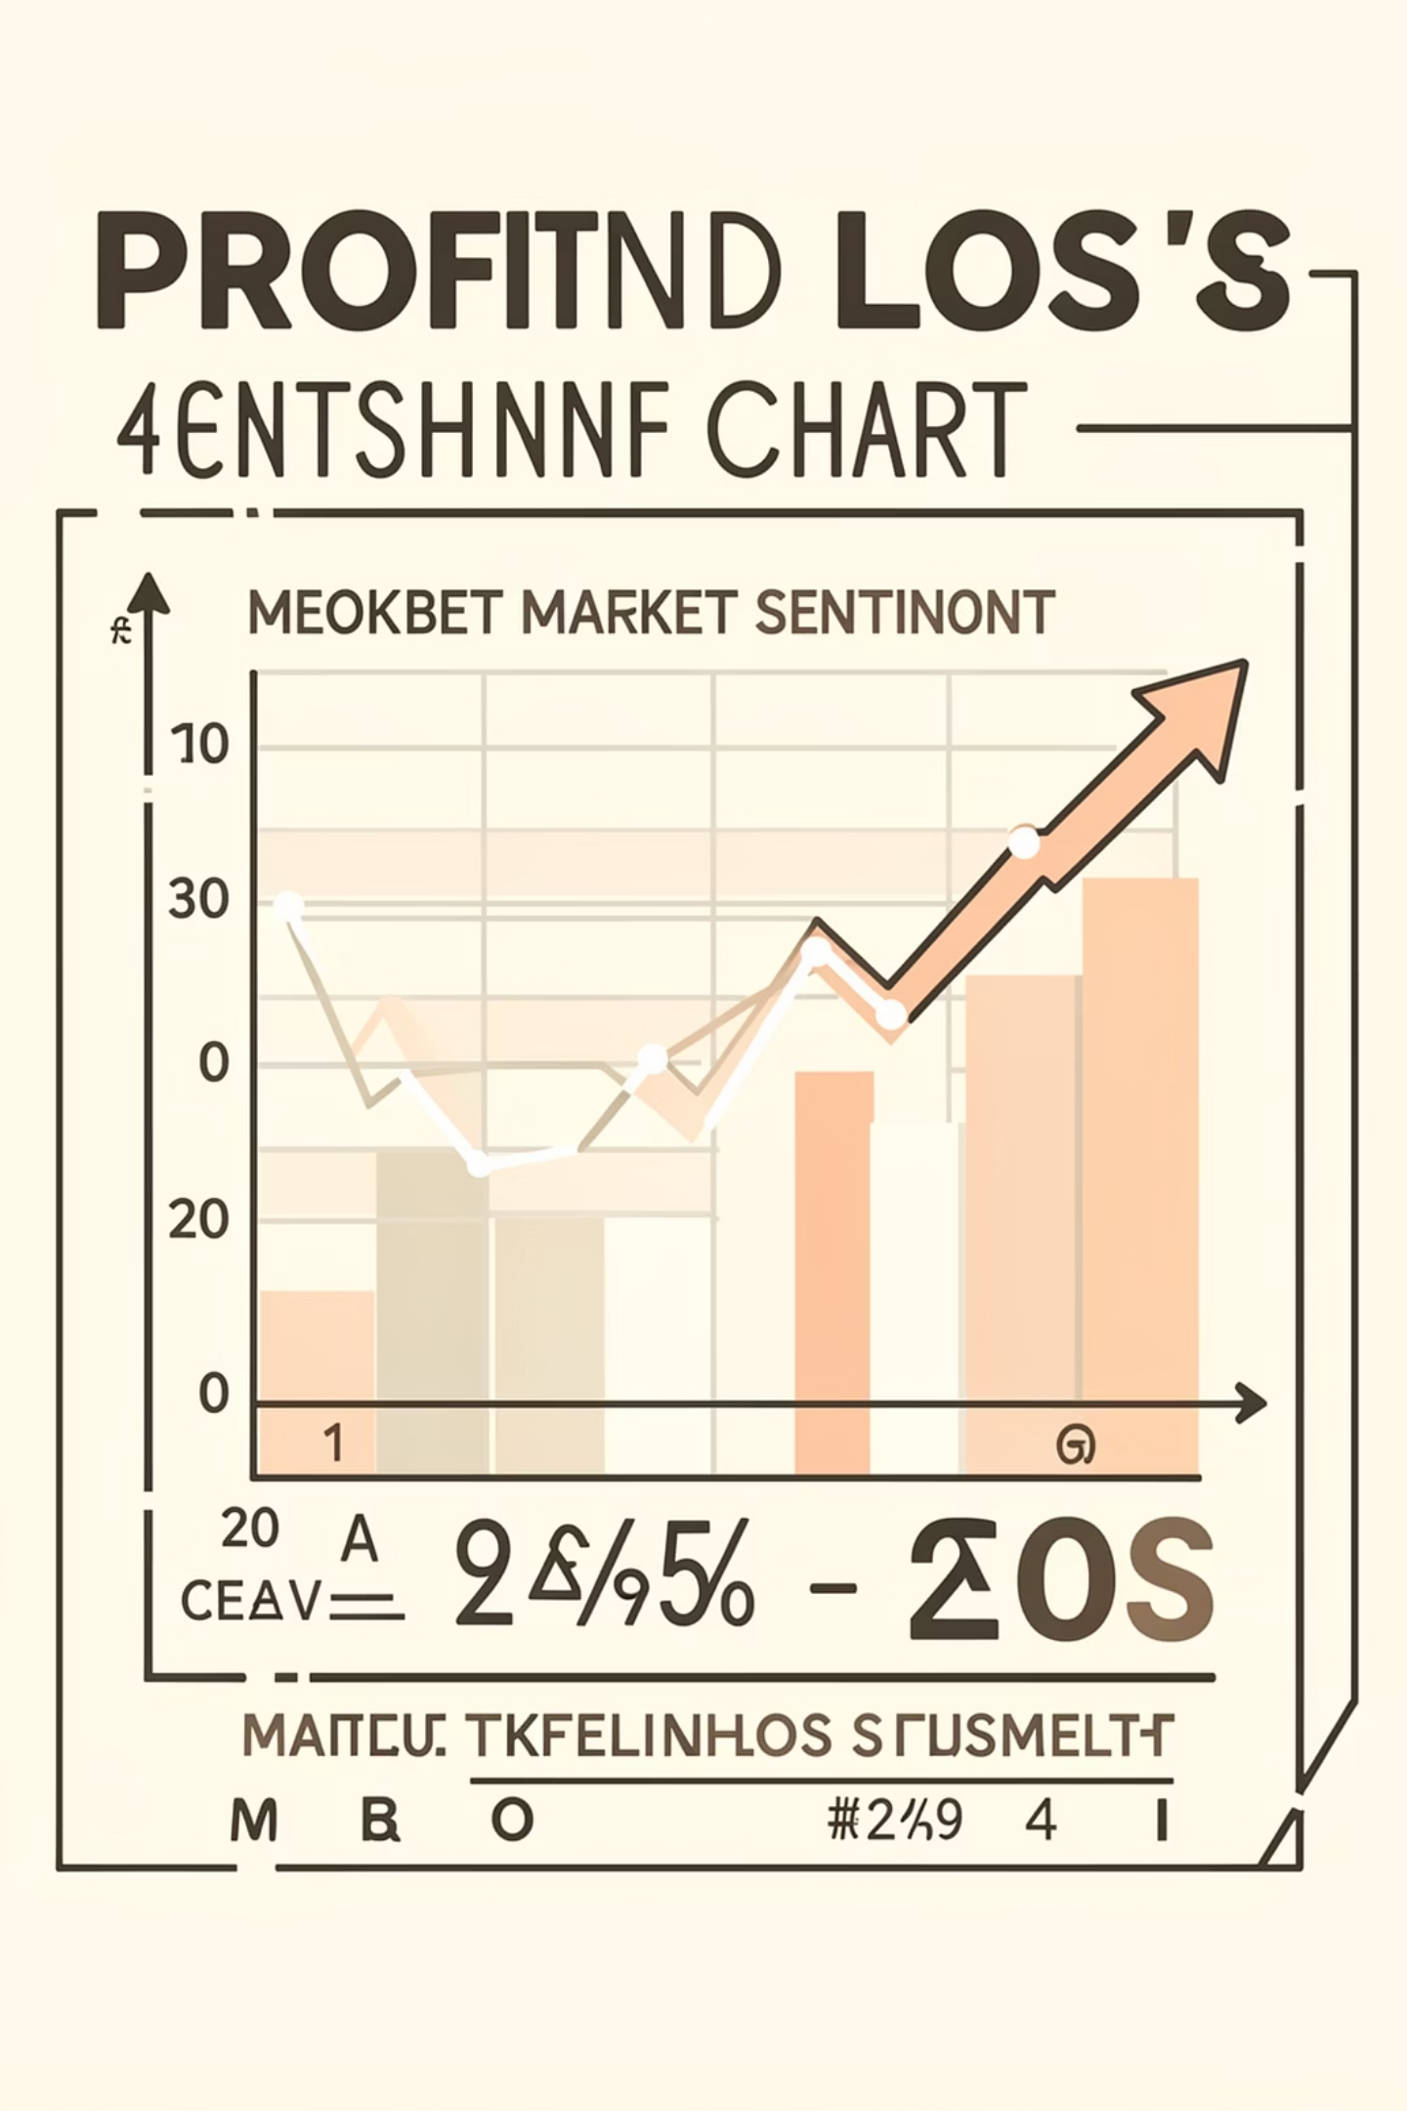
Profitability vs. Sentiment
$5,185
$4,144
+25%
Average Daily PnL
Average Daily PnL
Performance Delta
During Fear conditions (Index 0-40)
During Greed conditions (Index 61-100)
Higher profitability during fear-driven markets
Contrary to popular belief, average daily profitability was 25% higher during Fear than during Greed. This outperformance is largely driven by Whale segments who successfully capitalize on extreme fear conditions, buying undervalued positions and selling into recovery rallies.

Slide 7
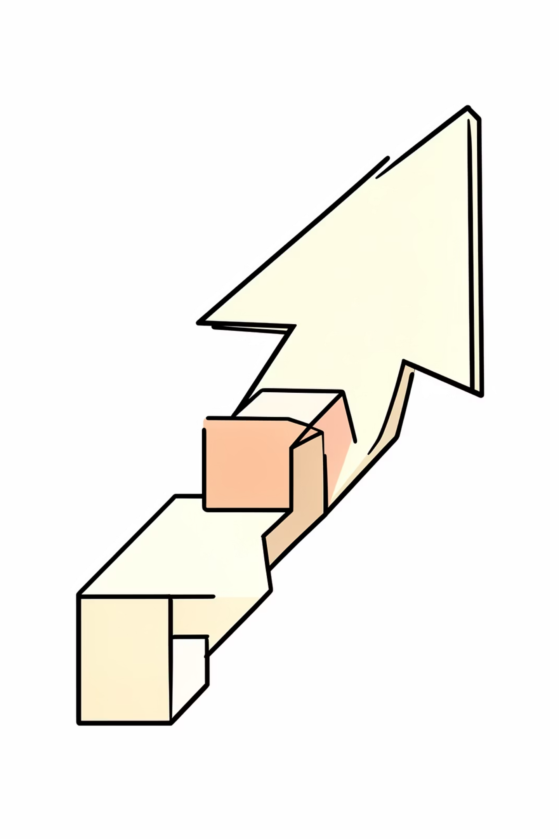
Persistent Bullish Bias
Long/Short Ratio > 3.0
Consistently elevated long positions regardless of market sentiment levels
Structural Optimism
Retail participants maintain bullish positioning even during "Extreme Fear" conditions when fundamentals suggest caution
Behavioral Pattern
Persistent bias indicates anchoring to previous highs, recency bias, or FOMO-driven positioning rather than sentiment-adaptive strategies

Slide 8
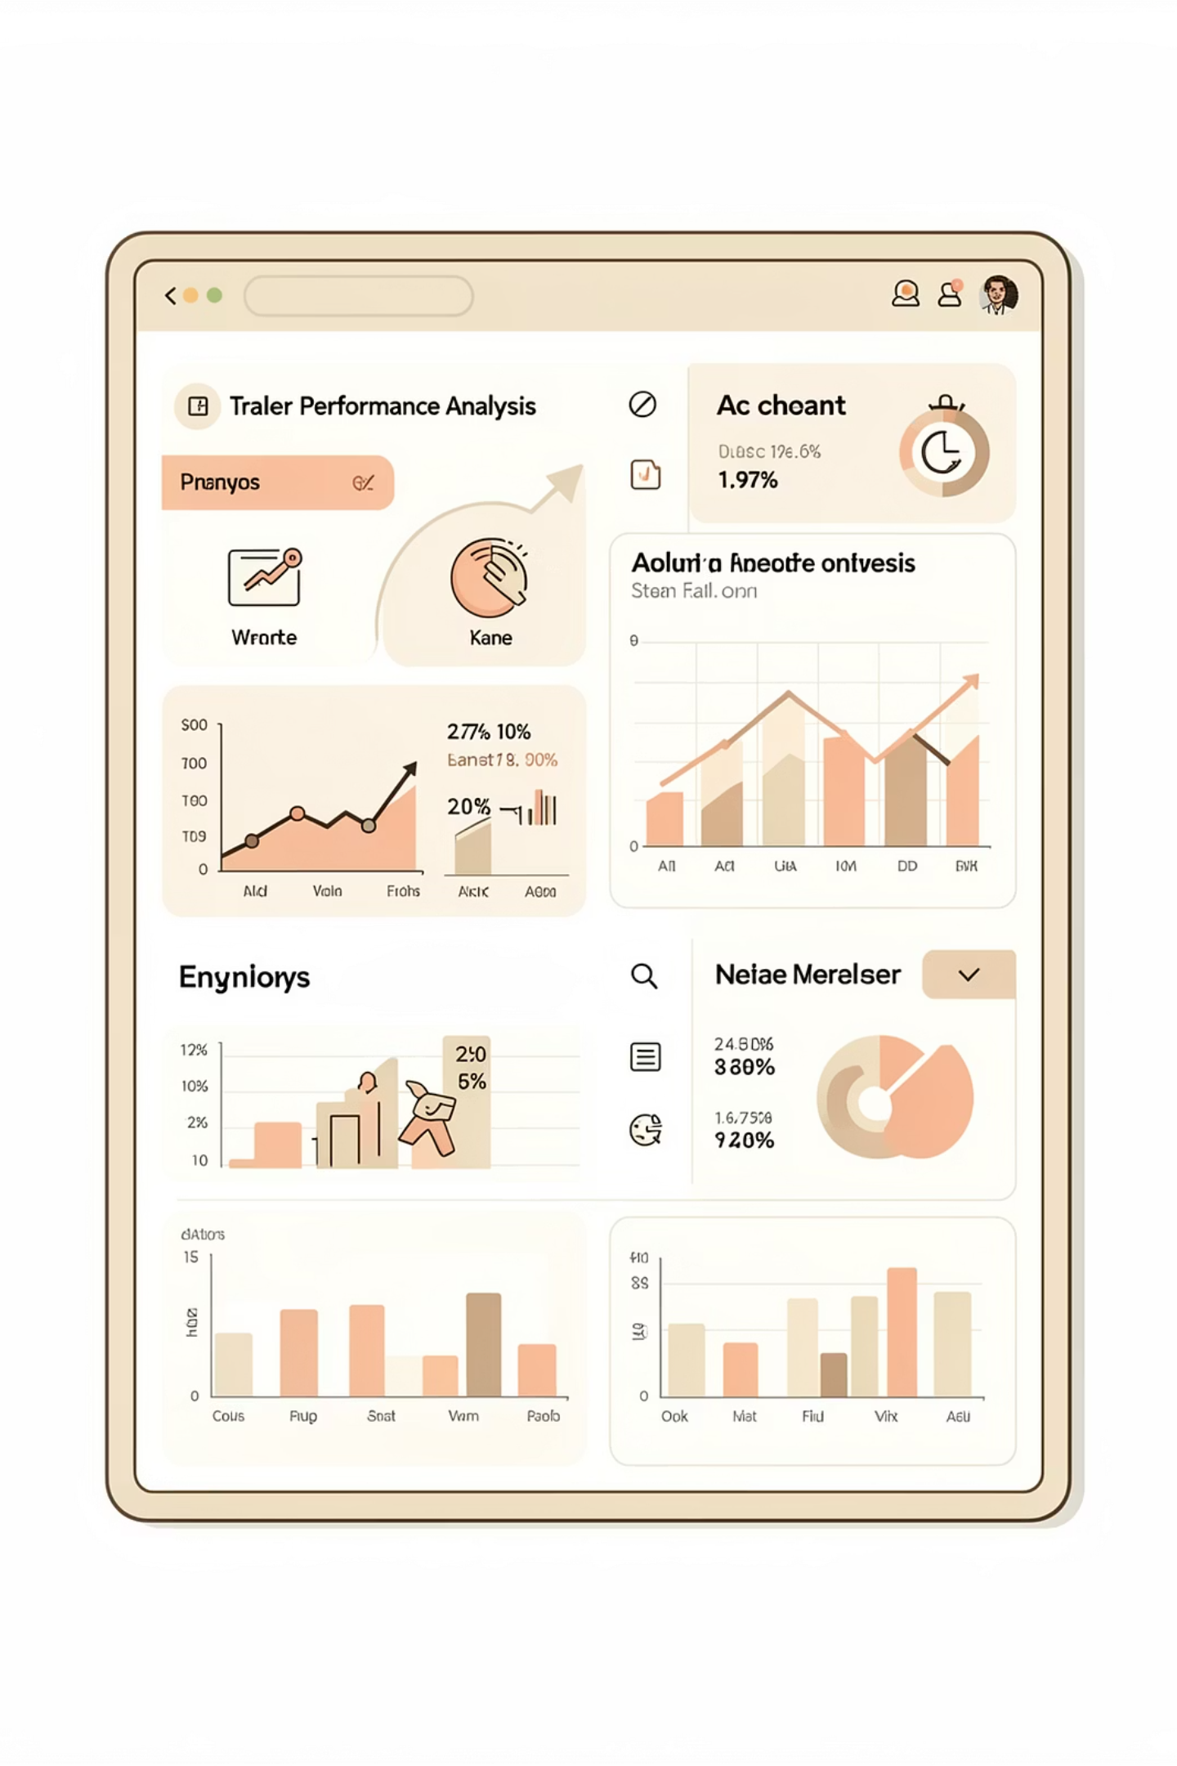



Performance by Trader Segment
Whales
Peak profitability during Extreme Fear (Index < 25). Strategic contrarian positioning capitalizes on market dislocations and liquidity crises.
Frequent Retail
Win rates do not improve during Greed despite increased activity. High-frequency trading without sentiment adaptation leads to diminished returns.
Occasional Retail
Limited data due to low frequency, but patterns suggest missed opportunities during optimal fear-driven entry points.

Slide 9



Actionable Strategies
The "Extreme Fear" Liquidity Strategy
When Index values drop below 25, Whale segments demonstrate peak profitability. Offer fee rebates to Whale participants to encourage market-making activity precisely when liquidity is most scarce and needed.
The "Greed" Leverage Cap
Retail win rates show no improvement during Greed conditions despite elevated trading frequency. Implement dynamic leverage caps when F&G Index exceeds 75 to prevent over-exposure at market tops.

Slide 10
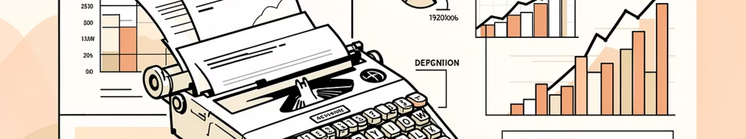
Key Takeaways
1
Fear drives activity, not caution
2
Profitability peaks during stress
37% increase in trading frequency during fear contradicts rational risk management assumptions
25% higher returns during fear conditions, driven by strategic Whale positioning
3
Bullish bias persists structurally
4
Segment-specific interventions
Long/short ratios exceed 3.0 regardless of sentiment, indicating behavioral anchoring
Fee rebates during extreme fear and dynamic leverage caps during greed optimize platform performance

