Slide 1
ScRibBLE
Get your Chances. Know you Future.

Slide 2
Introduction: NoSQL and Tkinter Doesn’t get better than this
The project unleashes the combined power of NoSQl and Tkinter to develop a software that can predict the chances of students to get admitted in a college given some data.
This would be helpful for the students to decide the steps they need to take to nurture their future.
It uses SVM (Support Vector Machine) to predict the odds of admission using facts like GRE and TOEFL Score, University Rating etc.
The software also enables the students to view relationship between various factors visually via graph. This mechanism is in-built in the software.

Slide 3
Contents You ought to know what’s inside
The software interface contains following features:
1. Login Window
1. Selection Page
1. Update and Delete
1. Update
2. Calculate Chances
2. Retrieval
1. Sort
2. Find
3. Graphing Page
4. Help and Credits Page

Slide 4
Existing Model and Gaps they Possess Gaps are meant to be filled
Although many works have been published on this topic but most of them lack either proper management of data, effective prediction or very difficult interface to operate it.
The project worked upon has covered all the loopholes and bottlenecks which were unseen before, ignored or unsolved.
This project employs interface simplicity via Tkinter library and easy connectivity through PyMongo Engine.
No existing works and research employed all the features available with the MongoDB but our project employs all what is available.

Slide 5
Methodology
It was first decided that ourselves being proficient in Python, this will be used for designing. All the functionalities were decided beforehand.
MongoDB was chosen to be the de facto NoSQL database to be used because of its ability to auto-shard and replicate the data. For this helps in creating dummies when required.
We also had technical know-how of Machine Learning and hence added its gist to the project.
The MongoDB procedures of projection, aggregation and querying were tested in this project.

Slide 6
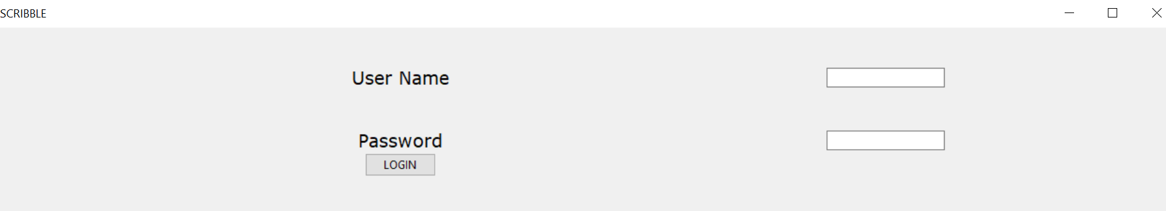
ScreenShots Visually Enchanting

Slide 7
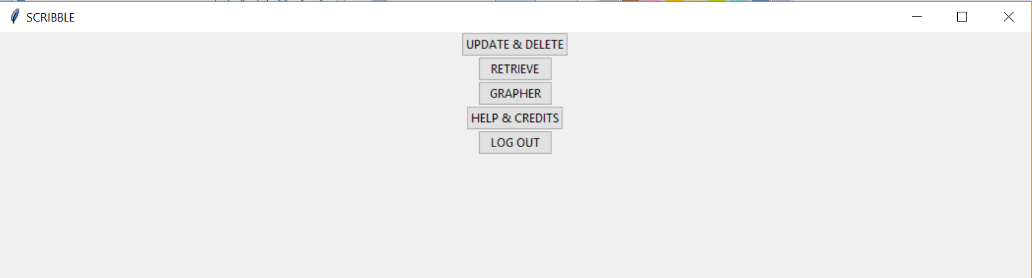
ScreenShots Visually Enchanting

Slide 8
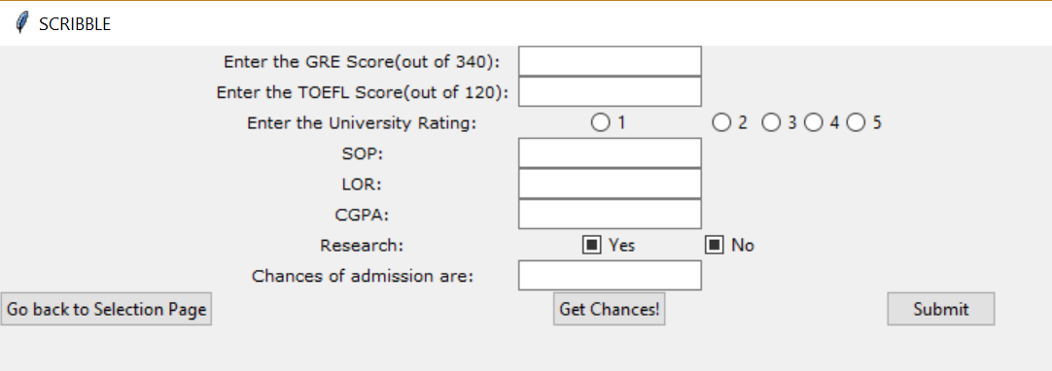
ScreenShots Visually Enchanting

Slide 9
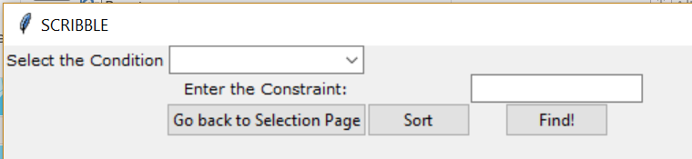
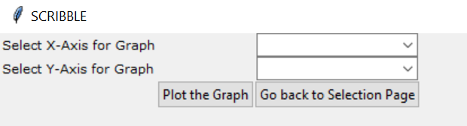
ScreenShots Visually Enchanting

Slide 10
References Gratitude is due to be given
https://www.tutorialspoint.com/mongodb/mongodb_advantages.htm
https://docs.mongodb.com/manual/reference/method/db.collection.aggregate/
https://docs.mongodb.com/manual/reference/operator/projection/positional/
https://www.researchgate.net/topic/Support-Vector-Machine
https://www.python-course.eu/python_tkinter.php

