Slide 1
TrenzHire
Interview Assistant
LangGraph | PostgreSQL+pgvector | Groq LLM | Gemini AI |
Node.js ESM | MCP Protocol

Slide 2
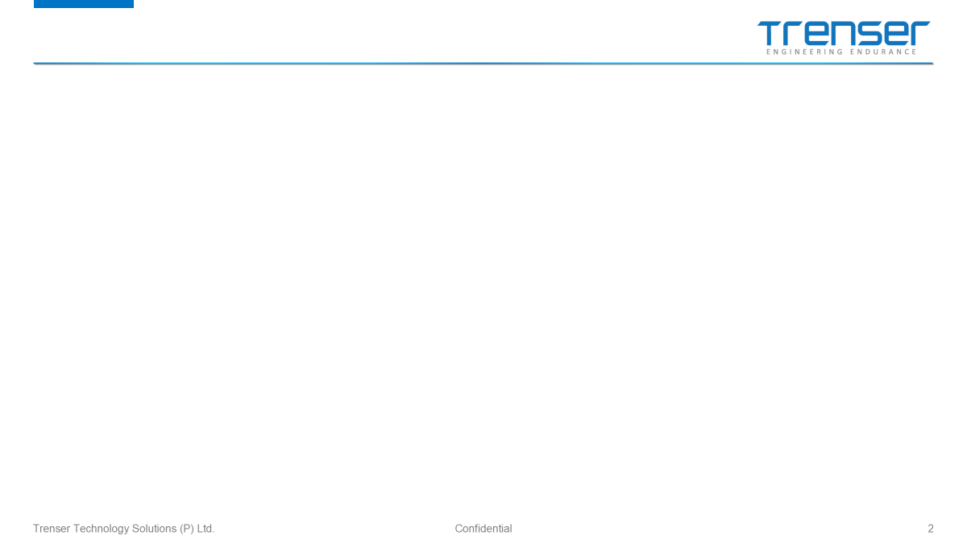
The Problem We Solve
Next-Generation HR Management
BEFORE — The Old Way
AFTER — With Interview Assist
✗ Hundreds of resumes screened manually
✗ Interviewer-candidate skill mismatch undetected
✗ Unstructured video interviews — no scoring
✗ Scheduling chaos: endless email back-and-forth
✗ No audit trail or data-driven decisions
✓ AI pipeline screens & scores resumes instantly
✓ Gemini Vision scores fluency, skills & confidence
✓ Skill-aware matching with HR approval workflow
✓ Automated slot booking, tokens & confirmation emails
✓ Full candidate lifecycle tracked in one dashboard

Slide 3

Architecture Diagram
OVERVIEW · INPUTS → EXPRESS → LANGGRAPH → MCP MANAGER → MCP SERVERS → SERVICES
INPUTS
🌐 Web Upload
POST /upload
AI / SERVICES
⚡ Gemini 2.5
Scores + Skills
⚡ Groq Whisper
Transcript
BACKEND
Video Analyzing
HTTP
⚡ Express.js
API Router
📧 Email IMAP
imapflow
🔀MCP CLIENT MANAGER
TOOL_REGISTRY — routes by tool name
MCP SERVERS
🧠 Ollama
nomic-embed
⚡ Groq LLM
scorer
analyze_resume analyze_resume_only send_invite → resume server
stdio
Embedding Inference
📄⚙️ MCP Resume
mcp-resume-server
Resume Scoring
🕵️ Folder Watch
chokidar
🔄 LangGraph
Workflow
callMCPTool()
mcp-client-manager.js
Store Embeddings
🗄️ PostgreSQL
+pgvector
candidate_lookup candidate_benchmarks → candidate server
stdio
👤⚙️ MCP Candidate
mcp-candidate-server
Candidate CRUD
🗄️ PostgreSQL
candidates
schedule_candidate auto_assign_and_confirm → scheduling server
stdio
📅⚙️ MCP Scheduling
mcp-scheduling-server
Slot Management
🗄️ PostgreSQL
slots
📮 Nodemailer
SMTP
list_hr_requests approve_hr reject_hr → hr server
stdio
👥⚙️ MCP HR
mcp-hr-server
Request Tracking
🗄️ PostgreSQL
requests
create_event → calendar (ext)
HTTPS
🌐⚙️ Calendar MCP
StreamableHTTP (ext)
Calendar Integration
⟳ Auto-respawn on close · Per-server stats · isMCPToolAvailable()
📅 Google/Yahoo
Calendar
HTTP/POST
JSON-RPC stdio
SQL/pgvector
StreamableHTTP
SMTP
In-process JSON

Slide 4

Application Startup
src/server.js — orchestrates every subsystem in sequence before HTTP binds
1
validateEnv()
6 BACKGROUND WORKERS
Checks GROQ_API_KEY, GMAIL_USER, PGHOST and all required vars. Calls process.exit(1) on missing.
2
initDB()
▸ CV Watcher (chokidar) ▸ Email Ingest (IMAP) ▸ Auto-Schedule (every 3 min) ▸ Bulk Email (every 1 min) ▸ No-Show Monitor (every 1 hr) ▸ Video Reminder (every 1 hr)
Runs ensureDatabase() → creates 11 tables, all ALTER TABLE migrations, seeds default admin account.
3
initMCPClients()
Spawns 4 local MCP servers via StdioClientTransport. Registers 10 delegation tools. Sets mcpAvailable=true.
4
createGraph()
Builds LangGraph StateGraph with 4 nodes. Attaches PostgresSaver (falls back to MemorySaver). Compiles.
5
createApp()
Express with session (connect-pg-simple), Pug views, multer, and 8 route groups mounted.
6
startCVWatcher()
chokidar watches /cvs/ at depth=1. On 'add' event for PDF/DOC/DOCX → invokes compiled graph.
7
startEmailIngest()
CHECKPOINT PERSISTENCE
Reads IMAP settings from DB. Polls inbox on configurable interval. Saves resume attachments to /cvs/auto/.
▸ Tries PostgresSaver first ▸ Falls back to MemorySaver ▸ State keyed by thread_id (UUID) ▸ Enables graph resume on crash ▸ connString built from PGHOST/PORT/DB/USER
8
startAutoSchedulePassedCandidates()
Runs immediately then every 3 min. Finds status=Done candidates without a scheduled interview.
9
startBulkOutcomeEmailWorker()
Ticks every minute. Within the 18:00 ± 30 min daily window, sends pass/fail emails to finalized candidates.
10
startNoShowMonitor()
Ticks every hour. Finds confirmed interviews past slot_end with no completed_at → marks noshow → emails HR.
11
startVideoReminderWorker()
Ticks every hour. Finds AwaitingVideo candidates older than 48 h with video_reminder_sent=FALSE.
12
app.listen(PORT, HOST)
Binds HTTP server. Logs localhost + all LAN IPv4 URLs when HOST=0.0.0.0.

Slide 5

Resume Ingestion — 3 Entry Points
All three entry paths invoke the same compiled graph
PHASE 1
PATH A — File System Drop
chokidar watches /cvs/ at depth=1 /cvs/<uuid>/ → pinned to that interview /cvs/auto/ → AI auto-match engine picks interview Email extracted from filename or resume text Invokes graph → moves file to /cvs/processed/
LANGGRAPH PIPELINE — 4 Nodes + 2 Conditional Routers
Node 1 — check_domain_and_duplicate
SHA-256 hash → dedup check scoped to interview_id → INSERT candidates row
⬡ domainGate()
Duplicate → END | New → Node 2
PATH B — IMAP Email Ingest
imapflow connects via TLS to configured inbox Polls for UNSEEN messages with PDF/DOC/DOCX attachments Saves attachment to /cvs/auto/{uid}-{filename} chokidar picks it up → PATH A continues
Node 2 — analyze_resume
PDF/DOCX/DOC extract (3-strategy) → RAG: pgvector JD chunks → Groq LLM → score 0-100, skills[], summary
⬡ thresholdGate()
score ≥ pass_threshold (default 60) → Node 3 | score < threshold → Node 4
PATH C — HTTP Upload
Node 3 — send_invite
POST /upload/:threadId · multer · max 200 MB MIME validated after body received interviewId from URL params or form body Returns JSON { success, threadId }
Random token + temp password → bcrypt hash → sendInvitationEmail() → status = AwaitingVideo
Node 4 — reject_candidate
UPDATE status = Rejected → sendRejectionEmail()
AUTO-MATCH ENGINE (for /cvs/auto/ & IMAP paths)
Embed resume → pgvector cosine vs jd_chunks → top-3 interviews → Groq LLM picks best → returns { interviewId, confidence }

Slide 6

LangGraph Pipeline — 4 Nodes + 2 Routers
PHASE 2
src/graph/index.js · nodes.js · helpers.js — stateful agent graph with conditional routing
Node 3 send_invite
Start
Node 1 check_domain _and_duplicate
Node 2 analyze_resume
END
domainGate()
thresholdGate()
Node 4 reject_candidate
Duplicate → END New → Node 2
Score ≥ threshold → Node 3 Score < threshold → Node 4
Node 1 — check_domain_and_duplicate
• crypto.randomBytes(4).toString('hex') → 8-char token • crypto.randomBytes(6).toString('base64url') → temp password • bcrypt.hash(password, 10) → password_hash • UPDATE: login_token, password_hash, must_change_password=TRUE • sendInvitationEmail(email, threadId, plainPassword) • Status → AwaitingVideo
Node 2 — analyze_resume
Node 3 — send_invite
Helpers & Retry Logic
• SHA-256 hash of resume buffer • SELECT WHERE resume_hash=$1 AND interview_id=$2 • If duplicate found → status=Rejected, return END • If new → INSERT candidates row: thread_id (UUID), interview_id, email, resume_hash, status='Screening', assignment_method, match_confidence • Returns { resumeHash, status: 'Screening' }
• Magic bytes detect PDF / DOCX / DOC • PDF: 3-strategy cascade (pdf-parse → pdfjs-dist → BT/ET regex) • DOCX: mammoth.extractRawText() • DOC: word-extractor • RAG: retrieveRelevantChunks() → pgvector cosine • Groq llama-3.3-70b → { score, matching[], missing[], summary } • UPDATE candidates SET resume_score, summary, status='Screened' • Returns { resumeScore }
callWithRetry(fn, maxRetries=3): • Catches HTTP 429 rate-limit errors • Backoff: 2s → 4s → 8s (max 15s cap) • Wraps ALL Groq + Gemini calls parseJSON(raw): • Strips markdown code fences (```json) • Falls back to raw JSON.parse() • Score clamped 0–100 downstream pass_threshold: • Read from interviews.pass_threshold • Default = 60 if not set
• UPDATE candidates SET status='Rejected' • sendRejectionEmail(email) (bulk rejection emails also sent by BulkOutcomeEmailWorker at 18:00) • No invitation link is generated • Candidate is not notified of score
Node 4 — reject_candidate

Slide 7

Candidate Portal & Video Analysis
src/routes/candidate.js · src/graph/actions.js · src/services/video-analysis.js
PHASE 3
Login
SMART SCHEDULING ENGINE — autoAssignAndConfirmCandidate()
Candidate visits /login/candidate · must_change_password redirect first
suggestInterviewersForCandidate()
Record & Upload
Query interviewers assigned to this interview → fallback: all with available slots computeInterviewerMatchPercent() → skill string overlap → scoreInterviewersWithAI() → Groq score 0-100 + can_interview bool
POST /upload/:threadId · multer · MediaRecorder API (WebM/MP4) · max 200 MB
Groq Whisper
HR Review Gate (AI_HR_THRESHOLD = 40)
whisper-large-v3 transcribes audio track → stored in candidates.video_transcript
topMatch < 40 OR !can_interview → INSERT interviewer_assignment_requests sendHrApprovalRequestNotification() → HR approves manually
Gemini 2.5 Flash
Receives transcript + resume summary + JD context Returns: english_score, confidence_score, skills[], video_summary
Auto-Confirm Path
Combined Score
findAvailableSlots() → Priority 1: match% > 50 → Groq ranks slots for variety INSERT scheduled_interviews (status='confirmed') → book slot → send emails
combinedScore = (resume_score × 0.4) + (video_score × 0.6) Pass → status=Done | Fail → status=Rejected
Auto-Schedule Trigger
Confirmation Emails
status=Done immediately calls autoAssignAndConfirmCandidate() Background worker (every 3 min) catches any missed transitions
sendScheduleConfirmedEmails() → candidate gets date + meet link Interviewer gets date + candidate info → createCalendarEvent() via MCP
Interviewer Response
Token link: Confirm → status=confirmed | Decline → slot freed → auto-reschedule Portal route (OTP login): same confirm/decline logic

Slide 8

MCP Layer — Tool Routing, AI Models & External Services
All AI calls go through the MCP client manager with graceful in-process fallback
MCP CLIENT MANAGER (mcp-client-manager.js)
TOOL_REGISTRY routes each tool name to the correct server · Auto-respawn on close · Per-server stats · Graceful fallback: if MCP fails → runs logic in-process directly
MCP SERVER #1 Resume Server
MCP SERVER #2 Scheduling Server
MCP SERVER #3 HR Server
MCP SERVER #4 Calendar (ext)
stdio (StdioClientTransport)
stdio (StdioClientTransport)
stdio (StdioClientTransport)
StreamableHTTP (HTTPS)
• analyze_resume → full LangGraph invoke • analyze_resume_only → analyzeResume node • send_invite → sendInvite node • candidate_lookup → DB SELECT candidates • candidate_benchmarks → score aggregates
• schedule_candidate → scheduleCandidate() • auto_assign_and_confirm → full scheduling flow • Finds slots → AI ranks → books → emails • HR gate: <40% match → HR review request
• list_hr_assignment_requests • approve_hr_assignment_request • reject_hr_assignment_request • HR admin actions via MCP delegation
• create_event → summary, start/end, attendees • meet_link embedded in event • Swap URL in admin → zero code change • Google Calendar or any MCP calendar
DATA LAYER
AI MODELS
AI MODELS
DATA Layer
NOTIFICATIONS
Groq llama-3.3-70b
Resume scoring · Interviewer ranking · Slot selection · Auto-match LLM
PostgreSQL + pgvector
11 tables · cosine similarity (<=>) · vector(768)
Gmail SMTP (Nodemailer)
Invite · reject · confirm · reminder emails
Groq Whisper v3
Audio → transcript from candidate video
PostgresSaver
LangGraph checkpoint keyed by thread_id · fallback MemorySaver
sendInvitationEmail
Candidate gets login URL + temp password
Gemini 2.5 Flash
english_score · confidence_score · skills[] · video_summary
connect-pg-simple
Express sessions stored in DB (sessions table)
sendScheduleConfirmedEmails
Both candidate + interviewer get meet link
Ollama nomic-embed
768-dim embeddings for pgvector RAG · localhost:11434
pg pool
8 connections · docker: pgvector/pgvector:pg16
HR Alerts
No-show · no-slots · assignment request emails

Slide 9

Interviewer Lifecycle & Auto-Reschedule
src/routes/interviewer.js — token-link flows + portal with automatic fallback
Token Security
Each scheduled_interviews row has two unique 48-char hex tokens (candidate_token + interviewer_token). Status check prevents re-processing of already-handled tokens. No login required — token IS the credential.
Slot Liberation on Decline
When interviewer declines, slot is immediately returned to 'available'. This ensures the auto-reschedule attempt can find it for a different candidate without any manual intervention.
Auto-Reschedule
Both the token route and the portal route trigger autoAssignAndConfirmCandidate() on decline. Candidate is rescheduled to the next best AI-ranked slot with zero manual steps.
No-Slots Alert
If auto-reschedule returns { reason: 'no_slots' }, sendAdminNoSlotsAlert() fires immediately so HR knows to add interviewer availability before the candidate times out.
Interviewer Portal & OTP
Interviewers log in via OTP email (/interviewer/login). They manage single, multi-slot, or weekly-recurring availability. Slots marked 'blocked' are never offered to candidates.

Slide 10

Architecture Diagram vs Code Flow — Confirmation
Architecture Element
Code Location
Status
CV Web Upload → POST /upload → Express.js
src/routes/upload.js + src/app.js
EXACT
IMAP Email Ingest → Email Ingest Worker → /cvs/auto/
src/services/email-ingest.js + watcher.js
EXACT
Admin Dashboard → JSON POST /admin/trigger → File Watcher
src/routes/admin.js + src/services/watcher.js
EXACT
LangGraph 4 nodes: check_domain, analyze_resume, send_invite, reject
src/graph/index.js + src/graph/nodes.js
EXACT
domainGate (duplicate check) + thresholdGate (score vs pass_threshold)
src/graph/index.js:30-38
EXACT
MCP Server #1 stdio — analyze_resume_only, send_invite, schedule_candidate, auto_assign
src/services/mcp-resume-server.js + mcp-scheduling-server.js
EXACT
MCP Server #2 Calendar — StreamableHTTP HTTPS, create_event
src/services/calendar-mcp.js + mcp-scheduling-server.js
EXACT
Groq Whisper → transcript + Gemini 2.5 Flash → scores
src/services/video-analysis.js
EXACT
Ollama nomic-embed-text 768-dim embeddings → pgvector cosine search
src/services/embeddings.js + interview-matcher.js
EXACT
Background Workers: auto-schedule, no-show, bulk-email, video-reminder
src/services/scheduler.js (4 exported worker functions)
EXACT
Graceful MCP fallback: if MCP fails, logic runs in-process
src/graph/nodes.js:50-64 + scheduler.js:508-522 (try/catch + local call)
EXACT
PostgresSaver checkpoint keyed by thread_id, fallback to MemorySaver
src/graph/index.js:60-75
EXACT
HR assignment request flow (<40% AI score → HR review gate)
src/services/scheduler.js:654-688 (AI_HR_THRESHOLD = 40)
EXACT
Numbered flow steps 1-15 in architecture match ingestion → graph → MCP → email → calendar
server.js (startup) → watcher.js (ingest) → nodes.js (graph) → scheduler.js (schedule)
EXACT
VERDICT: The architecture diagram and the code flow are fully aligned. Every component, protocol, numbered step, and fallback path in the architecture PDF maps 1-to-1 with the actual source code.

