Slide 1
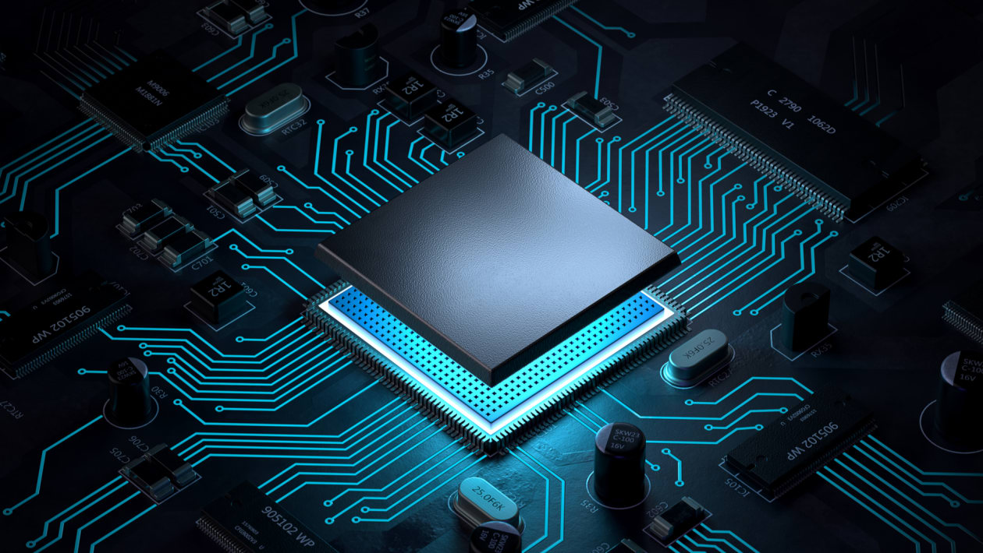
Embedded
System
A system is an arrangement in which all its unit assemble work together according to a set of rules
What is Embedded System?
Embedded means something that is attached to another thing.
An embedded system is a combination of both hardware and software, which performs a particular task within the specified period.

Slide 2
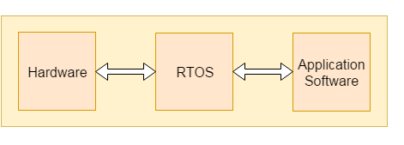
Components of Embedded Systems
Embedded Hardware : The micro-controller is the heart of the embedded system, where multiple peripherals are interfaced to embedded hardware for communication purposes.
Embedded RTO’s : An embedded real-time operating system is used to perform all complex .
Device Drivers : It acts as a bridge between the operating systems and peripheral devices.
Communication stacks : It is used for communicating with external devices.
Embedded applications : It performs the predefined function of the embedded device.
So we can define an embedded system as a Microcontroller based, software driven, reliable, real-time control system

Slide 3
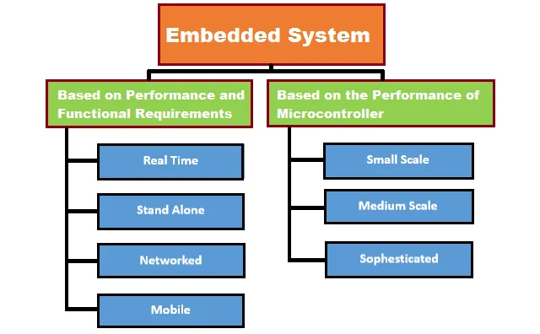
Types of Embedded System

Slide 4
Types of Embedded System
Mobile embedded systems are small-sized systems that are designed to be portable. Digital cameras are an example of this.
Networked embedded systems are connected to a network to provide output to other systems. Examples include home security systems and point of sale (POS) systems.
Standalone embedded systems are not reliant on a host system. Like any embedded system, they perform a specialized task. However, they do not necessarily belong to a host system, unlike other embedded systems. A calculator or MP3 player is an example of this.
Real-time embedded systems give the required output in a defined time interval. They are often used in medical, industrial and military sectors because they are responsible for time-critical tasks. A traffic control system is an example of this.

Slide 5
Embedded system working
Here is an example of how an embedded system works.
It takes the analog/digital input from the user. Examples are Push-button switch, Keypad, Sensor, Touch Screen.
Then, it processes the given input. Processing may be calculation or conversion. For example, an ADC (Analog to digital converter) converts a sensor analog input to digital output.
After converting the analog value to digital output, you need to control using output devices. Examples are Motor, LCD, and Touchscreen.

Slide 6
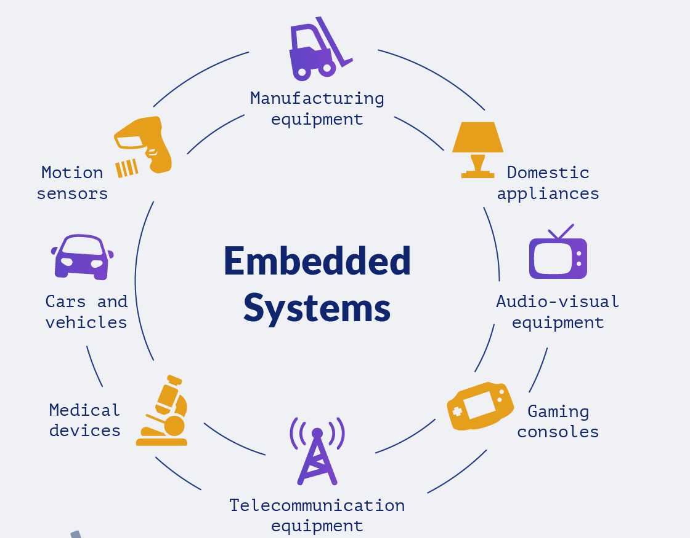
Embedded Software
An embedded software is computer software, which is used to control devices by providing a set of instructions.
It is also named firmware, various devices with various functionalities can be programmed using embedded software, by maintaining design constraints (like response time constraints, strict deadlines, and processed data) and storing the final data in memory (Ram/ Rom).
The embedded software is inbuilt in all electronics like cars, telephones, robots, security systems, etc

Slide 7
Embedded System Programming Languages
Embedded software uses an operating system, which is a real-time operating system that performs multiple tasks at a time.
The embedded programs are programmed using in C / C++, Phyton, and Java Scripts languages and are processed on operating systems like Linux OS, VxWorks, Fusion RTOS, Nucleus RTOS, micro C/OS, OSE, etc.
Selection of programming language plays a vital role in developing embedded software, which is based on certain factors as shown below,
Size: The amount of memory required by a program plays an important role, as embedded processors (microcontrollers) have a specific amount of ROM based on its application.
Speed: The speed of program execution must be fast
Portability: Different processors can be compiled using one program.

Slide 8
Advantages of using Java on embedded systems
Time to market is important, providing less development time: Java has ideal memory management and it’s easier to detect errors (and fix them)
It is recommended for GUI projects with over 5 screens
Sturdiness from the first version on (thanks to package concepts, design patterns and SOLID principles)
Simplicity
Portability to different CPU or operating systems (no need for code rewriting)
Security, with support for encrypting sensitive data
A large arsenal of OS-independent libraries
Debuggable on the desktop and remotely
Best compromise in terms of high level language and high performance (depends on the Virtual Machine used)

Slide 9


Disadvantages of using Java on embedded systems
There are a lot of good reasons for choosing Java. But, there are three main disadvantages of using Java on embedded systems:
Java is quite verbose.
It is complex and vast (217 packages with 4240 classes).
Low performance.

