Slide 1

Rust
Sahil Pant

Slide 2


About me
Software Developer (Backend Developer)
Blockchain Developer
Crypto Enthusiast and Investor
Learning Distributed Computing

Slide 3



Who all uses rust

Slide 4
Rust Language
Focus on Safety (null pointers, dangling pointers, or data races)
Safe for Concurrency
Created by Graydon Hoare in Mozilla in 2010
No Automated Garbage Collector (Rust uses RAII)

Slide 5
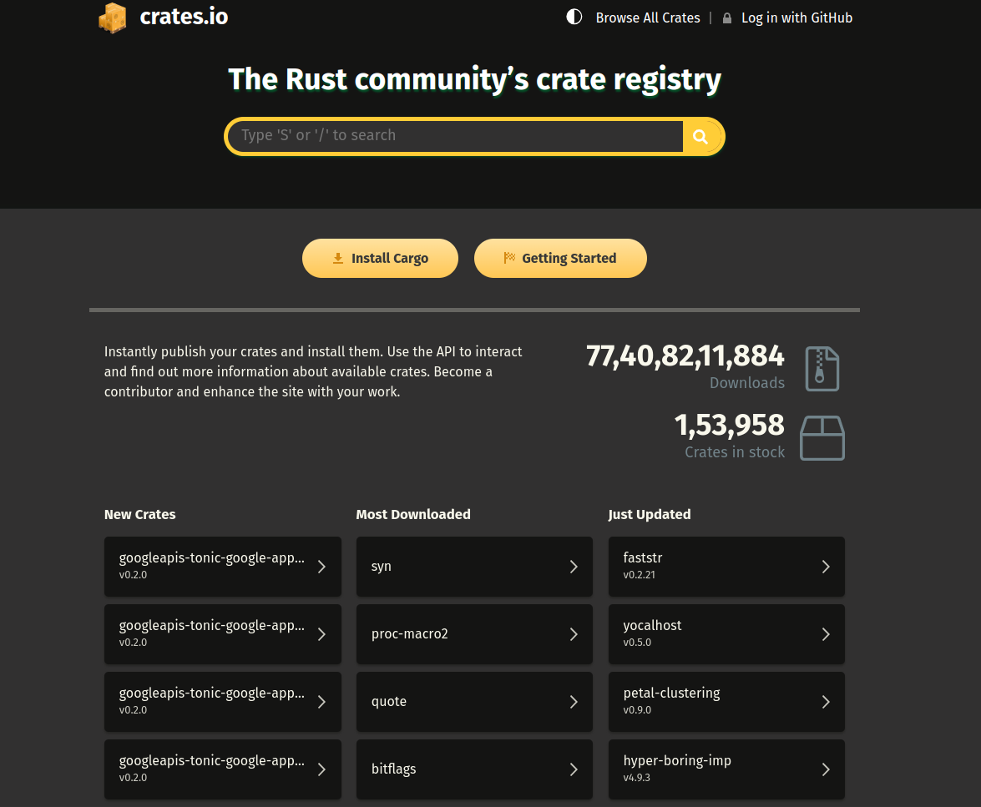
Cargo & Crates

Slide 6
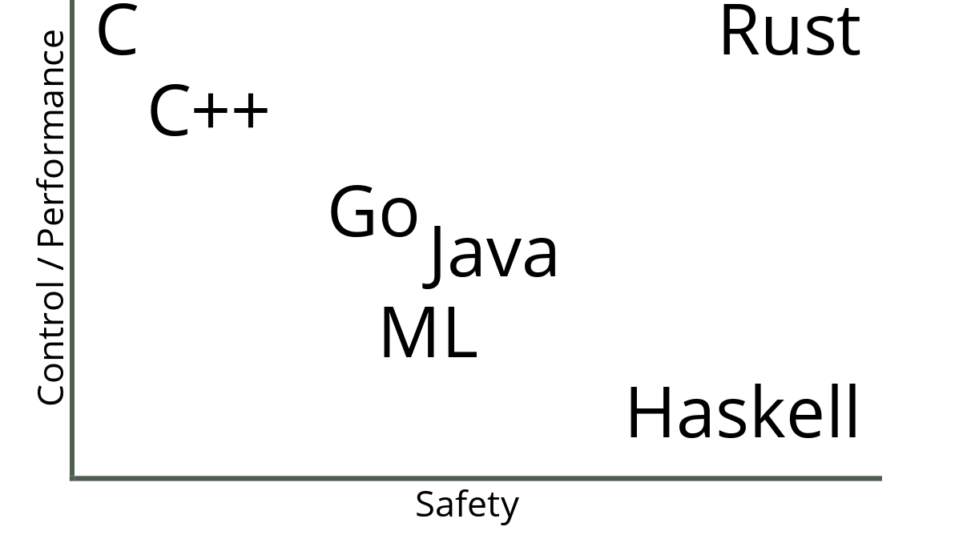

Slide 7
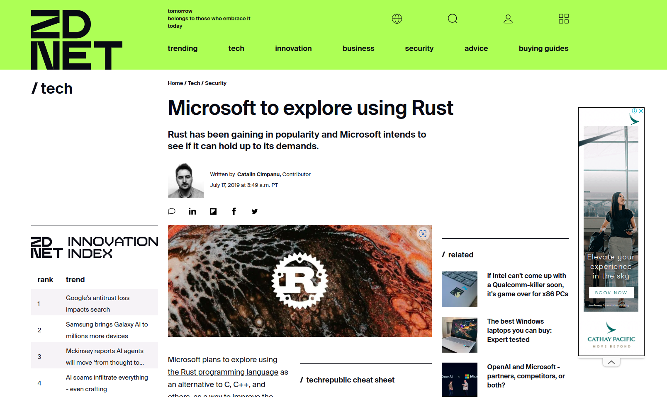
70% of all microsoft patches are for memory related bugs

Slide 8
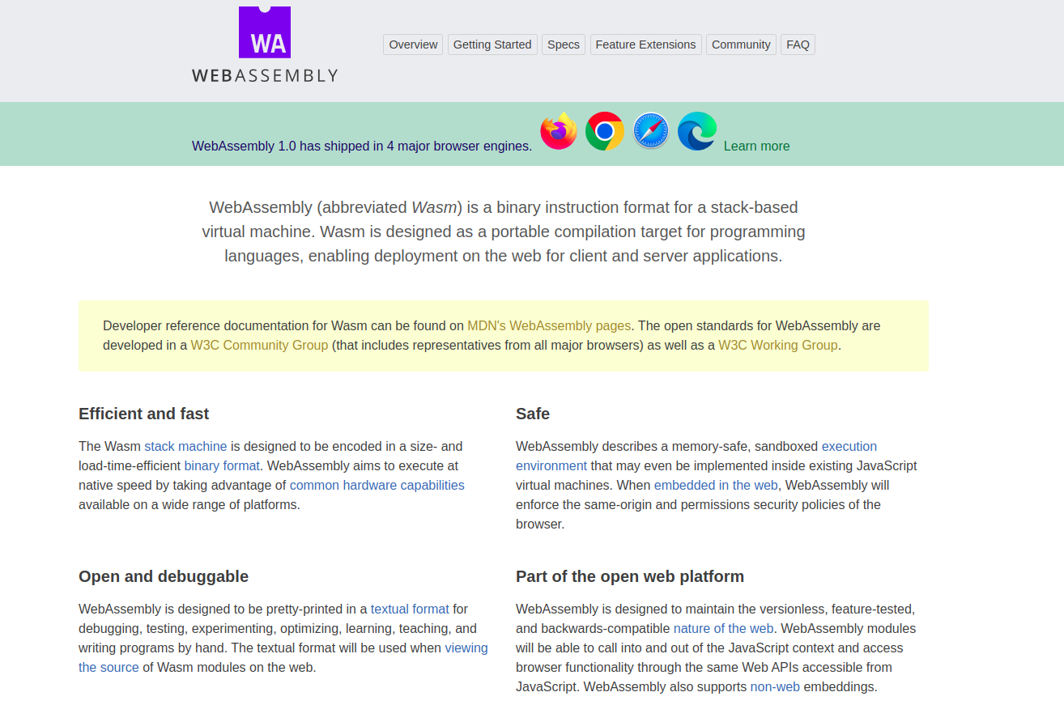
Web assembly

Slide 9
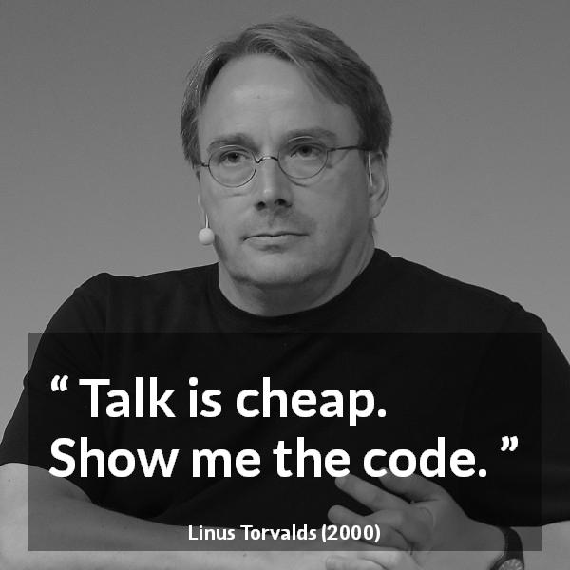

Slide 10
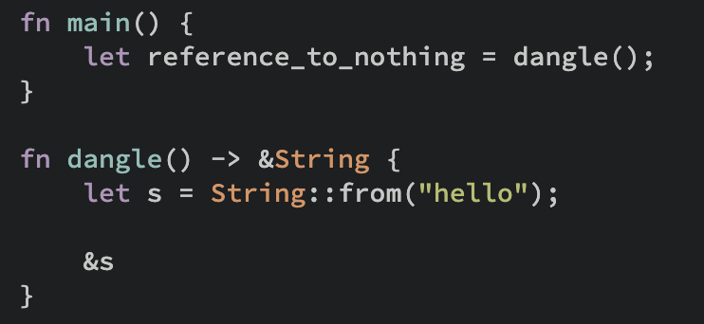
Dangling Pointers

Slide 11
RAII
use std::fs::File;
use std::io::{self, Write};
use std::sync::Mutex;
fn write_to_file(message: &str) -> Result<(), io::Error> {
// |mutex| is to protect access to
// |file| (which is shared across threads).
static FILE_MUTEX: Mutex<()> = Mutex::new(());
// Lock |mutex| before accessing |file|.
let _lock = FILE_MUTEX.lock().unwrap();
// Try to open file.
let mut file = File::create("example.txt")?;
// Write |message| to |file|.
writeln!(file, "{}", message)?;
// |file| will be closed first when leaving scope (regardless of result)
// |mutex| will be unlocked second (from |_lock| destructor) when
// leaving scope (regardless of result).
Ok(())
}
fn main() {
match write_to_file("Hello, RAII in Rust!") {
Ok(()) => println!("Write successful."),
Err(err) => eprintln!("Error writing to file: {}", err),
}
}

Slide 12
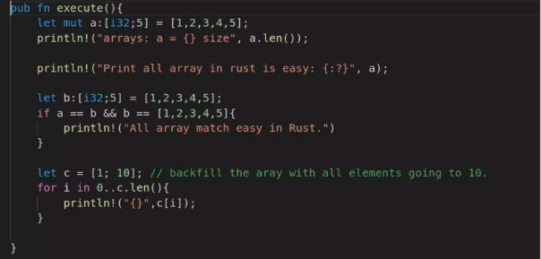
Immutable and Mutable

Slide 13
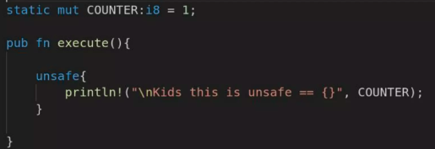
Unsafe

Slide 14
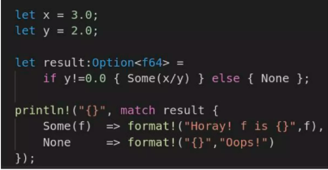
Option <T>

Slide 15
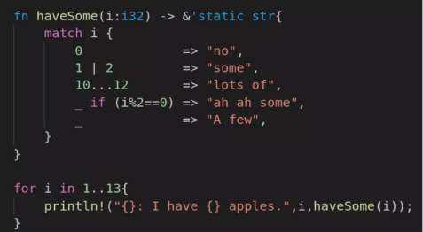
Pattern Matching

Slide 16
Resources
https://doc.rust-lang.org/book/
https://docs.rs/rdkafka/latest/rdkafka/
https://rust-lang.github.io/async-book/
https://www.oreilly.com/library/view/designing-data-intensive-applications/9781491903063/

