Slide 1
WEB-TECH PROJECT (UE19CS204)

Slide 2
Community blog space
Submitted by:
Name | SRN | Section
Sahil Elton Lobo | PES2UG19CS348 | F
Sinchan Samajdar | PES2UG19CS390 | F
Serena A. Gomez | PES2UG19CS372 | F

Slide 3
ABSTRACT OF THE PROJECT
Community blogs are predominantly websites where many authors can post journal entries on a single space and where people can respond by commenting on posts to the community blog.
Our website is created with the intention of bringing like-minded bloggers together to create an active field of discussion.
It allows you to submit your blog article which can then be reviewed and promoted by other users.
The review can be done by either a voting system or by commenting on the post, or both!
Each post is submitted under predefined categories to make them easier to find.

Slide 4
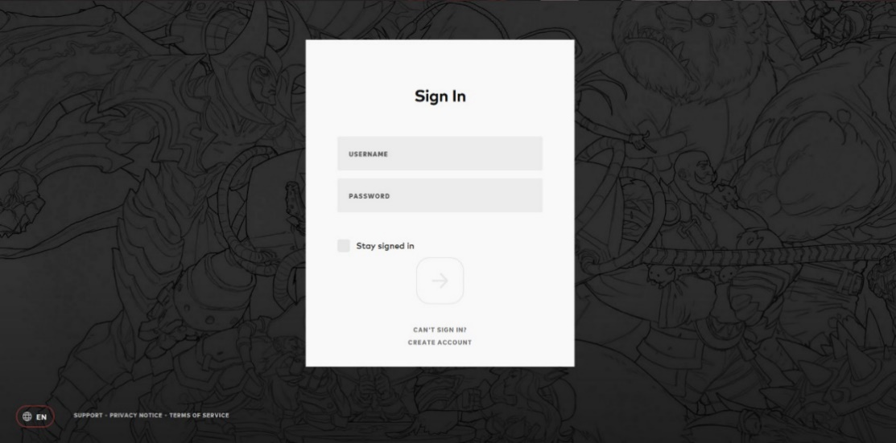
functionalities
Sign-in page: If the user already has an account. Similar to the image below:
Sign-up page: if the user wants to create a new account.

Slide 5
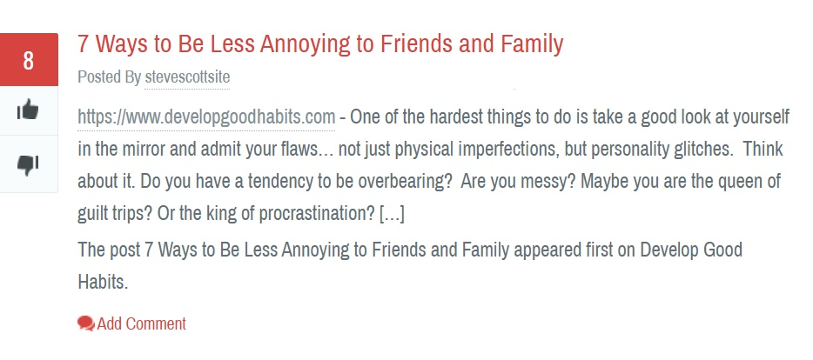
Profile page: consisting of the users’ info and posts.
Home page: consisting of the various categories of posts, and the top voted posts in each category
Each category will have a page of its own, consisting of posts under that category only.
Each post will have both a comment section and a voting system; a link to the bloggers article and its title, or just a random post. They will be similar to the image below:

Slide 6
Thank you.

