Slide 1

UE19CS204 – Web Technologies Mini Project
Project Title – Community Blog Space
Section – F
Sahil Elton Lobo – PES2UG19CS348
Serena A. Gomez – PES2UG19CS372
Sinchan Samajdar – PES2UG19CS390
GITHUB Link - https://github.com/sahilpesugit/CommBlogg

Slide 2
ABSTRACT OF THE PROJECT
Community blogs are predominantly websites where many authors can post journal entries on a single space.
Our website is created with the intention of bringing like-minded bloggers together.
It allows you to submit your blog article which can then be reviewed and promoted by other users.
The review can be done by a voting system on the post.

Slide 3
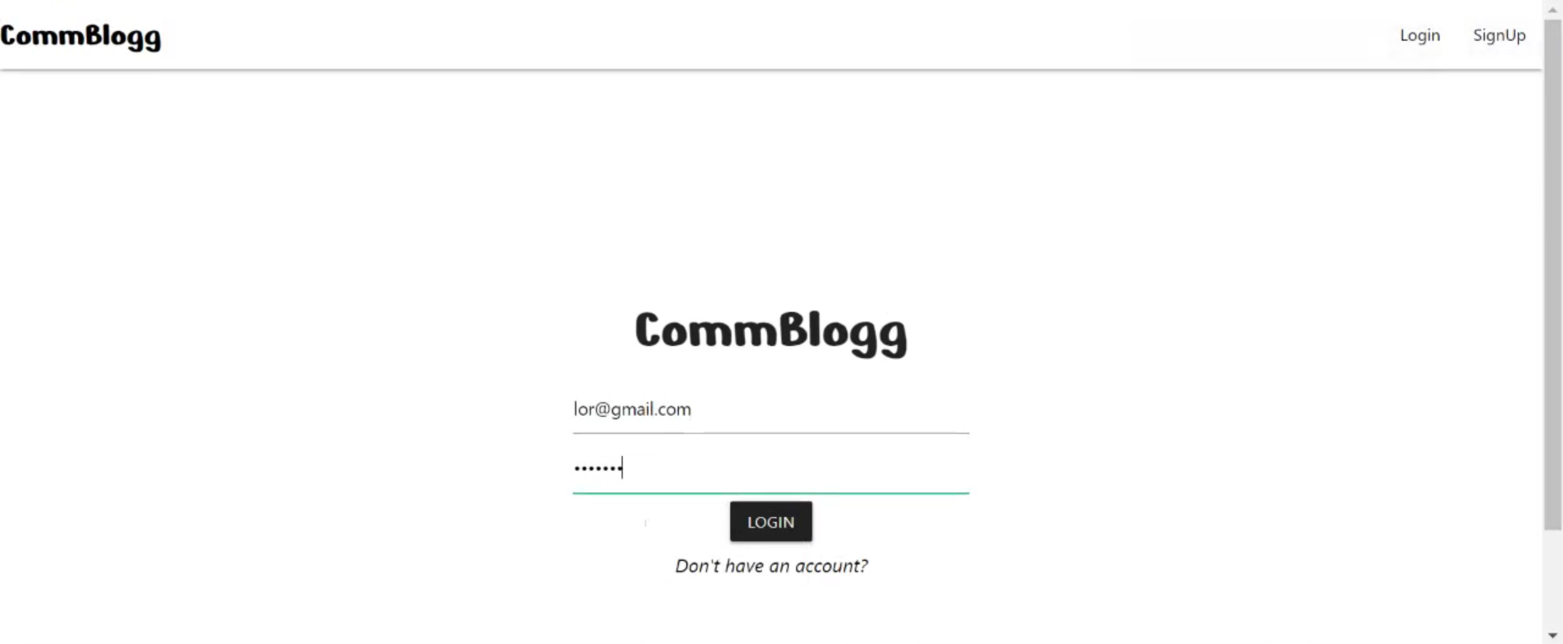
functionalities
Log-in page—If the user already has an account, a page similar to the image below will be seen to the user:
There are two fields on this page, one to enter an email and one to enter a password.
These fields check the database for existing users.

Slide 4
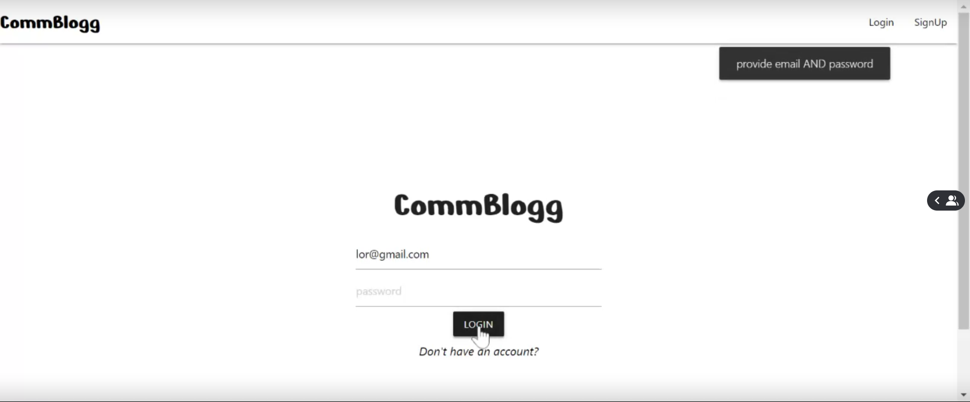
If the entered details don’t belong to an existing user, he/she will have to create a new account via the Signup links in the navigation bar, which redirects them to a sign-up page.
The page checks if both the required fields are filled and gives an indicator if they are not.

Slide 5
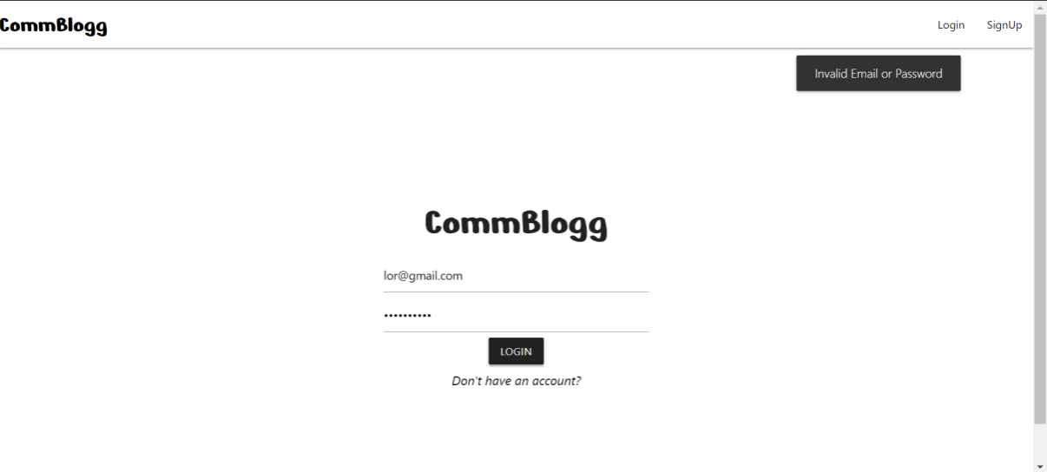
This message pops up when the password entered for the email is incorrect, or when the email doesn’t exist in the database.

Slide 6
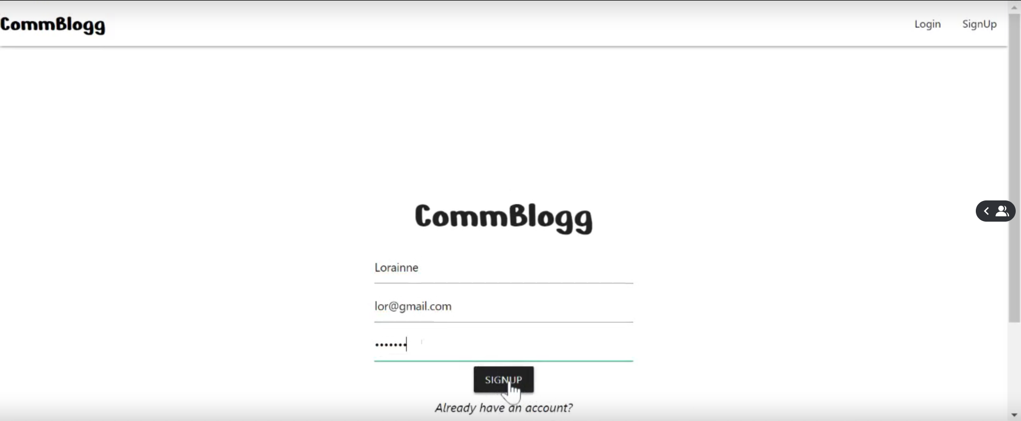
Signup Page:
The fields on the signup page have a RegEx check to validate the entered email id.
The entered password is masked.
On entering all valid details and clicking on the ‘SIGNUP’ button, a new user will be registered.

Slide 7
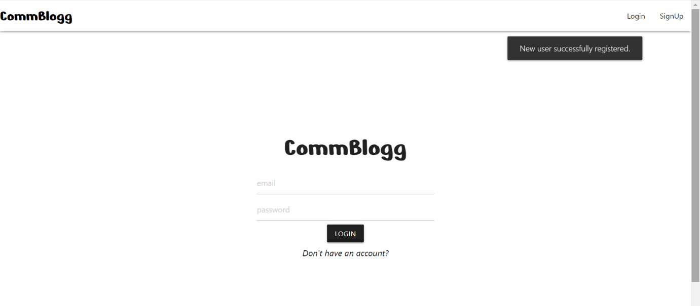
On registering a new user successfully, you would be redirected to the login page where you can use your credentials to log in.

Slide 8
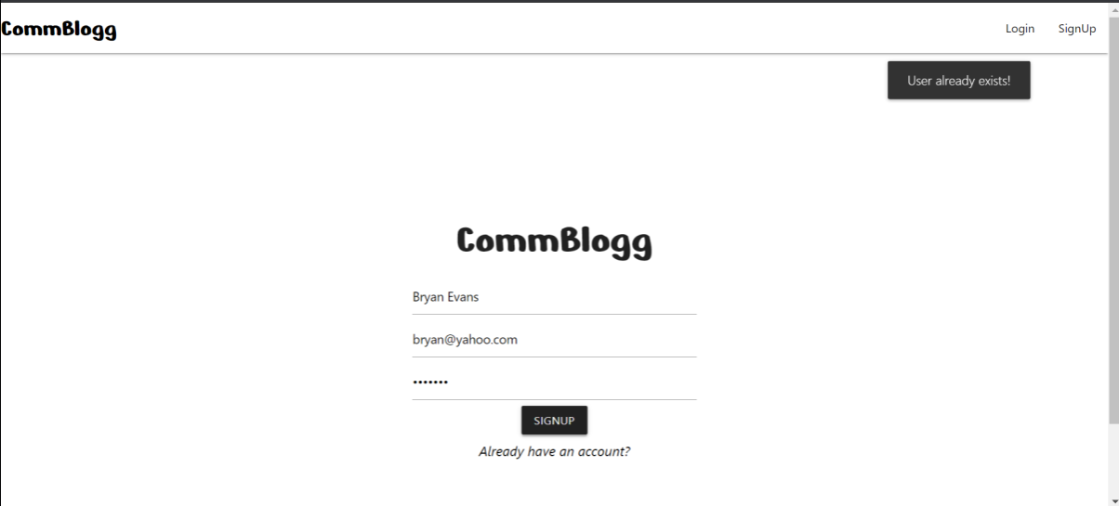
This message pops up while registering, if a pre-existing email id is entered.

Slide 9
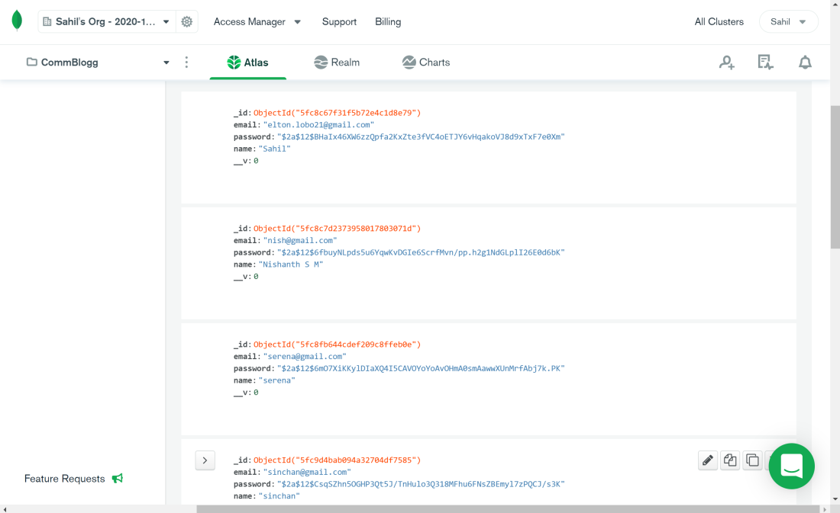
User database schema implemented using MongoDB.
User details are stored in this database, and the passwords are stored in a hashed method, ensuring user privacy.

Slide 10
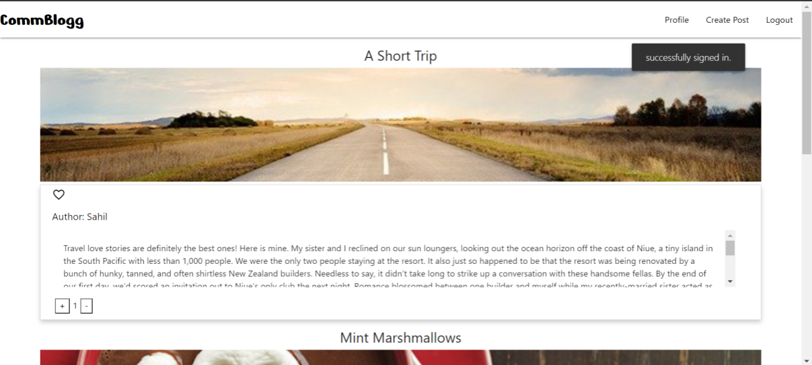
Home Page:
On signing in successfully, the user will be redirected to the home page, which contains the blogs posted by all users of the platform.
The User can interact with these posts via the voting poll.
The navigation bar, on signing in successfully, provides links to the user’s profile, create post, and log out.

Slide 11
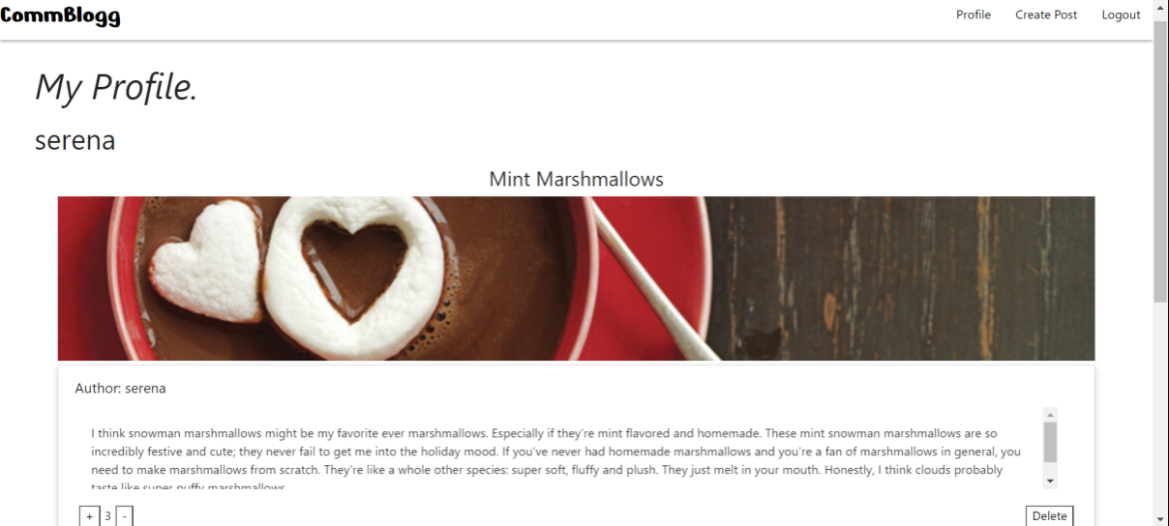
Profile page:
The profile page contains all the posts posted by the user currently logged in.
The user can delete their posts from this page.

Slide 12
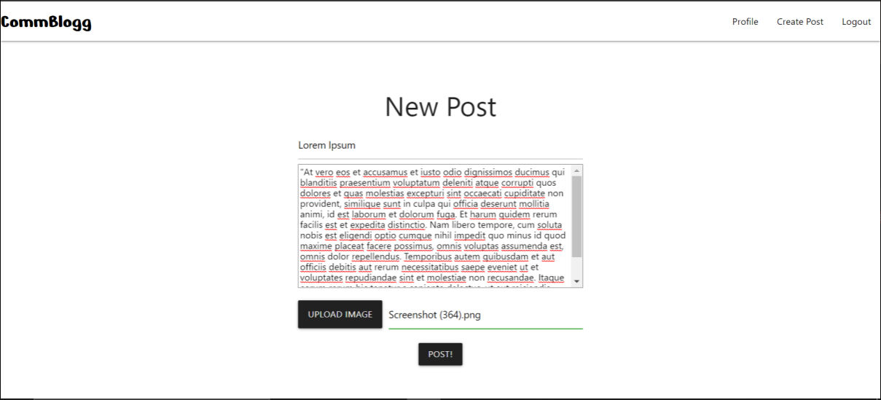
Create Post:
This page allows the user to create a new post by filling out the fields—Title, body and an image.
The ‘Post!’ button, posts the content onto the blog.
All the fields are required to be filled before the user can post.

Slide 13
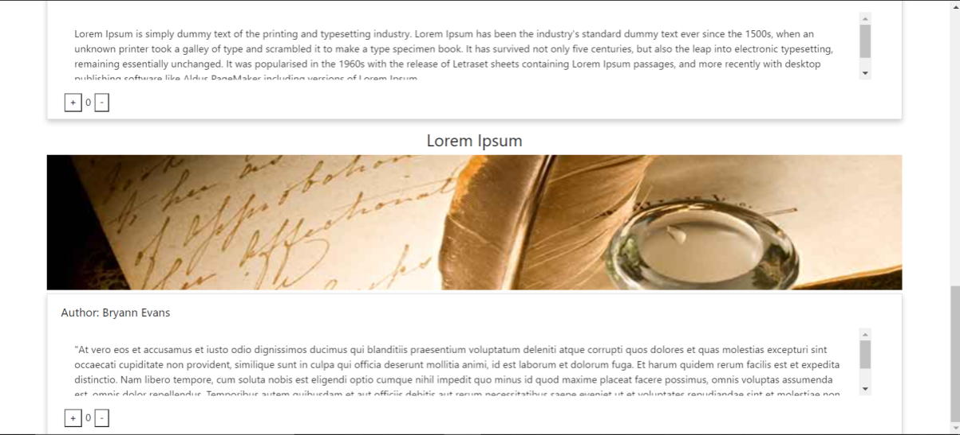
On successfully creating a new post, the post will appear on the home page of all other users, as well as the profile page of the current user.

Slide 14
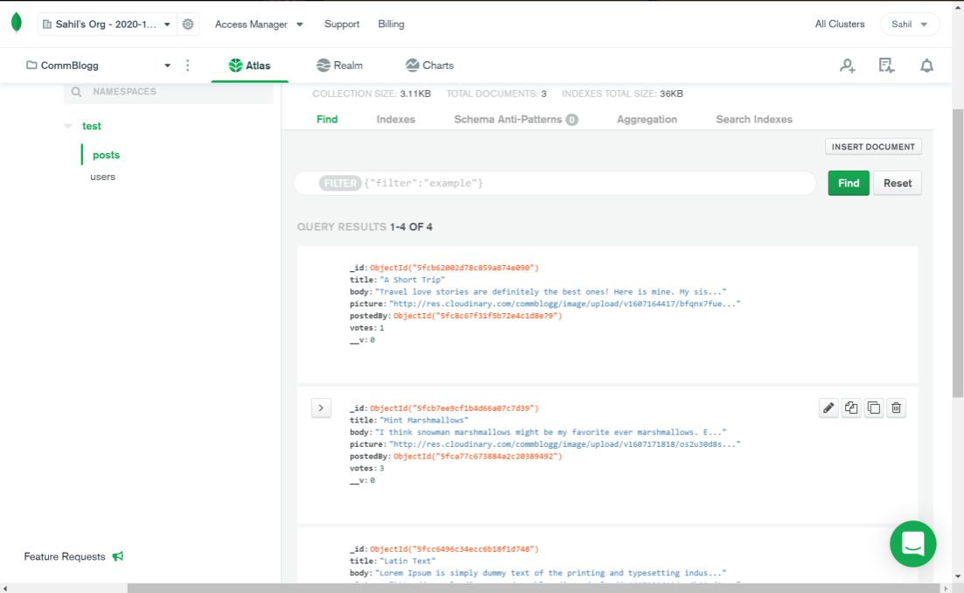
Post database schema implemented using MongoDB.
Post details are stored in this database, which consists of two Ids: posted by (user id) and post id.
This also contains the image URL of the pictures uploaded by the users.
These images are stored on a cloud-based media management system called Cloudinary.

Slide 15
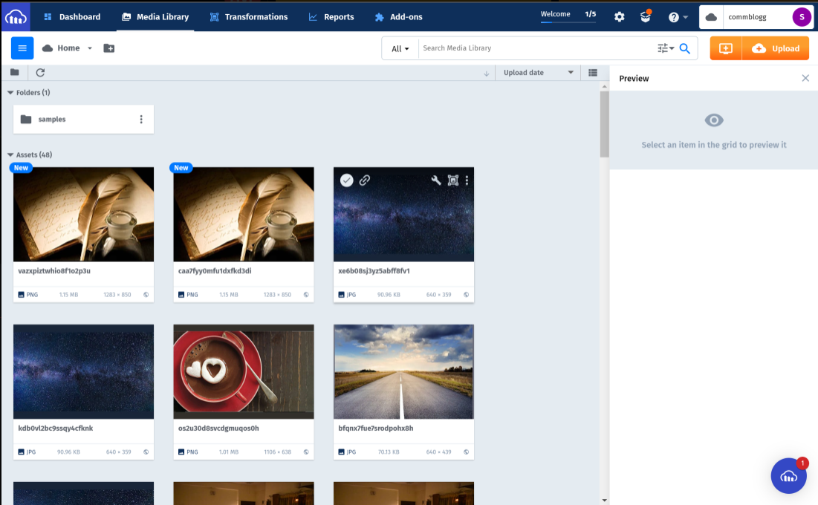
UI of Cloudinary, that contains the images posted by users.

Slide 16
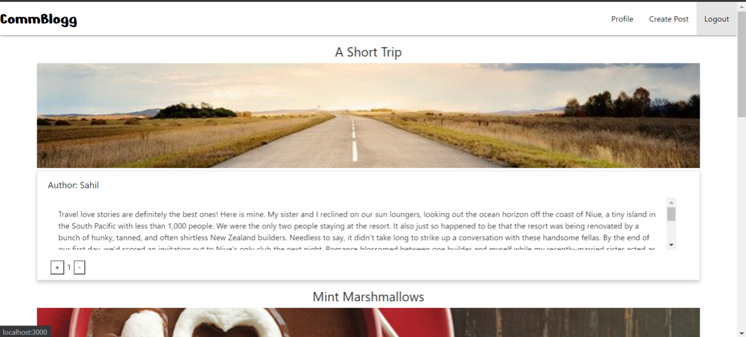
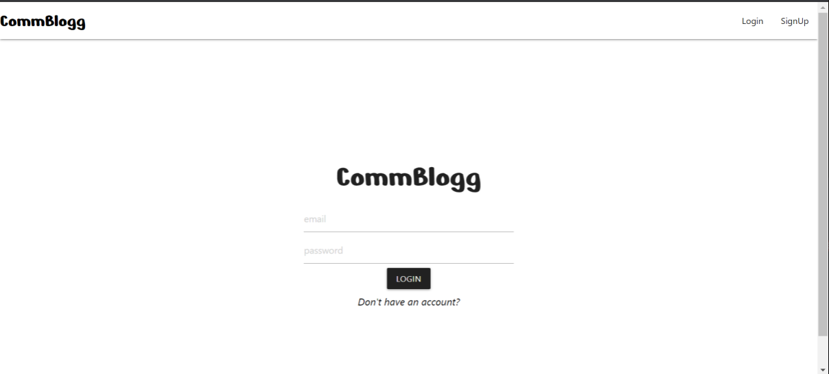
On clicking the Logout button on the top right corner, logs the user out, and redirects them to the login page.

Slide 17
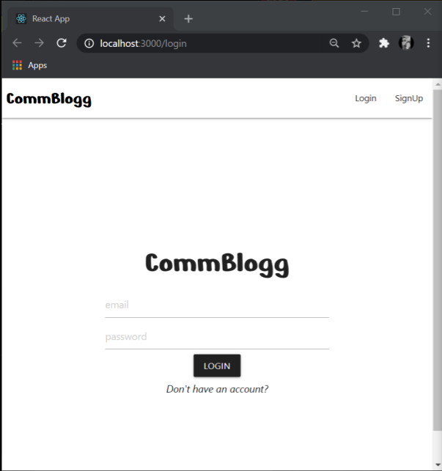
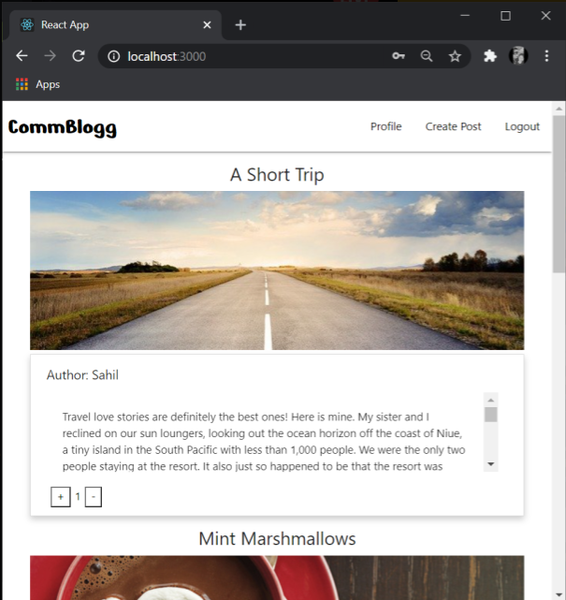
Versatile

Slide 18
Contributions
Sahil Elton Lobo – PES2UG19CS348
Server Side: Authorization route, User schema, Post Schema
Client Side: Login and Signup screens, Logout function.
Serena A. Gomez – PES2UG19CS372
Server Side: Login request middleware, Post route.
Client Side: Home page, Create post, Navigation Bar.
Sinchan Samajdar – PES2UG19CS390
Server Side: app.js , keys.js
Client Side: App.js, Profile screen, Delete Post.

Slide 19
Thank you.

