Slide 1
PANTHORA
PREMIUM STREETWEAR E-COMMERCE PLATFORM
Full-Stack MERN Web Application
College Project Presentation | Built with MongoDB • Express.js • React • Node.js
Presented by: Arpit

Slide 2
PROJECT OVERVIEW
What is Panthora Clothing?
Panthora Clothing is a full-stack e-commerce web application designed for a premium streetwear brand specializing in hoodies, tees, and joggers.
The platform features a sleek dark-mode aesthetic with glassmorphic UI elements, JWT-based authentication, real-time product catalog with filtering/sorting, persistent shopping cart, COD checkout, order tracking, and a dedicated Admin Portal for complete store management.
Frontend
React 18 (Vite)
Redux Toolkit
Tailwind CSS
React Router v6
Backend
Node.js
Express.js
JWT Authentication
REST API
Database
MongoDB / Mongoose
In-Memory Fallback
Auto-Seeding
Tools
Axios + Interceptors
react-hot-toast
react-icons
Concurrently

Slide 3
FEATURES
Key Features & Capabilities
🎨 Dark Mode Design
🔐 JWT Authentication
Custom color palette (#0a0a0a background, #d4c5a9 gold accents), glassmorphism navigation, Outfit + Inter typography
Secure user registration & login with bcrypt password hashing, role-based access control (user/admin)
🛍️ Product Catalog
🛒 Cart & Checkout
Filter by category (Hoodies, Tees, Lowers), sort by price/newest, detailed product pages with size/color selectors
Persistent cart with localStorage, quantity management, COD checkout with shipping address form
📦 Order Tracking
⚙️ Admin Control Center
Customers track order status: Pending → Confirmed → Shipped → Delivered, full order history
Manage Products (CRUD), Manage Categories, Manage Orders with status updates, live dashboard KPIs
📱 Responsive Design
🔄 Auto-Seeding
Fully responsive across mobile, tablet, and desktop with mobile hamburger menu navigation
Database auto-populates with 12 streetwear products, 3 categories, and demo admin account on startup

Slide 4
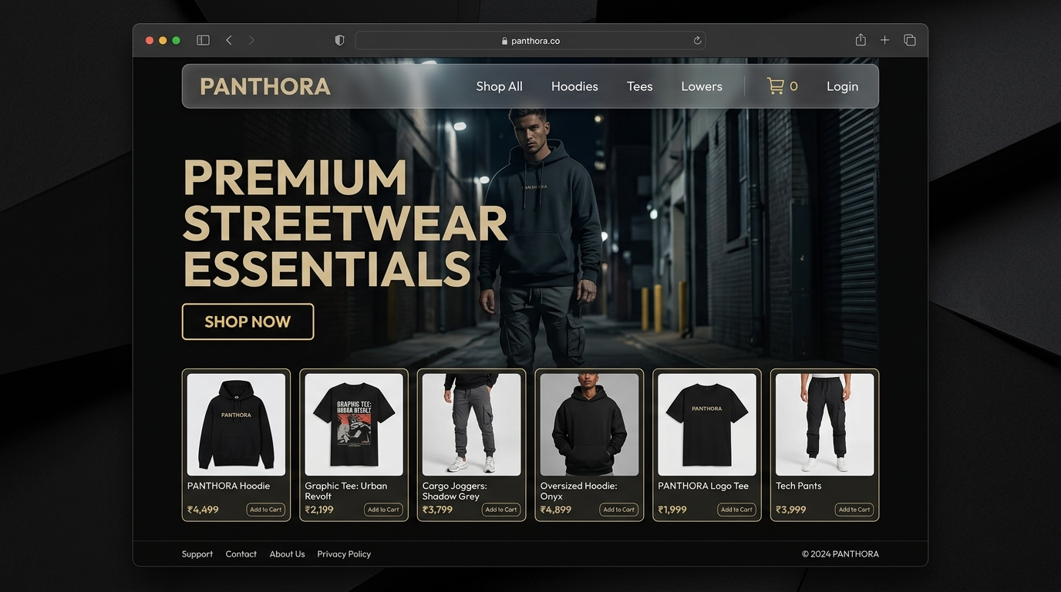
CUSTOMER FRONTEND
Homepage — Hero & Featured Products
Key Highlights
• Bold hero section with brand tagline and CTA button
• Featured products grid showcasing hoodies, tees, and joggers
• Glassmorphic navbar with category links, cart, and auth buttons
• Dark premium aesthetic with gold (#d4c5a9) accent colors
• Responsive layout adapting to mobile, tablet, and desktop

Slide 5
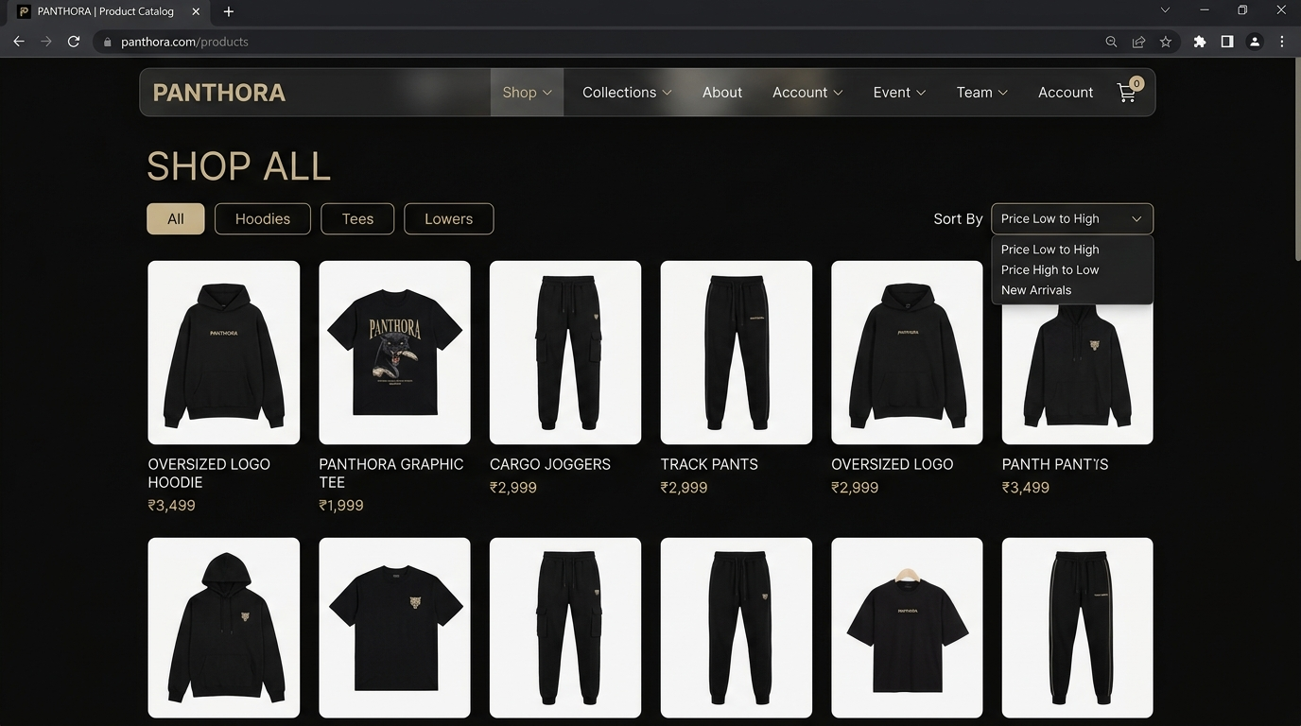
CUSTOMER FRONTEND
Product Catalog — Browse & Filter
Key Highlights
• Full product grid with all streetwear items
• Category filter buttons: All, Hoodies, Tees, Lowers
• Sort options: Price Low→High, Price High→Low, Newest
• Product cards with image, name, price in INR
• Click-to-navigate product detail routing

Slide 6
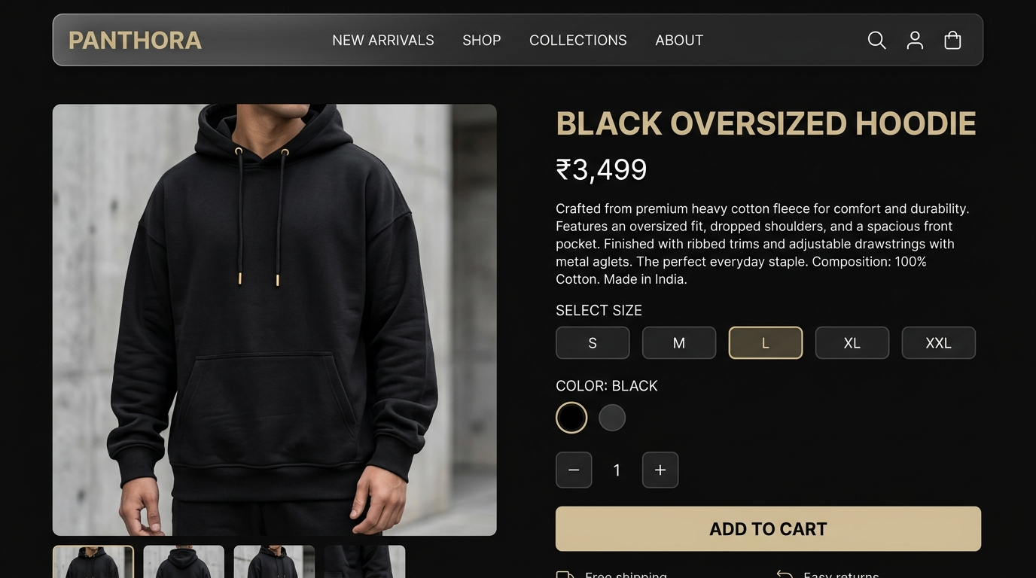
CUSTOMER FRONTEND
Product Detail — Size, Color & Cart
Key Highlights
• Large product image with detail view
• Product name, price (₹), and description
• Interactive size selector (S, M, L, XL, XXL)
• Color picker with visual circle selectors
• Quantity counter and ADD TO CART button
• Cart persisted via localStorage

Slide 7
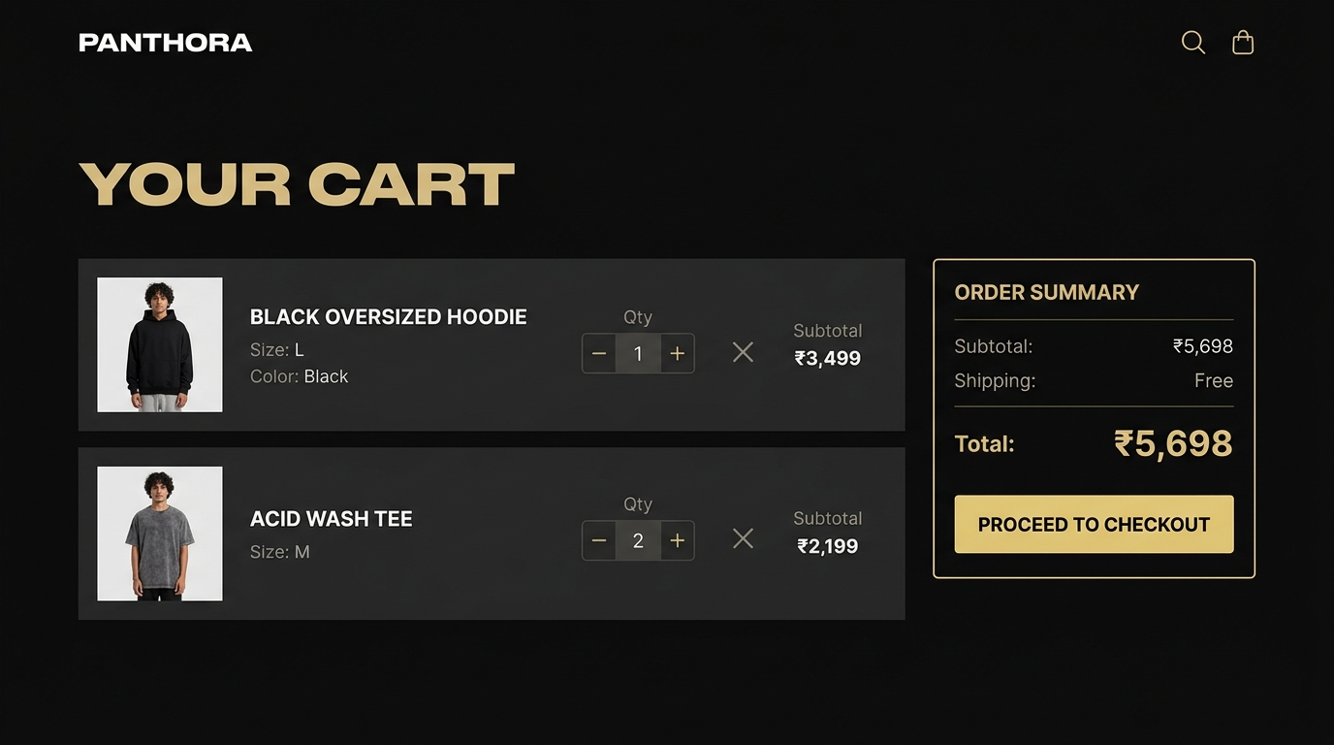
CUSTOMER FRONTEND
Shopping Cart — Review & Checkout
Key Highlights
• Cart items with thumbnails, name, size, color, quantity
• Inline quantity +/- controls and remove button
• Order Summary with subtotal calculation
• Free shipping display
• PROCEED TO CHECKOUT CTA button
• Persistent across browser sessions (localStorage)

Slide 8
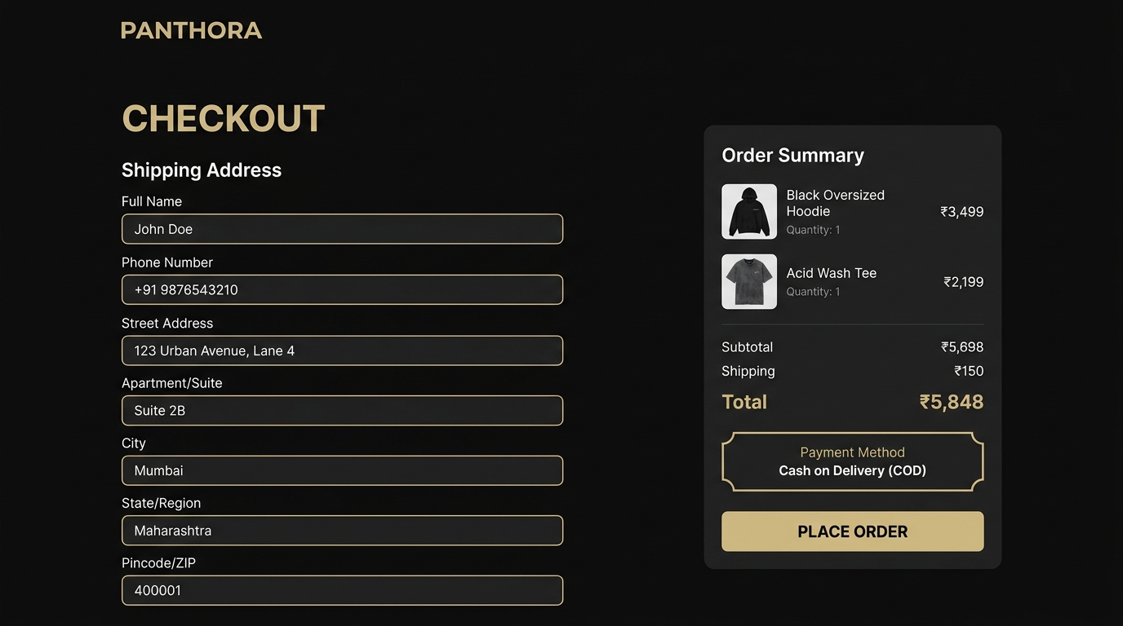
CUSTOMER FRONTEND
Checkout — Shipping & Order Placement
Key Highlights
• Shipping address form with validation:
Full Name, Phone, Address, City, State, Pincode
• Order Summary with item breakdown
• Cash on Delivery (COD) payment method
• Total amount display
• PLACE ORDER button submits to backend API

Slide 9
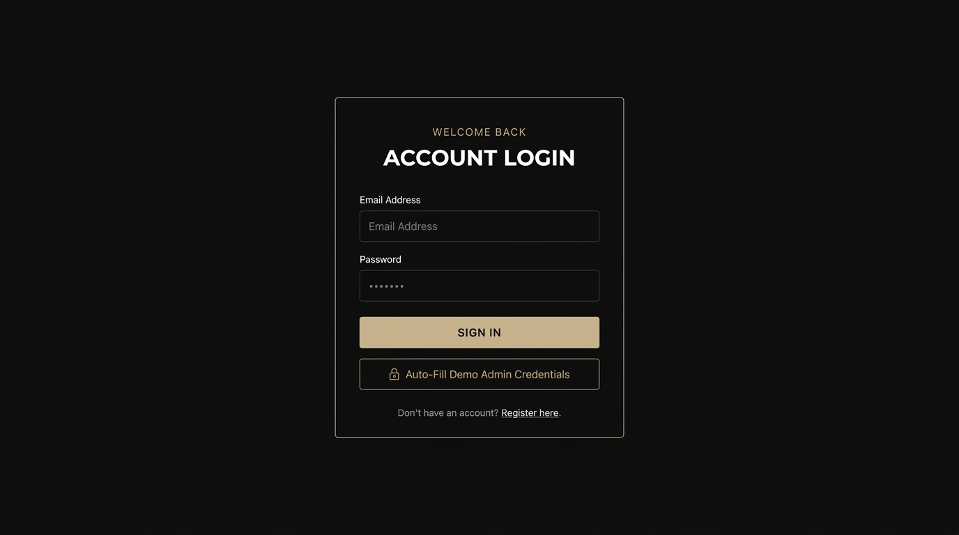
USER AUTHENTICATION
Authentication — Login & Registration
Key Highlights
• JWT-based secure authentication
• Email + Password login form with validation
• Auto-Fill Demo Admin Credentials button
• Role-based redirect (Admin → Dashboard)
• Registration with Name, Email, Password, Phone
• bcrypt password hashing on server side

Slide 10
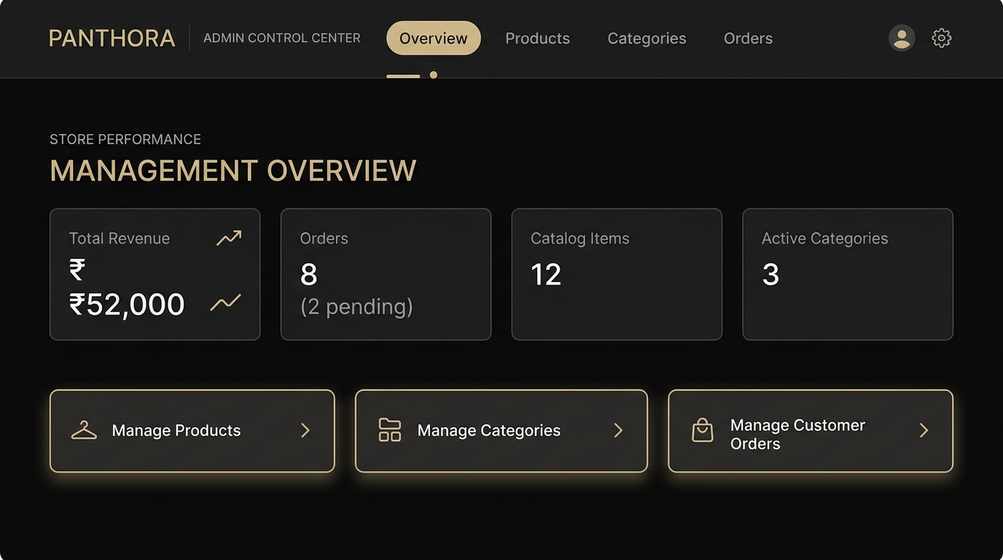
ADMIN CONTROL CENTER
Admin Dashboard — Store KPIs & Overview
Key Highlights
• Real-time KPI cards:
Total Revenue, Orders, Catalog Items, Active Categories
• Pending orders alert badge
• Low stock warning banner
• Quick navigation cards to Products, Categories, Orders
• Admin nav bar with tab switching

Slide 11
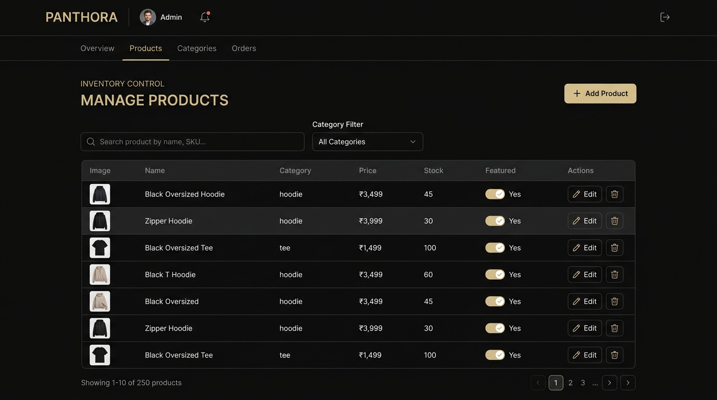
ADMIN CONTROL CENTER
Admin — Product Inventory Management
Key Highlights
• Full product table with Image, Name, Category, Price, Stock, Featured columns
• Add Product button → Modal form with all fields
• Search products by name
• Filter by category dropdown
• Low stock alert badges (<10 items)
• Edit and Delete actions per product

Slide 12
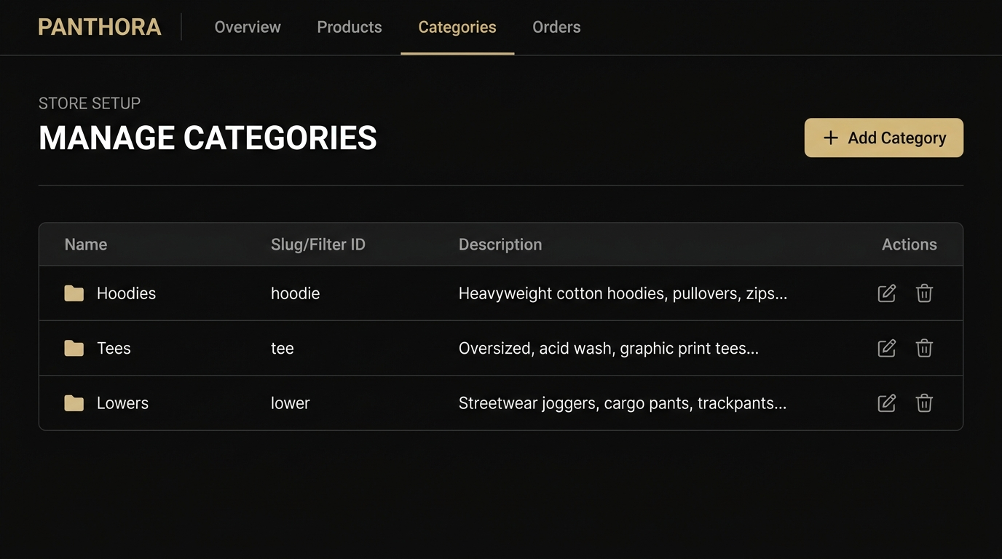
ADMIN CONTROL CENTER
Admin — Category Management
Key Highlights
• Category table with Name, Slug (URL ID), Description
• Add Category → Modal with auto-slug generation
• Edit category name, slug, and description
• Delete categories safely
• Dynamic integration with product forms
• Auto-seeded: Hoodies, Tees, Lowers

Slide 13
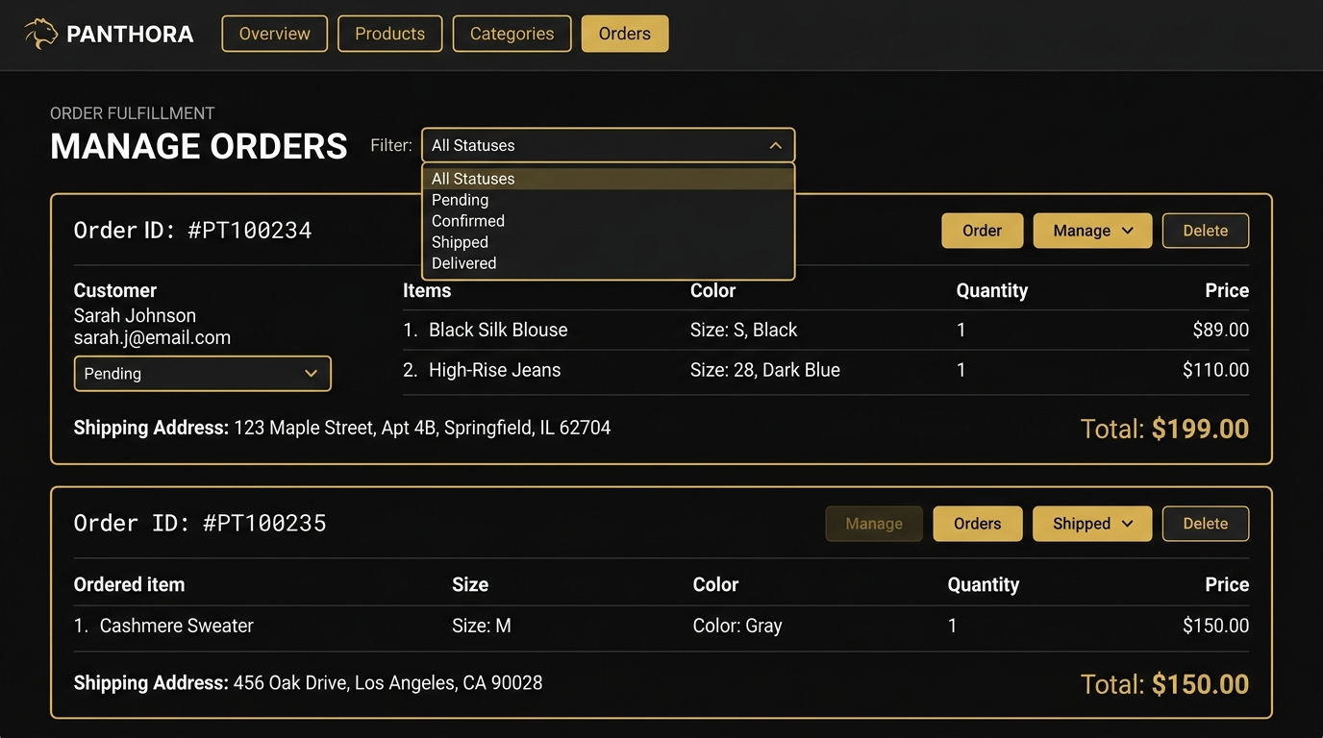
ADMIN CONTROL CENTER
Admin — Order Fulfillment & Tracking
Key Highlights
• View all incoming COD orders
• Filter by status: Pending, Confirmed, Shipped, Delivered, Cancelled
• Status dropdown to update fulfillment
• Customer details: name, email, phone
• Shipping address and pincode
• Item breakdown with size/color/qty/price

Slide 14
ARCHITECTURE
System Architecture & API Design
AUTH
PRODUCTS
CATEGORIES
ORDERS
POST /api/auth/register
POST /api/auth/login
GET /api/auth/me
GET /api/products
GET /api/products/:id
POST /api/products (Admin)
PUT /api/products/:id (Admin)
DELETE /api/products/:id (Admin)
GET /api/categories
POST /api/categories (Admin)
PUT /api/categories/:id (Admin)
DELETE /api/categories/:id (Admin)
POST /api/orders
GET /api/orders/myorders
GET /api/orders (Admin)
PUT /api/orders/:id/status (Admin)

Slide 15
THANK YOU
Panthora Clothing — Premium Streetwear E-Commerce
✦ Full-Stack MERN Application (MongoDB, Express, React, Node.js)
✦ JWT Authentication with Role-Based Access (User & Admin)
✦ 12+ Products Auto-Seeded with 3 Dynamic Categories
✦ Complete Admin Portal: Products, Categories & Order Management
✦ Premium Dark Mode UI with Glassmorphism & Micro-Animations
✦ Production-Ready: Deployable on Vercel + Render
Built by Arpit • github.com/arpit • 2026

