Slide 1
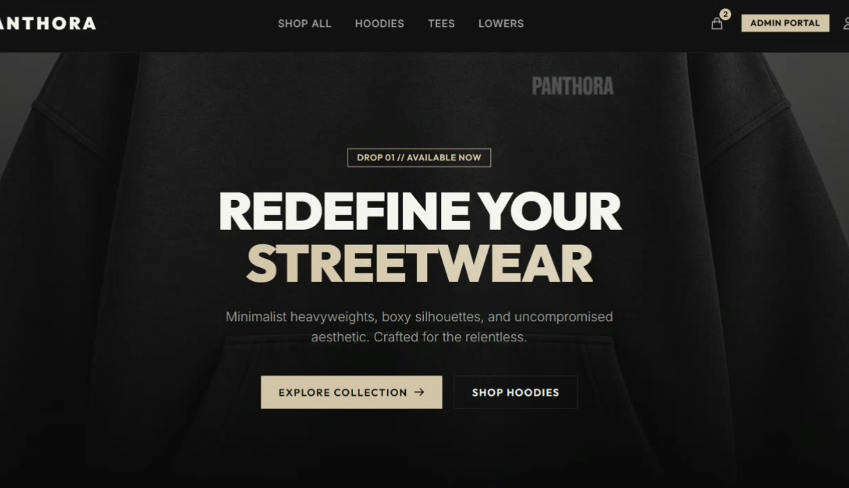
PANTHORA
FULL-STACK MERN WEB APPLICATION
Premium streetwear e-commerce platform
MongoDB • Express.js • React • Node.js

Slide 2
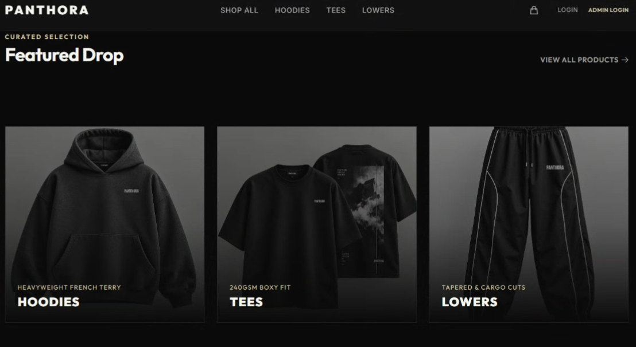
01 / INTRODUCTION
02 / 20
Project Profile & Introduction
PROJECT PROFILE
INTRODUCTION
PANTHORA CLOTHING
What is Panthora Clothing?
A complete storefront + administration system built around a premium streetwear experience.
Panthora Clothing is a full-stack e-commerce web application designed for a premium streetwear brand specializing in hoodies, tees, and joggers.
PROJECT TYPE
DOMAIN
Full-stack MERN e-commerce
Premium streetwear
Dark-mode aesthetic with glassmorphic UI elements
JWT-based authentication and role-based access
Real-time product catalog with filtering and sorting
Persistent shopping cart, COD checkout and order tracking
Dedicated Admin Portal for complete store management
CORE STACK
ACCESS
MongoDB / Express / React / Node
Customer + Admin
PANTHORA / 2026

Slide 3
01 / INTRODUCTION · 02 / SYSTEM STUDY
03 / 20
Technology Profile & Software Requirement
Technology & Platform Profile
FRONTEND
BACKEND
DATABASE
TOOLS
React 18 (Vite)
Redux Toolkit
Tailwind CSS
React Router v6
Node.js
Express.js
REST API
JWT Authentication
MongoDB / Mongoose
In-memory fallback
Auto-seeding
Axios + interceptors
react-hot-toast
react-icons
concurrently
Software Requirement
Frontend
React 18 / Vite / Redux Toolkit / Tailwind CSS
Security
JWT / bcrypt
Routing
React Router v6
Utilities
Axios / react-hot-toast / react-icons / concurrently
Backend
Node.js / Express.js / REST API
Deployment
Vercel / Render
Database
MongoDB / Mongoose
PANTHORA / 2026

Slide 4
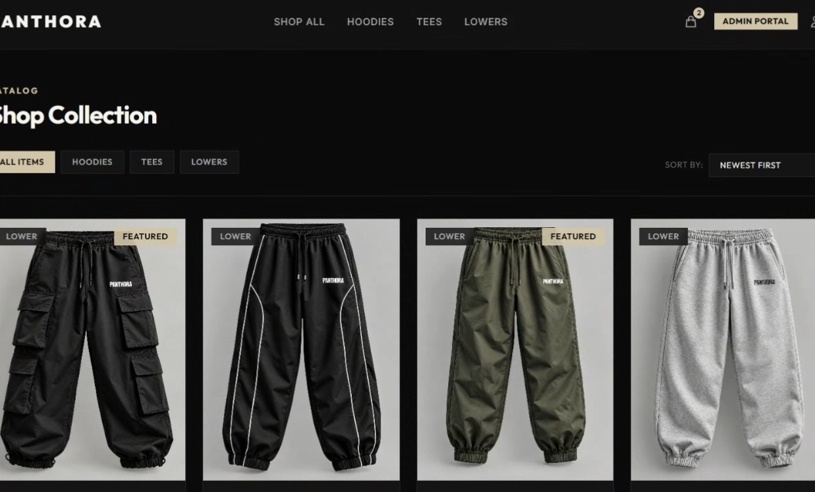
02 / SYSTEM STUDY & ANALYSIS
04 / 20
System Study & Existing / Baseline Experience
02 · SYSTEM STUDY
EXISTING / BASELINE
System Study
Baseline Store Experience
A focused digital storefront for browsing, purchasing, authentication and store administration.
The presentation source does not document a separate legacy application; the project is presented as a purpose-built digital storefront.
1
2
BROWSING
PURCHASING
Product discovery through categories, filters and sorting.
Cart, shipping details and Cash on Delivery checkout.
CUSTOMER
AUTH
Browse → detail → cart → checkout
Register / login / role routing
3
4
ACCOUNT
OPERATIONS
CATALOG
ADMIN
Secure login / registration with role-based routing.
Admin tools for products, categories and customer orders.
Category filters + sorting
Products / categories / orders
PANTHORA / 2026

Slide 5
02 / SYSTEM STUDY & ANALYSIS
05 / 20
Need For New System & Hardware Requirement
Need For New System
Hardware Requirement
01
Reduce friction in product discovery and checkout
The project source does not specify fixed hardware minimums. The application is browser-based and deployed as a web system.
02
Provide fast, accurate catalog information
WEB
API
DATA
Responsive UI
REST services
MongoDB
03
Improve data security through JWT authentication
04
Manage products, categories and orders centrally
CLIENT
Desktop / laptop / mobile browser
05
Keep shopping cart state persistent across sessions
RUNTIME
Node.js server environment
STORAGE
MongoDB database
06
Provide a responsive premium storefront experience
DEPLOYMENT
Vercel + Render
PANTHORA / 2026

Slide 6
02 / SYSTEM STUDY & ANALYSIS
06 / 20
DFD 0.0 System Context & E-R Diagram
DFD 0.0 — System Context
E-R Diagram
USER
ORDER
ORDER ITEM
CUSTOMER
PANTHORA SYSTEM
ADMIN
browse • login • cart • order
manage • update • fulfill
ADMIN
PRODUCT
CATEGORY
DATA STORES
AUTH
PRODUCTS
Customers place orders • products belong to categories • order items reference products • admins manage store data
CATEGORIES
ORDERS
PANTHORA / 2026

Slide 7
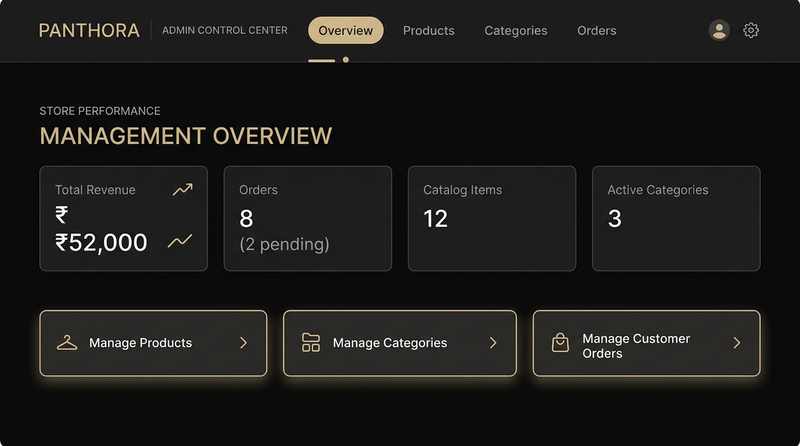
02 / SYSTEM STUDY & ANALYSIS
07 / 20
First Level DFD — Customer & Admin
Customer
01
02
03
04
05
06
Browse catalog
View product
Authenticate
Manage cart
Checkout
Track order
Admin
01
02
03
04
05
Admin login
Dashboard KPIs
Manage products
Manage categories
Manage orders
PANTHORA / 2026

Slide 8
03 / SYSTEM DESIGN & DEVELOPMENT
08 / 20
System Design & Data Dictionary
System Design & Development
From data and API design to customer flows, administration and deployment.
UI
STATE
API
DATA
React
Redux
Express
MongoDB
Data Dictionary
Core data objects represented by the application's documented features and admin workflows.
USER
PRODUCT
CATEGORY
ORDER
CART
Registration, login, role-based access
Name, price, category, stock, featured state
Hoodies, Tees, Lowers + slugs/descriptions
Customer, shipping details, items, status
Items, quantity, size, color, persisted state
PANTHORA / 2026

Slide 9
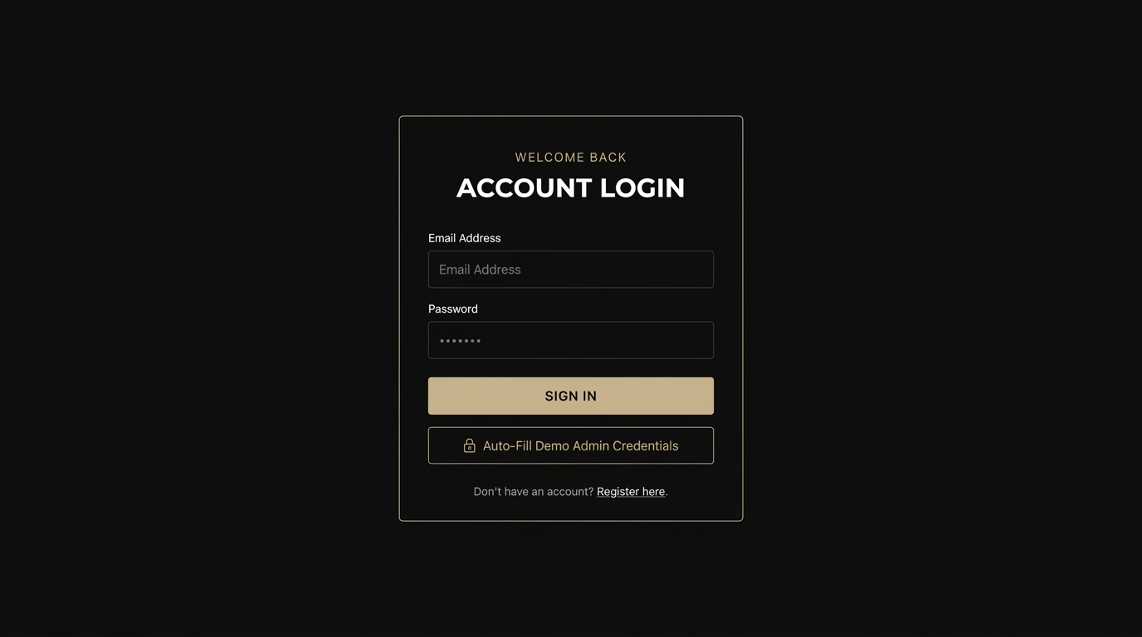
03 / SYSTEM DESIGN & DEVELOPMENT
09 / 20
Data Dictionary — User & Product
User
Product
IDENTITY
Name / email / phone
NAME
Product title
AUTH
Password handled server-side with bcrypt
PRICE
INR selling price
ACCESS
User or Admin role
CATEGORY
Hoodies / Tees / Lowers
SESSION
JWT-based authentication
STOCK
Available units
ROUTING
Admin redirects to dashboard
FEATURED
Homepage / featured state
VARIANTS
Size and color selectors
PANTHORA / 2026

Slide 10
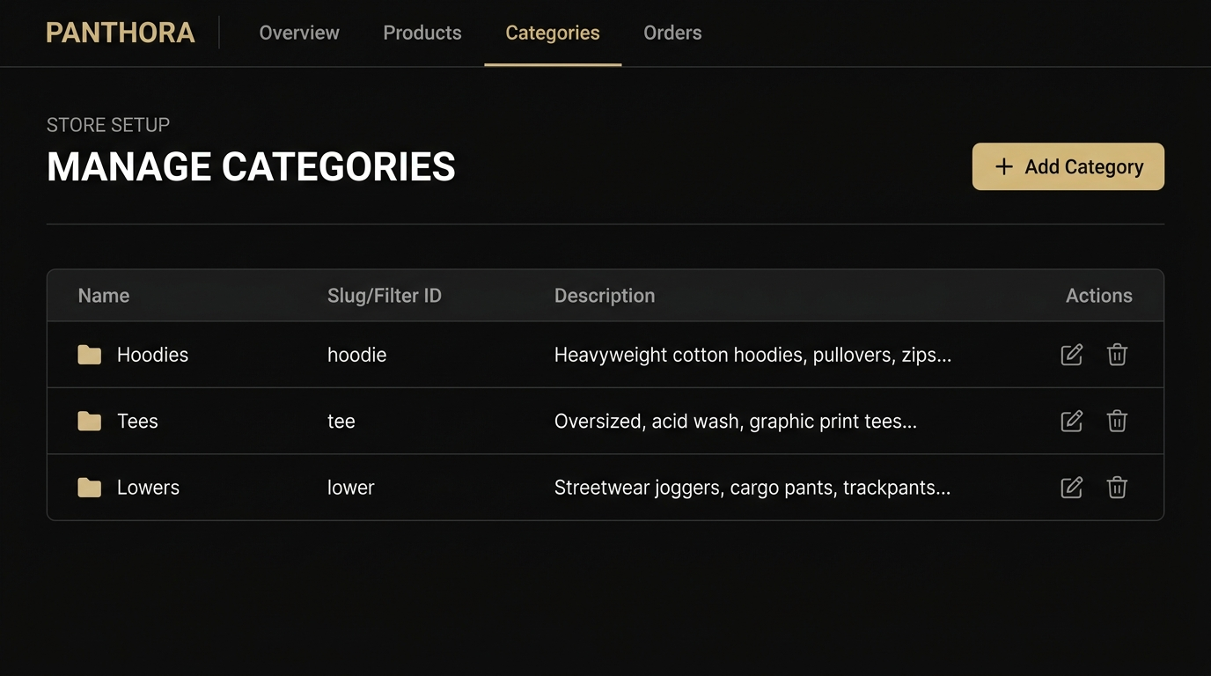
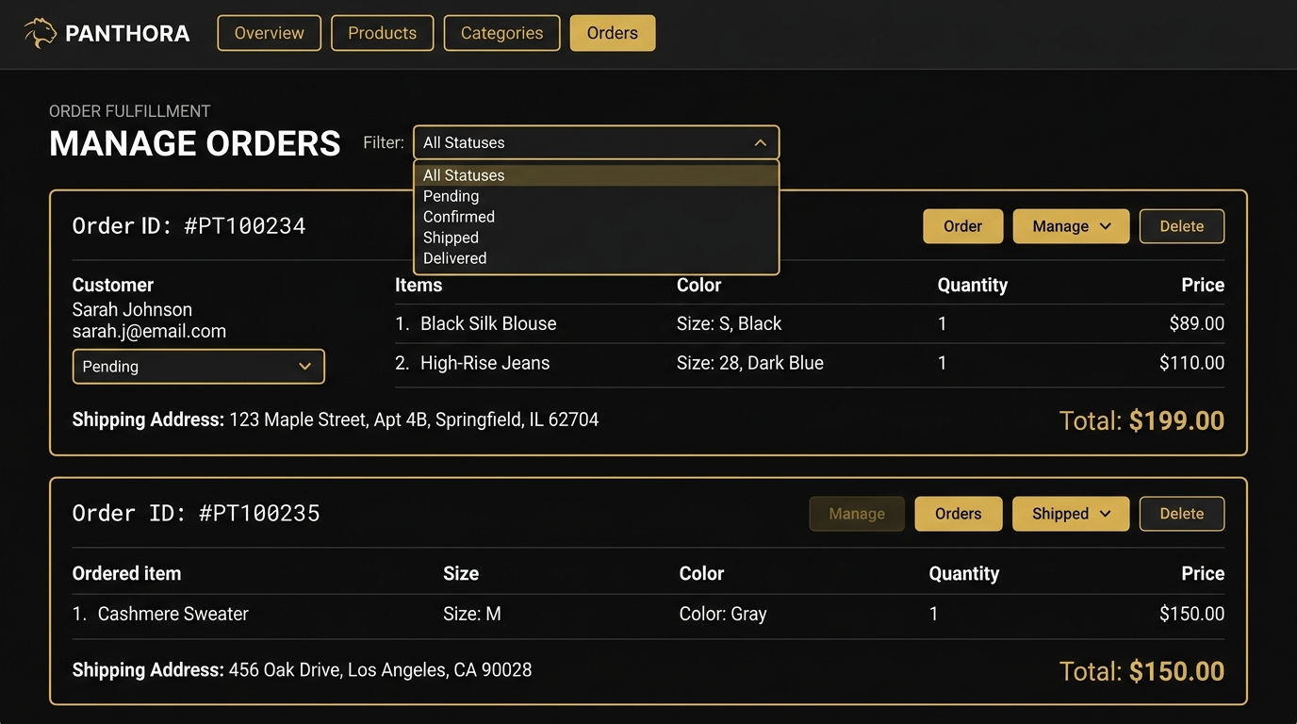
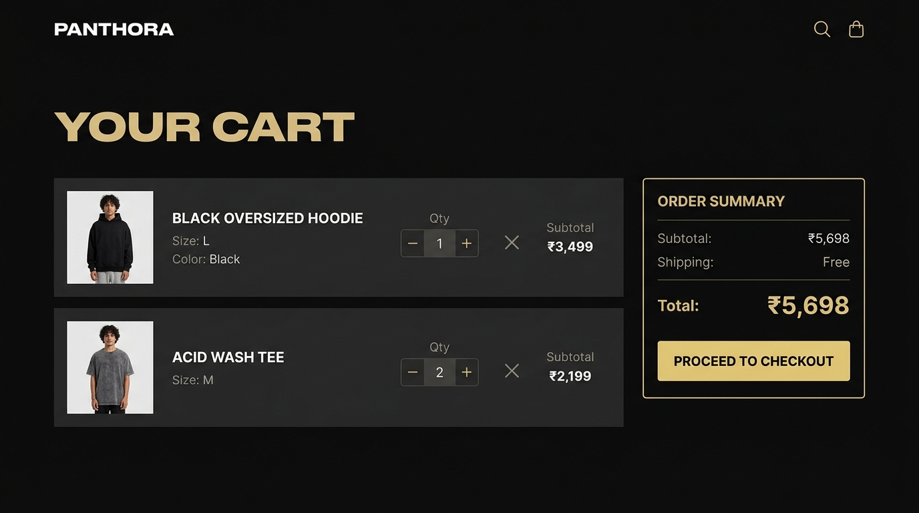
03 / SYSTEM DESIGN & DEVELOPMENT
10 / 20
Data Dictionary — Category, Order & Cart
Category
Order
Cart & Session State
NAME
Category label
CUSTOMER
Name, email, phone
ITEM
Product + thumbnail
SLUG / FILTER ID
Used for catalog filtering and routing
SHIPPING
Address, city, state, pincode
VARIANT
Size + color
DESCRIPTION
Category explanation
ITEMS
Product, size, color, quantity, price
QUANTITY
Inline +/- controls
SEEDED DATA
Hoodies • Tees • Lowers
PAYMENT
Cash on Delivery
TOTAL
Subtotal calculation
ADMIN CONTROL
Add / edit / delete
STATUS
Pending → Confirmed → Shipped → Delivered / Cancelled
PERSISTENCE
localStorage
PANTHORA / 2026

Slide 11
04 / INPUT DESIGN
11 / 20
Input Design & Homepage
04 · INPUT DESIGN
Homepage — Hero & Featured Products
Input Design
Customer inputs move through authentication, catalog selection, cart and checkout.
Bold hero section with brand tagline and CTA
Featured products grid: hoodies, tees, joggers
Glassmorphic navbar with category links, cart and auth
Dark premium aesthetic with gold accents
Responsive across mobile, tablet and desktop
PANTHORA / 2026

Slide 12
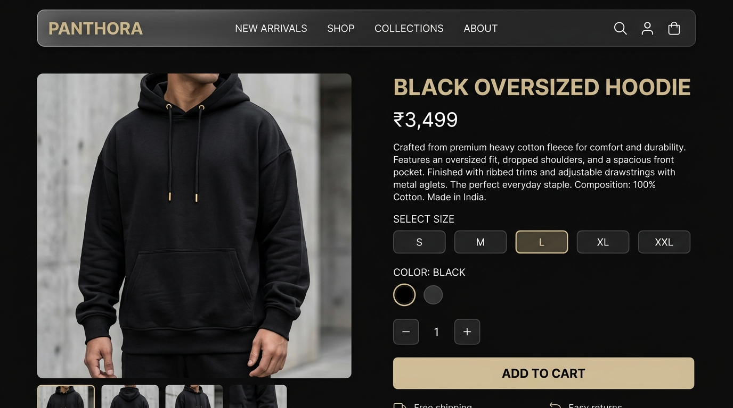
04 / INPUT DESIGN
12 / 20
Product Catalog & Product Detail
Product Catalog — Browse & Filter
Product Detail — Size, Color & Cart
Full product grid
All / Hoodies / Tees / Lowers filters
Sort by price or newest
Product cards show image, name and INR price
Click-to-navigate product detail routing
Large product image and detail view
Product name, price and description
Size selector: S / M / L / XL / XXL
Color picker and quantity controls
ADD TO CART + localStorage persistence
PANTHORA / 2026

Slide 13
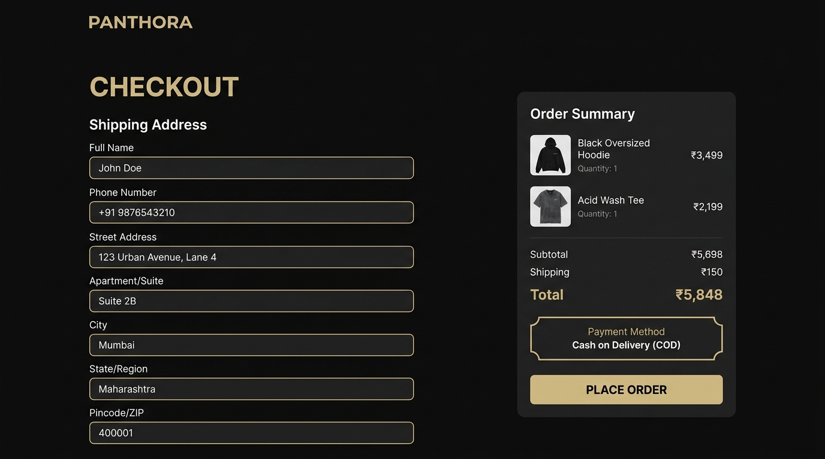
04 / INPUT DESIGN
13 / 20
Shopping Cart & Checkout
Shopping Cart — Review & Checkout
Checkout — Shipping & Order Placement
Cart items with thumbnail, name, size, color and quantity
Inline quantity +/- and remove controls
Order summary with subtotal
Free shipping display
PROCEED TO CHECKOUT CTA
Full Name, Phone, Address, City, State, Pincode
Validation before submission
Order summary with item breakdown
Cash on Delivery payment method
PLACE ORDER submits to backend API
PANTHORA / 2026

Slide 14
04 / 05 · INPUT → OUTPUT DESIGN
14 / 20
Authentication & Admin Control Center
Authentication — Login & Registration
Admin Control Center
JWT-based secure authentication
Email + Password login with validation
Auto-Fill Demo Admin Credentials
Role-based redirect: Admin → Dashboard
Registration with Name, Email, Password, Phone
bcrypt password hashing on server side
Store management, inventory, categories and customer order fulfillment.
PANTHORA / 2026

Slide 15
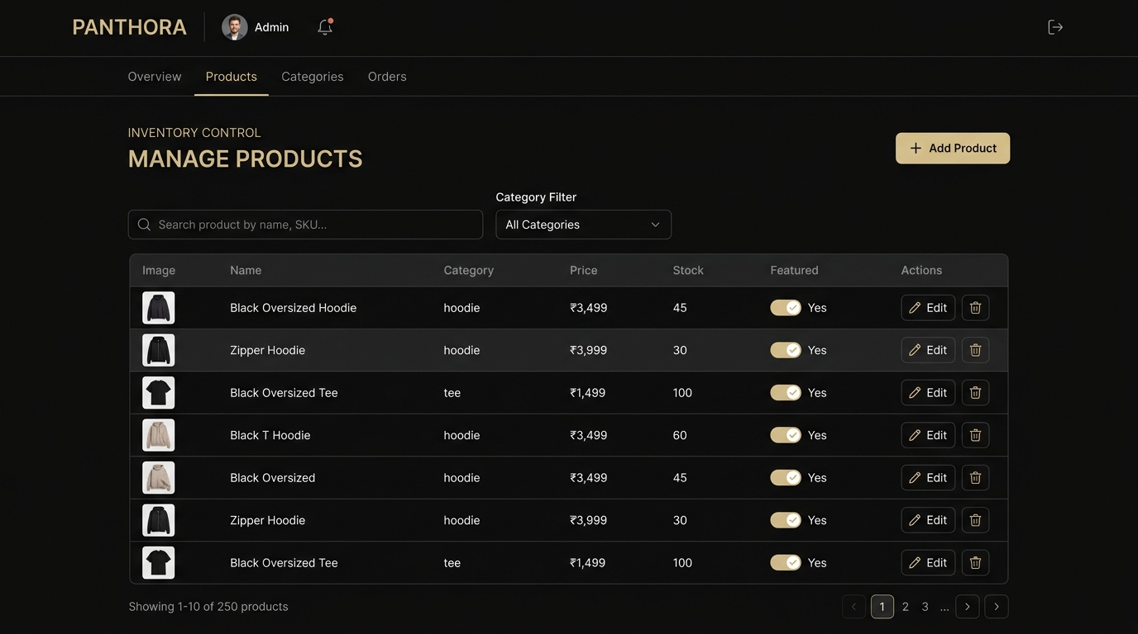
05 / OUTPUT DESIGN
15 / 20
Admin Dashboard & Product Inventory
Admin Dashboard — Store KPIs & Overview
Admin — Product Inventory Management
Total Revenue / Orders / Catalog Items / Active Categories
Pending orders alert badge
Low stock warning banner
Quick navigation to Products, Categories and Orders
Admin navigation with tab switching
Image, Name, Category, Price, Stock, Featured
Add Product modal
Search by product name
Filter by category
Edit / Delete actions and low-stock alerts
PANTHORA / 2026

Slide 16
05 / OUTPUT DESIGN
16 / 20
Category Management & Order Fulfillment
Admin — Category Management
Admin — Order Fulfillment & Tracking
Name, Slug and Description table
Add Category with auto-slug generation
Edit category details
Safe deletion controls
Auto-seeded: Hoodies, Tees, Lowers
View incoming COD orders
Filter by Pending / Confirmed / Shipped / Delivered / Cancelled
Update fulfillment status
Customer name, email, phone and shipping details
Item breakdown with size, color, quantity and price
PANTHORA / 2026

Slide 17
06 / SYSTEM ARCHITECTURE
17 / 20
System Architecture & Customer Data Flow
System Architecture & API Design
CUSTOMER / ADMIN React + Redux
AUTH register • login • me
ROUTING React Router
PRODUCTS list • detail • create • update • delete
API Express REST
CATEGORIES list • create • update • delete
DATA MongoDB / Mongoose
ORDERS create • myorders • admin orders
Customer Data Flow
USER
Browse / login
FRONTEND
React + Redux
API
Express
DATABASE
MongoDB
Product discovery • Authentication • Cart persistence • Checkout / order creation • Catalog reads • JWT validation • Order API • Data persistence
PANTHORA / 2026

Slide 18
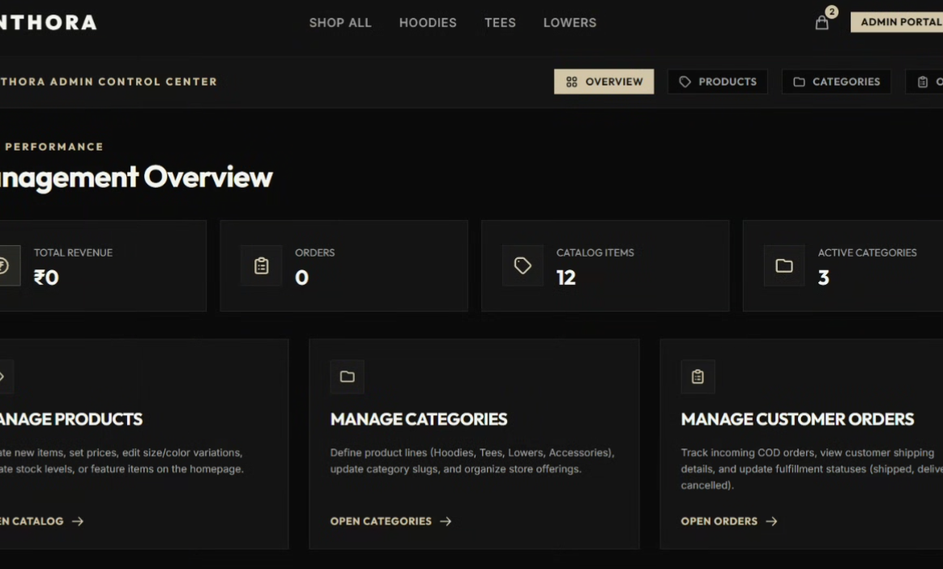
06 / SYSTEM ARCHITECTURE
18 / 20
Admin Data Flow & API Design Overview
Admin Data Flow
API Design Overview
ADMIN
Login
ADMIN PORTAL
Dashboard
API
Products / Categories / Orders
DATABASE
MongoDB
1 AUTH
JWT
2 PRODUCTS
ADMIN
POST /register
POST /login
GET /me
GET /products
GET /products/:id
POST / PUT / DELETE
Manage products
Manage categories
Update order status
3 CATEGORIES
ADMIN
4 ORDERS
ADMIN
GET /categories
POST / PUT / DELETE
POST /orders
GET /myorders
GET /orders
PANTHORA / 2026

Slide 19
07 / DEPLOYMENT
19 / 20
Production-Ready Architecture & Platform Delivers
Production-Ready Architecture
What the Platform Delivers
DEPLOYABLE
STOREFRONT
✓
Vercel + Render
01
Premium dark-mode shopping experience
SECURITY
✓
FRONTEND
BACKEND
02
Vercel
Render
JWT + role-based access
OPERATIONS
✓
03
DATABASE
SECURITY
Admin inventory + fulfillment
MongoDB
JWT + bcrypt
DATA
✓
04
Persistent cart + MongoDB
Production-ready web architecture with separated client, API and database layers.
✓
05
SCALE
Deployable full-stack architecture
PANTHORA / 2026

Slide 20
07 – 09 / SNAPSHOT · FUTURE · REFERENCES
20 / 20
Snapshot, Future Enhancements & References
Final Technical Snapshot
Future Enhancements
References
Full-stack MERN application
React 18 + Vite + Redux Toolkit
Express REST API + JWT
MongoDB / Mongoose
12+ products + 3 categories
Admin products / categories / orders
COD checkout + order tracking
Vercel + Render deployment
The supplied project content does not list a formal future-enhancement roadmap. The current platform is already positioned as production-ready and deployable.
Panthora Clothing project source content
Application screenshots and interface flows
Stack: MongoDB, Express.js, React, Node.js
Deployment: Vercel and Render
PRODUCT DEPTH
STORE OPERATIONS
Expand the catalog beyond the current 12+ seeded products.
Extend management workflows as the product range grows.
EXPERIENCE
DEPLOYMENT
Continue refining responsive UI, security and micro-interactions.
Scale the Vercel + Render architecture as usage increases.
THANK YOU
Premium Streetwear
Full-Stack MERN Application
PANTHORA
PANTHORA / 2026

