Slide 1
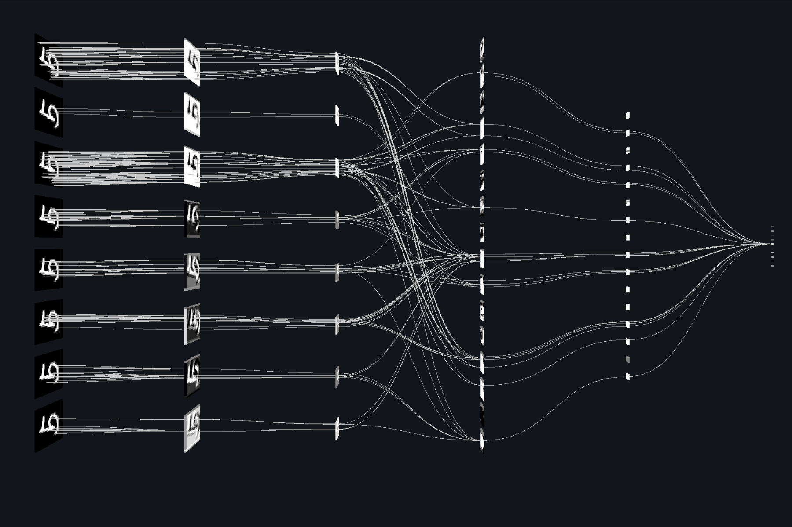
Image Recognition
Convolutional Neural Network
Sahil Pundora

Slide 2
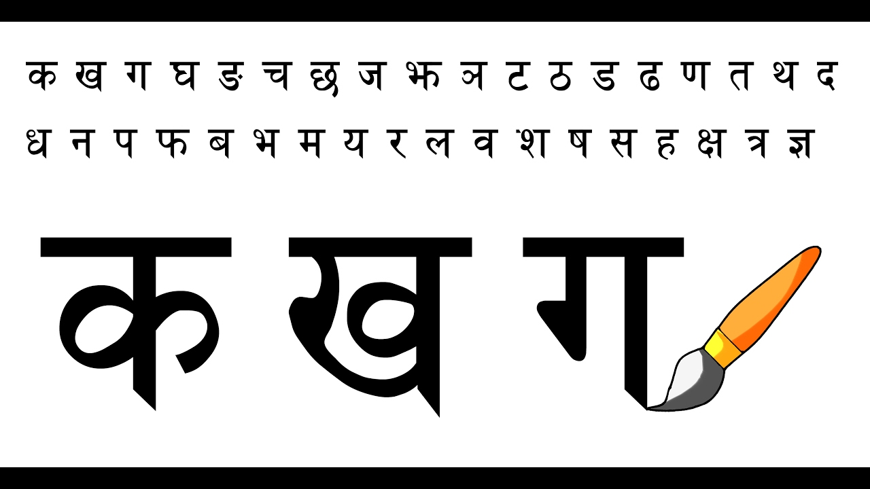
Devanagari Handwritten Character Dataset
Image database of Handwritten Devanagari(Hindi) characters
92,000 images of 46 classes of characters of Devanagari script from handwritten documents with 2000 examples each
Research Problem
Use CNN to recognize handwritten characters of Devanagari script with 46 target classes without any manual image preprocessing

Slide 3
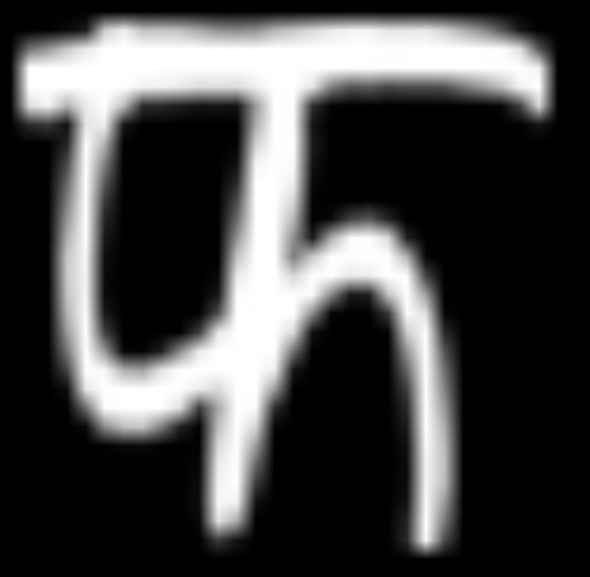

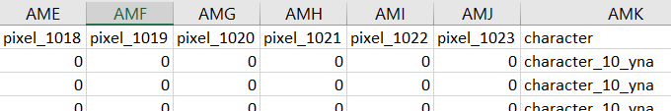
Dataset
Data Type: GrayScale Image
Image Format: .png
Resolution: 32 by 32
Images converted to array of 1024 (32X32) pixels with value ranging from 0 (Black) to 255(White)
Motivation
More pre-processing as compared to numerical dataset
High quality and greater size
Large number of target classes
Image Converted to Array

Slide 4
Convolutional Neural Network
Importing Dataset, Converting Image to Array (SciPy imread)
Target Label Encoding (SciPy), Normalizing, Target One Hot Encoding
Modelling: Conv2D -> Max Pooling -> Dropout
Flattening -> Dense Layer -> Output
Analyzing and Optimizing - Tensorboard
Training 60% (54,740 Samples)
Validating 25% (23,460 Samples)
Testing 15% (13,800 Samples)

Slide 5
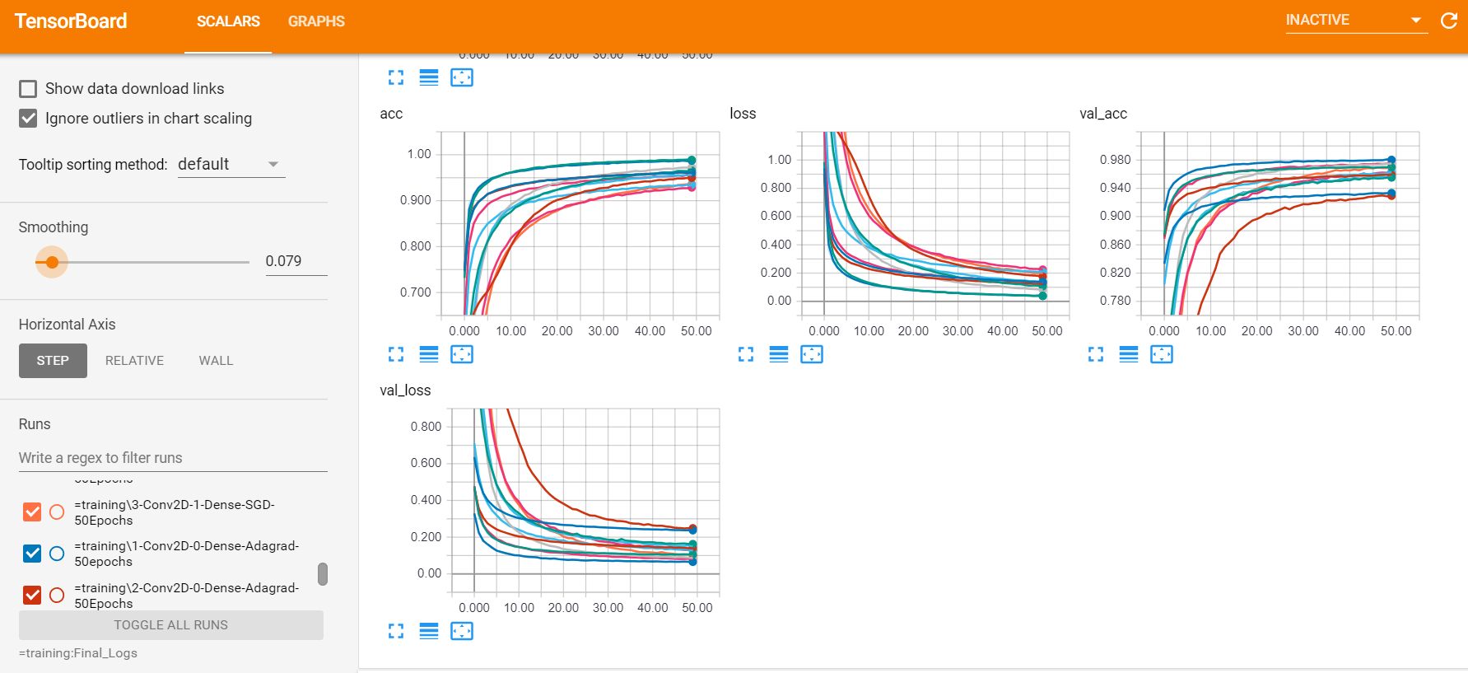
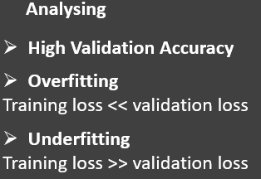
Tensorboard
Notes:
Ran a lot of models for 50 Epochs
But how do we find the best model, with highest accuracy, at the same time avoiding overfitting and/or underfitting

Slide 6
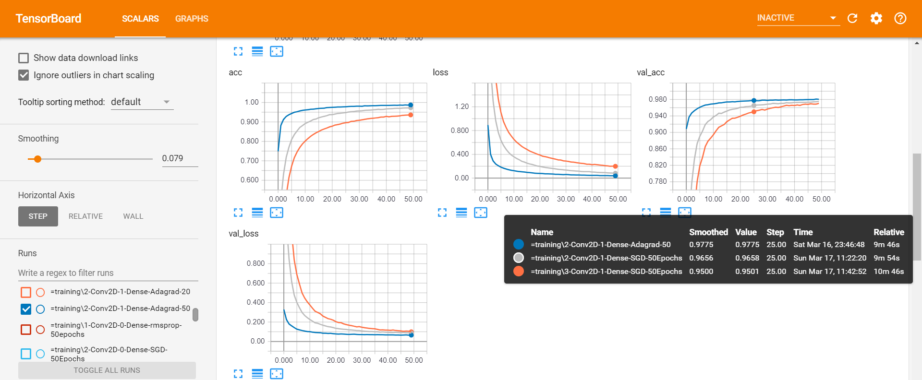
Comparison – Best Models
Notes:
We can see that 2 Convulation Layers, and 1 Dense Layer with Optimizer as Adagrad performs the best with 98.00% accuracy
When we increased the nodes on the layers, the model started to over fit

Slide 7
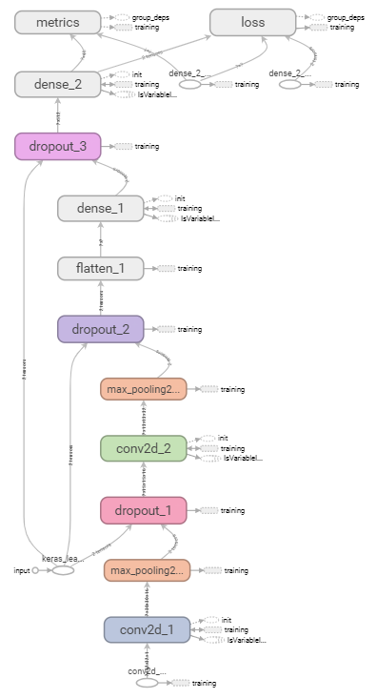
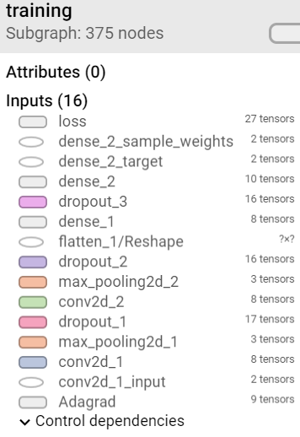
Final Model 2 Conv2D 1 Dense Hidden 1 Dense Output

Slide 8
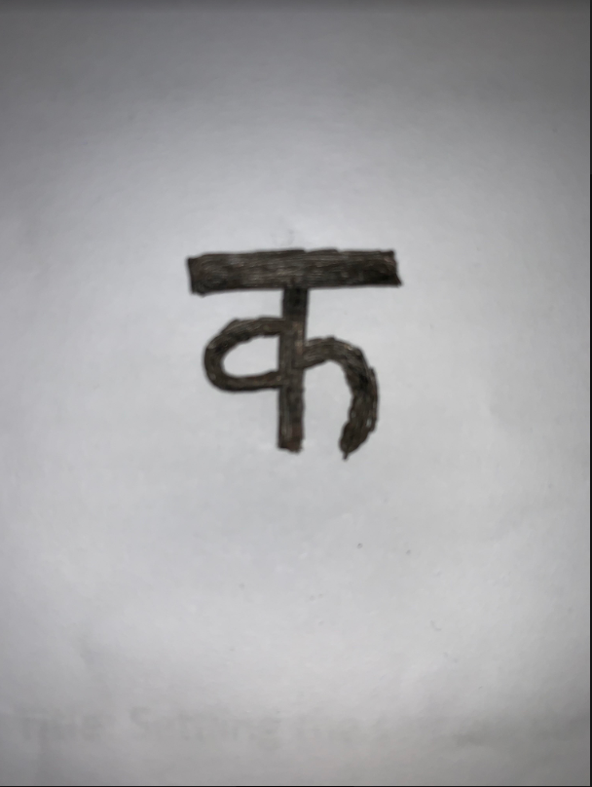
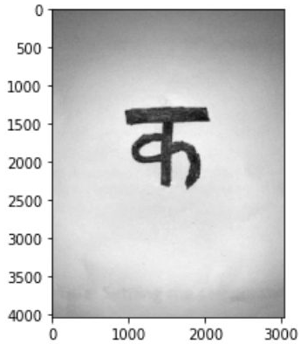

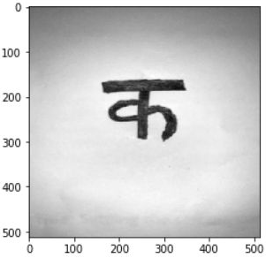
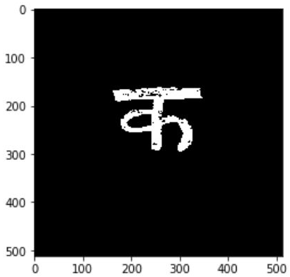
Image Manipulation
Original Image
Step 1
Step 1: Original image (RGB) converted into GrayScale
Step 2: Resizing to 512 X 512
Retains information
Faster computation for bulk processing
Step 3: Converted into Inverted Binary image using a threshold value
RGB
GrayScale
Step 2
Step 3
512 x 512 pixels
Binary Image

Slide 9
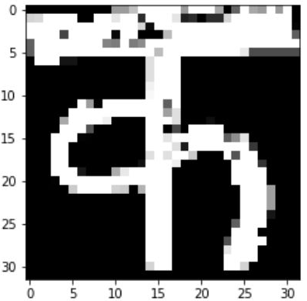
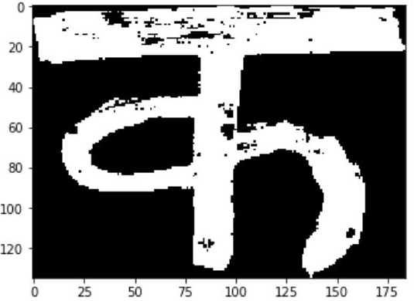
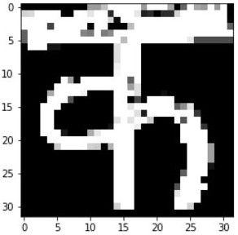
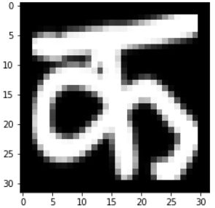

Step 4
Step 5
Image Manipulation
Step 4: Image cropped to remove unwanted background
Step 5: Resizing to 32 X 32 for input to model
Result: Our Prediction is ‘character_1_ka’
Cropped
32 x 32 pixels
Result
Our Image
Sample Image with same Label

