Slide 1

PhantomEye AI-Powered Honeypot System
Problem StatementID :Custom PhantomEye Problem
Problem Statement Title : Real-Time Cyber Threat Detection and Deception Using AI-Powered Honeypot System
Theme : Cybersecurity
PS Category : Software
Team Name (Registered on portal) : The Gitfather

Slide 2
PhantomEye: Invisible AI Honeypot System
Proposed Solution
A real-time AI-powered system that detects cyberattacks like SQL injection ,XSS,Brute Force Login Attacks,Reconnaissance Scanning Tools instantly and diverts attackers to a fake honeypot environment.
Prevents damage by detecting threats proactively, not after compromise.
Protects real systems by isolating malicious users.
Provides early warning and deep insights to security teams.
Combines detection + deception + alerting in a single lightweight tool.
Instant honeypot swap is invisible to attackers.
2
Notes:
2

Slide 3
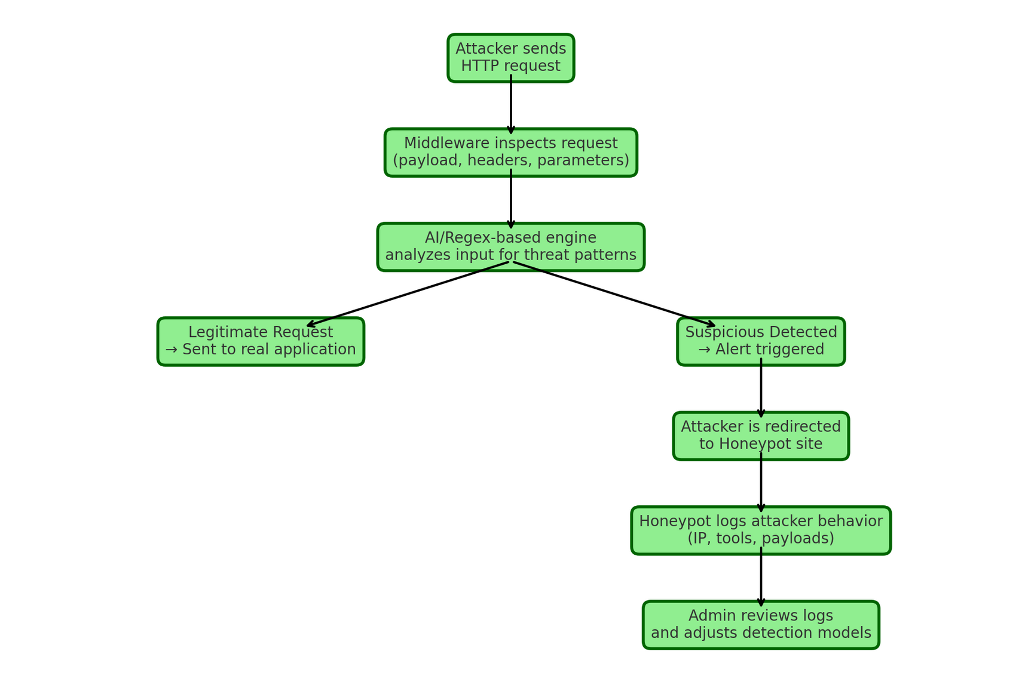
TECHNICAL APPROACH
Python – Core backend development
Flask – Lightweight web framework for real-time request handling
Regex / Pattern Matching – Payload detection and scanning
Telegram Bot API – For instant alerts to admins
HTML/CSS – To build realistic honeypot pages
Methodology & Implementation Process
Request Monitoring Layer (Middleware):
Threat Detection Layer
Trigger Response Layer
Logging & Analysis Layer
3
Notes:
3

Slide 4
FEASIBILITY AND VIABILITY
Feasibility Analysis
Can be developed using lightweight technologies like Python and Flask.
Works on any server (local, cloud, VPS).
No hardware dependency — fully software-based.
Scalable for small apps or large enterprise environments.
Integrates easily into existing web infrastructures.
Strategies to Overcome Challenges
Use adaptive ML models to improve detection accuracy.
Continuously update honeypot content to remain believable.
Set thresholds to reduce false alerts (e.g., trigger only on critical patterns).
Log only metadata and anonymize sensitive inputs.
Implement sandboxing for safe handling of potential malware scripts.
4
Notes:
4

Slide 5
IMPACT AND BENEFITS
Potential Impact on Target Audience
Helps government portals, banking apps, e-commerce, and healthcare systems stay protected from real-time cyber threats.
Provides early threat detection and attacker tracking, improving national cybersecurity posture.
Useful for educational institutes to train students on cyber deception techniques and ethical hacking.
Benefits of the Solution
Social Impact :
Reduces risk of identity theft, fraud, and data leaks.
Protects users' digital privacy by preventing successful attacks.
Economic Impact
Avoids financial loss from data breaches and downtime.
Reduces cost of post-attack recovery and incident response.
5
Notes:
5

Slide 6
RESEARCH AND REFERENCES
Reference Links and Research Sources:
1. OWASP Honeypots Guide
https://owasp.org/www-community/Honeypots
2. Cowrie Honeypot (SSH/Telnet)
https://github.com/cowrie/cowrie
3. Flask Framework Documentation
https://flask.palletsprojects.com
4. Telegram Bot API Docs
https://core.telegram.org/bots/api
5. Regex for Security Input Validation
https://github.com/firasdib/Regex101
6
Notes:
6

