Slide 1

Analysis of AMCAT Data

Slide 2
About me
Education Background –
My name is Sahil Singh Rana and I am currently pursuing a Bachelor of Technology (B.Tech) in Computer Engineering with a specialization in Artificial Intelligence and Deep Learning at Graphic Era University, Dehradun. My academic journey has been marked by consistent performance and a keen interest in emerging technologies, reflected in my GPA of 8.51/10.
Why i want to learn Data Science –
My interest in Data Science stems from its transformative impact across various domains. The ability to analyze and interpret complex datasets to derive actionable insights is a skill that I find both challenging and immensely rewarding. Data Science combines my passion for mathematics, statistics, and computer science, enabling me to contribute to innovative solutions and informed decision-making processes. The interdisciplinary nature of Data Science and its application in solving real-world problems motivate me to delve deeper into this field.
LinkedIn and GitHub Profiles –
LinkedIn: https://www.linkedin.com/in/sahil-singh-rana-b33923230/
GitHub: https://github.com/sahil-singh-rana

Slide 3
Work Experience –
While I am currently a student, I have undertaken several projects that have provided me with hands-on experience in various technical skills and tools relevant to Data Science.
These projects include:
Computer Vision-based Object Recognition: Developed a graphical user interface (GUI) supporting Ultralytics YOLov8 models using the tkinter library.
MERN Stack Food Delivery App: Built a robust e-commerce food delivery application using MongoDB, Express.js, React, and Node.js.
Vehicle Number Plate Detection and Recognition: Created a GUI for live image capture and upload, employing computer vision techniques and Optical Character Recognition (OCR).
Signature Verification: Developed an application for comparing signatures, enabling accurate decision-making processes.
Land Cover Classification Through Satellite: Classified satellite images into various land cover classes and calculated the area of each class for scientific estimations.
Instagram Clone Application: Developed a clone of Instagram using HTML and CSS.
These projects have equipped me with a solid foundation in programming languages (C, C++, Java, Python, HTML, CSS, JavaScript), machine learning tools (Scikit-learn, TensorFlow, OpenCV, YOLO), database management (Oracle SQL Server, MySQL, MongoDB), and cloud platforms (Google Cloud).

Slide 4
Business Problem and Use case domain understanding
Significance of the Study:
Understanding the factors influencing employment outcomes is crucial for improving educational programs and career guidance.
Domain Understanding:
Focus on employment outcomes such as salary, job titles, and job locations.
Examination of cognitive, technical, and personality skills and their impact on employment outcomes.
Objective of the Project
To improve the recruitment process by accurately forecasting a candidate’s job performance and fit based on their test scores, educational background, and demographic information.
Recruiters and employers need an efficient way to match candidates to roles, all while reducing hiring costs and enhancing retention rates. By utilizing this data, companies can more effectively identify highpotential candidates and optimize their recruitment strategies.
Summary of the Data
Dataset Overview:
Number of data points: 4000
Number of independent variables: 40
Types of variables: continuous, categorical, and dates

Slide 5
Exploratory Data Analysis (EDA) --
Imported Libraries: Pandas, NumPy, Matplotlib, and Seaborn for data manipulation and visualization.
Load Dataset: Read the dataset into a Pandas DataFrame for exploration.
Initial Exploration: Use functions like .shape, .describe(), and .info() to understand the dataset size, data types, and summary statistics.
Data Cleaning Steps –
Handling Missing Values:
Missing values were identified and analyzed.
If appropriate, missing values were imputed or removed to maintain data integrity.
Erroneous Data Points:
Treatment of Outliers and Incorrect Data Entries:
Outliers were identified using statistical methods and visualization.
Erroneous entries were corrected or removed to ensure data quality.
b. Data Manipulation Steps –
Normalization and Encoding:
Continuous variables were normalized to ensure consistent scaling.
Categorical variables were encoded for analysis.

Slide 6
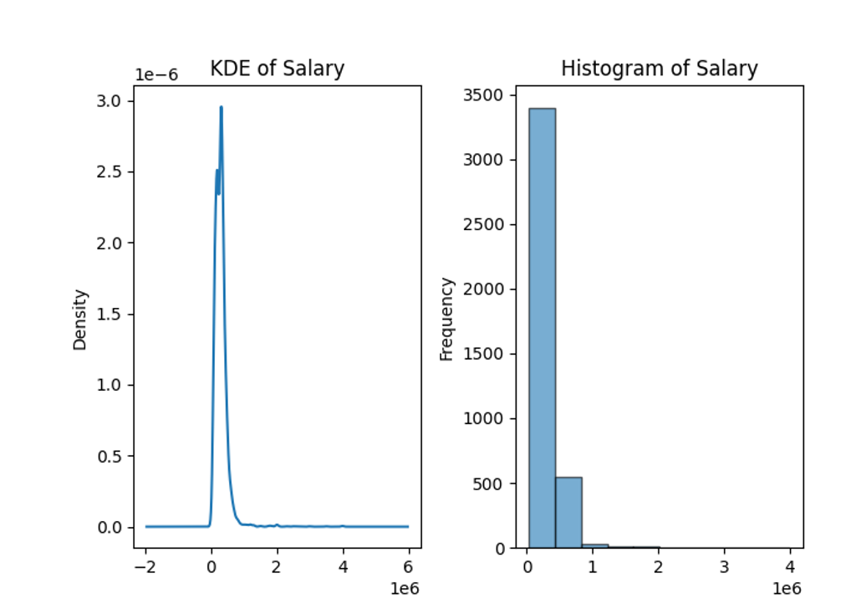
New Variables:
Creation of Derived Variables:
New variables were created to capture additional insights.
Example: Employment duration calculated from DOJ and DOL.
c. Univariate Analysis
Individual Variable Analysis:
Visualization and Descriptive Statistics:
Histograms and KDE plots were used to visualize distributions.
Descriptive statistics provided summaries of key variables.
Example: Salary Analysis
df['Salary'].plot(kind='hist', title='Histogram of Salary')
df['Salary'].plot(kind='kde', title='KDE of Salary')
print(df['Salary'].describe())

Slide 7
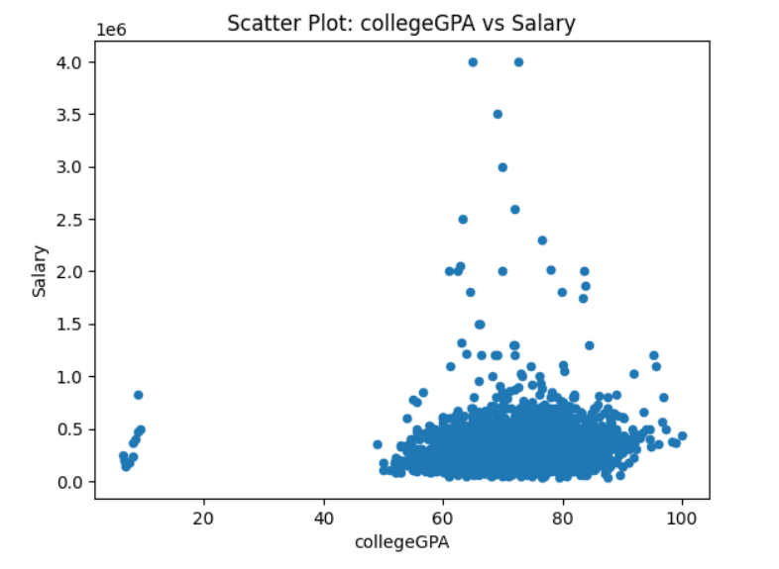
Bivariate Data Analysis
Scatter plots to visualize the relationship between two continuous variables.

Slide 8
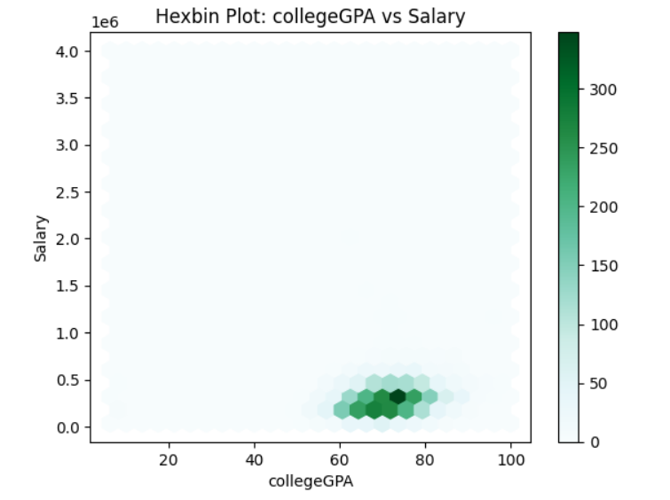
Hexbin Plots:
Hexbin plots to visualize the density of data points where two continuous variables intersect.

Slide 9
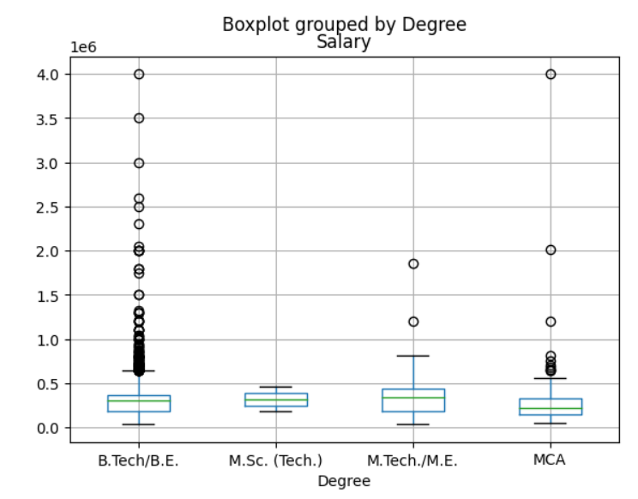
Boxplots by Category:
Boxplots to compare the distribution of a numerical variable across different categories.

Slide 10
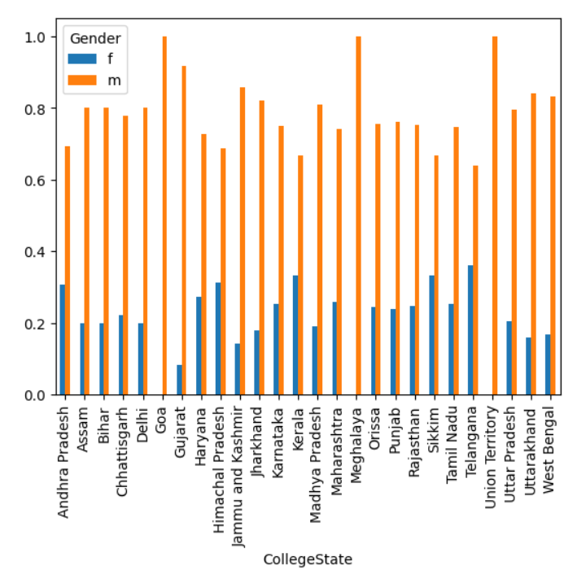
Bar Plots of Cross-tabulations:
Bar plots to show the relationship between two categorical variables.

Slide 11
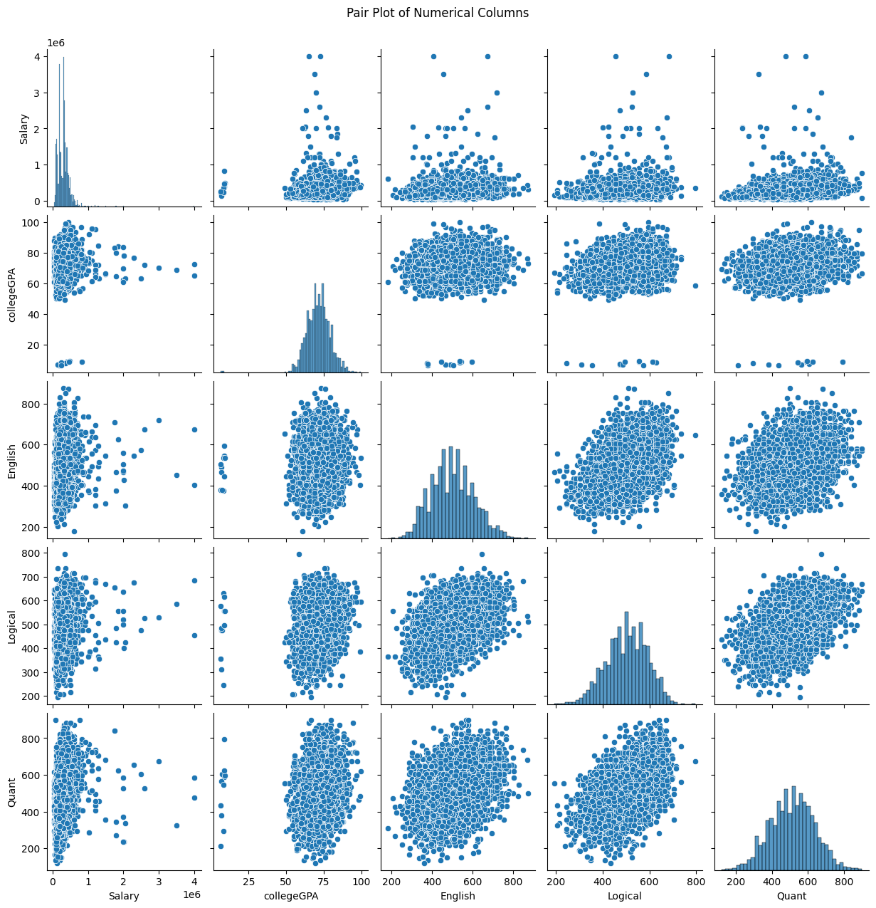
Pair Plots:
Pair plots to show pairwise relationships between several numerical variables.

Slide 12
Conclusion --
Key Findings:
Salary Influencing Factors:
Cognitive skills (e.g., English, Logical, Quantitative) and technical skills (e.g., Computer Science, Electronics) have a significant impact on salary.
Higher scores in these areas generally correlate with higher salaries.
College GPA Correlation:
College GPA is positively correlated with salary and job roles.
Graduates with higher GPAs tend to secure better job roles and higher salaries.
Gender and Specialization:
There is a significant relationship between gender and specialization.
Certain specializations have a higher representation of a particular gender, impacting employment outcomes.
Implications:
For Educational Institutions: Focus on enhancing cognitive and technical skills in the curriculum.
For Employers: Recognize the importance of these skills in hiring and salary decisions.
For Graduates: Aim to excel in both academic and skill-based assessments to improve employment prospects.

Slide 13
Experience and Challenges --
Personal Experience:
Learning Opportunity: The project provided an excellent opportunity to apply data analysis techniques to real-world data.
Skill Development: Enhanced skills in data cleaning, manipulation, and exploratory data analysis using Python and visualization tools like Seaborn and Matplotlib.
Challenges Faced:
Data Quality Issues: Handling missing values, erroneous data, and outliers posed significant challenges.
Web Scraping: If applicable, difficulties in extracting consistent data from various websites due to differences in structure and format.
Complex Analysis: Conducting in-depth statistical analysis and ensuring the accuracy of the results required meticulous attention to detail.
Learnings:
Data Cleaning Techniques: Learned various methods to handle missing and erroneous data effectively.
Advanced Analysis: Gained experience in using statistical methods such as regression analysis and chi-square tests to derive meaningful insights.
Problem-Solving: Developed problem-solving skills by overcoming challenges related to data inconsistencies and analysis complexities.

Slide 14

N N O M A T I C S
E S E A R C H L A B S
Q &A

Slide 15

THANK YOU

