Slide 1
Signature verification system
Submitted by:
Student Name University Roll No.
SAHIL SINGH RANA 2019582
Under the Mentorship of
Ms. Meenakshi Maindola
Assistant Professor

Slide 2
INTRODUCTION
The Signature Matching Application provides an automated and reliable solution for signature comparison
The application leverages image processing techniques and advanced algorithms to evaluate signature similarity objectively
Signatures are unique personal identifiers used for document authentication and identity verification
Manual comparison of signatures is prone to error
Signature verification is mostly done in banks to clear the cheque.

Slide 3
PROBLEM STATEMENT
Inconsistency: Human judgment can introduce subjectivity and inconsistency, leading to errors in assessing signature resemblance.
Time-consuming: Manual comparison of signatures is a time-consuming process, particularly with large volumes of signatures.
Variations in conditions: Differences in lighting, image quality, and writing styles complicate the comparison task.

Slide 4
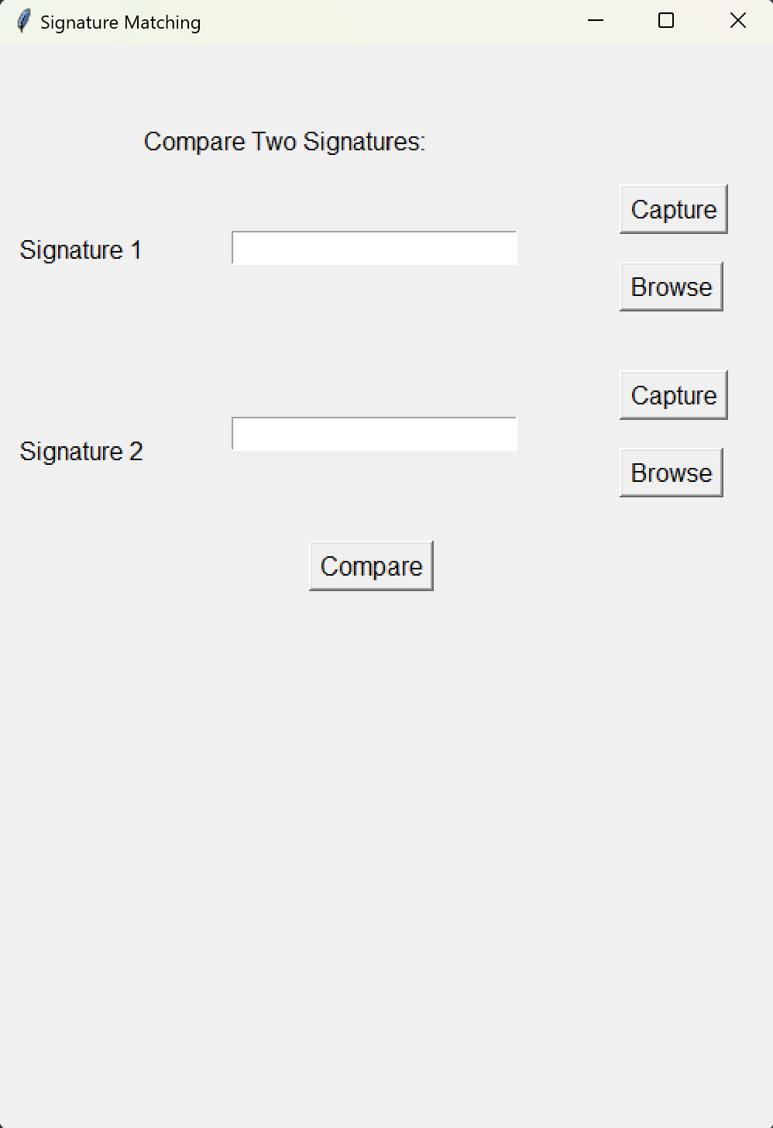
METHODS
USER INTERFACE AND INPUT IMAGE

Slide 5
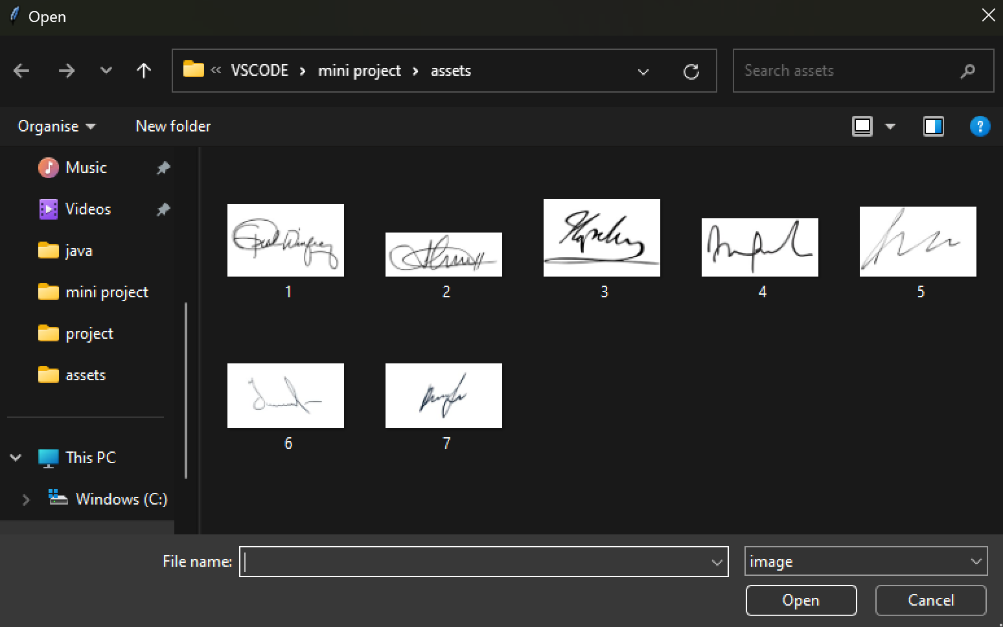
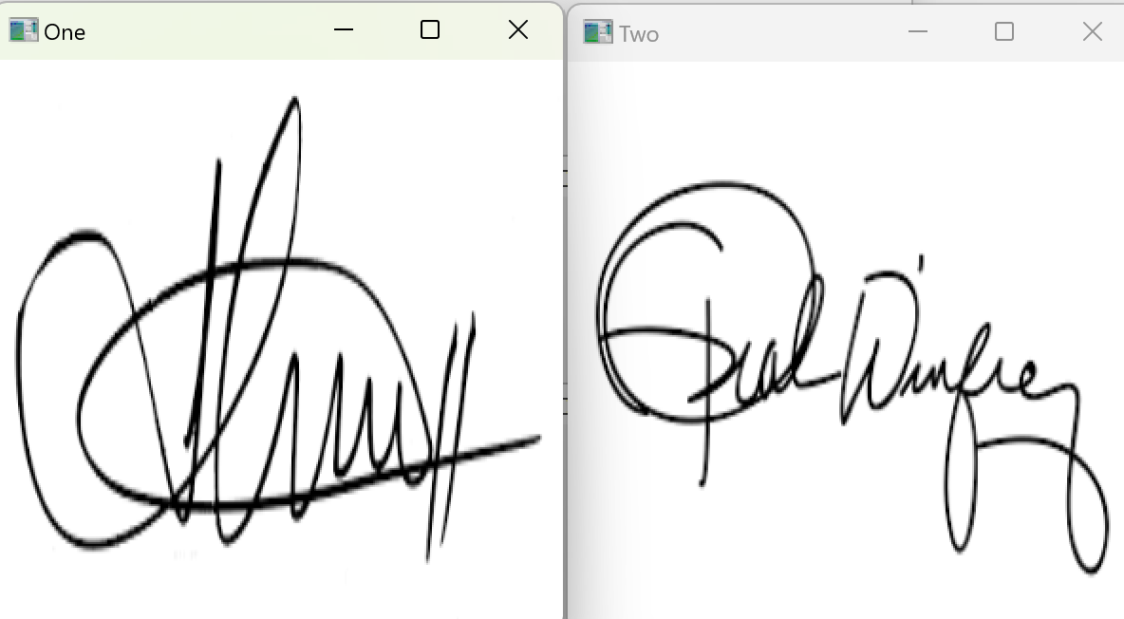
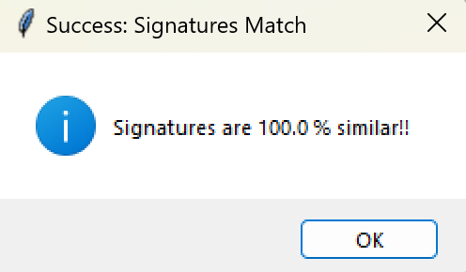
IMAGE CAPTURE
SIGNATURE MATCHING
OUTPUT & FEEDBACK TO USER

Slide 6
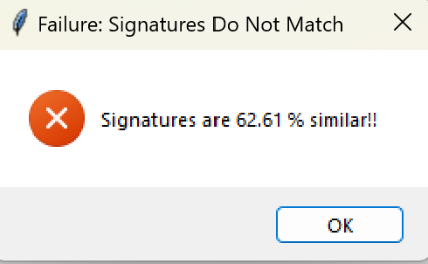
RESULT
The implemented Signature Matching Application successfully allows users to compare the similarity of two signature images.
By comparing the calculated similarity score against a predefined threshold value of 85, the application determines whether the signatures match or not.
If the similarity score exceeds the threshold
otherwise, it displays a failure message

Slide 7
CONCLUSION
The Signature Matching Application enables users to compare the similarity of two signature images through a user-friendly and efficient interface.
Users have the option to capture signature images using their device's camera or select existing images for comparison.
By utilizing the structural_similarity function, the application accurately calculates the structural similarity between the images.
The application compares the similarity score against a predefined threshold value of 85 to determine if the signatures match or not.
Immediate feedback is provided to users through success or failure messages

