Slide 1
ZEPTO
Sales Analysis
Dashboard
Excel analytics project | Interactive reporting | Quick-commerce insights
DATASET
DATA MODEL
REPORTING
5,000 order records
21 order-level fields
KPIs + interactive slicer
Portfolio presentation

Slide 2
Project at a glance
Turning order-level data into a decision-friendly Excel dashboard
BUSINESS GOAL
ANALYTICAL APPROACH
INTERACTION
Understand sales mix, customer preferences, and delivery outcomes.
Summaries, pivot-style aggregations, KPIs, and chart-based comparisons.
Order Month slicer supports month-level dashboard exploration.
Questions the dashboard helps answer
• Which products and brands appear most often in the selected period?
• How does demand vary by category and city?
• Which seller stores contribute the largest share?
• What are the delivery-status and payment-mode distributions?
• What are the headline delivery-time and customer-rating metrics?

Slide 3
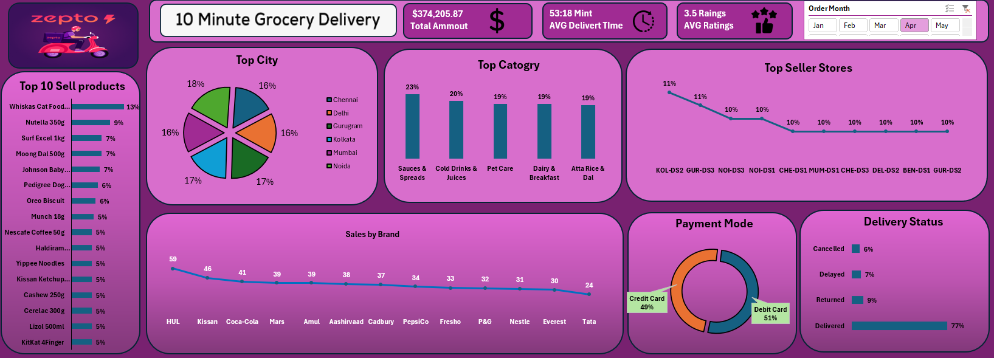
Dashboard walkthrough
The supplied screenshot shows April selected in the Order Month slicer

Slide 4
KPI snapshot
Values visible in the supplied dashboard image; confirm metric definitions in the workbook
TOTAL AMOUNT
AVG. DELIVERY TIME
AVG. RATING
$374,205.87
53:18 shown
3.5
Important interpretation notes
• The screenshot is filtered to April, so these are period-specific values.
• The delivery-time card displays “53:18 Mint”; verify the underlying calculation and number format before reporting it as minutes.
• The workbook's full dataset contains 5,000 rows dated from Jan 1 to Oct 1, 2025.

Slide 5
Product and sales mix
Use category, product, and brand rankings to spot high-interest items
TOP CATEGORIES SHOWN
BRAND RANKING SHOWN
PRODUCT RANKING
Sauces & Spreads
Cold Drinks & Juices
Pet Care
Dairy & Breakfast
Atta Rice & Dal
HUL — 59
Kissan — 46
Coca-Cola — 41
Mars — 39
Amul — 39
The left panel ranks products by the measure used in the dashboard. Check pivot value settings before describing it as units, orders, or revenue.
Possible business use
Use the selected-period rankings to guide assortment reviews, promotional planning, and category-level follow-up. Compare multiple months before treating one month's leaders as a sustained trend.

Slide 6
Delivery and customer experience
Operational indicators shown in the dashboard snapshot
Delivered
77%
Returned
9%
Delayed
7%
Cancelled
6%
FOLLOW-UP IDEA
DATA QUALITY CHECK
Investigate returned, delayed, and cancelled orders by store and category.
Confirm rating coverage and the delivery-time measure before drawing conclusions.

Slide 7
Payment modes and seller stores
Compare customer payment preferences and relative store activity
PAYMENT MODE SNAPSHOT
TOP STORES SHOWN
Debit Card — 51%
Credit Card — 49%
The visible chart appears to focus on card payments; inspect pivot filters for the full payment mix.
KOL-DS2 — 11%
GUR-DS3 — 11%
NOI-DS3 — 10%
NOI-DS1 — 10%
Several other stores — 10%
Analysis opportunity
Check whether store-level differences persist across months and compare delivery outcomes alongside store activity to avoid ranking stores on volume alone.

Slide 8
Excel workflow and skills demonstrated
A portfolio-friendly summary of the work
01
Structure
Organize 5,000 records across 21 order-level fields.
02
Summarize
Build pivot-style summaries for products, brands, categories, cities, stores, payments, and delivery statuses.
03
Visualize
Use KPI cards, bar charts, a pie chart, a line chart, and a doughnut chart.
04
Filter
Use an Order Month slicer to explore a selected reporting period.
05
Communicate
Turn operational data into a concise dashboard view for business users.

Slide 9
Recommended next steps
Ways to make the dashboard more decision-ready
METRIC DEFINITIONS
TIME KPI FORMAT
Document the formula, unit, and reporting period for every KPI.
Resolve the 53:18 display and label average delivery time consistently in minutes.
TREND ANALYSIS
DATA HYGIENE
Add monthly revenue, order count, delivery success, and average rating trends.
Standardize sheet/field spellings and clarify whether revenue is selling price × quantity.
ACTIONABLE INSIGHTS
Add a short takeaway section explaining what changed and what action is recommended.
Thank you

