Slide 1

CodeBuddies
A pair-programming platform

Slide 2
Team Members
Saloni Mathure
Sahil Satramani
Lavanya Rajesh
Nehal Vaiti

Slide 3
Introduction
What is pair-programming?
Pair Programming is an agile software development practice where two programmers work together at the same workstation, sharing the same code, with one writing the code and the other reviewing it in real-time.

Slide 4
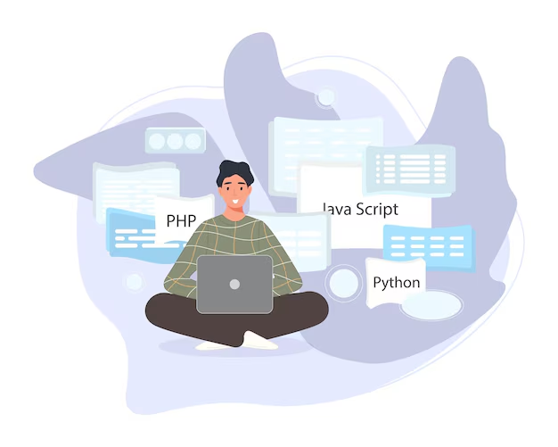
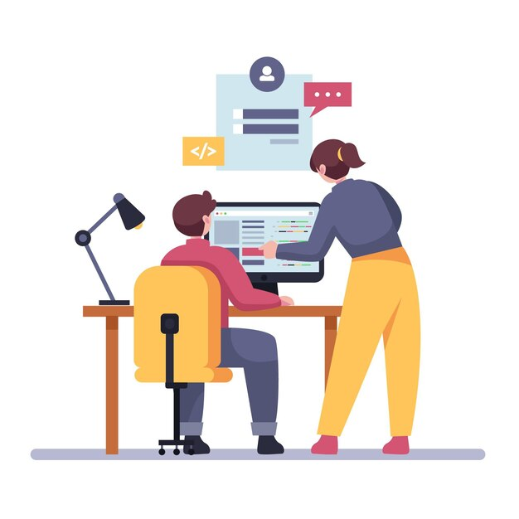
Introduction
Who are the stakeholders?
Driver (Coder)
Observer (Proctor)

Slide 5

Use Cases in the industry
Employee Onboarding
Technical Interviews
Code Reviews
Mentoring
Debugging

Slide 6
Background of CodeBuddies
CodeBuddies is a collaborative platform designed to facilitate pair programming sessions. The application allows users to connect in real-time, with features for video calls, a shared code editor and session recording, making it ideal for remote development, mentoring, and onboarding processes.

Slide 7
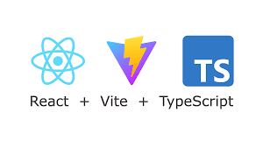


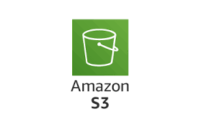
Tech Stack
Server-side
Client-side
Cloud Storage

Slide 8


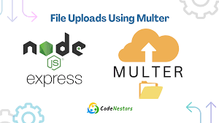


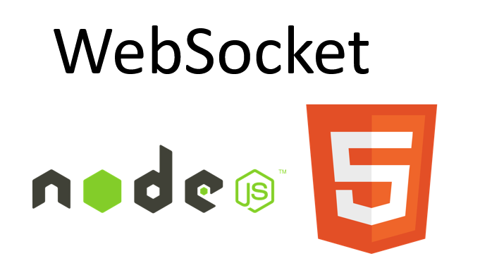




Tools and Technologies

Slide 9
Key Features
Organisation level (RBAC)
Collaborative Coding using WSS
Session Creation and Video Calls using WebRTC and WebSocket Server
Payments using Stripe
Storing Recorded Sessions as videos to an AWS S3 Bucket
Fugu Capabilities using File System Access API
PWA
Internationalisation using i18n

Slide 10
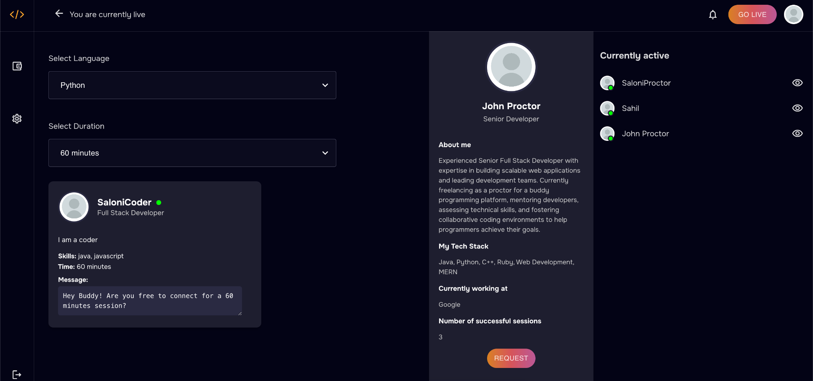
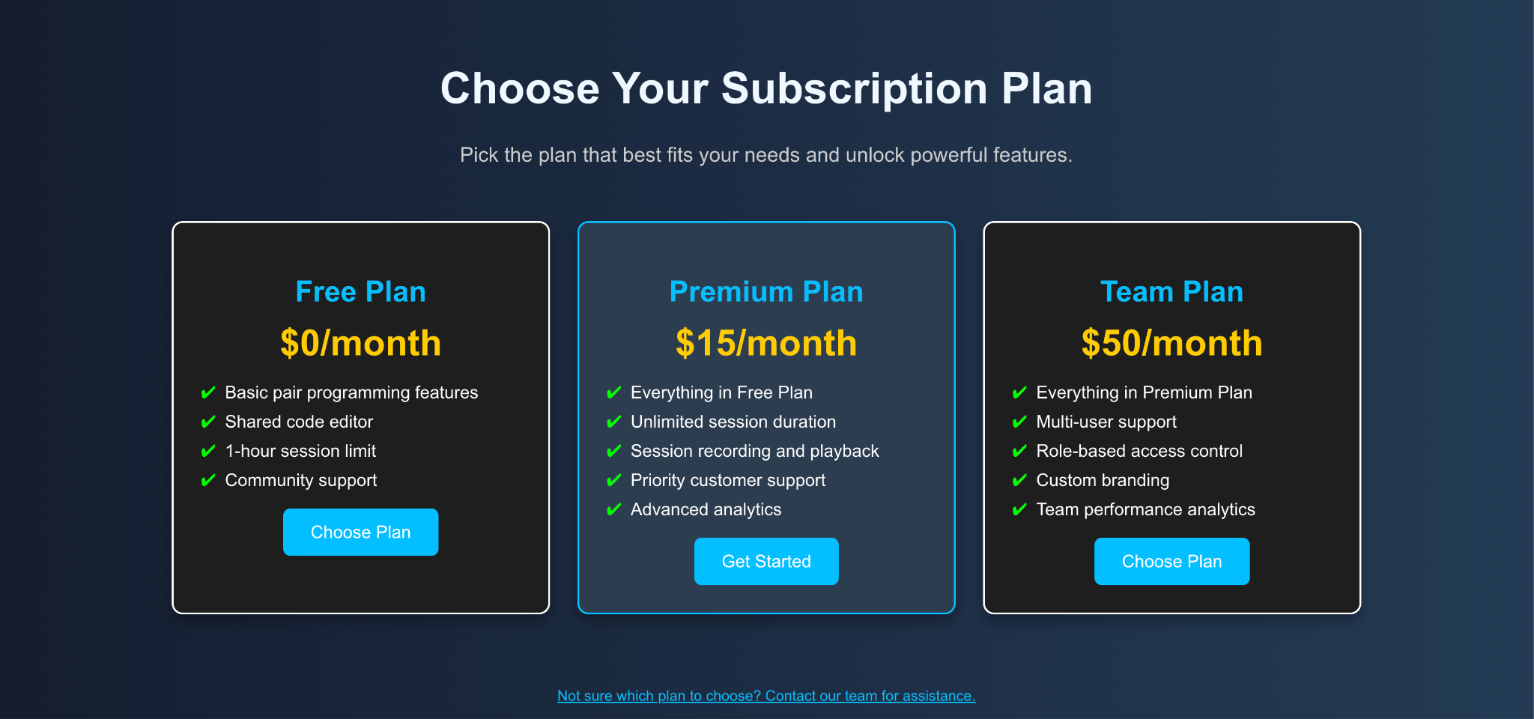

Slide 11
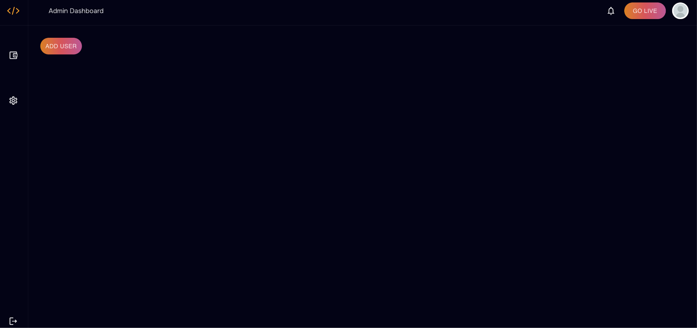
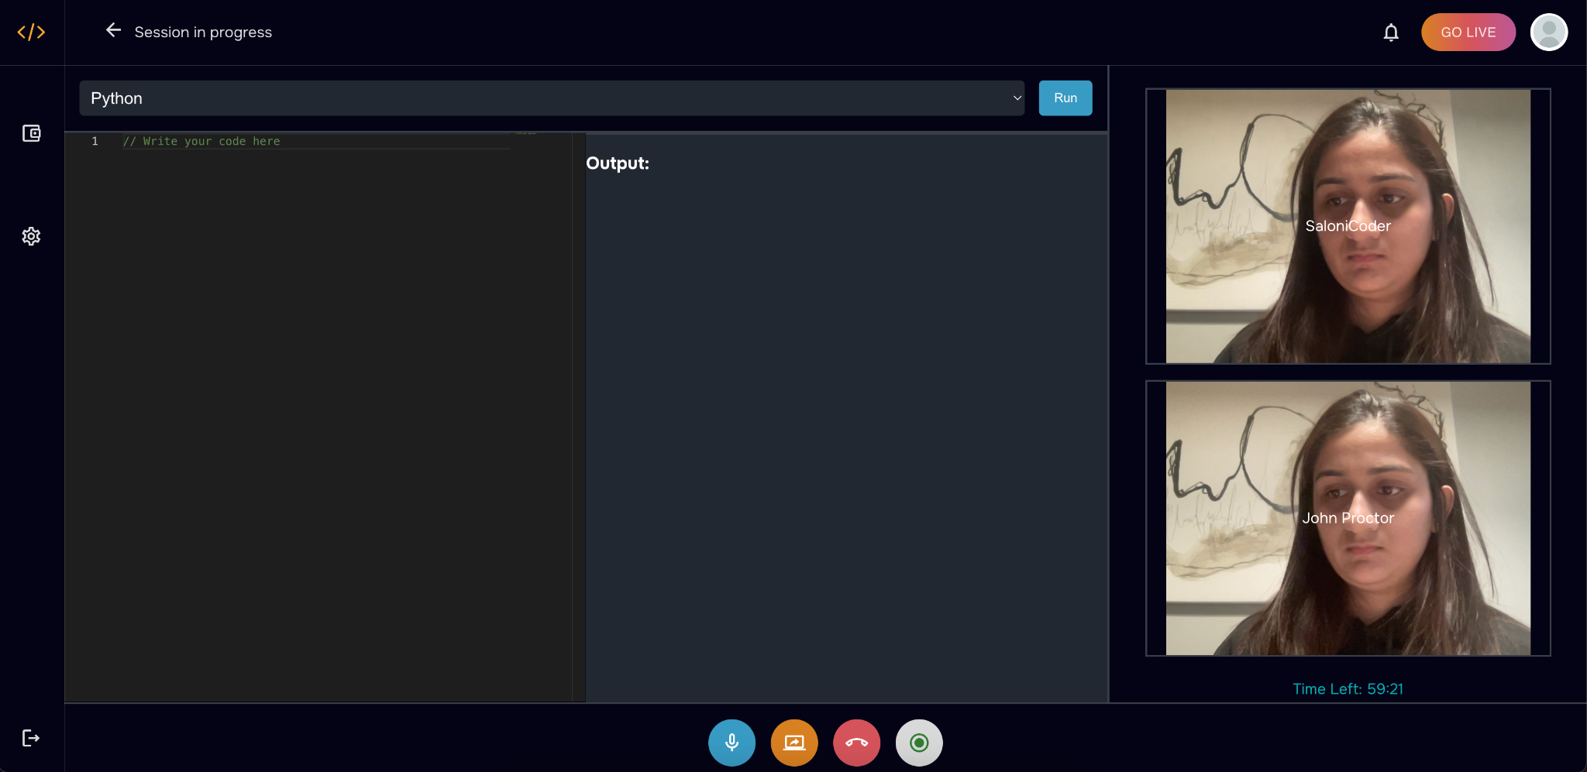

Slide 12
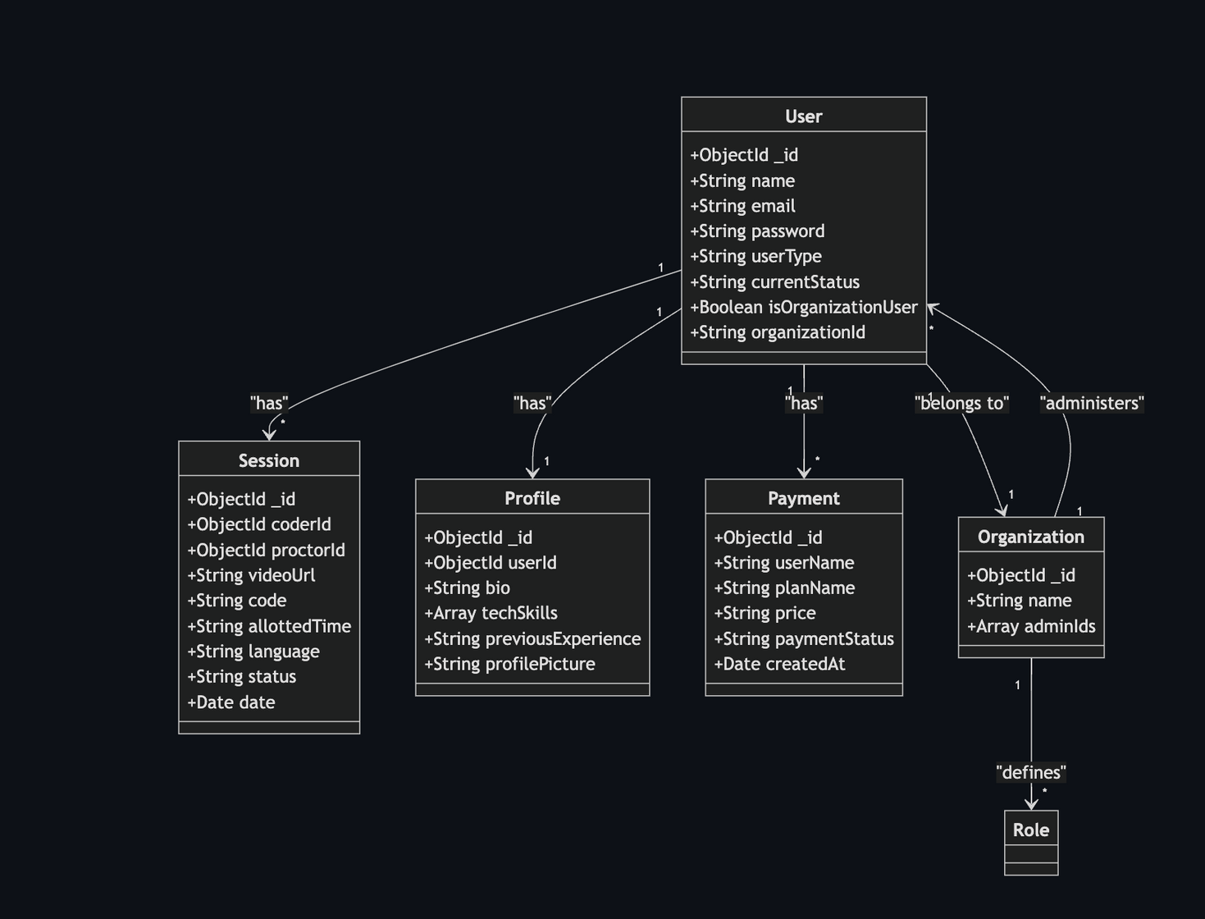
Database Schemas

Slide 13
Demo

Slide 14
Thank you

