Slide 1



TrackFlow
A Jira-style ticket tracker running on AWS and Azure, with failover between clouds and one-click environments
github.com/sahilsahni18/multicloud-tms
Notes:
TrackFlow is a ticket tracker in the style of Jira. What makes it interesting is where and how it runs: the same containers on Kubernetes in two AWS regions and two Azure regions behind one URL, all built from code, plus an admin portal that creates a new environment with one click.

Slide 2



What we set out to build
A ticket tracker teams can run themselves
Two clouds, four regions, one URL
New environments in one click
Four roles, a full ticket lifecycle, Kanban board, history and dashboards. Login with JWT.
Identical images on EKS and AKS. If a region or a whole cloud goes down, the same URL keeps working.
An admin picks cloud, region and environment; a real pipeline builds it and reports every step live.
Rule we kept: build and prove everything locally first; touch the cloud last, and only through code.
Notes:
Three goals from the PRD. The rule that shaped the schedule: everything was built and proven on a laptop with Docker and kind before we spent any cloud credits, and the cloud is only ever changed through OpenTofu and GitHub Actions.

Slide 3
Results at a glance
4
38 s
45 s
Kubernetes clusters
Regional failover
Cross-cloud failover
2 on AWS EKS, 2 on Azure AKS
AWS us-east-1 → us-west-2
Target: under 2 minutes
Both AWS regions down → Azure
Target: under 2 minutes
93%
~3 min
0
Backend line coverage
Portal click → live environment
Cloud keys stored
98 backend + 19 frontend tests
Target: 70%
Own namespace, database and URL
GitHub Actions logs in with OIDC
Notes:
The headline numbers. Both failover tests beat the two-minute target by a wide margin. Coverage is well above the 70 percent goal. The portal creates a working environment in about three minutes, and no long-lived cloud credentials exist anywhere.

Slide 4
The application
01
Roles, tickets, stack and security
Notes:
First, the application itself.

Slide 5




Four roles, enforced in the API and the UI
ADMIN
PROJECT_MANAGER
DEVELOPER
USER
Platform admin
Delivery lead
Engineer
Requester
Users and roles
Every project and ticket
Deployment Portal
Own projects and members
Assign, close, reopen
Reports and team metrics
Tickets assigned to them
Move status on the board
Comment and discuss
Raise tickets
Follow their own tickets
Reopen within 14 days
Enforced twice: @PreAuthorize on every API method, row-level rules in one TicketAccessPolicy, and menus and routes built from one role map in React. A forbidden call returns 403.
Notes:
Four roles. The important point is that the rules live in the backend: every endpoint has a PreAuthorize check, and the 'own ticket' and 'assigned ticket' rules sit in one TicketAccessPolicy class that is unit tested. The UI hides what you can't do, but the API is what enforces it.

Slide 6



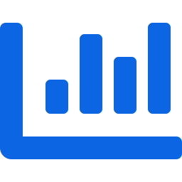


A ticket lifecycle the API actually enforces
OPEN
IN PROGRESS
IN REVIEW
CLOSED
Reopen: PM, admin or the reporter
Illegal moves are rejected with 409 Conflict · two editors can't overwrite each other (@Version)
Kanban board
History and activity
Search and filters
Drag a card to change status
Who changed what, and when
Project, status, priority, assignee
Dashboard and reports
Comments
Audit-friendly data
Charts and team productivity
Edit your own; soft delete
Flyway schema, UTC, soft delete
Notes:
The ticket workflow is a real state machine in the backend. Moves that skip a step are rejected with a 409, and optimistic locking stops two people overwriting each other. Around it: a Kanban board, a full change history, filters, dashboards and comments.

Slide 7

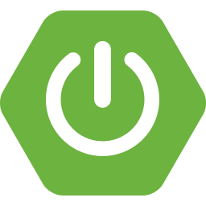
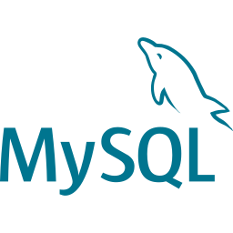
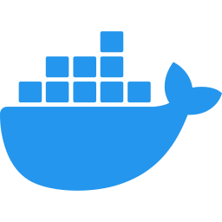
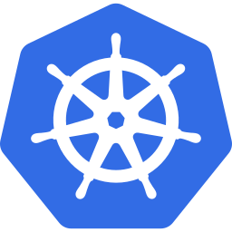

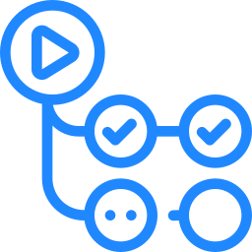

Technology stack
Frontend
Backend
React 19, TypeScript, Vite, Redux Toolkit + RTK Query, MUI 7
Java 21, Spring Boot 3.5, Spring Security, JPA, MapStruct, Flyway
Database
Containers
MySQL 8: Docker locally, Amazon RDS, Azure MySQL Flexible
Multi-stage Docker builds; non-root, read-only file system
Orchestration
Infrastructure as code
Kubernetes 1.33 on kind, EKS and AKS; Kustomize overlays
OpenTofu 1.10; remote state in S3 and Azure Storage
CI/CD
Testing
GitHub Actions with OIDC logins; Trivy image scanning
JUnit 5, Mockito, Testcontainers (real MySQL), Vitest
Notes:
The stack. Everything is current: React 19, Spring Boot 3.5 on Java 21, Kubernetes 1.33. Integration tests run against a real MySQL in a container, not an in-memory fake.

Slide 8

Security from login to cloud credentials
Request flow
1
Login returns a 15-minute access token (kept in memory) and a 7-day refresh token in an httpOnly cookie
Hardening
Every API call carries the access token; a filter validates it and loads the user's roles
BCrypt (cost 12) passwords; HS512-signed JWTs
Login, register and refresh limited to 10 per minute per IP
Pods run as non-root with a read-only file system
Trivy scan fails CI on any CRITICAL vulnerability
GitHub reaches AWS and Azure through OIDC: no stored cloud keys
Pipeline callbacks to the portal are HMAC-signed
2
3
@PreAuthorize checks the role; TicketAccessPolicy checks ownership of the row
4
On a 401 the client refreshes once and retries; refresh tokens rotate and are stored hashed
5
Logout revokes the refresh token
Notes:
Security works at every layer. Short-lived access tokens in memory, refresh tokens in an httpOnly cookie that rotate on every use. On the infrastructure side the key point is OIDC: GitHub proves who it is to AWS and Azure for each run, so there are no cloud keys in the repository or in the app.

Slide 9
Architecture
02
How one codebase runs on two clouds
Notes:
Now the architecture.

Slide 10

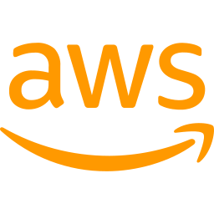

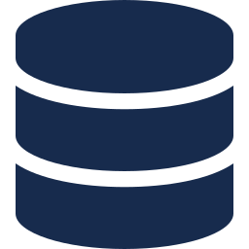
One URL, four clusters, two clouds
Azure Traffic Manager · priority routing
trackflow-dev-sahil.trafficmanager.net · probes /actuator/health every 10 s
us-east-1
us-west-2
eastasia
koreacentral
P1 · primary
P2
P3
P4
EKS · 1 × c7i-flex.large
EKS · 1 × c7i-flex.large
AKS · 1 × B2als v2
AKS · 1 × B2als v2
AWS
ECR in both regions
Azure
One ACR, both clusters pull
RDS MySQL 8 (us-east-1); us-west-2 connects over VPC peering
Azure Database for MySQL Flexible Server (eastasia)
Notes:
This is the whole system. Users only know one address, the Traffic Manager name. Traffic Manager checks the health endpoint of all four clusters every 10 seconds and sends everyone to the highest-priority healthy one: us-east-1 first, then us-west-2, then the two Azure regions. Each cloud has one database; the two AWS clusters share it over VPC peering, and the two Azure clusters share theirs. Cross-cloud failover is disaster recovery: Azure keeps serving with its own data.

Slide 11
Inside every cluster
Backend · Spring Boot
Managed MySQL
/api, /actuator
2 pods, autoscaled 2–6 at 70% CPU
Disruption budget keeps 1 always up
Health, readiness and liveness probes
Outside the cluster; TLS required; schema by Flyway
ingress-nginx
AWS: on the node's public IP
Azure: behind a load balancer
Web app · nginx + React
Config per cluster
everything else
2 pods serving the SPA; proxies
/api to the backend (one origin)
ConfigMap + Secret written by the deploy pipeline from tofu outputs
Same images everywhere. The only differences between kind, EKS and AKS are a Kustomize overlay and the values the pipeline fills in.
Notes:
Every cluster runs the same thing. Ingress-nginx routes API paths to the backend and everything else to the web app, so the app and the API share one origin. The backend runs two pods with autoscaling and a disruption budget. The database is managed by the cloud, outside the cluster.

Slide 12
Infrastructure as code with OpenTofu
AWS modules
Azure modules
How it's run
vpc
aks
One-time bootstrap: state bucket, storage account and GitHub OIDC trust
Apply and destroy only from GitHub Actions; apply needs your approval
cluster_count (1–5) is a for_each over clusters
Free-plan limits are flags: enable_replicas, enable_cloudfront, domain_name
eks
acr
ecr
mysql
rds
traffic-manager
frontend (S3 + CloudFront)
static-web-app
route53
us-east-1 + us-west-2 · 63 resources
eastasia + koreacentral · 17 resources
Fresh accounts to a running multi-cloud stack: one apply + one deploy, about 40 minutes, no console clicks.
Notes:
All infrastructure is OpenTofu. Eleven modules across the two clouds. A one-time bootstrap creates the state storage and the OIDC trust; after that, nothing is created by hand. Features that new free accounts don't allow, like read replicas and CloudFront, are switches rather than different code.

Slide 13




CI/CD: from git push to four clusters
Push to main
CI
Build images
Push
Roll out
Traffic Manager
Tests, lint, Trivy scan
Tagged with the Git SHA
ECR × 2 regions + ACR
All 4 clusters in parallel
Endpoints updated
cloud.yml
deploy.yml
provision.yml
Creates or destroys both clouds. Apply waits for approval; a nightly 02:00 IST run destroys anything left (paused with KEEP_UP).
Runs after every green backend CI while the cloud is up. Builds once, rolls out to 4 clusters, updates Traffic Manager.
Started by the Deployment Portal. Creates, plans or destroys an environment and reports each step back.
Notes:
One push to main runs the backend, frontend and Kubernetes CI. When the backend CI is green and the cloud is up, the deploy workflow builds the images once, pushes them to the registries in both clouds, rolls out to all four clusters and refreshes Traffic Manager. Three workflows cover the cloud lifecycle, deployments and the portal.

Slide 14
Failover in under a minute
How it works
Traffic Manager probes /actuator/health on all 4 clusters every 10 s
3 failed probes mark a cluster Degraded; DNS TTL is 60 s
Traffic goes to the next healthy priority: P1 → P2 → P3 → P4
When the primary recovers, traffic returns to it automatically
Each cloud has its own database, so moving to Azure is disaster recovery, not live replication
Notes:
Both failover tests were run live by stopping the backend in a region. Losing us-east-1 moved traffic to us-west-2 in 38 seconds. Losing both AWS regions moved it to Azure in 45 seconds, and logins worked there. The target was two minutes.

Slide 15
One-click Deployment Portal
03
An admin page that drives a real pipeline
Notes:
The third part: the Deployment Portal.

Slide 16
One click starts a real pipeline
Admin
TrackFlow backend
GitHub Actions
EKS / AKS + MySQL
Picks cloud, region, environment, clusters
Stores QUEUED; calls GitHub's workflow_dispatch API
provision.yml runs OpenTofu and kubectl
Namespace, database, backend, web app
The workflow reports each step back to the backend, signed with HMAC-SHA256
What the admin sees, live:
QUEUED
NETWORK
CLUSTER
DATABASE
BACKEND
FRONTEND
COMPLETED
Cloud credentials never enter the app: the backend only holds a GitHub token that can start workflows.
Notes:
When the admin clicks Deploy, the backend doesn't touch the cloud itself. It saves the request and asks GitHub to start the provisioning workflow. The workflow does the work with the cloud logins GitHub already has through OIDC, and after each stage it posts a signed report back to the app, which moves the stepper on screen. The app itself never holds cloud credentials.

Slide 17




Three actions, all tested live
APPLY · Dev
PLAN · QA and Prod
DESTROY
A new, isolated environment on the region's cluster: its own namespace, its own database on the cloud's MySQL server, backend and web app, and its own URL.
A real tofu plan of the full stack for that environment and region, from an empty state. Nothing is created and nothing is billed.
Drops the environment's database and deletes its namespace. Available once an apply has finished or failed.
#2: COMPLETED in about 3 minutes; URL live, health UP
#3: Azure Prod, 20 resources incl. 2 AKS clusters, MySQL, ACR, Traffic Manager
#1: database dropped, namespace deleted in about 1 minute
Why environments, not new clusters: a new EKS/AKS cluster takes 20+ minutes and exceeds new-account quotas. The full-stack path is what PLAN shows and what cloud.yml already proves.
Notes:
We tested all three actions against the real cloud. An apply produces a working copy of the app with its own database and URL in about three minutes. QA and Prod run a real tofu plan, which is free. Destroy cleans everything up. The first apply also showed that failures are reported clearly: a hostname bug made the final check fail, the portal showed exactly which step failed and linked to the log, and the fix was verified by the next deployment.

Slide 18
Decisions and operations
04
What changed from the plan, and how we kept it cheap
Notes:
Finally, the decisions we made along the way and how we ran it.

Slide 19
Where reality changed the plan
PRD plan | What we built | Why
Azure East US + West Europe | Azure East Asia + Korea Central | The student subscription allows only five regions
Route 53 in front of Traffic Manager | Traffic Manager across all four clusters | One global URL without buying a domain
Load balancer ingress; SPA on S3 + CloudFront | ingress-nginx on the node IP; SPA in every cluster | New AWS accounts can't create load balancers or CloudFront until Support enables them
Cross-region read replicas | One database per cloud; us-west-2 over VPC peering | Replicas aren't allowed on free plans (enable_replicas flag)
Portal creates new clusters | Portal creates isolated environments; Plan shows the full stack | New clusters take 20+ min and exceed quotas
7 days, 12 steps | 3 days, 9 steps, cloud last | Prove everything locally before spending credits
Notes:
We were honest about the constraints of new free cloud accounts. Each change keeps the goal of the PRD: two clouds, regional failover, one URL, everything as code. Where a paid feature was blocked, like replicas or CloudFront, it is a switch in the code rather than a redesign.

Slide 20

Quality and cost control
Quality
Cost
98
backend tests (unit + Testcontainers)
~$1.45/h
4 clusters + 2 databases (AWS ~$1.33, Azure ~$0.12), from free credits: $0 out of pocket
19
frontend tests (Vitest)
Nightly destroy at 02:00 IST; KEEP_UP pauses it for reviews
Smallest free-plan node and database sizes
After every destroy, both accounts checked for leftovers
Portal Plan is free; Apply reuses existing clusters
Lesson: EKS 1.33 is now in extended support (6× control-plane price); 1.34 fixes it
93%
backend line coverage
4
CI workflows: backend, frontend, k8s, infra
Notes:
Quality: 98 backend tests including integration tests against a real MySQL, 93 percent line coverage, and CI on every push. Cost: the full system costs about 1.45 dollars an hour from free credits, most of it the two EKS control planes: Kubernetes 1.33 is in EKS extended support, which costs six times the standard price, and moving to 1.34 brings it back down. A scheduled workflow destroys everything every night unless we explicitly keep it up.

Slide 21
Live demo
1
Architecture
This deck: one URL, four clusters, two clouds
2 min
2
Ticket lifecycle
USER raises a critical bug → PM assigns → DEVELOPER moves to In Review → PM closes; history and dashboard
5 min
3
Deployment Portal
ADMIN: Apply AWS us-east-1 Dev and watch the steps; open the new URL. Plan Azure Prod
4 min
4
Failover
Take us-east-1's backend down; Traffic Manager marks it Degraded; the same URL keeps working
3 min
5
Questions
1 min
Demo logins: admin@, pm@, dev@, user@trackflow.dev
Notes:
The live part: the ticket lifecycle across all four roles, then the portal creating a real environment, then a failover. If the network fails, there is a backup video.

Slide 22
One codebase, two clouds, one click
All 9 delivery steps done and tested in the real cloud
Next steps
HTTPS through CloudFront once AWS enables it on the account
Cross-region database replicas on a paid plan (one flag)
Prometheus is exposed already; add Grafana dashboards and alerts
github.com/sahilsahni18/multicloud-tms
Notes:
To sum up: the same code runs on two clouds and four regions behind one address, fails over in under a minute, and an admin can create a new environment with one click, all built and run from code. Thank you; happy to take questions.

