Slide 1
~ AEval ~
App to speed up our interviews!
Sahil Sareen

Slide 2


What did I use?
django
MySQL
CSS
Python
HTML

Slide 3
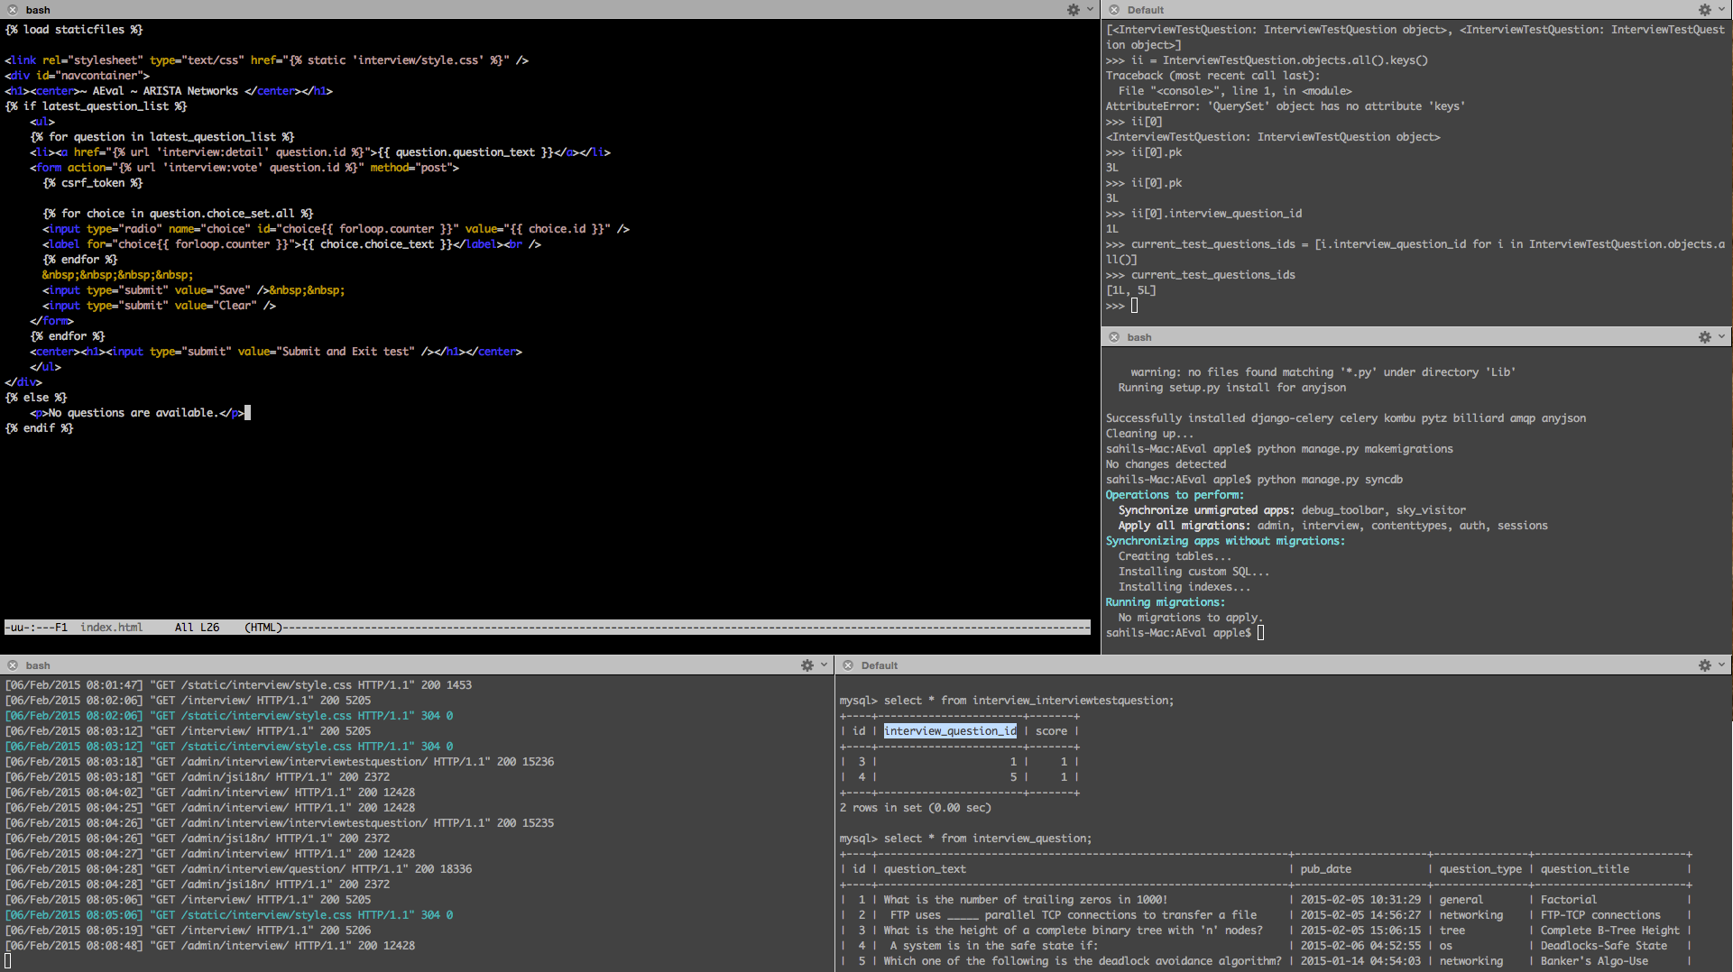
A django dev’s monitor

Slide 4
The App
Speed up the interview process
No more on paper interview
No need to check manually
Analytics
Question Bank
Scales to ~ 3529 people

Slide 5
Admin
Login
Invite/Register/… users
Authorization
  Add users/groups to DB
  Set Privileges
Question Bank – Add/Update/History/Search/Filter/Sort-By/Select-for-interview

Slide 6
Candidate side
TBD
Only the interfaces are ready with some CSS and HTML

Slide 7
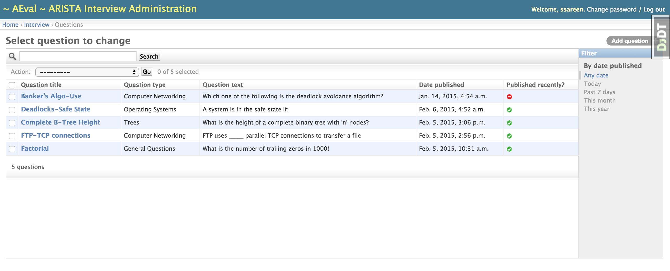
Screenshots

Slide 8
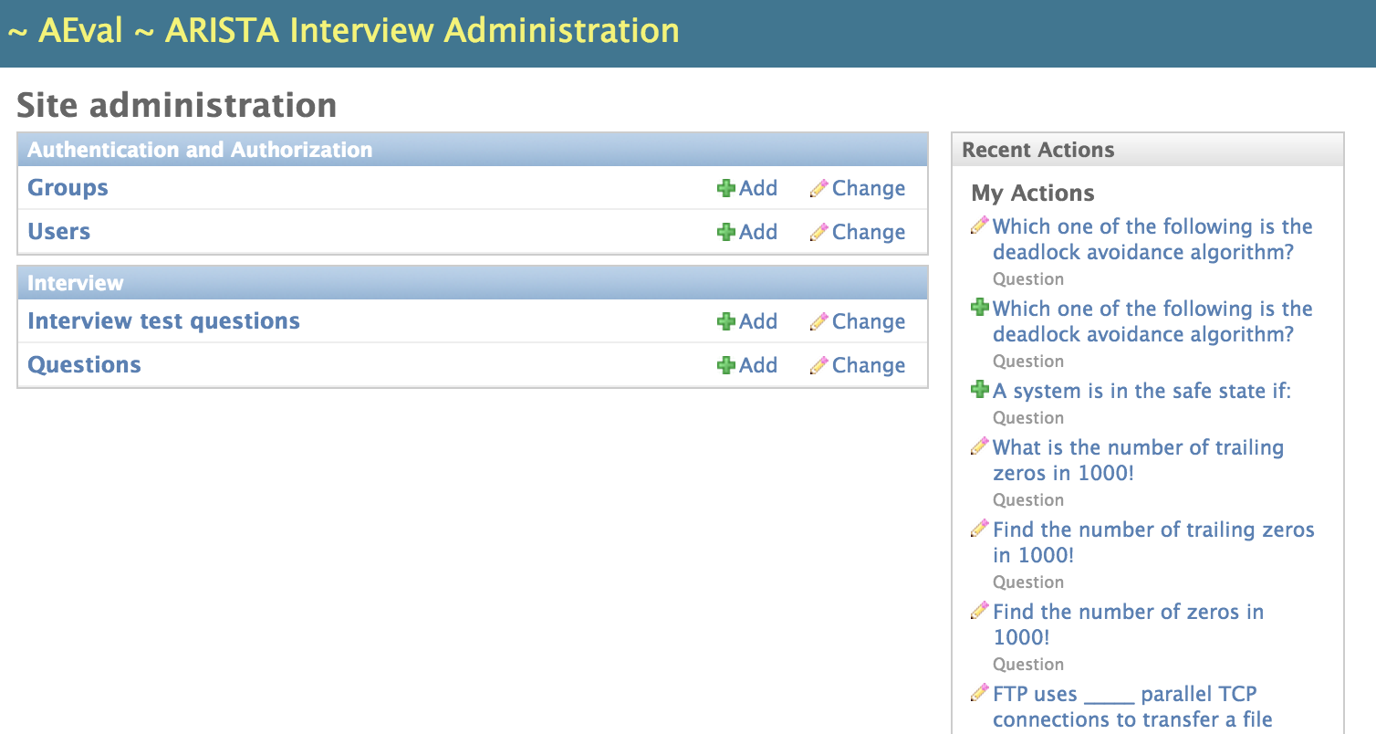

Slide 9
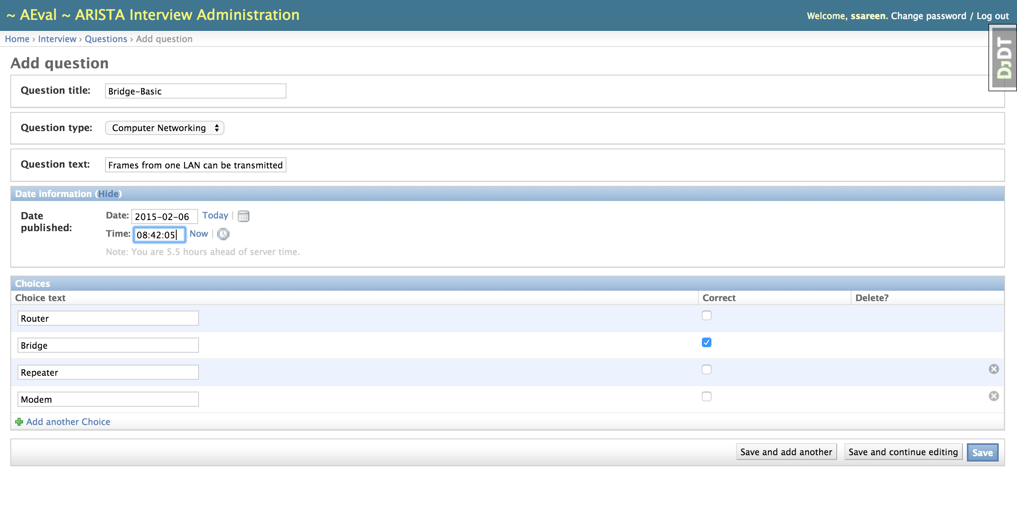

Slide 10
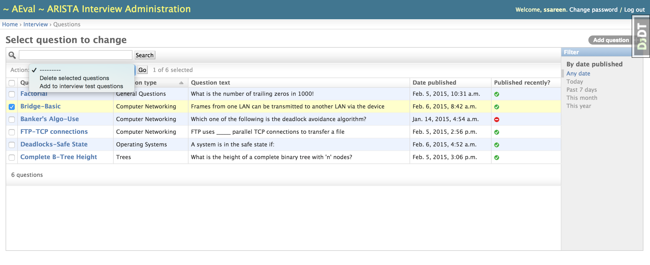
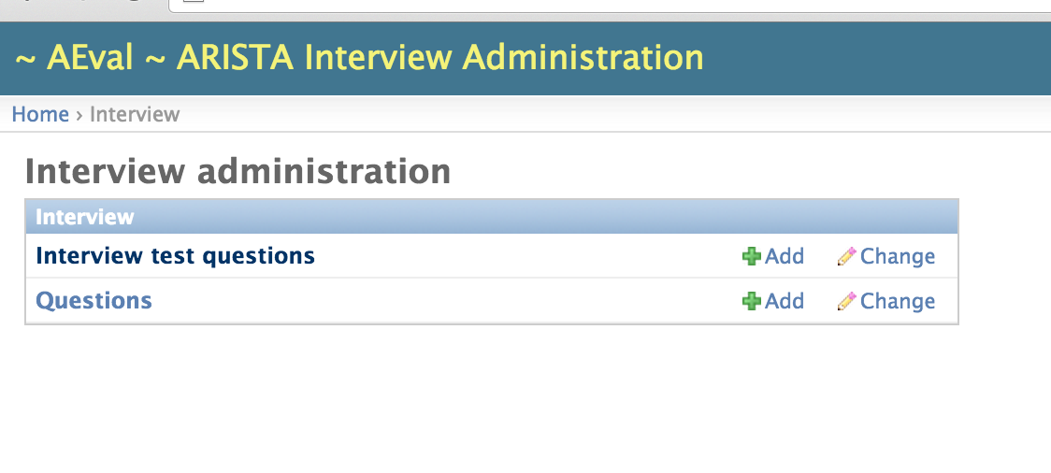

Slide 11
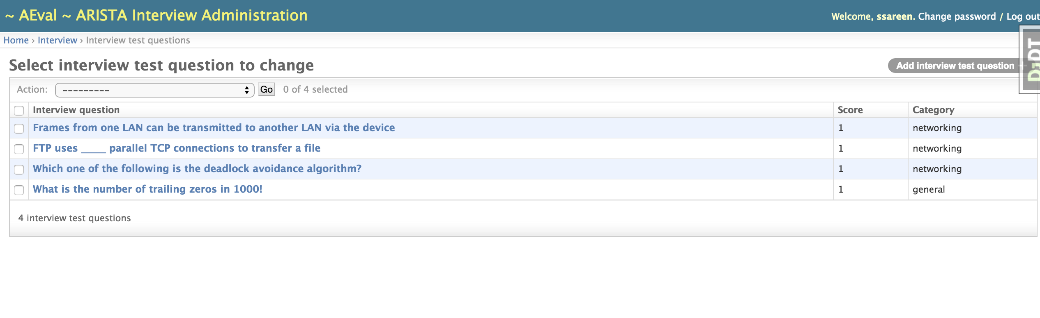
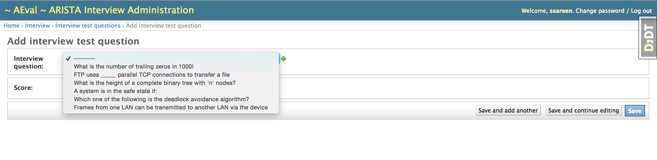
The interview test

Slide 12
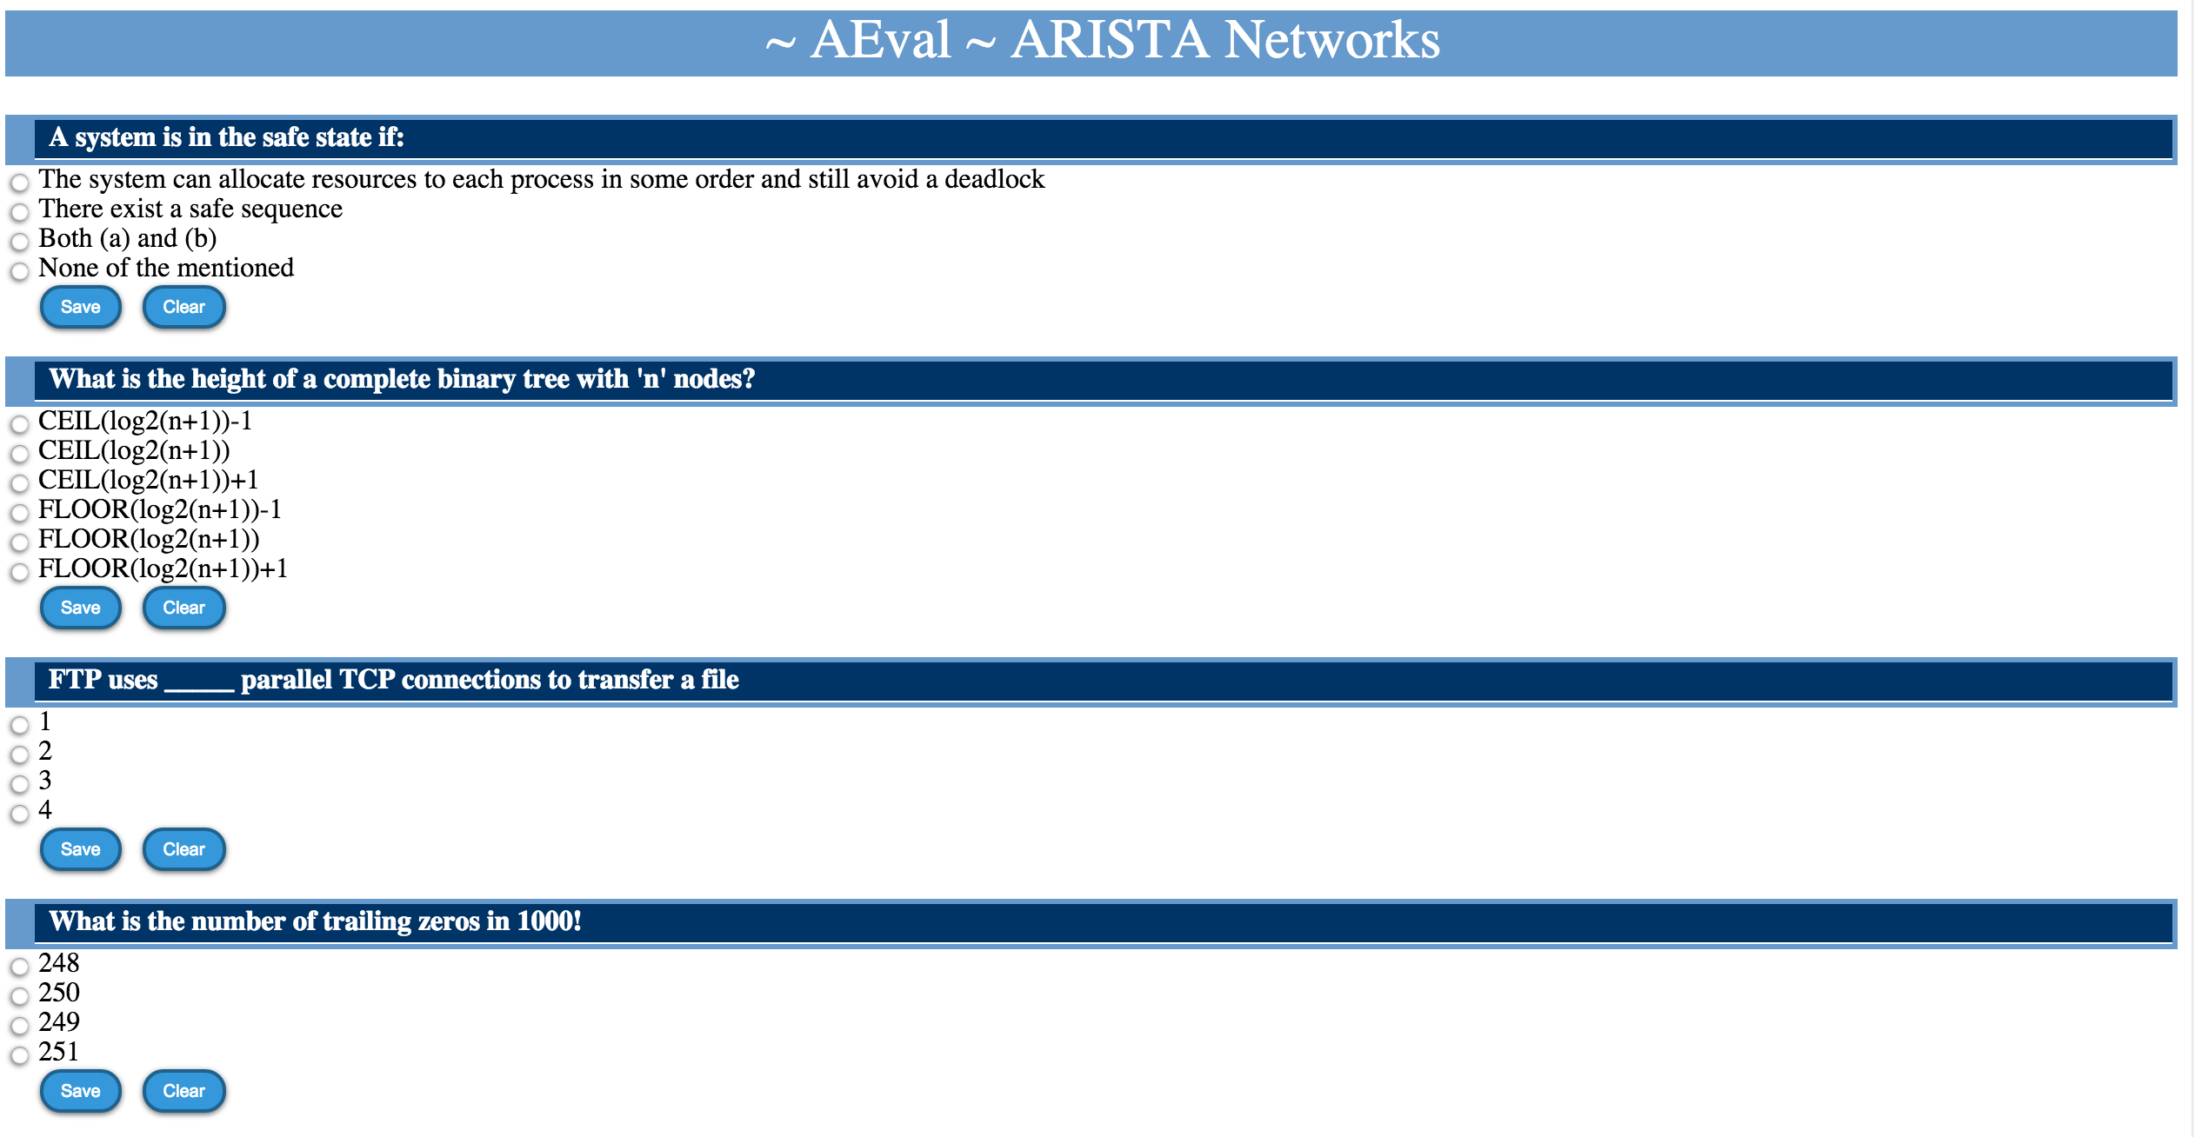
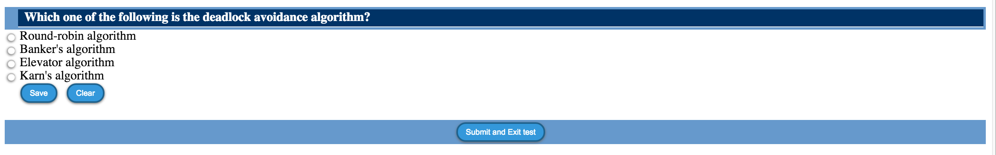

Slide 13
~ AEval ~
Demo

