Slide 1

A PROJECT PRESENTATION ON
COMBAT READINESS : Enhancing Mission Success through Health Monitoring & Predictive Analytics
SUBMITTED TO THE SAVITRIBAI PHULE PUNE UNIVERSITY, PUNE
IN THE FULFILLMENT OF THE REQUIREMENTS
FOR THE AWARD OF THE DEGREE
BACHELOR OF ENGINEERING
IN
COMPUTER ENGINEERING
SUBMITTED BY
Dhavale Omkar Suresh Exam No: B400840133
Solat Omkar Sunil Exam No: B400840176
Sathe Sahil Rajendra Exam No: B400840169
Under The Guidance of
Prof. S.B.Bhosale
DEPARTMENT OF COMPUTER ENGINEERING
JCEI’S JAIHIND COLLEGE OF ENGINEERING
KURAN , PINCODE 410511

Slide 2

CONTENT:
INTRODUCTION
PROBLEM STATEMENT
MOTIVATION
GOALS AND OBJECTIVES
LITERATURE REVIEW
STUDY OF DIFFERENT ALGORITHMS
EXISTING SYSTEM
IMPLEMENTATION DETAILS
ARCHITECTURAL DESIGN
ADVANTAGES
REQUIREMENT SPECIFICATION
RESULT
FUTURE SCOPE
CONCLUSION
REFERENCES

Slide 3
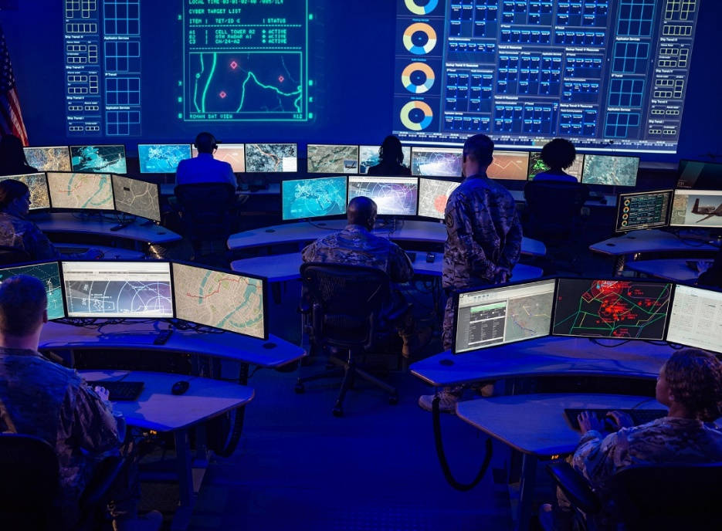
Introduction:
COMBAT REDINESS : Enhancing mission success through Health monitoring & Predictive Analysis
Project Overview: A system for health monitoring and predictive analytics for soldiers during training in military camps.
Objective: To enhance soldier readiness and safety by detecting potential health risks early.
Target Use Case: Designed for use during training or probation periods, before soldiers are deployed in actual combat.
Technology: Utilizes wearable sensors, machine learning, and predictive analytics for comprehensive health monitoring.
Outcome: Enables timely interventions and informed decision-making to ensure soldiers' combat readiness

Slide 4

Problem Statement:
Assessing the combat readiness of soldiers during training is challenging due to the absence of health monitoring and predictive analytics. This project aims to develop a comprehensive system that continuously monitors soldiers' health using wearable sensors and predicts potential health risks through machine learning. The goal is to ensure accurate health assessments, enabling informed decision-making and optimizing soldier readiness before deployment.

Slide 5
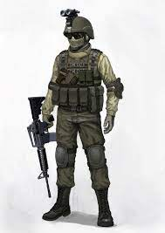



Motivation:
Enhancing Soldier Readiness:
"Ensure soldiers are physically and mentally fit before deployment”
Preventing Health Crises:
"Detect potential health issues early to avoid serious conditions during training.”
Improving Decision-Making:
"Provide commanders with data-driven insights to optimize soldier deployment and training.”
Boosting Safety in Training:
"Use quick health monitoring to create a safer environment during intensive military exercises.”

Slide 6

Goals:
Primary Goal:
Enhance Combat Readiness: Develop a comprehensive health monitoring system for soldiers during training to ensure their physical and mental fitness before deployment by identifying and addressing potential health risks proactively.
Secondary Goals:
Utilize Wearable Sensors: Implement advanced wearable technology to continuously track vital signs and health metrics of soldiers during training.
Integrate Predictive Analytics: Employ machine learning algorithms to analyze health data and forecast potential health issues, allowing for early intervention.
Develop a User-Friendly Dashboard: Create an intuitive dashboard for commanders to visualize soldiers’ health data , enhancing decision-making capabilities.
Improve Training Safety Protocols: Establish protocols for timely medical interventions based on health monitoring data to reduce the risk of health-related incidents during training.
Optimize Resource Allocation: Streamline medical support and training resources by identifying soldiers in need of additional care or attention before deployment

Slide 7

Objectives:
To monitor health by implementing wearable sensors to continuously track soldiers' vital signs during training.
To analyze data using machine learning to predict potential health risks based on collected health metrics.
To create a dashboard for commanders to visualize soldiers’ health status.
To enhance safety by establishing protocols for timely medical interventions to prevent health crises during training.
To optimize resources by improving allocation of medical and logistical support based on health assessments before deployment.

Slide 8
Literature Review:
Author(s) | Year | Title | Key Findings | Implication
Vinit Patel, Nikhil Yeware, Balganesh Thombre., Prof.Dr.Abhay Chopde | 2024 | SOLDIERS HEALTH MONITORING AND POSITION TRACKING SYSTEM | This comprehensive system provides real-time monitoring of soldiers' vital signs, including heart rate and body temperature, while simultaneously tracking their location. | The system's ability to provide real-time monitoring, reliable emergency response, and user friendly interface makes it a promising solution for military applications.
Dharam Buddhi,Abhishek Joshi | 2022 | Tracking Military soldiers Location and Monitoring Health using Machine Learning and LORA model | This study enables real-time tracking of the geolocation and health monitoring of soldiers who would get lost or hurt on the battleground. | This technology aids in the monitoring of the soldier's health metrics, environmental circumstances, and geographic locations.
S. Usharani, R.Rajmohan, P.Manju Bala , D.Saravanan, P.Agalya,D.Raghu Raman | 2022 | Integrated Implementation of Hybrid Deep Learning Models and IoT Sensors for Analyzing Solider Health and Emergency Monitoring | Soldier health monitoring model embedded and interfaced with mobile computing, health devices and health care networking facilities.. | With our proposed system's help, an effective safety and security precaution necessity will be formed by group action, wireless and surrounded technology developments. It helps with a successful top-secret operation. .

Slide 9

Study Of Different Algorithms:
Random Forest Classifier
Use: Predicts health issues based on various health metrics.
Accuracy: Approximately 91% (varies based on data).
Best for: Robust predictions across diverse data types and handling missing values.
Support Vector Machines (SVM)
Use: Classifies health status using continuous health data.
Accuracy: Around 85-90%.
Best for: Binary classification and high-dimensional datasets.
Gradient Boosting Machines (GBM)
Use: Improves prediction accuracy by combining weak learners.
Accuracy: Approximately 90-95%.
Best for: Handling complex relationships and improving model performance.

Slide 10
K-Nearest Neighbors (KNN)
Use: Identifies clusters of similar health profiles.
Accuracy: Around 80-85%.
Best for: Simple implementation and anomaly detection in smaller datasets.
Neural Networks
Use: Recognizes complex patterns in health data.
Accuracy: Typically 85-95%, depending on architecture and data.
Best for: Large datasets and non-linear relationships.
Decision Trees
Use: Creates decision rules based on health metrics.
Accuracy: Around 80-85%.
Best for: Visualizing decision-making processes and handling categorical data.
Best Algorithm: The Random Forest Classifier is the best algorithm due to its high accuracy, robustness to overfitting, ability to handle diverse data types, and provision of feature importance insights, making it ideal for predicting soldier health issues.
Accuracy Consideration: The Random Forest Classifier achieves approximately 91% accuracy, making it highly reliable for predicting health issues based on various metrics collected from soldiers.

Slide 11
EXISTING SYSTEM:
1. Basic Wearable Trackers Track heart rate, steps, and basic vitals; lack predictive capabilities and military-grade precision.
2. Health Monitoring via IoT Devices Collect data using sensors (smartwatch), but limited to health logging; no risk alerts.
3. Centralized Dashboards Aggregate health data but lack data-driven predictions and personalized readiness scores.
4. Limitation Overview
No predictive analysis of mission readiness.
No integration with deployment decisions.
Inconsistent performance in harsh field conditions.

Slide 12
IMPLEMENTATION DETAILS:
Step 1: Data Acquisition via Wearable IoT Sensors
We utilize wearable devices like Garmin and Whoop to continuously monitor the following health and performance metrics:
Heart Rate (HR)
Body Temperature
Blood Oxygen (SpO₂)
Fatigue Levels
Sleep Patterns
Step Count & Activity Levels
These devices transmit data using Bluetooth Low Energy (BLE), received by a Raspberry Pi or directly into a centralized cloud system/server using REST APIs.
Step 2: Data Preprocessing & Feature Engineering
Incoming data is:
Time-stamped and structured into a time-series format.
Cleaned to handle missing values, noise, and anomalies.
Aggregated into meaningful health features such as average HR, daily fatigue score, sleep quality index, and activity trend.
Data is stored in SQLite or Firebase for fast access and historical analysis

Slide 13
Step 3: Predictive Analytics Engine
A predictive module uses hybrid models combining LSTM (for time-series health trend prediction) and Random Forest (for classification based on structured metrics).
Key functions:
Readiness Score Generation: A continuous score (0–100) quantifying the soldier's combat readiness.
Risk Classification: Based on thresholds derived from model predictions:
🟥 High Risk (0–40)
🟧 Moderate Ready (41–70)
🟩 Mission Ready (71–100)
This classification is visualized as color-coded indicators on the dashboard.
Step 4: Recommendation System
Based on risk class and predictive trends, the system generates customize recommendations:
High Risk → "Immediate rest required", "Consult medical team".
Moderate Ready → "Moderate workload", "Monitor fatigue".
Mission Ready → "Fit for deployment", "Maintain hydration".
Recommendations are rule-based, supplemented by learned patterns from past soldier data using decision trees and correlation metrics

Slide 14
Step 5: Deployment Using Streamlit
All data visualizations, readiness scores, and predictions are displayed on a system built with Streamlit:
System Modules:
Live Health Feed
Readiness Score Monitor
Risk Classification Status
Recommendation Panel
Soldier Health Reports (Exportable)
This makes the system easily accessible on laptops, tablets, or mobile devices used by commanders.
Step 6: Health Report Generation
For each soldier, a comprehensive health report is generated:
Overview of weekly vitals
Trends in performance and fatigue
Readiness history and risk logs
Custom health advice
Exportable PDF/CSV format for review and archiving
This report is generated automatically at the end of each mission or training session.

Slide 15

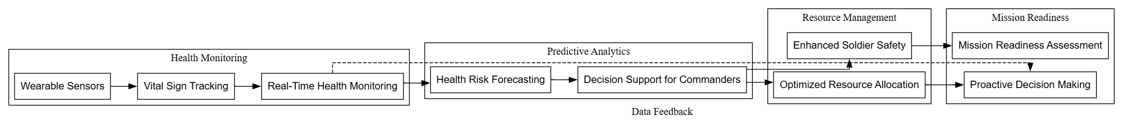
Architectural DESIGN:

Slide 16
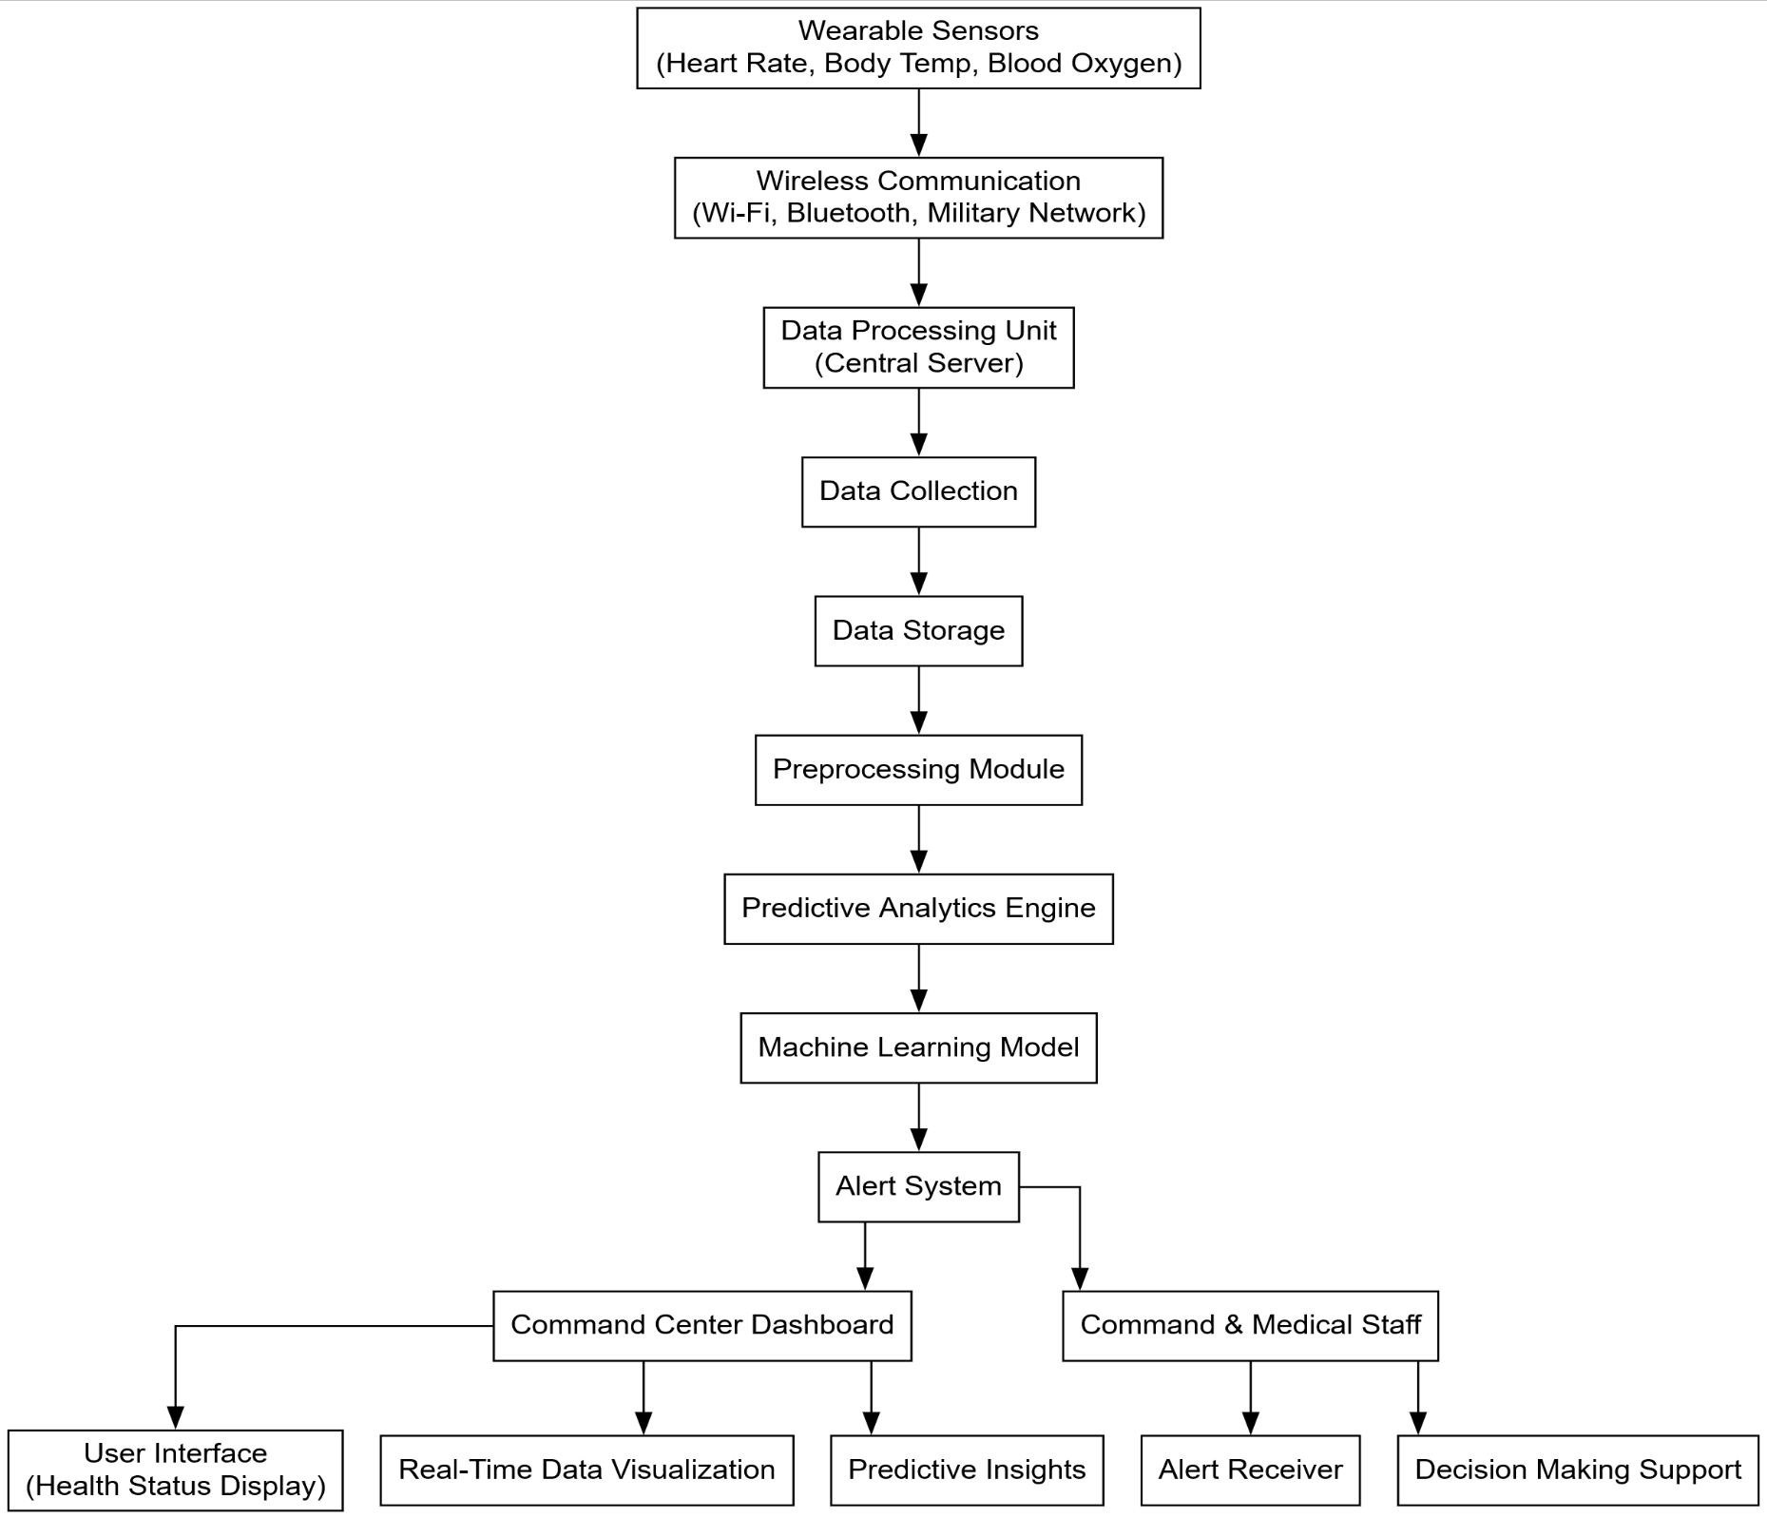

Slide 17
ADVANTAGES:
Social
Economic
Environmental
Improves soldier safety through early health alerts.
Cuts medical and evacuation costs.
Uses eco-friendly wearable tech.
Promotes well-being and reduces deployment stress.
One-time investment supports multiple deployments.
Reduces resource usage with digital monitoring.

Slide 18

REQUIREMENT SPECIFICATION:
Software:
Programming Languages: Python, R, or Java for algorithm implementation.
Frameworks/Libraries: - Scikit-learn (for machine learning)
- Pandas (for data manipulation)
- NumPy (for numerical operations)
- Matplotlib/Seaborn (for data visualization)
Database: SQL or NoSQL (e.g., MongoDB) for storing health data.
Cloud Platform: AWS, Google Cloud, or Azure for data storage and processing.
Hardware:
Computing Device: High-performance computer or server with a multi-core CPU and sufficient RAM (16GB or more).
Wearable Sensors: Devices like WHOOP or GARMIN to collect real-time health data (e.g., heart rate monitors).
Networking Equipment: Reliable internet connection for data transmission between sensors and the central system

Slide 19
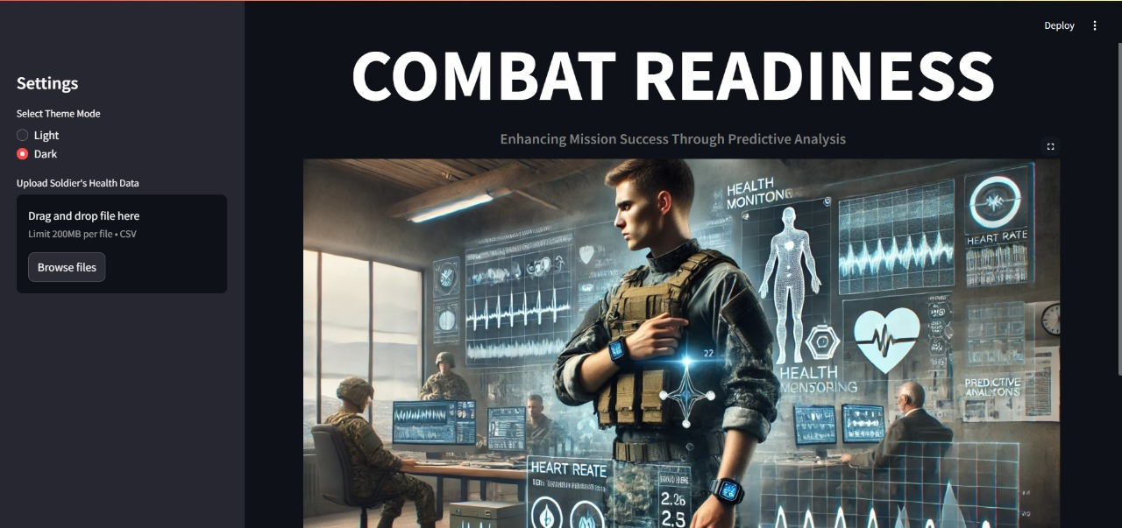
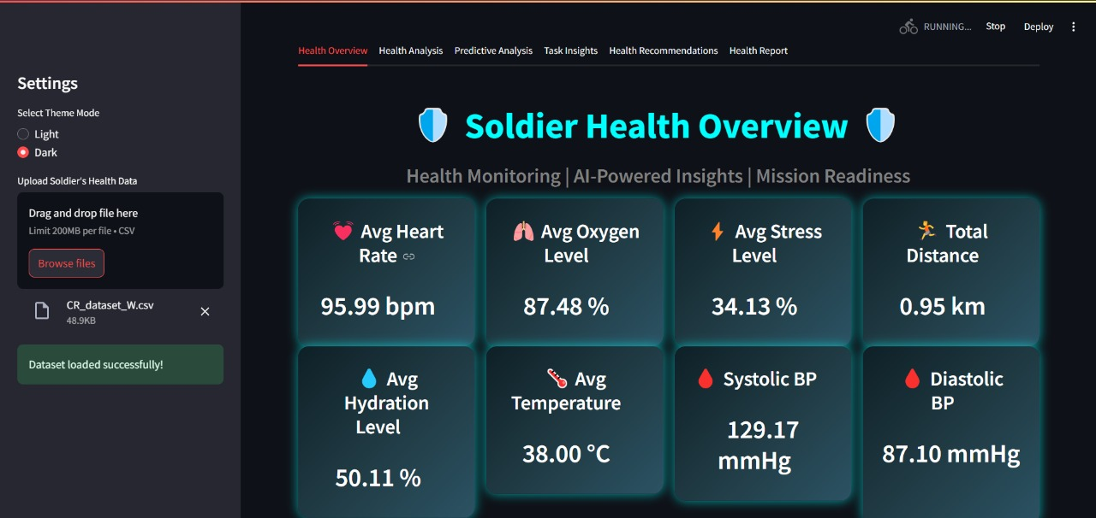
RESULT:

Slide 20
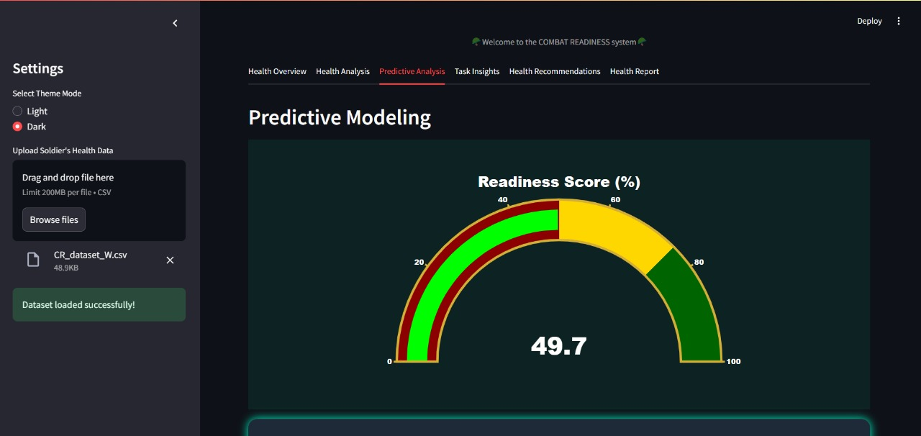
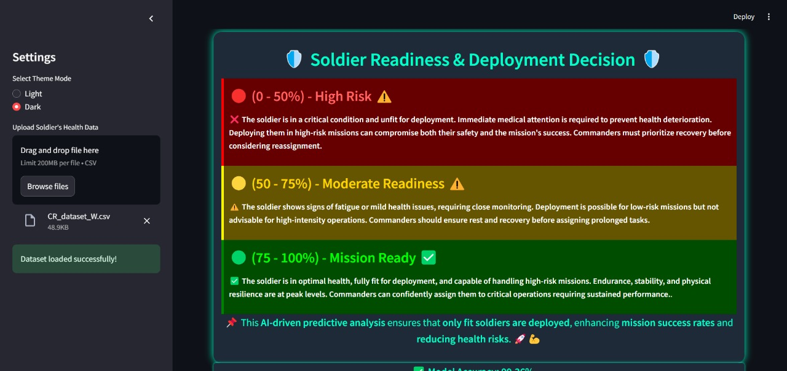
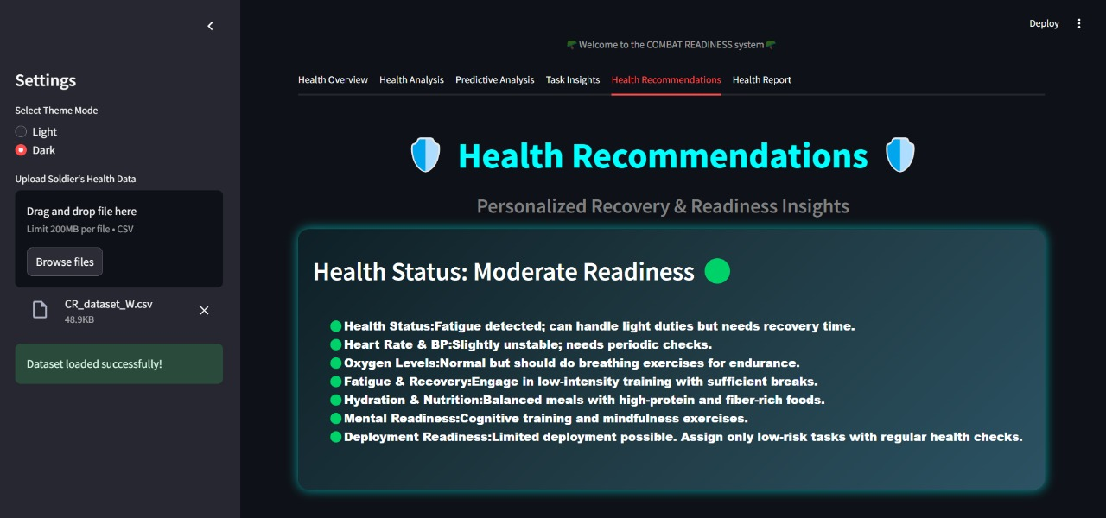

Slide 21

Conclusion:
The “COMBAT REDINESS" system revolutionizes soldier health management by integrating real-time Health monitoring and predictive analytics, ensuring that troops are medically fit for deployment. Its innovative approach enhances safety, improves decision-making, and optimizes resources, significantly contributing to mission success and operational efficiency in military settings. Additionally, this system is highly beneficial for various military academies, enhancing mission readiness through predictive health analysis. This project exemplifies the transformative potential of technology in fostering a proactive health management culture within the armed forces.

Slide 22
FUTURE SCOPE:
🚁 Drone & Smart Helmet Integration
Sync health data with surveillance tools for real-time battlefield insights.
📱 Mobile App for Commanders
Enable on-the-go monitoring and decision-making through secure mobile access.
🧬 Advanced Health Metrics
Include ECG, hydration, and stress detection using next-gen wearable sensors.
🧠 AI-Powered Deployment Suggestions
Use predictive models to recommend soldier deployments based on health trends.
📊 Historical Performance Tracking
Analyze long-term data for training optimization and early risk detection.
🌐 Cross-Force Scalability
Adapt system for use in police, disaster relief, and paramilitary training units.

Slide 23
REFERENCES:
[1] S. Sharma, S. Kumar, A. Keshari, S. Ahmed, S. Gupta and A. Suri, “A Real Time Au- tonomous Soldier Health Monitoring and Reporting System Using COTS Available Entities,” Second International Conference on Advances in Computing and Communication Engineering (ICACCE), Deharadun-India, May 2023.
[2] Hock Beinge Limn “A Soldier Health Monitoring System for Military Applications”2010 International Conference on Body Sensor Networks (BSN).
[3] Pulimamidia, B., Kumar, D. N., & Prasad, S. V. S. (2022, October). Soldier tracking and health monitoring system. In AIP Conference Proceedings (Vol. 2269, No. 1, p. 030017). AIP Publishing LLC.
[4] Samal, T., Bhondve, S., Masal, S., & Gite, S. (2023). Soldier Health Monitoring And Tracking System Using Iot. International Journal.

Slide 24
THANK YOU!!!

