Slide 2
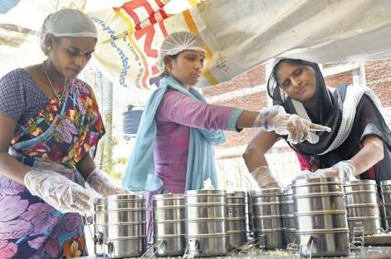
IDEA
Providing online platform to tiffin vendors
Provide people with a variety

Slide 3
Problem Validation
Surveys conducted among students and working professionals staying away from home.
The surveys included questionnaires asking all the information related to the prevailing problem.

Slide 4


Why we are working on this?
JUNK FOOD
IRREGULAR DIETS

Slide 5
Does the market really need us?

Slide 8
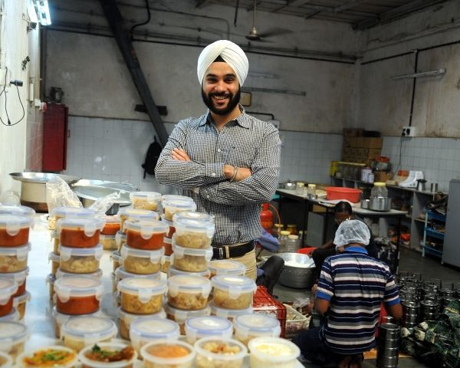
OUR KEY PARTNERS

Slide 9
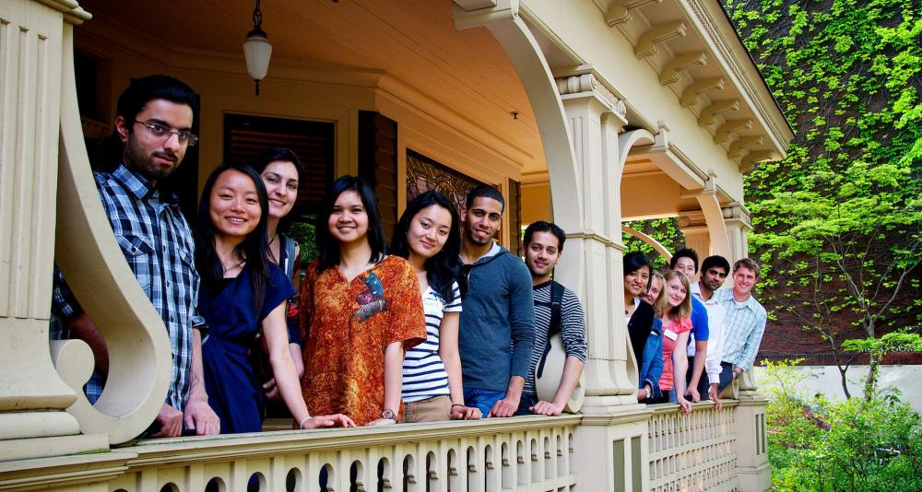

Whom do we target?
Students
Office People

Slide 10
What is our Market?
Student who stay away from home and look for a healthy and affordable meal.
Working professional staying away from home and have limited access to home like food.

Slide 11
Revenue Model
No. of areas in Delhi:
50
No. of tiffin vendors per area
5
26
20
Orders per day(2 meals) per tiffin vendor
No. of working days per month
Average Rate Per tiffin
50
Revenue: Rs. 65 lakh per month.

Slide 12
Profit Model
Listing fee per vendor per month
200
No. of vendors:
250
50,000
Total fee generated
Profit per month:
Rs. 5,20,000
+
Rs.50,000
= Rs.5,70,000

Slide 13
VALUE PROPOSITION
For Vendors:
They get to list themselves and increase the market reach.
For people buying tiffins:
They get a variety of tiffin vendors to choose from.

Slide 14
We conduct regular Quality Control Checks, ensuring the quality of product served
Customers get to rate and review the vendors and in turn use the same to select one from the many
Easy access to affordable and healthy food.

Slide 15
SOCIAL IMPACT
Platform for unorganized market
We increase the revenue of local tiffin vedors who provide healthy and affordable meals.

Slide 16
Minimum Viable Product

Slide 17
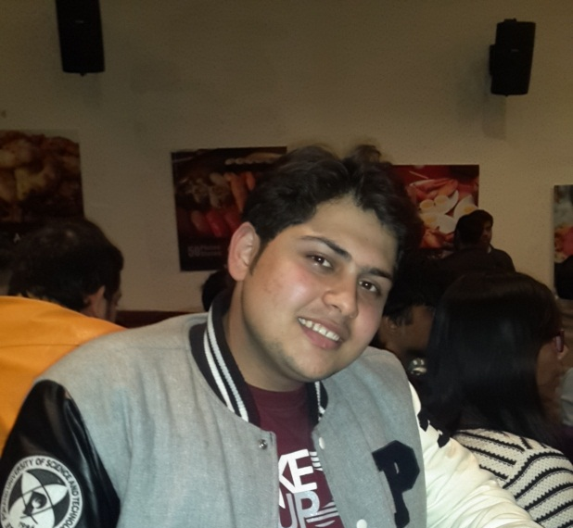
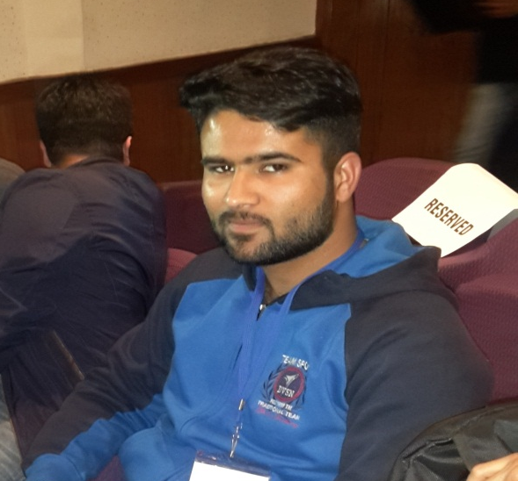
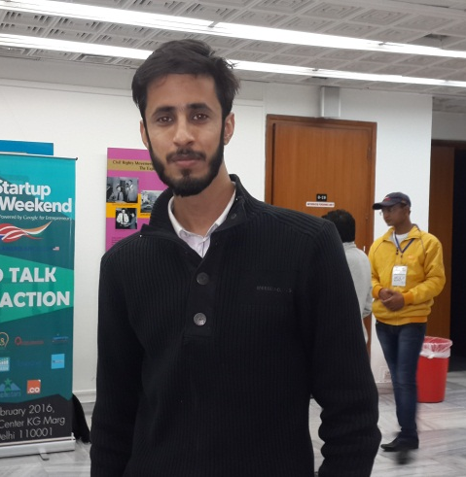
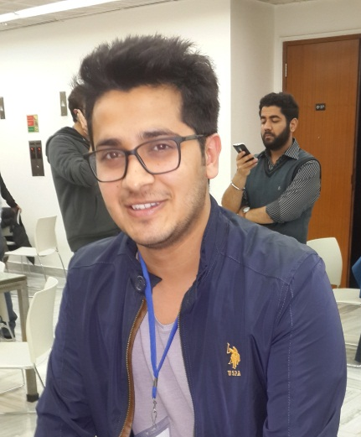
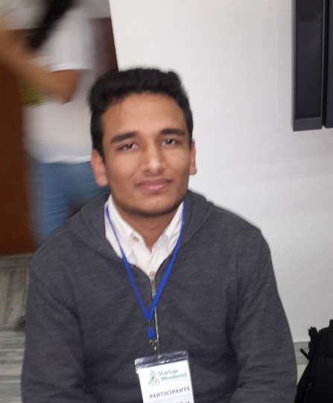
Team
Vikrant
(Marketing)
Mohit
(Finance)
Sahil
(Developer)
Kshitij
(Operations)
Rishabh
(Developer)

Slide 18
Thank you

